Slide 1
UIG Resolution
Weekly Progress Update 13 April 2018

Slide 2
DM read rejection update
Pot 1 Key messages
Outstanding last week = 4
Closed this week = 2
0 meter points still impacting UIG (estimated consumption not accurate)
Row Labels | DMSP | N/A | SHIPPER | MAM | XOS | Grand Total
Assigned | 0 | 0 | 0 | 0 | 0 | 0
Closed | 0 | 175 | 0 | 0 | 0 | 175
Fix in Progress | 0 | 0 | 1 | 0 | 1 | 2
New | 0 | 0 | 0 | 0 | 0 | 0
Monitor | 0 | 0 | 0 | 0 | 0 | 0
Failed | 0 | 0 | 0 | 0 | 0 | 0
Total | 0 | 175 | 1 | 0 | 1 | 177
Total number of meter point queries open |  |  |  |  |  | 2
Pot 2 Key messages
Outstanding last week = 29
New Rejections identified = 0
Closed this week = 12
5 meter points still impacting UIG (estimated consumption not accurate)
Row Labels | DMSP | N/A | SHIPPER | MAM | XOS | Grand Total
Assigned | 0 | 0 | 3 | 2 | 3 | 8
Closed | 0 | 162 | 0 | 0 | 0 | 162
Fix in Progress | 3 | 0 | 1 | 0 | 2 | 6
Fixed | 0 | 0 | 0 | 0 | 0 | 1
New | 0 | 0 | 0 | 0 | 0 | 0
Monitor | 0 | 0 | 0 | 0 | 0 | 0
Total | 3 | 162 | 4 | 2 | 5 | 176
Total number of meter point queries open |  |  |  |  |  | 17

Slide 3
DM Financial Adjustments Progress
Root Cause Fixed:
169 (0)
CA Needed:
76 (-4)
New/Valid Contact Submitted:
45 (-4)
Shipper Notification Received:
31 (0)
CA Decision Pending:
5 (0)
No CA Required/ Closed:
88 (+4)
No Contact:
22 (-3)
Invalid Contact:
9 (+3)
Invoiced:
16 (0)
In Progress:
20 (-6)
Awaiting Billing:
9 (+2)
Not Required:
5 (0)
Complete:
11 (0)
Under Review:
11 (-9)
Issue With Adj:
9 (+3)
To Be Billed:
8 (+2)
Held Pending Rec:
1 (0)
POT 1: 177 (0)
Root Cause Pending:
8 (0)
Kwh:
111,788,618
(0)
Kwh:
-78,945,281
-(5,872,222)
Accurate as of 11.04.2018
Exposure: Retrospective CA not yet invoiced = 73 (-4)
[Root Cause Pending] + [CA Decision Pending] + [CA Needed] – [Invoiced]

Slide 4
Invoiced Figures (CA Only)
Deemed Not valid:
5 (0)
Invoiced: 16 (0)
Complete:
11 (0)
Jan-18:
1
Kwh: 0
GRE (£): 0.00
Feb-18:
4
Kwh: 128,335,231
GRE (£): 1,788,429.70
Kwh: -16,546,613
GRE (£): -145,611.57
Mar-18:
6
Apr-18:
Pending
Kwh: tbc
GRE (£): tbc
Kwh value represents the primary debit/(credit) equal and opposite value feeds UIG Reconciliation
Accurate as of 11.04.2018

Slide 5
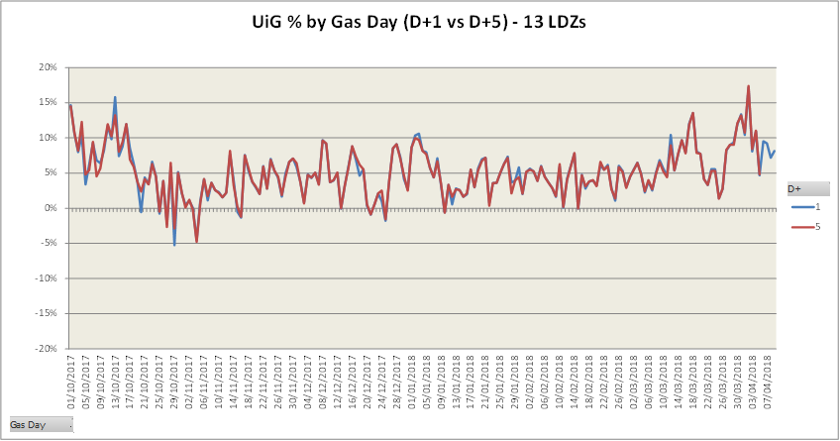
Latest UIG volatility

