Slide 1



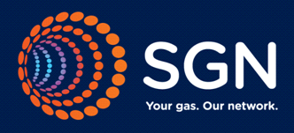
Mod 0621
Amendments to Gas Transmission Charging Regime
GDN Impact Analysis

Slide 2

Agenda
Summary
Drivers of change
GDN Recovery of NTS Costs
GDN Obligations
GDN Impact Analysis
    Cadent
    SGN
    WWU
    NGN
Key Concerns

Slide 3
Summary
Currently Shippers on GDN networks pay NTS exit commodity charges and GDN capacity charges that include recovery of NTS exit capacity charges.
The enduring impact from Mod 0621 on GDN customers resulting from the removal of NTS exit commodity charges is likely to be a redistribution of charges to those with peakier demands from those with less peaky demands.
The reason for this is in the enduring period from October 2021 NTS charges will be recovered by GDNs through capacity charges as NTS exit commodity charges to Shippers will cease, and all NTS exit revenue from customers on GDN networks will be recovered by means of NTS exit capacity charges to GDNs. GDNs in turn recover this from their charges to Shippers and by means of capacity charges.
However in both the transition and enduring periods there will be substantial redistribution of charges between LDZs due to the move to the new NTS charging model, and these changes may swamp the effect described above.
In addition to this, GDNs have allowances set in their price control for the NTS exit capacity and are allowed to collect the allowance with any under-recovery being subject to a two year lag.
Therefore the long term effect on GDN customer charges is a complex interaction of the effects described above.
There is an obligation on GDN’s to plan and develop a system to meet the expected demand on a peak day. GDN’s ensure they meet these demands via Exit Capacity, Storage and Interruption services.

Slide 4
Drivers of change
The main drivers of change are the change to the CWD methodology, use of Obligated values for Forecasted Contract Capacity and the absorption of commodity charging.
Where GDN flows remain the same, the revenues collected from GDNs significantly increase in the enduring scenario, as shown below:
 | Current | Transitional Period |  | Enduring Period
 |  | Oct 19 to Sept 20 | Oct 20 to Sept 21 | Oct 21 to Sept 22
Revenue Collected from GDNs | £197,443,761 | £178,568,460 | £185,044,868 | £339,649,231
% of total Exit Revenue | 50% | 45% | 45% | 80%
Values from 10 April 2018 Transmission Services CWD model v2.2

Slide 5
GDN Recovery of NTS Exit Capacity Charges
Prior to the implementation of GDNPC06 in October 2012 NTS levied Exit Capacity Charges (ECN) directly to shippers. These alternative arrangements resulted in GDN’s allowances being adjusted to reflect the NTS costs in respect of the offtakes within the distribution network. The introduction of this GDN charge was considered to facilitate improved cost reflectivity and predictability. The GDN’s now charge shippers directly to recover the NTS charges to the DNs, with any variance between the set allowance and actual cost being trued-up on a two-year lag.
NTS Allowance (determined by Ofgem) in year t
+ Cost v Allowance variance in t-2 recovered on a two year lagged basis
+ Associated under/over recovery “k” from t-2 again on a two year lag
= Allowed Revenue to be recovered via the ECN charge
Note that GDN’s have the same charging objectives as NTS these are stipulated in Standard Special Condition A5, paragraph 5. The ECN charges that distribution networks set are reflective of NTS’s charges, cost reflectivity is maintained by using the published final/ indicative prices multiplied by the volumes booked at offtake level, which are then aligned to the relevant exit zone. Note due to this cost weighting differing charges are levied within the GDN.

Slide 6
GDN Obligations
There is an obligation on GDN’s to plan and develop a system to meet the expected demand on a peak day (see next slide).
GDN’s ensure they can meet these demands via the procurement of Exit Capacity, Storage and Interruption services.
To minimise the risk of loss of supply to customers, overrun charges to the GDN’s and possible reputational damage following either of these, a GDN will ensure they have enough capacity booked from the NTS to cover the expected 1 in 20 demand at either an offtake or an LDZ level.
Capacity is ordinarily secured with enduring and annual capacity products. Daily capacity products are available via the daily auction process but this carries a risk of possible withdrawal on a difficult day. GDN’s are unlikely to run the risk of not having enough capacity secured from the NTS as doing so would lead to breach of Licence.
The GD1 capacity incentive mechanism has financially rewarded GDN’s for reducing capacities at their offtakes and allows unused capacity to utilised elsewhere. Note: currently user commitment charges at an offtake level restrict GDN’s from reducing capacities at all offtakes, therefore some GDN’s have capacity levels higher than their expected 1 in 20 demand level until this UC is satisfied.

Slide 7
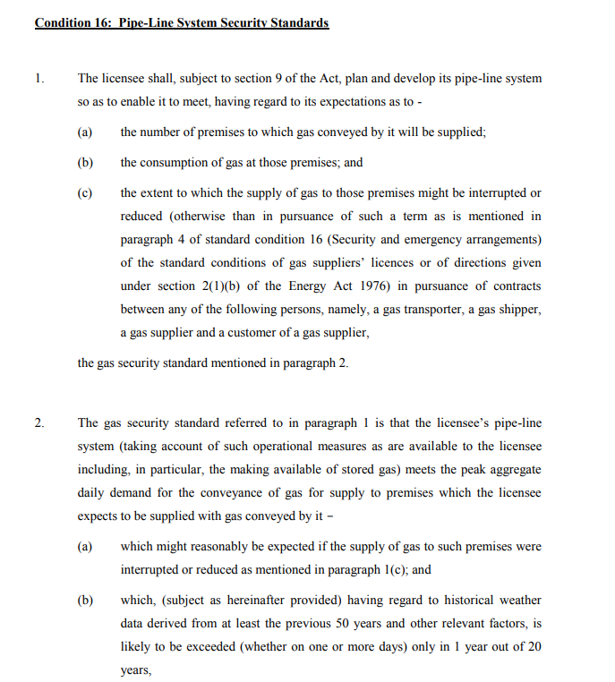
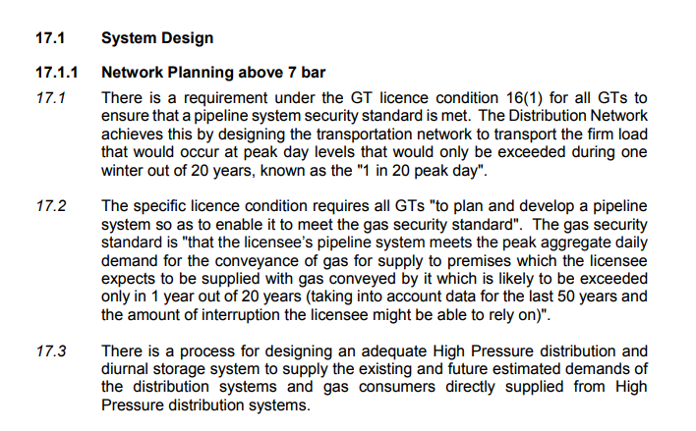
GDN Obligations – Licence & Safety Case

Slide 8
GDN analysis of Mod 0621 impacts
GDN assumptions :-
The analysis reflects the impact on Transmission Services only - Transmission Services CWD Model V2.2 has been used to determine the firm exit capacity prices by offtake;
The forecasted impact of the change in GDN exit capacity charge (ECN) levels only, (the one exception being the impact of commodity charges is reflected in WWU’s second slide (slide 14);
The current level of GDN bookings as at October 2017;
That there are no changes to the revenue mechanisms currently in place for GD1, cost v allowance variance reflected on a two year lagged basis;
That Ofgem will re-set allowances at the start of GD2 to reflect NTS forecasted costs;
The impacts shown reflect the charging period April to March.
Charges which comprise the current LRMC levied cost do not reflect any updated view published on 1 May 2018 by the NTS.
Note: without changes to charging methodology or DNs absorbing some cash flow impact, then changes to ECN will flow through to customer in line with their use of DN capacity.

Slide 9
Cadent Impact Analysis – EE and London
Please note that the charges shown reflect the exit capacity charges only and does not incorporate the impact of commodity charges

Slide 10
Cadent Impact Analysis – NW and WM
Please note that the charges shown reflect the exit capacity charges only and does not incorporate the impact of commodity charges

Slide 11
Cadent Impact Analysis - Overall
Please note that the charges shown reflect the exit capacity charges only and does not incorporate the impact of commodity charges

Slide 13
WWU Impact Analysis - Allowances
The WWU allowances show significant volatility with a high of £58.4m to be collected in 2019/20 followed by a low in 2021/22 of £19.2m. This volatility is in part a reflection of the volatility in charges WWU has been levied throughout the GD1 price control, an effect of the operation of the LRMC model.
The GDN price control for GD1 was built with the premise that NTS forecasted costs would remain in line with those forecast at final settlement. Where costs materially vary there was a further protection for GDNs that allowances could be adjusted on publication of T-3 price forecasts. The experience for WWU through GD1 has been that the T-3 forecasts have not reflected final outturn costs, and consequently, as can be seen in 2018/19, further volatility is being caused. It is hoped that the move away from the LRMC will play a part in resolving some of the issues that have been experienced by WWU going forward. However, as the new charges settle in WWU is forecasting continued significant volatility in the allowances it will use to set its future charges.

Slide 14
WWU Impact Analysis – our exit charges
Our allowances:
Result in significant variation year on year for all our customers. As NTS charges are levied on a single unit rate, regardless of DN load size, the relative changes in % terms remain the same for all customers. For example, a Large Hospital, with an assumed AQ of 100,124GWh and SOQ of 551GWh would see a variance in cost from 2021/22 to 2023/24 of 262% (£40k). An extreme of large power station is equally an uplift in cost of 262% (£826k)
Please note that the above charges reflect the capacity charges only and therefore is not the total charge to the customer

Slide 15
WWU Impact Analysis – total bills
The analysis overleaf shows the impact of the DN only levied charges. When the end consumer bill is considered, both the Capacity element (levied by the DN) and the Commodity element (levied on shippers directly by the NTS) must be looked at jointly.
The following shows the TOTAL charge for an end customer for NTS (assuming their supplier pass it on £:£ - note that many of the suppliers serving the customers of our shippers will enter into long term (2 year) contracts with their end customers so the ability to adjust for the actual charges we will levy may be limited).
All charges are in £ and assume costs are passed on by shipper/supplier to their end customer

Slide 16
WWU Impact Analysis – direct competition for large loads
WWU has some significant very large loads connected within its network, many of which are directly competing with similar loads connected to the NTS. The NTS volatility of charges would therefore impact similar customers differently, potentially giving rise to competition issues for such sites.
The above example shows that at the extreme a DN load would have a charge relating to NTS 30% (£3.8m) higher than a direct connected site in the same location would have. The picture reverses in 2021/22 with the DN Power Station receiving 24% (£2.5m) lower charges.
If NTS charges remained accurately forecast at T-3, these variances would largely disappear.

Slide 17
Key Assumptions
Analysis assumes October 2017 capacity bookings throughout
Based on latest available prices from NTS
Inclusive of both change in exit methodology (from LMRC to CWD in Oct 2019) and also the movement from Commodity to Capacity NTS pricing structure from Oct 2021 onwards
Illustrative guide below for impact on customer bills for domestic and Industrial/Commercial premises
£ Nominal Prices throughout

Slide 18
Key Concerns
  GDN’s have four key areas of concern in relation to the proposals put forward by UNC modification 0621.
  1.Does the modification better facilitate the charging objectives?
  NTS and GDN's have the same charging objectives - GDN's need to be comfortable that these are satisfied. In particular there have been concerns expressed regarding the demonstration of cost reflectivity. This firstly relates to the unconstrained nature of CWD compared with how the system is actually utilised/constrained and secondly the increased proportion of revenue recovered from GDN’s due to the assumed basis for Forecast Contract Capacity (FCC) in the enduring period.
  Can cost reflectivity be sufficiently demonstrated ?- Can it be evidenced that Scotland and Northern offtakes have in reality an equitable chance of being supplied from Southern entry points as assumed by the CWD model? If this can not physically be the case then the model is inappropriately designed for the UK system and will result in inappropriate charges.
  What cost justification is there for moving from recovering 50% of exit capacity revenue from GDN’s to 80% as proposed in the enduring (reference slide 4)?
  Are end consumer costs reflective of the demands and requirements they place on the National Transmission system, and importantly that differing user groups are not unnecessarily cross subsidizing others (either Geographically or by load type)? The absence of any analyses of what costs make up the NTS allowance provides little comfort that this is not the case.
  Does the FCC, Revenue Recovery and K mechanisms outlined by the modification result in charges and total revenue levels that are appropriate and proportionate to the bookings made? – Due to the revenue recovery and K not being targeted, how can GDN’s be assured of this given the stability and long term ability to forecast that the DNs provide NTS regarding their capacity requirements?

Slide 19
Key Concerns
  2.Does the modification reduce charging volatility?
  The modification signposts that its implementation will result in charges that are less volatile. From the impact analysis produced GDN’s have concerns that there will be increased and for some significant short to medium term ECN charge volatility as a result of implementing this proposal.
  GDN’s currently have no visibility of the timing of when NTS proposes to give sight of the associated indicative, final prices and revenue forecasts. This makes it very difficult to assess where there are potential timing conflicts with our own price setting process and signpost where GDN’s have the potential to introduce further volatility and risk due to the lack of certainty. There is also apprehension regarding the timeline for agreeing the methodology used for FCC in the enduring period. Significantly, any future variance between the costs forecast for RIIO GD2 and what NTS ultimately charge may result in longer term price volatility for our customers. The future uncertainty puts significant doubt on the ability of NTS to accurately forecast our charges for RIIO 2.
  Currently GDN’s set exit capacity prices informed by NTS October charge levels, GDN’s are currently unsure as to what issues introducing an April price change in the enduring period will have on their ability to accurately forecast price and costs. Where NTS charges for October vary from the indicatives used at our price setting, the cost reflectivity we set out to achieve is diminished.
  GDN’s will have limited visibility of any behavioural changes following implementation. They will also have no control over the application of FCC and any potential forecasting errors.
  How do NTS plan to mitigate any further volatility? What are the consequences of a significant forecast error i.e. FCC in the enduring?
  Note the analysis provided does not take into account any further volatility that could arise from allowance resets, transitional price control and T2 impact. GDN’s also recognise that the implemented modification may not be the optimum solution and that there may be a need to raise further significant modifications to address issues resulting from implementation and that has the potential to introduce longer term volatility into the process.

Slide 20
Key Concerns
  3. The Message –How do we communicate this change?
  The Modification aims to introduce stability, yet we are forecasting substantial changes and fluctuations for customers, particularly in Scotland and the North. How do we clearly articulate the change to all parties, communicating to those that have not been engaged with the process?
  4. Has there been sufficient assurance around the models and time given to the process?
  Distribution networks would like to see visibility that the model’s produced and used to determine the potential impacts have undergone some independent assurance and validation. All GDN’s hold the view that a published external report would provide comfort that the model calculations reflect the intent set out in the UNC and that the inputs made into that model reflect the underlying data they represent.

