Slide 1
XRN4572 – UK Link Release 3
13th June 2018 |  | Overall Project RAG Status |  |  | A
 |  | Plan/Time | Risks and Issues | Cost | Resources
RAG Status |  | A | A/R | G | A
Status Explanation
Objective | Full project delivery of UK Link Future Release 3 Scope
Plan/Time | Project took an approach to split Detailed Design & Build into 2 tracks to give XRN 4454 stakeholders extension to complete requirements, the progress against each track is as below – Track 1 (13 Changes) – Detailed Design Complete. Build commenced and completed for 4 Changes, 9 in progress and on track to complete as per plan. Track 2 (XRN4454 – Cadent/NGT Separation) – Reporting and File Format confirmation for both Cadent and NG finalised 4/6/18. Extensions were given to allow for full review. Potential risk that the agreement carries some level of assumed requirements. A full assessment of the requirements and design, build components being completed but build plan is now impacted by extended delay. Internal & External training requirements for all changes are being assessed by the Xoserve Business Change team and engagement with industry will be via DSG in July. Further engagement to be undertaken on Market Trials with DSG in June/July ‘18 define the Market Trials Approach.
Risks and Issues | R3 plan parallelism: there Is greater parallelism within plan to accommodate XRN 4454 Conclusion of the requirements confirmation was later than planned leading to shorter timescales for Build/ test activities, Progress to be monitored and any potential impact to delivery date escalated. Notional Go Live Date dependent on close management of parallelism in plan and other elements i.e. Market Trials approach/implementation plan agreement.
Cost | Full Delivery costs approved at ChMC in April ’18 - forecasts are currently within budget.
Resources | Greater resource (mainly SMEs) need for XRN 4454 for fulfilling the need for extended clarifications and analysis work. SME profile and need for Build and System Testing being managed weekly with internal Xoserve business teams.

Slide 2
UK Link Release 3 - Plan
Primary Scope | Scoping |  |  | Initiation |  | Delivery |  |  |  |  |  |  | Realisation
Stage | Scope Prioritisation | Scope Defined | Funding | Initiation | Analysis and HLD | Detailed Design | Build & System Test (Track 1 – 13CRs) | Build & System Test (Track 2 – XRN4454) | Acceptance Test | Performance Test | Market Trials | Reg. Test | Imp. | PIS
Baseline Plan | 10/01/18 | 07/02/18 | 11/04/18 | 13/04/18 | 13/04/18 | 27/04/18 | 03/08/18 | 12/08/18 | 31/08/18 | 31/08/18 | 12/10/18 | 28/09/18 | 02/11/18 | 06/01/18
Current Plan | 10/01/8 | 07/02/18 | 11/04/18 | 13/12/17 | 13/04/18 | 04/06/18 | 03/08/18 | 12/08/18 | 31/08/18 | 31/08/18 | 12/10/18 | 28/09/18 | 02/11/18 | 06/01/18
Planning/Milestone date to be confirmed
Milestone date forecast to be met
Milestone date forecast to be at risk
Milestone date forecast to be missed
Milestone completed
RAG Key – Milestones are end dates:

Slide 3
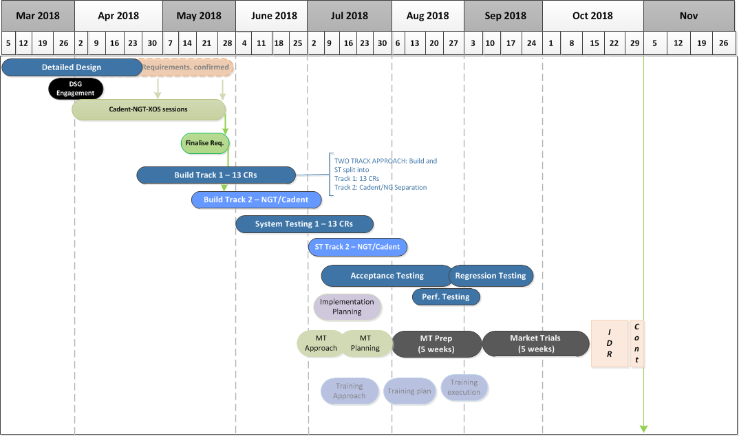
Release 3 Plan view

