Slide 1
Content Suggestions for the BP19 Customer Class Packs

Slide 2
Summary
This presentation sets out content suggestions for the Customer Class Packs to be used in the BP19 process.
Packs will be produced for the following customer classes
Distribution Networks
National Grid Transmission
Shippers and
iGT’s
… and will be issued in line with the consultation timescales
We would welcome your feedback on:-
The suitability of the suggested content
Anything else you would like us to include

Slide 3
High Level Cost Classification in BP18
Demand driven, mandated, or capability uplift.
Capital element split between bought in and internally resourced costs
Maintain the Business Costs – Non People
Maintain the Business Costs - People
Xoserve
Change
Transmission Investment
Retail
Investment
Other Market Investment Leverage
Network Investment
Outcomes:
Continuous Improvement, Industry Mandated Change, New Capability Delivery
Maintain the Business costs - fixed or semi variable, cut by segment and activity type
Examples:
 | Customer Demand Driven Investment Xoserve propose, Customers choose including timings and any consequential costs | UK Link, Gemini, DSC
 | Market Driven Investment Xoserve and customer jointly consult on environmental impacts | CSS, RIIO2
 | Xoserve Change and Xoserve Maintain the Business Xoserve develop, Customers are consulted | TransformUs, Smart Meter, TCS Hosting

Slide 4
Content suggestions for Customer Class Packs
Content | Dist’n Networks | NG T | Shippers | iGT’s
1. Summary page(s) a) High level written overview / context b) BP19 version change tracker c) Charges shown in tabular format using definitions in the Charging Statement (similar to BP18 pack). | Enterprise Level information Will be included in all Customer Class Packs
2. Totex variance - Waterfall that shows charges movements at Xoserve level (opex /capex split in start and end points). BP18 19/20 to BP19 19/20 Budget or forecast 18/19 to BP19 19/20 [& 20/21 & 21/22] Impact of Scenarios
3. Individual Customer Class variance – Waterfall that shows charges movements at Customer Class level (opex /capex split in start and end points) BP18 19/20 to BP19 19/20 Budget or forecast 18/19 to BP19 19/20 [& 20/21 & 21/22] Risks & Benefits Cost Sensitivities | Yes Yes Yes Yes | Yes Yes Yes Yes | Yes Yes Yes Yes | Yes Yes Yes Yes
4. Meter Point Count as at 1/9/18 & 1/12/18 broken down by Distribution Network & iGT totals and % proportions Individual Distribution Network counts | Yes Yes | - - | - - | Yes -
5. Charging by Meter Point Bands – Comparison of total charges broken down by Meter Point bands so Shippers can get a view on their expected charges. | - | - | Yes | -

Slide 5
Section 1a – BP19 Version Change Tracker
We will capture relevant changes by year by reason
TOTEX £m | Year 1 | Year 2 | Year 3
September Board v1 | X | Y | X
Change reason 1
Change reason 2
Change reason 3
Change reason 4
November Board v2 | X2 | Y2 | Z2
Change reason 5
Change reason 6
January Board v3 | X3 | Y3 | Z3

Slide 6
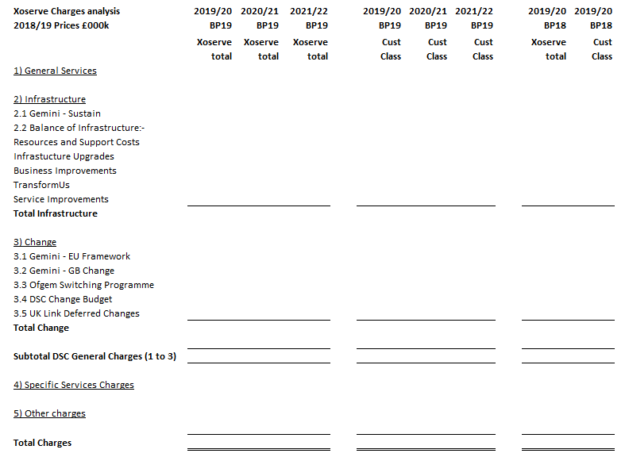
Section 1c – Charges in tabular format
Charge classifications taken from 18/19 Charging Statement, expect to see something similar for BP19

Slide 7
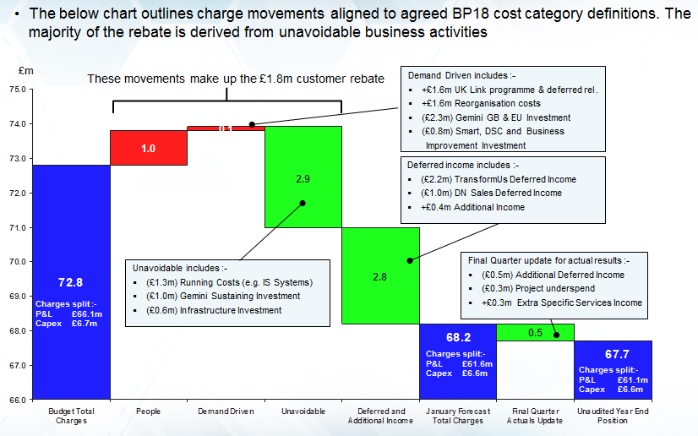
Section 2 & 3 – Totex Waterfall
This example shows the totex waterfall 17/18 budget to January forecast to year end position. The format can be applied across a range of scenarios. Year 1 trace would be detailed, outer years less so

Slide 8
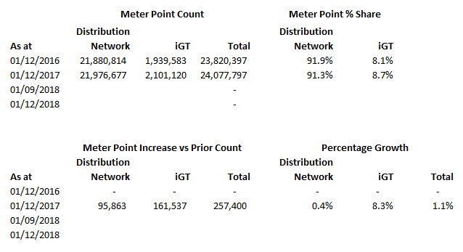
Section 4a – Meter Point Count DN & iGT
The meter point share percentages drive the allocation of shared general services lines.

Slide 9
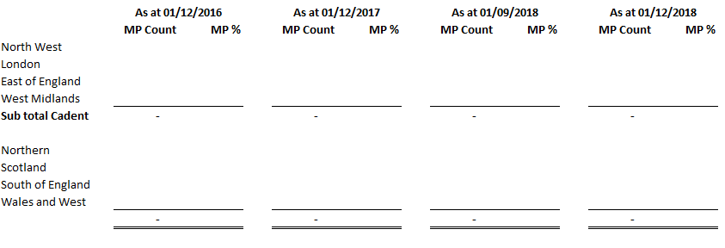
Section 4b – Meter Point Count DN level
The Meter Point count by discrete DN.

Slide 10
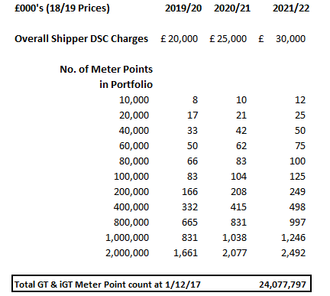
Section 5 – Charging by Meter Point Bands
Indicative charges by Meter Point bands (based on last available Meter Point Count), charges are illustrative

