Slide 1
2018/19 Q1 results and Key forecast themes

Slide 2
Management Summary
Q1 results
DSC income on track, slightly higher demand for Specific Services
Totex broadly in line with budget, variances largely due to activity timing differences against those assumed in the budget.
Q1 forecast
High level forecast, work still ongoing
Updated view on charges will be available in September (for information only)
Key themes:-
Totex (excluding CSS & UIG work) in line with budget at enterprise level
Potential variations in funding between customer classes
Risks and Opportunities identified are showing a net neutral position

Slide 3
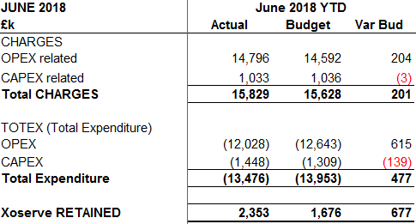
Q1 Totex Income and Cost vs Budget

Slide 4
Q1 forecast key themes
Overall assessment - the Q1 Forecast Totex for the business remains broadly in line with Budget
CSS & UIG – Potential shortfall against budget assumptions, magnitude unclear currently
Resourcing mix - more diversification of activities and changes in customer expectations are driving a change in resourcing mix. This may create variations in customer charging vs budget. However, we advise to wait until the half year before amending any charge statements given the limited amount of actual spend data to reference right now.
Timing differences - a few activities likely to start in 2019-20 and others progressing at a slower rate.
Risks and opportunities – a log has also been created for all known risks and opportunities with less than 50% likelihood, which currently shows a net neutral position

