Slide 1
PARR Dashboards
10 July 2018
PAFA

Slide 2
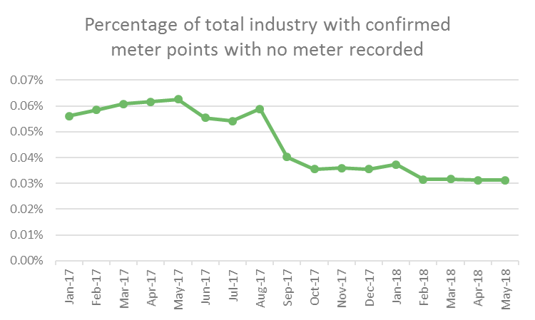
2A-2 No Meter Recorded
Report measures percentage of each Shippers portfolio of confirmed meter points with no meter recorded on the Supply Point Register as at the report snapshot date
Monthly change
0.07% ↓ Mumbles
0.02% ↓ Southsea Clarence
0.01% ↓ Beaumaris
0.12% ↑ Paignton
0.04% ↑ Eastbourne
0.01% ↑ Hastings
0.00% ↓ - Monthly change
0.03% ↓ - Annual change
0.54% Eastbourne
0.49% Lytham

Slide 3
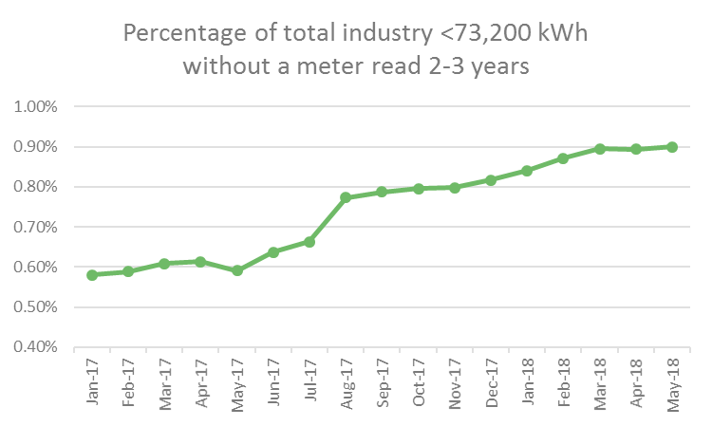
2A-7.1 No Read 2 - 3 Years <73200 kWh
Report measures percentage of Shipper's portfolio in the <73,200 kWh AQ band without a meter reading for the 2-3 year period as at the report snapshot date
Monthly change
2.35% ↓ Torquay
1.10% ↓ Cleethorpes
0.24% ↓ Southsea Clarence
0.53% ↑ Worthing
0.52% ↑ Blackpool South
0.47% ↑ Paignton
0.01% ↑ - Monthly change
0.31% ↑ - Annual change
27.06% Torquay
6.97% Weymouth Bandstand

Slide 4
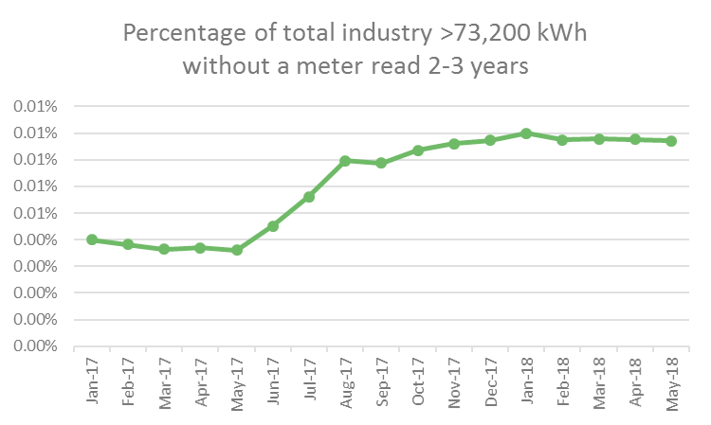
2A-7.2 No Read 2 - 3 Years >73200 kWh
Report measures percentage of Shipper's portfolio in the >73,200 kWh AQ band without a meter reading for the 2-3 year period as at the report snapshot date
Monthly change
0.06% ↓ Southsea Clarence
0.05% ↓ Gravesend
0.02% ↓ Eastbourne
1.10% ↑ Cleethorpes
0.06% ↑ Burnham-on-Sea
0.03% ↑ Hastings
0.00% ↓ - Monthly change
0.00% ↑ - Annual change
1.61% Walton-on-the-Naze
1.10% Cleethorpes

Slide 5
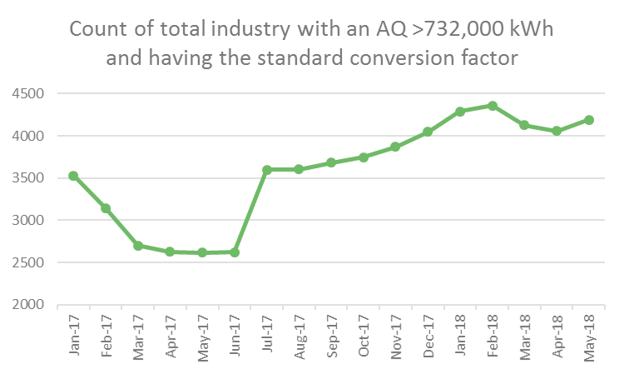
2A-9 Standard CF AQ > 732000 kWh
Report measures count of sites with an AQ >732,000 kWh, but having the standard conversion factor (i.e. 1.02264) as at the report snapshot date
Monthly change
18 ↓ Colwyn Bay
2 ↓ Eastbourne
1 ↓ Hastings
69 ↑ Falmouth
39 ↑ Morecambe Central
9 ↑ Mumbles
133 ↑ - Monthly change
1574 ↑ - Annual change
1031 Falmouth
912 Morecambe Central

Slide 6
PAFA@Gemserv.com
Nirav Vyas

