Slide 1
Cost Allocation review – CoMC update August 18

Slide 2
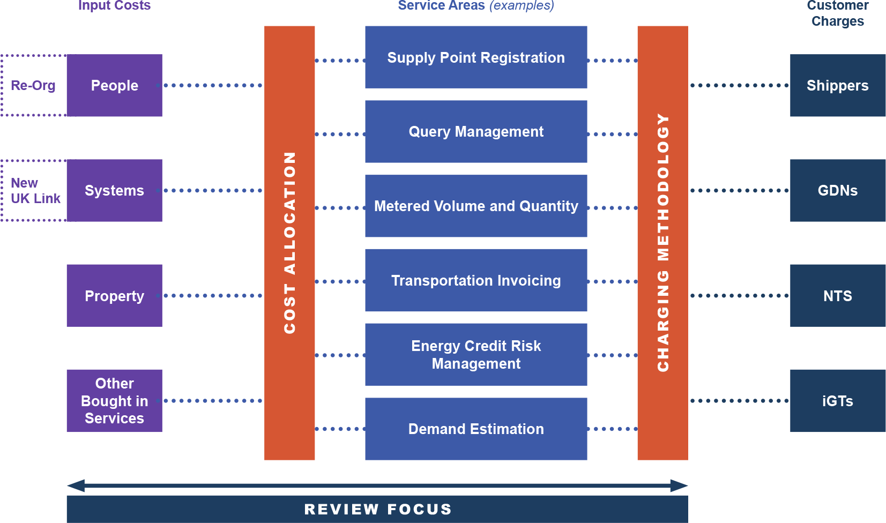
Recap from BP19 Principles presentation

Slide 3
Management Summary
People
Updated cost centre allocation across General Services, Investment and Support activities (based on the new organisation structure)
Resource allocations to General Service Lines updated
Investment resource cost centres reviewed but no changes made.
Systems Costs
Updated the allocations of input costs to applications
Used “old” UK Link cost breakdowns and allocations
Property & Other Bought in Services
No changes made to current allocation rules
Whilst there is still some work to do in this area, this presentation gives order of magnitude of the changes vs 18/19 charges
Any agreed changes to the allocations are not retrospective and will apply 2019/20 onwards

Slide 4
People
Updated costs associated with Reporting team and Customer facing activities.
Updated direct resources (FTEs) to Service Lines (bearing in mind we are still in a transitional period).
Reviewed Investment resources. The Retail & Network team are the only candidates for a non generic cost split.
Amendment & Rough Order of Magnitude Impact on Charges (18/19 Prices) | Shippers | National Grid NTS | Distribution Networks | iGTs
Update costs associated with reporting team and customer facing activities | +£0.1m | - | - | (£0.1m)
Update direct resources allocated to Service Lines | (£0.9m) | +£0.5m | +£0.4m | -
Investment Resources review | - | - | - | -
Total | (£0.8m) | +£0.5m | +£0.4m | (£0.1m)

Slide 5
IS Core
Bottom up cost allocation methodology used. Reflects new arrangements for UK Link.
Legacy hosting arrangement costs post UK Link removal -Applications in Pet/Ket data centres costing more (Gemini & CMS).
Amendment & Rough Order of Magnitude Impact on Charges (18/19 Prices) | Shippers | National Grid NTS | Distribution Networks | iGTs
Use of “bottom up” input costs to applications | (£0.2m) | +£0.8m | (£0.5m) | (£0.1m)

Slide 6
Overall Summary
Amendment & Rough Order of Magnitude Impact on Charges (18/19 Prices) | Shippers | National Grid NTS | Distribution Networks | iGTs
People Changes | (£0.8m) | +£0.5m | +£0.4m | (£0.1m)
Systems Costs Changes | (£0.2m) | +£0.8m | (£0.5m) | (£0.1m)
Property & Bought in Services Changes | - | - | - | -
Total | (£1.0m) | +£1.3m | (£0.1m) | (£0.2m)

