Slide 1
Market Trials
ChMC 8th August 2018

Slide 2
UK Link Release 3 – MT overview
Market Trials is a test period to provide an opportunity to validate the integration with Xoserve for the 13 changes in scope of Release 3, ensuring the changes are functioning to specification ahead of Implementation.
The Market Trials (MT) phase will constitute testing of solution components by Stakeholders to verify that they can functionally perform together in a production-like operational environment. This may be completed by executing a number of test scenarios relevant to the changes in scope of Release 3.
A limited test environment is to be provided to Market participants with a small provision of ‘production like’ data to enable parties to take part in Market trials testing
UK Link Market Trials will be carried out in two stages – split between the changes in scope of Track 1 (13CRs) and Track 2 (XRN4454).
The timelines to carry out Track 1 MT testing are 10th September to 05th October 2018 with closeout in w/c 08th October 2018
A more detailed presentation on Release 3 MT approach has been published to DSG (06th Aug) for feedback.
Market Trials is expected to be voluntary and registration process and links being issued separately to parties via email
To support MT test planning, Xoserve have compiled a list of stakeholders per change for verification:

Slide 3
MT Plan
UK Link Market Trials will be carried out in two stages – split between the changes in scope of Track 1 (13CRs) and Track 2 (XRN4454) This plan is to cover Track 1 MT testing
The timelines to carry out this testing are as shown below:

Slide 4
Release 3 MT Participation Recommendation (1)
Existing Change Proposal Number | Change Request Title | Service Areas Impacted* |  |  |  | Industry impacts & ~Xoserve Recommendation
 |  | Shipper Users | Transporters
 |  |  | National Grid NTS | Distribution
 |  |  |  | DN Operators | Independent Gas Transporters
XRN4534 | Amendment to RGMA Validation Rules for Meter Asset Installation Date | Yes | No | Yes* | Yes* | MT - Yes No Industry wide impact if some parties are not ready we recommend a 'Go' for MT iGTs and GTs are recipients only for Portfolio files if they wish to
XRN4273 | Introducing IHD (In-Home Display) | Yes | No* | Yes | Yes | MT - Yes - parties need to create IHD statuses within their system; Goes out in portfolio files to some parties (DNs/IGTs recipients only)
XRN3656 | Read Validation Tolerances | Yes | No | No | No | MT - Yes No Industry wide impact if some parties are not ready we recommend a 'Go' for MT
XRN4453 | File Format Should Have Changes | Yes | Yes* | Yes* | Yes | MT - Yes No Industry wide impact if some parties are not ready we recommend a 'Go' for MT
XRN4431 | Reads failing market breaker tolerance to be accepted for correct date following AQ Correction | Yes | No | No | No | MT - Yes No Industry wide impact if some parties are not ready we recommend a 'Go' for MT
XRN4481 | Resolution of penny mismatches within invoice supporting information for Core invoices. | Yes** | No | Yes** | Yes** | MT - Yes Recipients only Billing files will be shared for verification of penny mismatch Xoserve Internal change- no real external impact as Market parties are recipients only
*suggested – for industry review
** Recipients only, for Industry participant review on whether they would like to participate or not for these CRs

Slide 5
Release 3 MT Participation Recommendation (2)
Existing Change Proposal Number | Change Request Title | Service Areas Impacted* |  |  |  | Industry impacts & ~Xoserve Recommendation
 |  | Shipper Users | Transporters
 |  |  | National Grid NTS | Distribution
 |  |  |  | DN Operators | Independent Gas Transporters
XRN4337 | To change the optionality of the Supply Point confirmation reference for the T51 file | Yes | No | No | No | MT - Yes No Industry wide impact if some parties are not ready we recommend a 'Go' for MT
XRN4495 | Energy Tolerance Rejection code | Yes | No | Yes* | No | MT - Yes No Industry wide impact if some parties are not ready we recommend a 'Go' for MT
XRN4539 | New File Level Rejection | Yes | Yes | Yes | Yes | MT - Yes No Industry wide impact if some parties are not ready we recommend a 'Go' for MT
XRN4443 | File Format Changes Aug 16 Unique Sites (deferred items from CR252) | Yes | No | No | No | MT - Yes No Industry wide impact if some parties are not ready we recommend a 'Go' for MT
XRN4458 | Class 4 CSEPS Reconciliation Variance Identification | Yes | No | No | Yes* | MT - Yes No Industry wide impact if some parties are not ready we recommend a 'Go' for MT
XRN4486 | Meter Type O = Oriffice to be an acceptable value in file formats and reports | Yes | No | Yes** | Yes** | MT - Yes ; very few Meter type “O” No Industry wide impact if some parties are not ready we recommend a 'Go' for MT
XRN4538 | Insertion of Maximum Number of Occurrences in Meter Inspection Date Notice (MID) File. | Yes | No | No | No | MT - Yes No Industry wide impact if some parties are not ready we recommend a 'Go' for MT
*suggested – for industry review
** Recipients only, for Industry participant review on whether they would like to participate or not for these CRs

Slide 6
Business Change planned activities
To assist in the familiarisation and adoption of changes across the industry, we are providing an opportunity to gain further understanding and clarity surrounding the changes to be implemented as part of release 3.
For the high impacting and more complex changes we are creating training material that will be delivered by our in house trainers, onsite and supported by a member of the project team with in-depth business knowledge. This will offer an interactive experience with opportunity to ask questions on the day. These sessions will also be broadcast via WebEx where questions can be taken and responded by the SMEs.
We plan to hold sessions pre and post market trials and will be delivered at descriptive file format level. For the lower level impacting changes Educational Document will be created and released
This session will run alongside the customer day on the 5th September which will primarily focus on the Market Trial element of the change.

Slide 7
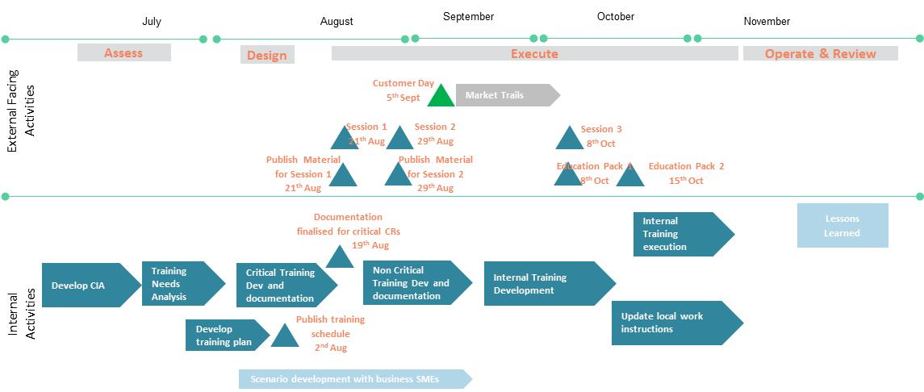
Business Change Roadmap Release 3 Track 1

Slide 8
Appendices

Slide 9
Business Change Session Contents
Session 1 : Training aimed primarily at Shippers and DMSP
XRN3656 & 4658 Read Validation Tolerance
XRN4495 Energy Tolerance Rejection Code
XRN4431 Reads Failed Market Breaker Tolerance
Session 2 : Training aimed primarily at Shippers and IGT
XRN4481 Resolution of Penny Mismatches
XRN4458 Class 4 CSEPS Recon. Variance ID
XRN4534 Amendment to RGMA Rules for MTR Install Date
Session 3 : Mop up for Sessions 1 & 2
Educational Document 1
XRN4453 File Format Should have Changes
XRN4443 File Format Changes Aug 16 Unique Sites (deferred items from CR252)
XRN4539 New File Level Rejection
Educational Document 2
XRN4273 Installed Status of Failed MOD614
XRN4337 To change the optionality of the Supply Point confirmation reference for the T51 file
XRN4486 Meter Type O = Orifice to be an acceptable value in file formats and reports
XRN4538 Insertion of Maximum Number of Occurrences in Meter Inspection Date Notice (MID) File
There are 3 levels of Educational Materials
The most intense level is Training, this will be live session either in house or via WebEx, with the opportunity to interact and ask questions. The material will then be published online. This will be used for more complex changes where there is an impact to process.
The next level in Training Material. Which is a self service e-learning or slide deck which will be published online. This will be used when changes have less impact to process and easier to understand.
Educational Documents will be used as an overview to the change. They will contain more detail and context than the change packs but are primarily aimed at participants who have not been close to the change throughout.

Slide 10
Next Steps
Dates for diary - 21st August -Session 1 will run covering 4 changes relating to read submission (2h)
Material for Session 1 will also be published online.WC20th August
29th August -Session 2 will run covering 3 changes relating to Involving and RGMA(2h)
Material for Session 2 will also be published online.WC27th August
8th October -Session 3 will run as a mop up for sessions 1&2 (3.5h)
-Educational pack 1 will be published online
15th October-Educational Pack 2 will be published online
Communications will be sent out on Tuesday 7th August for Stakeholder to register interest by Wednesday 15th as limited spaces will be available in house.
Interest will be emailed to box.xoserve.UKLRelease3@xoserve.com and request will be managed by the team on a first come and also evenly distributed basis.
This session will run alongside the customer day on the 5th September which will primarily focus on the Market Trial element of the change.

