Slide 1
UIG Task Force Progress Report
DSC ChMC 7/11/18

Slide 2
Background
Modification 0658: ‘CDSP to identify and develop improvements to LDZ settlement processes’ approved by Ofgem on 6th July 2018
Modification raised to authorise the CDSP to assign resources and incur costs related to a task force to investigate the causes and influencers of Unidentified Gas (UIG), with a target of reducing the volatility and scale of UIG and developing a robust predictive model for daily UIG for use by all parties.
BER for Change Reference Number XRN4695: ‘Investigating causes and contributors to levels and volatility of Unidentified Gas’ approved at ChMC on 11th July 2018
This Change Proposal added an additional service line into the DSC to enable Xoserve access to investigate, using resources and technology, causes and contributors to levels and volatility of Unidentified Gas. Xoserve is to provide monthly update reports and recommend proposals and subsequent changes or modifications for the industry.
The following slides provide:
Task Force Dashboard
POAP
Executive Summary of Sprint 3
Post Sprint 3: Areas Of Investigation (placeholder)
Shipper dashboards (placeholder)
Findings template
Reporting on budget

Slide 3
Plan on Page
C
Completed activity
Delivery team milestone
Advanced Analytics
DSC ChMC governance
I
 | August |  |  |  |  | September |  |  |  | October |  |  |  |  | November |  |  |  | December
 | 01/08 | 06/08 | 13/08 | 20/08 | 27/08 | 03/09 | 10/09 | 17/09 | 24/09 | 01/10 | 08/10 | 15/10 | 22/10 | 29/10 | 05/11 | 12/11 | 19/11 | 26/11 | 03/12 | 10/12 | 17/12
08/08 DSC ChMC
I
12/09 DSC ChMC
02/10 Extraordinary DSC ChMC
I
I
12/12 DSC ChMC
I
I
10/10 DSC ChMC
TBC Extraordinary DSC ChMC
07/11 DCS ChMC
I
I
03/09 Kick-off workshop with Vendor
27/08 Sprint 1 Exec Summary
12/10 Sprint 2 Exec Summary
Develop Investigation Log
C
C
C
C
C
C
25/10 Sprint 2 Exec Summary
Sprint 1
Sprint 2
Develop Industry Data Tree
Sprint 3
Develop Data Dictionary
Customer Engagement Manager Day 1
C
Sprint 4
24/8 Data Package 1 to vendor
03/9 Data Package 2 to vendor
14/9 Data Package 3a to vendor
27/9 Data Package 3b to vendor
C
12/10 Publish Industry Data Tree
Sprint 5
C
C
C
C
Sprint 6
C
Finalise inputs to data hamper
C
Develop stakeholder comms & engagement plan
Sprints 4-6 to continue at the same pace and follow directly after the initial sprints to maintain momentum and ensure existing team resources are fully utilised. A 14-day stand-down period applies at any time.
Mobilisation activity completed
C
Customer Advocate
Briefing Session
Confirm UIG points of contact & allocate Relationship Mgrs
Develop and manage shipper action plans (linked to Investigation Log)
C
05/10 Initial specification complete
22/10 Action plan template developed
Identify initial reporting inputs and outputs
C
10/10 Agree appropriate forum for creation of shipper dashboards
Define functional requirements for initial dashboard
C
Issue analysis and tracking (Investigation Tracker updated and published weekly)
Establish units of measurement & glide path

Slide 4
UIG Task Force: Dashboard
RAG
Time | G
Cost | G
Benefit | N/A
Overall RAG status:*
G
Progress since last month - key milestones | Workstream | Date | Status
Proposed dashboard specification complete | Customer | 05/10 | C
Complete Sprint 2 | AA + IA | 08/10 | C
Sprint 3 Kick off Workshop / Deliverable prioritisation | AA + IA | 08/10 | C
Agree appropriate forum for creation of shipper dashboards | Customer | 10/10 | C
Publish Data Tree | AA + IA | 12/10 | C
Publication of Sprint 2 Executive Summary | AA + IA | 12/10 | C
Publication of Sprint 3 Executive Summary | AA + IA | 25/10 | C
Priorities for next month – key milestones | Workstream | Date | Status
Attend UIG working group - dashboard | IA & AA | 31/10 | G
Findings report published | IA & AA | 08/10 | G
Publication of Sprint 4 Executive Summary | IA & AA | 08/10 | G
Publication of Sprint 5 Executive Summary | IA & AA | 22/11 | G

Slide 5
Sprint 3 Outcomes And Sprint 4 Areas Of Investigation

Slide 6
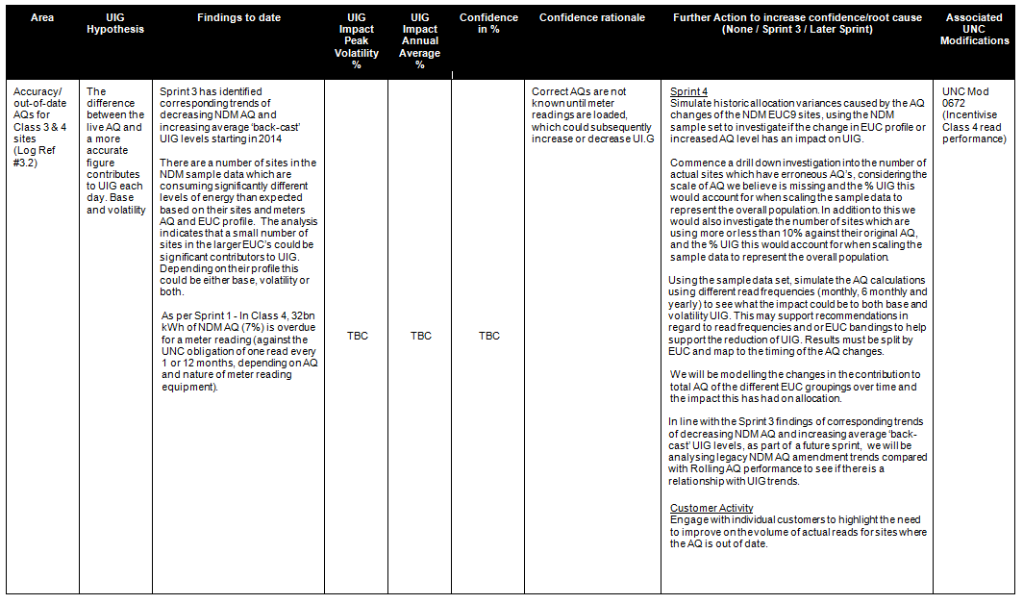
Sprint 3 Outcomes And Sprint 4 Areas Of Investigation

Slide 7
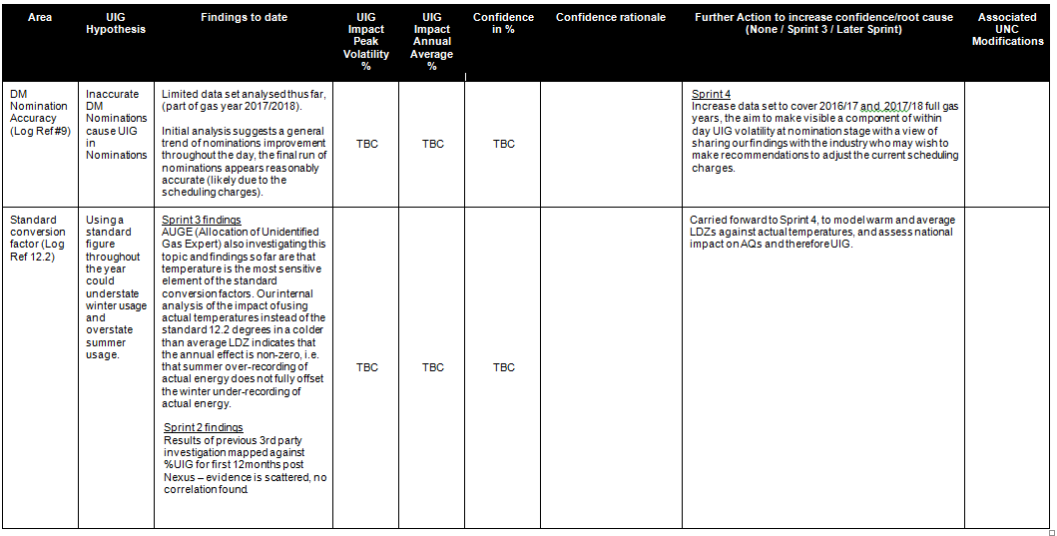
Sprint 3 Outcomes And Sprint 4 Areas Of Investigation

Slide 8
Sprint 3 Outcomes And Sprint 4 Areas Of Investigation

Slide 9
Sprint 4 Further Areas Of Investigation

Slide 10
Sprint 4 Early View of Findings
Sprint 4 due to complete Monday 5th November
To be updated post 5th Nov

Slide 11
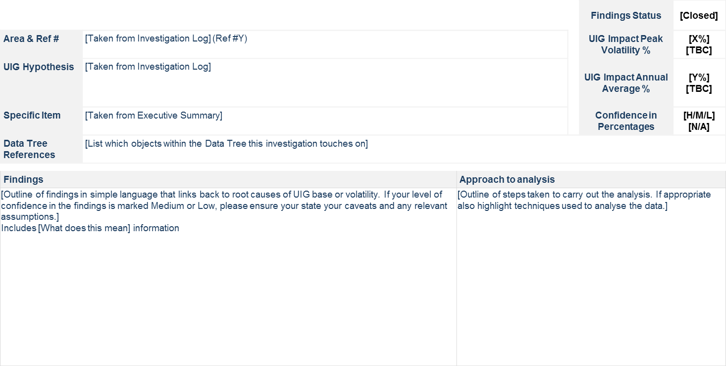
Sprint Findings Template

Slide 12
Shipper Dashboards
Industry Forum = UIG working group 31/10/18
To be updated post 31/10/18

Slide 13
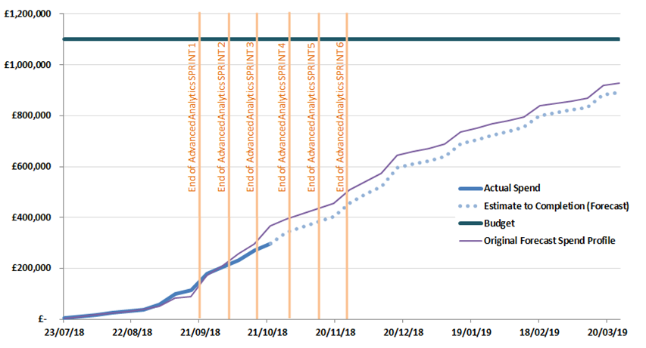
Overview Of Taskforce Funding

