Slide 1
UIG Task Force Progress Report
Contract Management Committee 19/12/18

Slide 2
Background
Modification 0658: ‘CDSP to identify and develop improvements to LDZ settlement processes’ approved by Ofgem on 6th July 2018
Modification raised to authorise the CDSP to assign resources and incur costs related to a task force to investigate the causes and influencers of Unidentified Gas (UIG), with a target of reducing the volatility and scale of UIG and developing a robust predictive model for daily UIG for use by all parties.
BER for Change Reference Number XRN4695: ‘Investigating causes and contributors to levels and volatility of Unidentified Gas’ approved at ChMC on 11th July 2018
This Change Proposal added an additional service line into the DSC to enable Xoserve access to investigate, using resources and technology, causes and contributors to levels and volatility of Unidentified Gas. Xoserve is to provide monthly update reports and recommend proposals and subsequent changes or modifications for the industry.
The following slides provide:
Task force dashboard
POAP
Reporting on budget
Task force next steps

Slide 3
UIG Task Force: Dashboard
RAG
Time | G
Cost | G
Benefit | N/A
Overall RAG status:*
G
Progress since last month - key milestones | Workstream | Date | Status
Complete Sprint 2 | AA + IA | 08/10 | C
Sprint 3 Kick off Workshop / Deliverable prioritisation | AA + IA | 08/10 | C
Agree appropriate forum for creation of shipper dashboards | Customer | 10/10 | C
Publish Data Tree | AA + IA | 12/10 | C
Publication of Sprint 2 Executive Summary | AA + IA | 12/10 | C
Publication of Sprint 3 Executive Summary | AA + IA | 25/10 | C
Attend UIG working group - dashboard | IA & AA | 31/10 | C
Publication of Sprint 4 Executive Summary | IA & AA | 08/10 | C
Publication of Sprint 5 Executive Summary | IA & AA | 22/10 | C
Priorities for next month – key milestones | Workstream | Date | Status
Publication of Sprint 6 Executive Summary | IA & AA | 06/12 | C
Publication of Findings - ongoing | IA & AA | 07/12 | G
Present documented Recommendations at ChMC December | IA & AA | 12/12 | C
Attend UIG working group | IA & AA | 07/12 | C
Run UIG Recommendation day under UIG work group banner | IA & AA | Jan 19 | G
AUGE

Slide 4
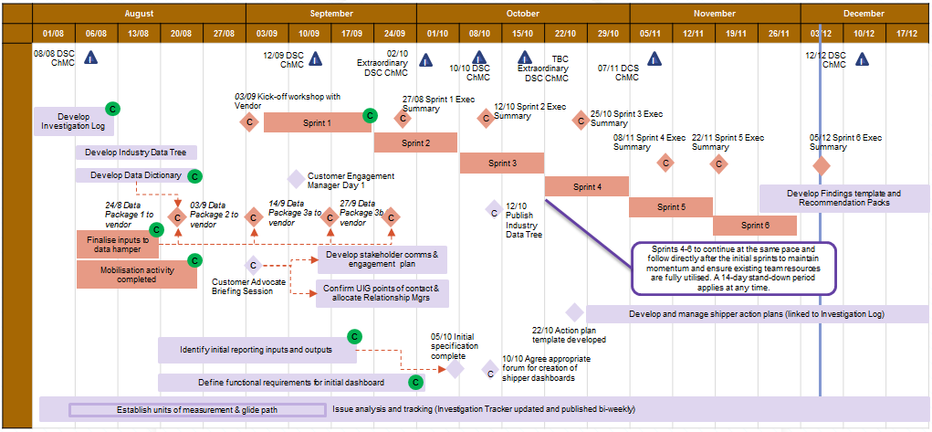
Plan on Page
C
Completed activity
Delivery team milestone
Advanced Analytics
DSC ChMC governance
I

Slide 5
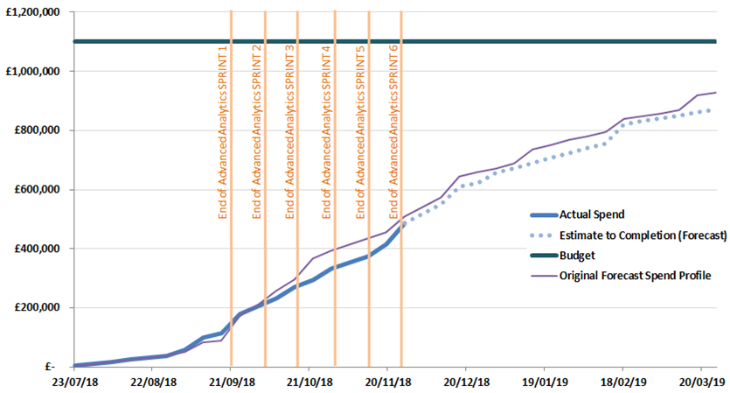
Overview Of Taskforce Funding

Slide 6
Task Force Update – Where we are
41 lines of Investigation
28 lines of Investigation analysed
13 to go
22 Completed lines of investigation
6 wip
19 lines of investigation - Continue analysis
Commercials in place for draw down with external analysis partner
13 Findings & Recommendations – UIG contributors
9 Findings only – None or minimal UIG contributors
Publish on Xoserve.com - Take to UIG Working Group for progression (Jan)
Notes:
22 lines require findings templates publishing of which 13 require recommendation, 9 do not
13 that require recommendations – 5 due 12/12/18. 6 due 21/12/18. 2 due 04/01/19.14
9 that require findings only – 2 due 14/12/18. 5 due 21/12/18. 2 due 04/01/19.
6 work in progress
Commercials in place with our external data analytics partner to carry out further analysis in the new year.

