Slide 1
Amendment Invoice AML/ASP Task Force Progress Report
DSC CoMC 20/02/19

Slide 2
Background
What’s the issue?
Xoserve’s UK Link system continues to experience problems when attempting to send accurate AML and ASP supporting information files to its shipper customers following the generation and submission of the monthly Amendment Invoice file (AMS).
Mismatches between the total Amendment Invoice charge within the AMS file to that of the total sum of charges contained within the ASP and AML files are presenting a number of shippers with difficulties in validating their monthly Amendment Invoice charge.
What have Xoserve done to-date to resolve this issue?
ASP Correction File Backlog considerably reduced
Large ASP mismatch anomalies witnessed for some shippers.
29x AML/ASP defects remain open.
AML mismatches continue.
BAU Defect Fixes
Unique Billing ID Solution Implemented
32x ring-fenced AML/ASP defects fixed
Time
June’17
Nexus Go-Live
May’18
Dedicated AML/ASP Task Force established
Jan’19
AML/ASP Task Force
reset

Slide 3
AML/ASP Task Force: Dashboard
RAG
RCA | A
Defect FIxes | R
BAU | A
Overall RAG status:*
Issue categorised as top priority item by Xoserve Executive Team for 2018/19 Q4.
Task Force workstreams restructured, including the reinforcement of teams with additional capability and expertise.
Defect fix prioritisation aligned to monthly Amendment Invoice schedule milestones
Fix glide path, for all known defects, currently running to March 2019 billing period.
Independent UK Link solution design/build review commissioned.
R
Progress since last month - key milestones | Workstream | Date | Status
Deploy fixes for final defects as part of the original 32x ring-fenced AML/ASP mismatch faults | Defect Fixes | 31/01/19 | Completed
Deploy AML ABAP correction routine to production | BAU | 08/02/19 | Completed
Secure priority resources onto the Task Force | All | 31/01/19 | Completed
Priorities for next month – key milestones | Workstream | Date | Status
Deliver Jan’19 Amendment Invoice | BAU | 26/02/19 | G
Deliver high-priority “Re-Reconciliation” impacting mismatch defect fixes into production | Defect Fixes | 25/02/19 | A
Conduct deep-dive RCA into Oct’18, Nov’18 and Dec’18 ASP mismatches. | RCA | 28/02/19 | A
Deliver automated ASP correction reporting into UK Link production | RCA / BAU | 25/02/19 | A
Complete independent UK Link solution design/build review | Design Review | 08/03/19 | G

Slide 4
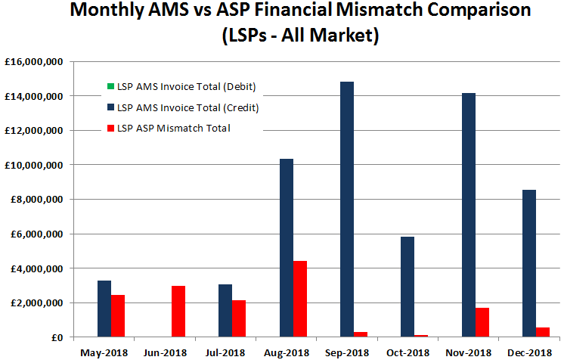
Unique Re-Reconciliation Anomalies
A limited number of shippers impacted by a handful of unique sites incurring large financial mismatches. RCA continues, although 7x Re-Reconciliation scenario AML/ASP defects prioritised as ‘highest priority’.
Unique Billing ID Implementation
Integration enhancement introduced between the UK Link Billing and Reconciliation modules to monitor Class 4 reconciliation.

Slide 5
Defect Fixes
At the time of slide pack submission, the Task Force’s Defect Fix and RCA teams continue to review all known defects across the Xoserve application landscape to determine the impact, before reviewing the fix prioritisations.
Seven defects have been identified as high priority, all linked to ‘Re-Reconciliation’ scenarios for which the prevailing energy derivation is presented wrongly wherever the start and/or end date is different between the original reconciliation period and the re-reconciliation period.
Three of these are being targeted for fix deployment ahead of the January 2019 billing cycle run for AMS and ASP file generation on 26th February 2019.
The remaining four will be targeted for February billing cycles.
Please continue to monitor the dedicated AML/ASP Task Force webpage for weekly communications of updated defect fix plans, located here.

Slide 6
Amendment Invoice Cycle Management
AML/ASP Task Force to ensure Defect Fix, RCA and Customer Management workstreams all align to BAU activities necessary to ensure the timely delivery of the monthly Amendment Invoice.
Monthly cycle to be run as a managed ‘countdown’ event
Daily management and tightening of process activities, hand-offs and issues
Pro-active management of risks and mitigation of customer impact
Earlier insight of in-cycle issues and customer impact
Co-ordinated and targeted customer interventions and communications
Delivery of highest priority AML/ASP defect fixes ahead of appropriate monthly invoice schedule milestone

