Slide 1
KVI Supporting Slide
CoMC
20th February 2019

Slide 2
January 2019 Period
KVI | Measure | Reporting Frequency | Commentary
Issue Resolution | 90% rated as ‘Exceeded Expectations’ or ‘Met Expectations’ | Monthly | 88.5% achieved. Only 52 responses to feedback requests received in January 2019; 2 ‘met some expectations’, 4 ‘did not meet expectations’. All feedback is passed back to relevant manager to provide to individuals. Where negative feedback is received an action plan must be provided to address. Analysis on all feedback: ‘you said’ – ‘we did’ will be provided next month.
Change Management | 90% rated as ‘Always’ or ‘Usually’ | Quarterly | 86.7% achieved for January 2019 from 9 responses. Separate slides providing results of analysis and further information under 4.3.1.
Relationship Management | 95% stated they ‘Trust’ Xoserve | Quarterly | Three surveys issued. The percentage scores for ‘Don’t Trust’ and ‘Trust’ categories have reduced driving up the percentage for ‘Starting to Trust’. Separate slides providing results of analysis for the three surveys issued to date under 4.3.1
Data Services | 90% rated as ‘Exceeded Expectations’ or ‘Met Expectations’ | As Required | No requests for feedback issued since May 2018. Survey will be issued early March for the current issues affecting AQ. From April 2019 this KVI will relate directly to ‘Issue Management’ activities.
Customer Data Security | Number of data breaches | Monthly | Two incidents categorised as ‘low’ in January 2019. Both are data loss incidents occurred as a result of human error. Covered under agenda item 4.5
Service Delivery | 98% of P1 & P2 KPIs met | Monthly | Two P2 KPIs missed due to a batch failure in UKLink which had a knock on effect to daily reads issued to Shippers and to the Allocation Agent. This also affected daily reads for Class 1 and 2 meter points, however all corrected within GFD+5. One P1 KPI missed - Amendment Invoice supporting files issued late for 2 Shippers.
Financial Reporting | Provision of quarterly reports | Quarterly | Provided in January 2019. Next due in April 2019.

Slide 3
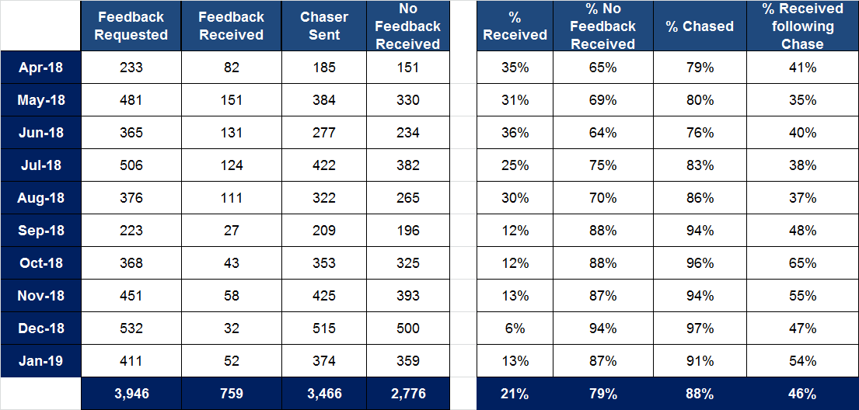
Issue Resolution Stats

