Slide 1
UIG Task Force Progress Report
Change Management Committee 13/02/19

Slide 2
Background
Modification 0658: ‘CDSP to identify and develop improvements to LDZ settlement processes’ approved by Ofgem on 6th July 2018
Modification raised to authorise the CDSP to assign resources and incur costs related to a task force to investigate the causes and influencers of Unidentified Gas (UIG), with a target of reducing the volatility and scale of UIG and developing a robust predictive model for daily UIG for use by all parties.
BER for Change Reference Number XRN4695: ‘Investigating causes and contributors to levels and volatility of Unidentified Gas’ approved at ChMC on 11th July 2018
This Change Proposal added an additional service line into the DSC to enable Xoserve access to investigate, using resources and technology, causes and contributors to levels and volatility of Unidentified Gas. Xoserve is to provide monthly update reports and recommend proposals and subsequent changes or modifications for the industry.
The following slides provide:
Task force dashboard
POAP
Recommendation stats
Reporting on budget
Task force next steps

Slide 3
UIG Task Force: Dashboard
RAG
Time | G
Cost | G
Benefit | N/A
Overall RAG status:*
G
Progress since last month - key milestones | Workstream | Date | Status
Publication of Findings & Recommendations ongoing | IA & AA | 07/12 | G
AUGE & PAFA – Task force present recommendations | IA & AA | 09/01/19 | C
Attend ChMC | IA & AA | 09/01/19 | C
Attend UIG working group | IA & AA | 22/01/19 | C
Run UIG Recommendation day under UIG work group banner | IA & AA | 28/01/19 | C
Priorities for next month – key milestones | Workstream | Date | Status
Attend CoMC | Task force | 20/02/19 | G
Attend UIG working group | Task force | 26/02/19 | G
Raise CRs & CPs to support recommendations allocated to Xoserve | Task force | 29/01/19 - ongoing | G
Develop a customer engagement strategy to support “engagement activities” to implement recommendations | Task force | 18/02/19 | G

Slide 4
Plan on Page
C
Completed activity
Delivery team milestone
Advanced Analytics
DSC ChMC governance
I
 | October |  |  |  | November |  |  |  | December |  |  |  |  | January |  |  |  | February
 | 08/10 | 15/10 | 22/10 | 29/10 | 05/11 | 12/11 | 19/11 | 26/11 | 03/12 | 10/12 | 17/12 | 24/12 | 31/12 | 07/01 | 14/01 | 21/01 | 28/01 | 04/02 | 11/02 | 18/02 | 25/02 | 05/03
I
I
12/12 DSC ChMC
09/01 DSC ChMC
I
28/01 CUSTOMER RECOMMENDATION DAY
C
13/02 DSC ChMC
10/10 DSC ChMC
TBC Extraordinary DSC ChMC
07/11 DCS ChMC
I
I
I
C
12/10 Sprint 2 Exec Summary
C
25/10 Sprint 3 Exec Summary
08/11 Sprint 4 Exec Summary
22/11 Sprint 5 Exec Summary
05/12 Sprint 6 Exec Summary
Sprint 3
C
C
C
Develop Xoserve owned Recommendation options – update and publish recommendation tracker in line with UIG working group meetings
Sprint 4
Develop Findings template and Recommendation Packs
C
12/10 Publish Industry Data Tree
Sprint 5
Sprint 6
Investigation Analysis
Sprints 4-6 to continue at the same pace and follow directly after the initial sprints to maintain momentum and ensure existing team resources are fully utilised. A 14-day stand-down period applies at any time.
Develop and manage shipper action plans (linked to Investigation Log)
22/10 Action plan template developed
C
10/10 Agree appropriate forum for creation of shipper dashboards
Issue analysis and tracking (Investigation Tracker updated and published bi-weekly)

Slide 5
Recommendations - where we are
13 finding & recommendations = 85 recommendation lines
6 PAFA/Xoserve
3 MOD - EON PAFA/Xoserve
41 Propose Close – no support
13 require UIG WG progress
22 recommendation options – Xoserve action
UIG WG 28th Feb
6 Pause review April-July
2 CPs raised
2 CRs raised
2 Options completed
1 defect
5 wip with UIG WG
4 Customer Engagement
As at 8/2/19
Notes:
85 lines in recommendation tracker
22 lines actions against Xoserve
6 pause review April – July = 3.2.1 option 4 & option 10, 3.2.2 option 7b, 1 option 3, 3.2.8 option 2 & option 4
2 CPs = 3.1 option 5 & option 7
2 CRs = 3.2.1 option 2, 1 option 2
2 Completed = 2 option 2 and option 3
1 Defect = 2 option 6
5 wip with UIG WG = 2 option 4 and 12.2 options 2,5,9 & 10
4 Engagement = 12.1/12.3 option 2, 3.2.8 option 2, 3.1 option 2, 2 option 5.
6 PAFA – 3.2.1 – option 3, 3.2.2 option 10, 1 option 4, 1 option 7, 12.1&12.3 option 3, 3.2.8 option 5.
3 MOD – 12.1&12.3 option 9a, 10 & 11.
41 – propose to close – no support.

Slide 6
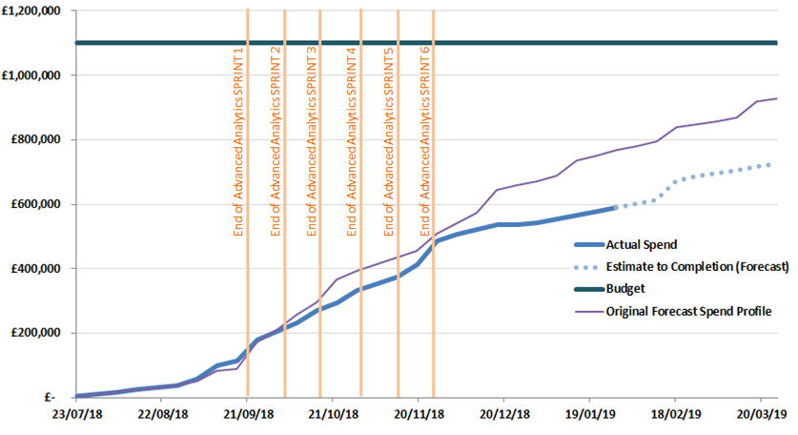
Overview Of Taskforce Funding

Slide 7
Taskforce Next Steps
Use the UIG working group as the mechanism to share progress on all recommendations where options were selected by our customers to progress.
Provide updates to the newly produced “Recommendation Tracker” in line with UIG Working Group timescales.
Continue analysis on investigation lines & publish investigation tracker updates bi-weekly.
Publish any new findings/recommendations drawn from investigation lines which are currently “work in progress” when completed.
Continue the customer engagement, development of CPs, development of CRs to support the recommendation options agreed at 28th January UIG-Recommendation session.
Offer support/guidance to develop MODs agreed as recommendation options.
Support the creation of new PAC reports as per the agreed recommendation options.
Consider any investigation lines which are not currently being analysed where requested by our customers.

