Slide 1
Amendment Invoice Task Force Progress Report
DSC CoMC 20/03/19

Slide 2
AML/ASP Task Force: Dashboard
RAG
RCA | R
Defect Fixes | A
BAU | A
Overall RAG status:*
Topic remains the top priority issue by Xoserve Executive Team for 2018/19 Q4.
Task Force workstreams restructured, including the reinforcement of teams with additional capability and expertise.
Task Force remains held at Red RAG status given the ongoing uncertainty surrounding the exact root causes to AML/ASP supporting information mismatches. First round of RCA complete, however ongoing RCA required on last month’s billing cycle to confirm trends/correlations in potential mismatch contributors.
Volume of outstanding Amendment Invoice defects reduced by 50% over the last 6-weeks, however new defects continue to be identified.
Defect fix prioritisation aligned to monthly Amendment Invoice schedule milestones.
R
Progress since last month - key milestones | Workstream | Date | Status
Deliver Jan’19 Amendment Invoice | BAU | 26/02/19 | G
Deliver high-priority “Re-Reconciliation” impacting mismatch defect fixes into production | Defect Fixes | 25/02/19 | G
Conduct deep-dive RCA into Oct’18, Nov’18 and Dec’18 ASP mismatches. | RCA | 28/02/19 | G
Deliver automated ASP correction reporting into UK Link production | RCA / BAU | 25/02/19 | R
Priorities for next month – key milestones | Workstream | Date | Status
LIS Impact Assessment (held back recs) and clearance | BAU | 29/03/19 | A
Deliver automated ASP correction reporting into UK Link production | BAU | 22/03/19 | A
Ongoing provision of prioritised defect fixes to UK Link production | Defect Fixes | Ongoing | A
Completion of RCA Phase 2 | RCA | 29/03/19 | A

Slide 3
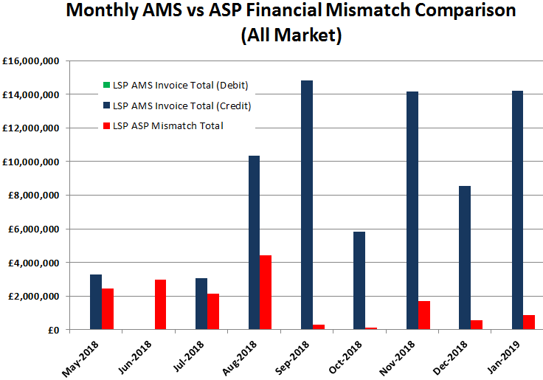
Unique Re-Reconciliation Anomalies
A limited number of shippers impacted by a handful of unique sites incurring large financial mismatches. RCA continues, although 7x Re-Reconciliation scenario AML/ASP defects prioritised as ‘highest priority’.
Unique Billing ID Implementation
Integration enhancement introduced between the UK Link Billing and Reconciliation modules to monitor Class 4 reconciliation.

Slide 4
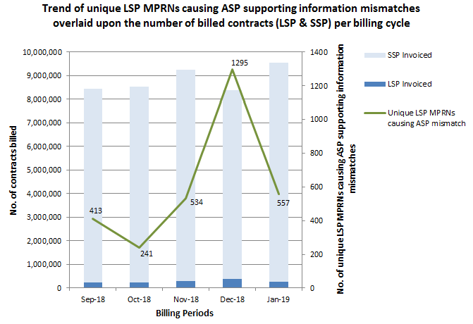
A 57% reduction in MPRNs causing LSP ASP mismatches was witnessed between the Dec’18 and Jan’19 billing cycles.
Some of this reduction can be attributed to the enhanced level of Unique Billing ID monitoring now in place following an initial round of RCA; however as can be seen from the Sept’18, Oct’18 and Nov’18 cycles, the very nature of reconciliation and the abundance of rec and re-rec scenarios appears to be driving a trend in ASP mismatch volumes that is difficult to predict.
RCA in this area continues.

Slide 5
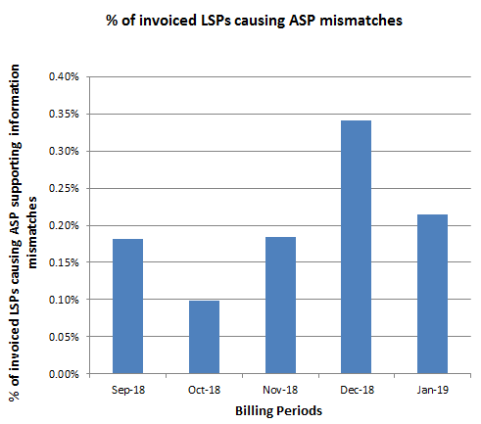
Over the last five billing cycles we’ve witnessed an average of 0.2% of invoiced LSPs that have caused ASP supporting information mismatches.
RCA continues to place a high emphasis on determining which scenarios and what system issues are causing such mismatches.
The Task Force has initiatives underway to quantify similar statistics for SSPs within the AML file.

Slide 6
Defect Fixes
At the time of slide pack submission, the Task Force’s Defect Fix and RCA teams continue to review all known defects across the Xoserve application landscape to determine AML/ASP impact, before reviewing the fix prioritisations.
15 defects, deemed to impact the AMS, ASP and/or AML, have seen fixes deployed to our UK Link production systems.
Currently, at the time of slide pack submission, the Task Force are working to resolve 16 open known defects.
Please continue to monitor the dedicated AML/ASP Task Force webpage for weekly communications of updated defect fix plans, located here.

