Slide 1
Market Participant Identity Process – migration to UNC

Slide 2
Governance Approach
UNC Modification 0682 has been raised to place the obligation on CDSP to maintain a register of Market Participant Identities
March Panel will consider this modification
This is a separate UNC Modification (not in the CSS Consequential SCR) as the migration is planned in advance of REC v2.0 go live
An equivalent SPAA CP (467) has also been raised which is currently out for Impact Assessment which alters the SPAA Schedule to reflect MDD being governed under UNC
This will result in new DSC Service Lines to maintain processes and publication of Market Participant Identities
Requirements
As per the recommendation from the Joint MDD UNC Workgroup, the MDD Publishing and Go-Live are to be distinct and aligned with SPAA MDD Dates

Slide 3
Process Proposal
The intention is to set up a sub group of DSC CoMC which will be conducted on the same day as the current SPAA CB where the process currently sits
The intention is for the CDSP to chair the MDD section of the current SPAA CB
Given commonality of approval, we suggest adopting the current SPAA process steps
We expect that, as the process matures, we will assess the efficacy of the Guidelines Document (maintained by CoMC) to see if the process approach can be streamlined
Any changes made in the future to the MDD process will be communicated through DSC committees

Slide 4
Process Steps and Timing Rules
Process Steps | Timing Rule
Closing date for submitting MDD Changes | 3WD before Change Pack Issued
MDD Change Pack Issued | 5WD before closing date for comments
Closing date for comments | 3WD before comments issued
Comments Issued | 5WD before SPAA CB
SPAA CB (MDD Market Participant section hosted by CDSP) | 2nd Tuesday of every month
Confirmation of Modified MDD table/Voting outcomes and minutes Issued | 5WD after CB
Appeals Window Closes | 5WD after confirmation of MDD modifications
Confirmation of MDD release contents | 2WD after appeal window closure
MDD Release Go-Live | 3WD after confirmation of contents
Working Backwards from SPAA Change Board
Working Forwards from SPAA Change Board

Slide 5
Example Dates for new Process
Process Steps | Timing Rule | August 2019 MDD Release | September 2019 MDD Release
Closing date for submitting MDD Changes | 3WD before Change Pack Issued | 17/06/2019 | 22/07/2019
MDD Change Pack Issued | 5WD before closing date for comments | 20/06/2019 | 25/07/2019
Closing date for comments | 3WD before comments issued | 27/06/2019 | 01/08/2019
Comments Issued | 5WD before SPAA CB | 02/07/2019 | 06/08/2019
SPAA CB (MDD Market Participant section hosted by CDSP) | 2nd Tuesday of every month | 09/07/2019 | 13/08/2019
Confirmation of Modified MDD table/Voting outcomes and minutes Issued | 5WD after CB | 16/07/2019 | 20/08/2019
Appeals Window Closes | 5WD after confirmation of MDD modifications | 23/07/2019 | 27/08/2019
Confirmation of MDD release contents | 2WD after appeal window closure | 25/07/2019 | 29/08/2019
MDD Release Go-Live | 3WD after confirmation of contents | 30/07/2019 | 03/09/2019

Slide 6
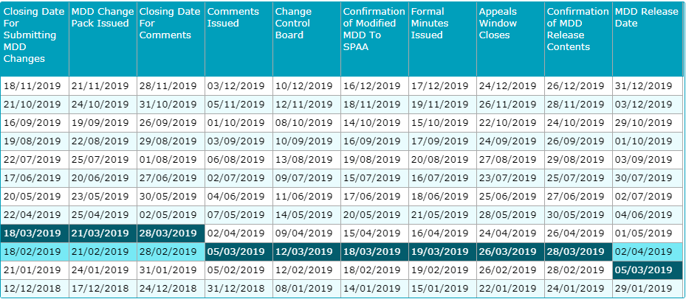
SPAA MDD Timelines for information

Slide 7
Thoughts?

