Slide 1
UIG Task Force Progress Report
DSC CoMC 01/05/19

Slide 2
Background
Modification 0658: ‘CDSP to identify and develop improvements to LDZ settlement processes’ approved by Ofgem on 6th July 2018
Modification raised to authorise the CDSP to assign resources and incur costs related to a Task Force to investigate the causes and influencers of Unidentified Gas (UIG), with a target of reducing the volatility and scale of UIG and developing a robust predictive model for daily UIG for use by all parties.
BER for Change Reference Number XRN4695: ‘Investigating causes and contributors to levels and volatility of Unidentified Gas’ approved at ChMC on 11th July 2018
This Change Proposal added an additional service line into the DSC to enable Xoserve access to investigate, using resources and technology, causes and contributors to levels and volatility of Unidentified Gas. Xoserve is to provide monthly update reports and recommend proposals and subsequent changes or modifications for the industry.
The following slides provide:
Task Force dashboard
POAP
Recommendation stats
Reporting on budget
Task Force next steps

Slide 3
UIG Task Force: Dashboard
RAG
Time | G
Cost | G
Benefit | N/A
Overall RAG status:*
G
Progress since last month - key milestones | Date | Status
Attend UIG working group | 25/03/19 | Complete
Attend March Change Management Committee | 13/03/19 | Complete
Attend March Contract Management Committee | 20/03/19 | Complete
Attend UIG work group | 08/04/19 | Complete
Support Modification Development – All draft modifications have allocated sponsors | 08/04/19 - ongoing | Complete
Attend April Change Management Committee | 10/04/19 | Complete
Final walk through of AUG weighting factors (teleconference) for vote | 12/04/19 | Complete
Priorities for next month – key milestones | Date | Status
Executive Summary Update | w/c 29/04/19 | G
Attend April UIG work group | 29/04/19 | G
Draft 3.2.5 Modification(s) | 29/04/19 | G
Attend May Contract Management Committee | 01/05/19 | G
Customer Training Day - UIG | 03/05/19 | G
Attend May Change Management Committee | 08/05/19 | G
Attend May Contract Management Committee | 15/05/19 | G
Attend May UIG work group | 21/05/19 | G

Slide 4
Plan on Page new
C
Completed activity
Delivery team milestone
Advanced Analytics
Governance
I
 | April |  |  |  |  | May |  |  |  | June |  |  |  | July |  |  |  |  | August |  |  |  | September
 | 01/04 | 08/04 | 15/04 | 22/04 | 29/04 | 06/05 | 13/05 | 20/05 | 27/05 | 03/06 | 10/06 | 17/06 | 24/06 | 01/07 | 08/07 | 15/07 | 22/07 | 29/07 | 05/08 | 12/08 | 19/08 | 26/08 | 02/09 | 09/09 | 16/09 | 23/09 | 30/09
I
I
I
I
I
I
10/04 DSC ChMC
08/05 DSC ChMC
12/06 DSC ChMC
10/07 DSC ChMC
07/08 DSC ChMC
11/09 DSC ChMC
w/c 29/4 Exec Summary
w/c 01/06/Exec Summary
w/c 01/07 Exec Summary
w/c 01/08 Exec Summary
w/c 02/09 Exec Summary
Develop Xoserve owned Recommendation options – update and publish recommendation tracker in line with UIG working group meetings
Develop Findings template and Recommendation Packs
Investigation Analysis
Support Mod development
Issue analysis and tracking (Investigation Tracker updated and published bi-weekly)
Draft Mods to support recommendations
I
I
I
I
I
I
01/05 CoMC
15/05 CoMC
19/06 CoMC
17/07 CoMC
14/08 CoMC
18/09 CoMC
w/c 01/07 create close out activity plan
I
I
I
I
I
I
I
w/c 23/09 Publish UIG Investigation guide V.2
08/04 UIG WG
29/04 UIG WG
21/05 UIG WG
24/06 UIG WG
23/07 UIG WG
20/08 UIG WG
23/09 UIG WG
03/05 Attend Customer Training Day
Review/draft updates to UIG user guide ongoing

Slide 5
Recommendations - where we are
14 finding & recommendations = 95 recommendation lines
40 CLOSED
10 do nothing
7 lines PAC /Xoserve – covered under existing changes 4876 & 4795. 4 with Xoserve
3 lines MOD 0681 – EON & Xoserve = 1 MOD 21.3.19 Panel
9 lines MOD – Scottish Power (12.2) = 1 MOD – sponsored
3 lines MOD – (3.2.1) = 3 MODS – 1 sponsored Total, 2 sponsored British Gas
2 BAU
10 new 3.2.5 options
7 completed
21 other options progressed
2 In progress
21 Future review
1 ongoing engagement using existing MI
1 CR4868 in progress - TBC
2 review April
4 review May
2 review June
4 review July
1 review August
4 review November
4 review December
As at 09/4/19
Notes:
95 lines in recommendation tracker
10 new recommendation options for 3.2.5.
40 lines closed =
10 do nothing: 3.2.1 option 1, 3.2.2 option 1, 1 option 1, 12.1/12.3 option 1, 12.2 option 1, 3.2.8 option 1, 3.1 option1, 13.2.5 option 1, 2 option 1, 13.2.2 option 1.
Bau=2. 3.2.2 option 5. 3.2.8 option2
Completed =7. 2 option 2, 2 option 3, 13.2.2 option 2, 13.2.5 option 2, 13.2.5 option 3. 3.2.1 option 2, 3.1 option 2. CR delivered – 3.2.1 option 2 - CR4867 sites over 58.6m kWh that need reconfirming
Progressed another option =21. 1 option 5,8. 3.2.1 option 5,8,9. 3.2.2 option 2,3,4,7a,8. 12.1/12.3 option 5,7,8,9b. 3.2.8 option 6, 10, 11. 3.1 option 3,4,8,9.
7 lines PAC/Xoserve action = 3.2.1 option 3 & 4 – with Xoserve/pac to deliver. 12.1/12.3 option 6 with xoserve/pac. 3.2.2 option 10 covered under 4876. 1 option 4 covered under 4795. 12.1&12.3 option 3 covered under 4876 . 3.2.8 option 5 covered under 4876.
3 lines EON/Xoserve MOD = 12.1&12.3 option 9a, 10, & 11.
9 lines Scottish power sponsored mod – 12.2 options 2,3,4,5,6,7,8,9&10.
2 lines BG sponsored mod 3.2.1 options 6,7
1 line Total sponsored mod 3.2.1 option10.
2 lines in progress =
1 ongoing engagement 12.1&12.3 option 2,
1 CR in progress – 1 option 2 - CR4868 class 1&2 read rejections
21 lines for future review =
2 review April 3.2.2 option6, 7b.
4 review May 2 option 5 & 6. 1 option 3. 1 option 7 with xoserve/pac to deliver
4 review July 3.2.1 option 11. 3.2.8 option 3 & 4. 12.1&12.3 option 4.
4 review November 3.1 option 6, 2 option 7. 3.1 option 5 & 7. (1 CP in progress – CP4866 removal of validation on uncorrected read – review in Nov 3.1 option 7), (1 CP in progress - 3.1 option 5 – CP4853 manual workaround starts April 2019)
4 review December 3.2.8 option 7, 8 & 9. 2 option 4.
2 review June 3.2.2 option 9. 1 option 9.
1 review August 1 option 6.

Slide 6
Breakdown
95 lines in recommendation tracker
10 new recommendation lines 3.2.5
40 lines closed =
10 do nothing: 3.2.1 option 1, 3.2.2 option 1, 1 option 1, 12.1/12.3 option 1, 12.2 option 1, 3.2.8 option 1, 3.1 option1, 13.2.5 option 1, 2 option 1, 13.2.2 option 1.
Bau=2. 3.2.2 option 5. 3.2.8 option2
Completed =7. 2 option 2, 2 option 3, 13.2.2 option 2, 13.2.5 option 2, 13.2.5 option 3. 3.2.1 option 2, 3.1 option 2. CR delivered – 3.2.1 option 2 - CR4867 sites over 58.6m kWh that need reconfirming
Progressed another option =21. 1 option 5,8. 3.2.1 option 5,8,9. 3.2.2 option 2,3,4,7a,8. 12.1/12.3 option 5,7,8,9b. 3.2.8 option 6, 10, 11. 3.1 option 3,4,8,9.
7 lines PAC/Xoserve action = 3.2.1 option 3 & 4 – with Xoserve/pac to deliver. 12.1/12.3 option 6 with xoserve/pac. 3.2.2 option 10 covered under 4876. 1 option 4 covered under 4795. 12.1&12.3 option 3 covered under 4876 . 3.2.8 option 5 covered under 4876.
3 lines EON/Xoserve MOD = 12.1&12.3 option 9a, 10, & 11.
9 lines Scottish power sponsored mod – 12.2 options 2,3,4,5,6,7,8,9&10.
2 lines BG sponsored mod 3.2.1 options 6,7
1 line Total sponsored mod 3.2.1 option10.

Slide 7
2 lines in progress =
1 ongoing engagement 12.1&12.3 option 2,
1 CR in progress – 1 option 2 - CR4868 class 1&2 read rejections
21 lines for future review =
2 review April 3.2.2 option6, 7b.
4 review May 2 option 5 & 6. 1 option 3. 1 option 7 with xoserve/pac to deliver
2 review June 3.2.2 option 9. 1 option 9.
4 review July 3.2.1 option 11. 3.2.8 option 3 & 4. 12.1&12.3 option 4.
1 review August 1 option 6.
4 review November 3.1 option 6, 2 option 7. 3.1 option 5 & 7. (1 CP in progress – CP4866 removal of validation on uncorrected read – review in Nov 3.1 option 7), (1 CP in progress - 3.1 option 5 – CP4853 manual workaround starts April 2019)
4 review December 3.2.8 option 7, 8 & 9. 2 option 4.

Slide 8
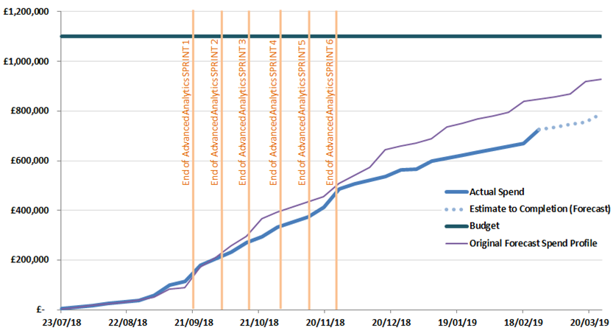
Overview Of Task Force Funding

Slide 9
Task Force Next Steps
Use the UNC UIG Work Group as the mechanism to share progress on all recommendations where options residing with Xoserve.
Provide updates to the “Recommendation Tracker” in line with UNC UIG Work Group timescales.
Continue analysis on investigation lines & publish investigation tracker updates fortnightly.
Publish any new findings/recommendations drawn from investigation lines which are currently “work in progress” when completed.
Develop draft Modifications to support recommendation options for 3.2.5 Inaccurate or out of date AQs – impact of rolling AQ – Xoserve take action on all options agreed.
Continue the customer engagement, progress the CPs & CRs raised to support the recommendation options agreed at 28th January UIG-Recommendation session.
Supporting MOD development to progress all sponsored modifications.
Continue the development of existing non Task Force changes 4876 & 4795 to support the PAC report recommendations.

