Slide 1
Mod UNC 0674 Business Rule Development
Mark Bellman (PAC) and Anne Jackson (PAFA)
on behalf of the Performance Assurance Committee (PAC)

Slide 2
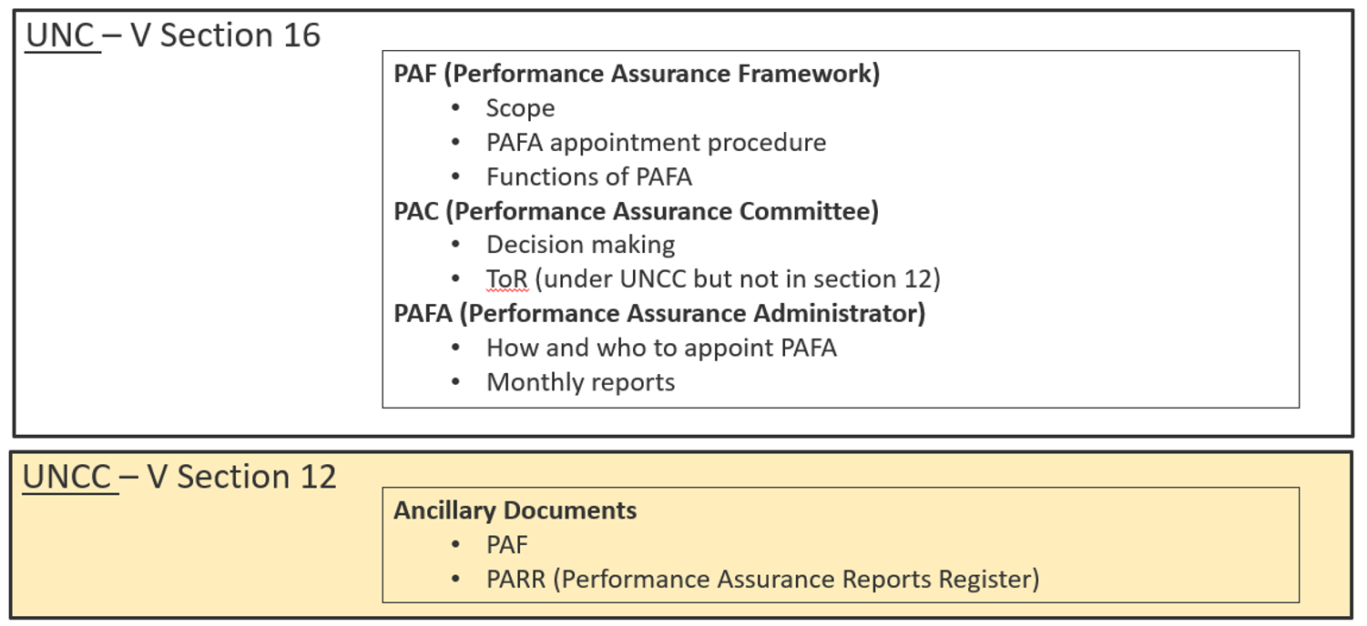
UNC – As Is

Slide 3
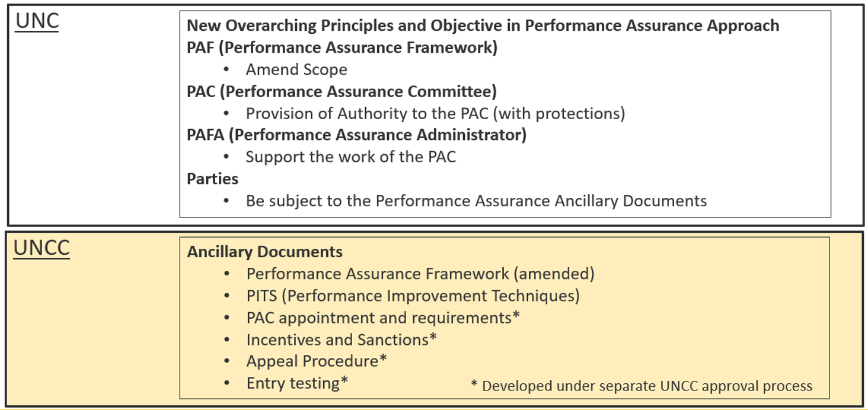
UNC0674 Proposal – To be (i.e. ‘as is’ plus)

Slide 4
Elements of Mod to be developed
Identify business rules for UNC changes:
Adding Performance Assurance Principle(s) / Objective(s)
Extending PAC authority (with boundaries, rather than processes specified in UNCC Ancillary Documents)
Requirements on Parties to be subject to the Performance Assurance regime and PAC decisions and authority.
Adding protections to PAC and Parties in the performance assurance decision making process.
Identify detail within Ancillary Documents:
Performance Improvement Techniques (PITs)
PAC Appointments, Responsibilities and Requirements
Incentives and Sanctions
Appeals Procedure
Market Entry Testing
Adjust detail in existing Ancillary Documents
Performance Assurance Framework

Slide 5
Overriding Principles / Objectives in UNC
Require UNC Parties to adhere to basic principles:
‘negligence, poor performance or bad behaviours must not distort settlement even when such behaviours have not specifically been precluded through prescription within the UNC’
‘performance of Parties in their actions and processes will be managed, monitored and measured by parties themselves as they strive to meet the requirements specified in the UNC’
Any others?
Outcome achieved:
Prescriptive mod is not required to stop activity that distorts settlement.
When poor behaviour identified, a request to cease those behaviours can be issued quickly, thereby mitigating the risk to settlement more speedily.
Increases agility in Performance Assurance.
‘Distort’ indicates the action could have a positive or negative impact.
No indication of magnitude or burden of proof.
Seeks to refute any assumption that any practice can be adopted unless the UNC precludes it.

Slide 6
UNC Business Requirements – PAC
The PAC are to be empowered to:
Require parties to respond to and meet PAC requests made in the context of performance matters and in line with the framework objectives.
Deploy Performance Improvement Techniques (PITs) described in the ancillary document as they deem appropriate.
Following the failure to make improvements as agreed, apply financial penalties or sanctions according to the relevant ancillary document.
Request adhoc performance reports as they deem relevant, based on their experience and expertise.
Access any standard performance reports that are provided to parties by the CDSP
Request the remedy of performance issues or party actions, where there is no explicit prescriptive performance standard or restriction specified in the code, where that issue or action is impacting settlement accuracy.
Determine the materiality of performance levels on the accuracy of settlement.

Slide 7
UNC Business Requirements – UNC Parties
UNC Parties (transporters, shippers, CDSP) are required to:
Manage and monitor their own processes and procedures in meeting the obligations in the UNC, including performance monitoring.
Provide the necessary permissions in respect of data, to ensure the PAC and PAFA can perform their duties without hindrance, subject to normal data security, protection and confidentiality measures being in place on both.
Provide data / information services requested by PAC or PAFA in the timescales requested (ref: 6.5.1 PAF Ancillary Document)
Comply with reasonable requests made by the PAC in performing their duties, such as requests for remedial action, plans of action, stage updates etc. in the timescales requested.
Take action to improve their performance and remedy issues if identified and requested by the PAC.
Be subject to any commitments they make to the PAC in the course of any kind of performance intervention, such as in plans, timescales or remedial action.

Slide 8
UNC Business Requirements – Protections (1)
PAC, PAFA and CDSP personnel attending closed PAC meetings may not reveal the workings or the decision making process in reaching any decisions, save when required due to an appeal from any party.
PAC, PAFA and CDSP personnel attending closed PAC meeting are required to sign and adhere to undying non-disclosure agreements and any confidential material downloaded must be deleted when no longer required and when ceasing attend the PAC (for whatever reason), whichever is sooner.
PAC, PAFA and any parties connected with a performance assurance decision directed at any Party or any parties deemed to be responsible for the UNC should be protected from any litigation connected with the operation of the performance assurance regime.
Any Party may appeal a PAC decision to impose financial reparations or sanctions under the Performance Assurance regime only.

Slide 9
UNC Business Requirements – Protections (2)
UNC or Ancillary Document?
In reaching a decision re an individual Party’s performance, the PAC may take into consideration (i.e. evidence)
Statistical performance measures.
Management of performance in the area of issue.
Willingness and speed in remedying the issue.
General co-operation in reviewing their case
The performance of any other party does not mitigate any other party in their own performance.

Slide 10
UNC Business Requirements – UNC V Section 12
Add additional ancillary documents to UNC Related Documents - Section 12.
The PAC suggests:
Performance Improvement Techniques (PITs)
PAC Appointments, Responsibilities and Requirements
Incentives and Sanctions
Appeals Procedure
Market Entry Testing
Should these elements be in ancillary documents?
Should these elements be UNC Mods?
Should there be additional ancillary documents?
Should all be developed for a single mod or should there be a phased approach?

Slide 11
The mod plans to achieve the following outcomes: (1)
Require UNC Parties to adhere to a basic principle that their negligence, poor performance or bad behaviours must not distort settlement even when such behaviours have not specifically been precluded through prescription within the UNC.
Determine additional tools and processes available to the PAC in its work in the provision of performance assurance within the code
Allow the Performance Assurance regime to be more agile and responsive to the information it is receiving by empowering the PAC to determine and action an appropriate response at any time.
Provide PAC and PAFA (PAF Administrator) access to any standard reports already being provided to individual UNC Parties within performance packs e.g. shipper performance packs
Require UNC Parties to take action to improve their performance and remedy issues if it is identified and requested by the PAC
Require UNC Parties to provide and adhere to any plans of action they provide.

Slide 12
The mod plans to achieve the following outcomes: (2)
Ensure that where it is proposed adding to or changing UNC performance standards within the UNC and performance monitoring is required, the report requirement must be added to the modification.
The CDSP will be required to provide a ROM (rough order of magnitude) for the production of the monitoring reports needed for that proposal, for the modification workgroup to determine if the cost of a report is not deemed prohibitive.
Specify the tools available to the PAC to incentivise, drive and require performance behaviours and to document these in a new ancillary document under UNCC (UNC Committee) governance.
Suitably empower the PAC, as an elected, independent and representative (skills) body, to make decisions for and on behalf of the UNC in respect of Performance Assurance matters.
Ensure that the PAC budget does not act to constrain the duties and requirements of the PAC.
Provide absolute clarity which UNC parties (Gas Transporters (GTs), Independent GTs (IGTs), Shippers etc.) fall under the remit of the PAC and performance assurance measures to be applied.

Slide 13
Appendix 1 – Performance Improvement Techniques (PITs)
Monitoring
REGULAR MONITORING
TARGETTED MONITORING
Shipper communication
PERFORMANCE OBSERVATION LETTER
DATA CLEANLINESS OBSERVATION LETTER
POOR PERFORMANCE OBSERVATION - RESOLUTION REQUIRED
PAC Meeting / call in
Publication of Stats/Name and Shame
Report to Ofgem
Other sanctions / incentives (Detailed in separate Ancillary Document)

Slide 14
Thank you
Any comments or feedback for the PAC on this modification may be provided to:
PAFA@gemserv.com

