Slide 1
UIG Task Force Progress Report
Change Management Committee 12/06/19

Slide 2
Background
Modification 0658: ‘CDSP to identify and develop improvements to LDZ settlement processes’ approved by Ofgem on 6th July 2018
Modification raised to authorise the CDSP to assign resources and incur costs related to a Task Force to investigate the causes and influencers of Unidentified Gas (UIG), with a target of reducing the volatility and scale of UIG and developing a robust predictive model for daily UIG for use by all parties.
BER for Change Reference Number XRN4695: ‘Investigating causes and contributors to levels and volatility of Unidentified Gas’ approved at ChMC on 11th July 2018
This Change Proposal added an additional service line into the DSC to enable Xoserve access to investigate, using resources and technology, causes and contributors to levels and volatility of Unidentified Gas. Xoserve is to provide monthly update reports and recommend proposals and subsequent changes or modifications for the industry.
The following slides provide:
Task Force dashboard
POAP
Recommendation stats
Reporting on budget
Advanced machine learning options
Task Force next steps

Slide 3
UIG Task Force: Dashboard
RAG
Time | G
Cost | G
Benefit | N/A
Overall RAG status:*
G
Progress since last month - key milestones | Date | Status
Executive Summary Update | w/c 29/04/19 | Complete
Draft 3.2.5 Modification(s) | 29/04/19 | Complete
Attend May Contract Management Committee | 01/05/19 | Complete
Customer Training Day - UIG | 03/05/19 | Complete
Attend May Change Management Committee | 08/05/19 | Complete
Attend May Contract Management Committee (cancelled) | 15/05/19 | Complete
Attend UNC Modification Panel (support draft mods) | 16/05/19 | Complete
Attend May UIG work group x 2 | 20&21/05/19 | Complete
Priorities for next month – key milestones | Date | Status
Executive Summary Update | w/c 03/06/19 | G
Attend May Change Management Committee | 12/06/19 | G
Attend May Contract Management Committee | 19/06/19 | G
Attend June UIG Work Group | 24/06/19 | G
Attend UIG Work Group Mod 0681 | 07/06/19 | G
Support Mod development (All) | June ongoing | G
Development of automated UIG reporting | End of June | G

Slide 4
Plan on Page new
C
Completed activity
Delivery team milestone
Advanced Analytics
Governance
I
 | April |  |  |  |  | May |  |  |  | June |  |  |  | July |  |  |  |  | August |  |  |  | September
 | 01/04 | 08/04 | 15/04 | 22/04 | 29/04 | 06/05 | 13/05 | 20/05 | 27/05 | 03/06 | 10/06 | 17/06 | 24/06 | 01/07 | 08/07 | 15/07 | 22/07 | 29/07 | 05/08 | 12/08 | 19/08 | 26/08 | 02/09 | 09/09 | 16/09 | 23/09 | 30/09
I
I
I
I
I
I
10/04 DSC ChMC
08/05 DSC ChMC
12/06 DSC ChMC
10/07 DSC ChMC
07/08 DSC ChMC
11/09 DSC ChMC
w/c 29/4 Exec Summary
w/c 01/06/Exec Summary
w/c 01/07 Exec Summary
w/c 01/08 Exec Summary
w/c 02/09 Exec Summary
Develop Xoserve owned Recommendation options – update and publish recommendation tracker in line with UIG working group meetings
Develop Findings template and Recommendation Packs
Investigation Analysis
Support Mod development
Issue analysis and tracking (Investigation Tracker updated and published bi-weekly)
Draft Mods to support recommendations
I
I
I
I
I
I
01/05 CoMC
15/05 CoMC
19/06 CoMC
17/07 CoMC
14/08 CoMC
18/09 CoMC
w/c 01/07 create close out activity plan
I
I
I
I
I
I
I
w/c 23/09 Publish UIG Investigation guide V.2
08/04 UIG WG
29/04 UIG WG
20&21/05 UIG WG
24/06 UIG WG
23/07 UIG WG
20/08 UIG WG
23/09 UIG WG
03/05 Attend Customer Training Day
Review/draft updates to UIG user guide ongoing

Slide 5
Recommendations - where we are
14 finding & recommendations = 95 recommendation lines
44 CLOSED
11 do nothing
6 lines PAC /Xoserve – covered under existing changes 4876 & 4795. 4 with Xoserve
3 lines MOD 0681 – EON
9 lines MOD – Scottish Power (12.2) = 1 MOD – sponsored
3 lines MOD – (3.2.1) = 3 MODS – 1 sponsored Total 0692), 2 sponsored British Gas 0690 & 0691
3 lines Xoserve drafted MODs 3.2.5
2 BAU
8 completed
23 other options progressed
5 In progress
22 Future review
1 ongoing engagement using existing MI
1 ongoing 3.2.5 option 3
2 CR4868 in progress - TBC
1 Trigger T51 files - 2 option 5
3 review June
6 review July
4 review August
5 review November
4 review December
All future reviews include non task force related changes that are pending, defects with planned resolution dates, other options which may be considered if engagement/PAC reporting does not deliver results. (PAC can look to deliver these when PAC reporting is updated).
As at 21/05/19

Slide 6
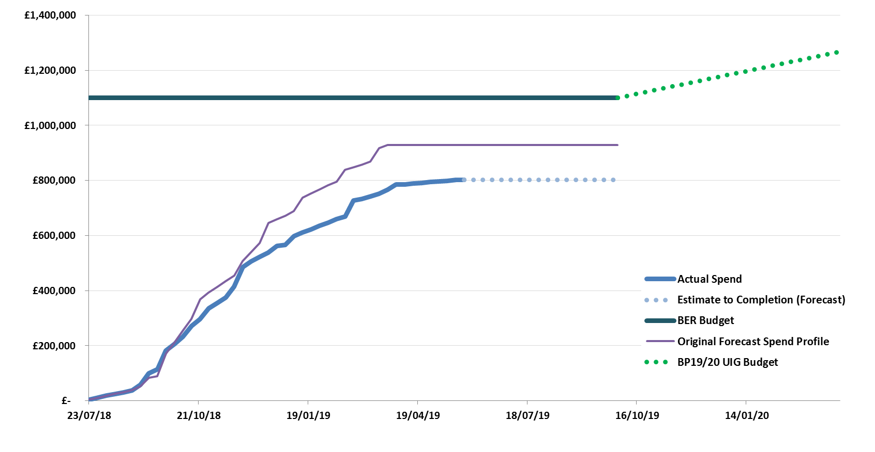
Overview Of Task Force Funding

Slide 7
Machine Learning Next Steps - Overview
The UIG Task Force and the UIG Analytics Partner have demonstrated that using advanced Neural Network Machine Learning models can reduce Base Level UIG by up to 70% and Volatility by up to 30%
See Investigation Item 13.2.6: NDM Algorithm - Advanced Machine Learning
We have tested this on EUC 01 for 12 LDZs
There are options for where we can go next with this line of investigation
We will Discuss these with DESC on 10th June 2019.

Slide 8
Options for Next Steps
Xoserve will host a Machine Leaning Discovery Day to discuss the benefits, considerations and implementation challenges of using Machine Learning algorithms to allocate NDM Energy
We are currently costing these options with our Analytics Partner
Rerunning the Neural Network performance comparison against the existing NDM algorithm for more recent Gas Days (propose 01/06/2018 – 31/05/2019)
Construct an API / Sandbox environment for Shippers to test Neural Network predictions using their own data
Develop Neural Network models for EUCs 2-8 to demonstrate whether the benefit can be seen across the whole market.

Slide 9
Task Force Next Steps
Use the UNC UIG Work Group as the mechanism to share progress on all recommendations where options residing with Xoserve.
Provide updates to the “Recommendation Tracker” in line with UNC UIG Work Group timescales.
Continue analysis on existing investigation lines, identify any new investigation lines & publish investigation tracker updates as required.
Publish any new findings/recommendations drawn from investigation lines which are currently “work in progress” when completed.
Supporting MOD development to progress all live and draft modifications.
Develop complex machine learning options with industry

