Slide 1
UIG Task Force Progress Report
Contract Management Committee 17/07/19

Slide 2
Background
Modification 0658: ‘CDSP to identify and develop improvements to LDZ settlement processes’ approved by Ofgem on 6th July 2018
Modification raised to authorise the CDSP to assign resources and incur costs related to a Task Force to investigate the causes and influencers of Unidentified Gas (UIG), with a target of reducing the volatility and scale of UIG and developing a robust predictive model for daily UIG for use by all parties.
BER for Change Reference Number XRN4695: ‘Investigating causes and contributors to levels and volatility of Unidentified Gas’ approved at ChMC on 11th July 2018
This Change Proposal added an additional service line into the DSC to enable Xoserve access to investigate, using resources and technology, causes and contributors to levels and volatility of Unidentified Gas. Xoserve is to provide monthly update reports and recommend proposals and subsequent changes or modifications for the industry.
The following slides provide:
Task Force dashboard
POAP
Recommendation stats
Reporting on budget
Advanced machine learning next steps
Task Force next steps

Slide 3
UIG Task Force: Dashboard
RAG
Time | G
Cost | G
Benefit | N/A
Overall RAG status:*
G
Progress since last month - key milestones | Date | Status
Executive Summary Update | w/c 03/06/19 | Complete
Attend May Change Management Committee | 12/06/19 | Complete
Attend May Contract Management Committee | 19/06/19 | Complete
Attend June UIG Work Group | 24/06/19 | Complete
Attend UIG Work Group Mod 0681 | 07/06/19 | Complete
Attend Work Group 674 | 26/06/19 | Complete
Priorities for next month – key milestones | Date | Status
Support Mod development (All) | July ongoing | G
Development of automated UIG reporting | End of June | R
Attend July UIG Work Group | 23/07/19 | G
Attend July ChMC | 10/07/19 | G
Attend July CoMC | 17/07/19 | G
Attend DESC | 10/07/19 | G
Commence UIG Task Force close down/extension options | 01/07/19 | Ongoing
Draft new Recommendation options to support 3.2.5 option 3. | July | G

Slide 4
Plan on Page new
C
Completed activity
Delivery team milestone
Advanced Analytics
Governance
I
 | April |  |  |  |  | May |  |  |  | June |  |  |  | July |  |  |  |  | August |  |  |  | September
 | 01/04 | 08/04 | 15/04 | 22/04 | 29/04 | 06/05 | 13/05 | 20/05 | 27/05 | 03/06 | 10/06 | 17/06 | 24/06 | 01/07 | 08/07 | 15/07 | 22/07 | 29/07 | 05/08 | 12/08 | 19/08 | 26/08 | 02/09 | 09/09 | 16/09 | 23/09 | 30/09
I
I
I
I
I
I
10/04 DSC ChMC
08/05 DSC ChMC
12/06 DSC ChMC
10/07 DSC ChMC
07/08 DSC ChMC
11/09 DSC ChMC
w/c 29/4 Exec Summary
w/c 01/06/Exec Summary
w/c 01/07 Exec Summary
w/c 01/08 Exec Summary
w/c 02/09 Exec Summary
Develop Xoserve owned Recommendation options – update and publish recommendation tracker in line with UIG working group meetings
Develop Findings template and Recommendation Packs
Investigation Analysis
Support Mod development
Issue analysis and tracking (Investigation Tracker updated and published bi-weekly)
Draft Mods to support recommendations
I
I
I
I
I
I
01/05 CoMC
15/05 CoMC
19/06 CoMC
17/07 CoMC
14/08 CoMC
18/09 CoMC
w/c 01/07 create close out activity plan
I
I
I
I
I
I
I
w/c 23/09 Publish UIG Investigation guide V.2
08/04 UIG WG
29/04 UIG WG
20&21/05 UIG WG
24/06 UIG WG
23/07 UIG WG
20/08 UIG WG
23/09 UIG WG
03/05 Attend Customer Training Day
Review/draft updates to UIG user guide ongoing

Slide 5
Recommendations - where we are
14 finding & recommendations = 95 recommendation lines
47 CLOSED
11 do nothing
2 lines PAC /Xoserve
4 lines MOD 0681 – EON
9 lines MOD – Scottish Power (12.2) = 1 MOD – sponsored 0693R
3 lines MOD – (3.2.1) = 3 MODS – 1 sponsored Total 0692), 2 sponsored British Gas 0690 & 0691
3 lines Xoserve drafted MODs 3.2.5
2 BAU
9 completed
25 other options progressed
1 In progress
26 Future review
1 ongoing 3.2.5 option 3
7 review July
8 review August
7 review November
4 review December
All future reviews include non task force related changes that are pending, defects with planned resolution dates, other options which may be considered if engagement/PAC reporting does not deliver results. (PAC can look to deliver these when PAC reporting is updated).
As at 25/06/19

Slide 6
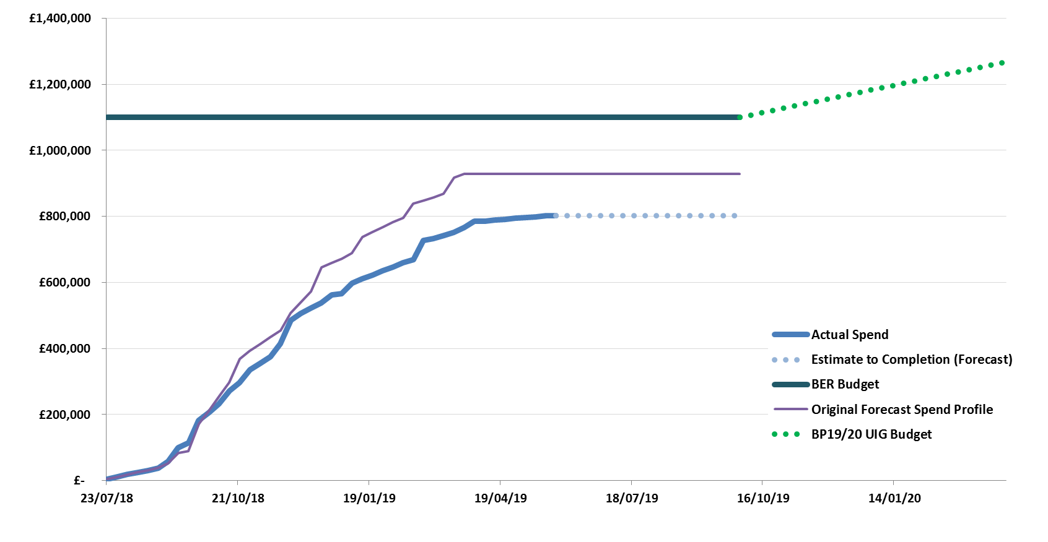
Overview Of Task Force Funding

Slide 7
Task Force Next Analysis Steps
Xoserve will endeavour to produce a Machine Leaning Video to highlight the benefits, considerations and implementation challenges of using Machine Learning algorithms to allocate NDM Energy
We are working with our Analytics Partner to complete:
Rerunning the Neural Network performance comparison against the existing NDM algorithm for more recent Gas Days for EUC 01 only (propose 01/06/2018 – 31/05/2019).
Develop improved estimation models for EUCs 2-8 to demonstrate whether the ML benefit can be seen across the whole market.
Explore using the models and findings developed to date to look at building a UIG predictive model.
Continue modelling work, focussing on reducing modelled volatility further.
Notes:
Do nothing no appetite
Involve our data analytics partner to run a day – cost
Create a ML education pack and issue on line
Xoserve develop a day to run with customers
CC suggested running NN live and compare it to NDM algorithm as a proof of concept – need to understand the amount of months that would be required to fully cost and assess the needs of the customer – we have had expressed interest from one customer for this option. We have to flag that this would due to time be using the updated ALPs only and therefore the previous reductions of 70% base and 20% volatility will be reduced.
Creation of a Sandpit - is there a desire for this or do customers have this capability internally and would not want this to be investigated further? We would also have to make a decision if this was supported or not and consider costs associated with this.
Development of NN for EUCs 2-8 wasn’t recommended by our analytics partner as we have already seen benefits for EUC01 and there is no reason to doubt that it wouldn’t be beneficial across the other EUC’s and also the most UIG is carried in EUC01.

Slide 8
Task Force Next Steps
Use the UNC UIG Work Group as the mechanism to share progress on all recommendations where options residing with Xoserve.
Provide updates to the “Recommendation Tracker” in line with UNC UIG Work Group timescales.
Continue analysis on existing investigation lines, identify any new investigation lines & publish investigation tracker updates as required.
Publish any new findings/recommendations drawn from investigation lines which are currently “work in progress” when completed.
Supporting MOD development to progress all live and draft modifications.
Complete complex machine learning next steps with Analytics partner & share outputs with the Industry.

