Slide 1
DSC ChMC Switching Programme Update 10th July 2019

Slide 2
Switching Programme
Xoserve’s detailed design phase continues, we are currently on track from our plan perspective to meet our planned completion date of September to finalise this phase.
Our build activities commenced on 20th June 2019, focussing on the consequential areas that were not dependent on the CSS physical design.
From a switching programme perspective we are currently tracking at an amber status, the reason for this status is due to the CSS physical design. Landmark have published their draft design, this draft design was walked through at the Ofgem Design Forum Monday 1st July. The design is currently now with the industry for review, any comments are being raised to Ofgem with a deadline of Monday 8th July. The design will continue to be refined with approval currently being planned for 23rd August via Switching Programme Design Authority.
Until this physical design is baselined Xoserve will continue to work at risk.

Slide 3
Switching Programme
During our last CSSC DSG workgroup we introduced the subject of our consequential testing. Jo Galloway has rejoined Xoserve to lead on our test activities.
Xoserve’s consequential test phase will be running in parallel with the switching programme test phases. Jo and the team are currently working up the plan and detail that will be going into this phase but has asked workgroup attendees to begin to think about testing requirements.
The programme Ofgem Testing Work Group has now held three meetings. A Core Systems and Services Integration Approach (CSSIA) document for test management has been published. The document details test activities, including:
Test summary
Assumption and risks
Test Governance and reporting
Test Phases
Defect reporting
Review and approval of this approach will continue via this workgroup. .The workgroup meet monthly and a technical test workgroup will shortly be created to begin to work up the lower level testing detail.

Slide 4
Actions from last meeting
0601 | 12/06/19 | 8.0 | Xoserve (EL) to provide information on the CSS Budget, spend to date and any potential requests for extra funding. | Xoserve (EL) | Pending
0602 | 12/06/19 | 8.0 | Xoserve (EL) to provide an update on CSS implementation dates following Ofgem re-planning activities. | Xoserve (EL) | Pending

Slide 5
CSSC Funding & Budget Position
Action 0601
CSSC is progressing delivery utilising the approved budget line with BP19 & BP20.
This budget was based on a Ofgem Programme Plan with a 2020 Go-live and on Level 2 Impact Analysis as of Aug 2018.
A reassessment of Xoserve’s delivery plan and costs is planned in Sept 2019, following Xoserve Detailed Design, CSS Physical Design Baseline and Ofgem Programme Plan re-baseline activities to provide firmer delivery costs.
The outputs of this exercise will be shared with Xoserve Board and all relevant stakeholders.
Any revisions to the budget line as a result of this exercise will be incorporated into BP20/21 budgets via the business planning process

Slide 6
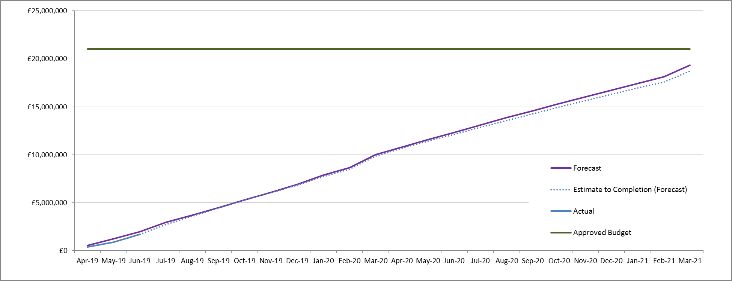
Overview Of CSSC Funding

Slide 7
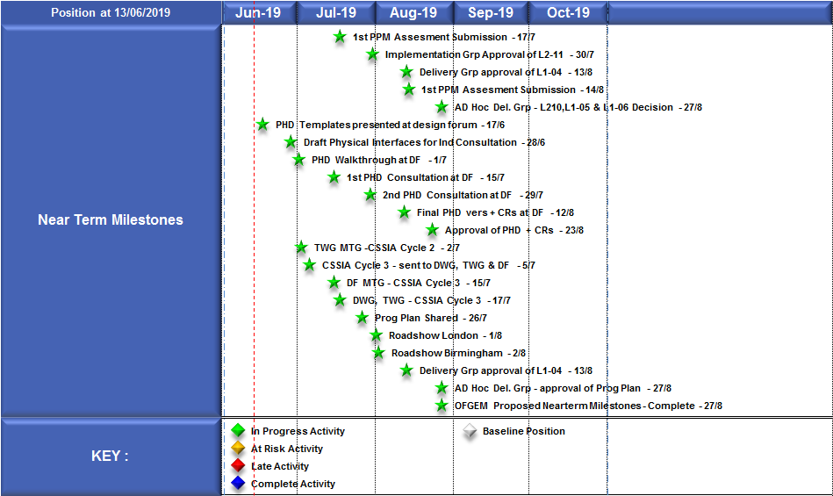
Ofgem "Near-Term" Milestone Plan
Action 0602

Slide 8
Approval requests
Following our high level design phase we produced three external BRD’s. Thank you very much, the Shipper BRD was approved a little while ago. Following industry consultation all received comments have been responded to. I would now like to request for approval for the following:
Network BRD
Gemini BRD
As we move through our detailed design phase we are updating all BRD’s. At the end of detailed design we will be following the same approval process as we have used for the high level BRD’s.

Slide 9
Approval requests
Following Richard’s introduction of this subject last month I would like to request ChMC approval for the following:
CSSC change packs to be issued separately from the BAU change packs
I want to be able to deliver you our design solutions as quickly as possible but ensuring you have the appropriate time along with BAU change packs to review and provide your representations. We have potential options:
In line with BAU schedule
In line with BAU schedule but giving CSS an increased response time for representation
CSSC change packs at fortnightly increments in between BAU packs
The consequential change programme has it’s own XRN (master), this will be retained. Each CSSC change pack will be given an individual XRN’s on issue, this will link back to the master
Each CSSC change pack will be titled as CSSC to ensure these are easily identifiable for you as they are released

