Slide 1
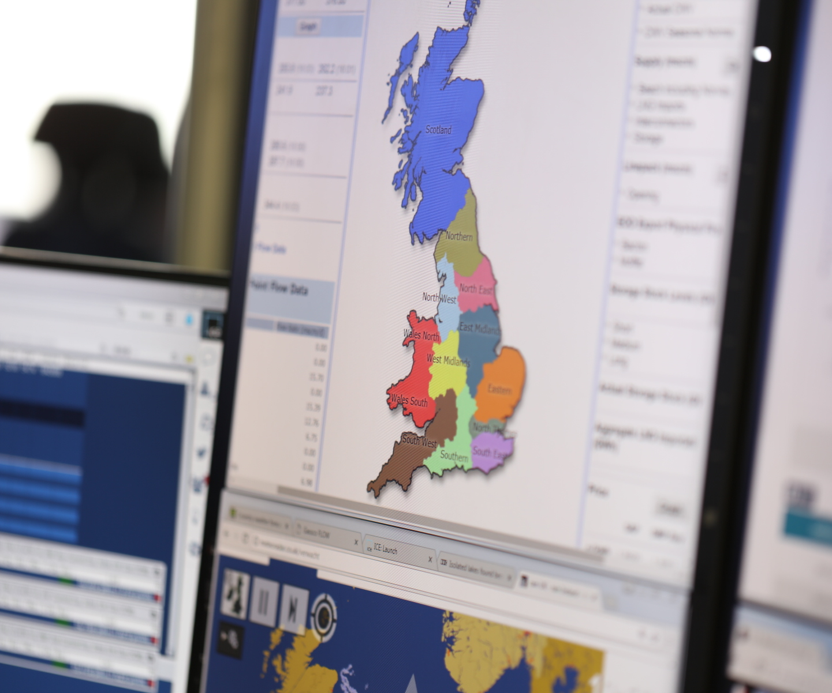


Capacity Access Review
Transmission Workgroup
5th September 2019

Slide 2
Context
    At Transmission Workgroup in August, National Grid made Transmission Workgroup aware of our proposal to continue to review network access arrangements with industry.
    At that workgroup National Grid took an action to provide an aggregated draft list of issues that could form part of the Capacity Access Review (action 0802). We did that on 9th August.
    Industry were requested to send details of any further topics they wish to be included and/or any comments
      Received three responses
    Purpose of today’s Workgroup:
      Discuss the scope of the Access Review through reviewing list of high level topics
      Agree process through which the topics should proceed
      Agree priority of topics
      Agree input to Request

Slide 3
Potential high level topics
1 | Substitution | Is the process and the associated timescales appropriate? (Lead times, Ofgem approval, treatment of decommissioned sites) | Are the processes for making capacity available where it needs to be effective?
 | Retainers | Are retainers still required with the introduction of PARCA?
 | Trade and Transfer | Any issues?
 | Zonal | Possible alternative solution to substitution and transfer
2 | PARCA | Appropriateness of fees Embedding and extending the “PARCA light process” embedded with CLoCC. | Are there any issues with the PARCA process? Is there an appetite for further review of PARCA?
3 | User Commitment | Are the levels of User Commitment appropriate? Potential links with PARCA and substitution | Are the arrangements for the varying types of User Commitment appropriate?
4 | Capacity Products | Any new products required or redundant products? Including additional auctions (e.g. duration); conditional products (e.g. temperature) | Are there any new or redundant products or processes?
 | Auctions / Applications | Any new processes, redundant processes or refined processes?
5 | Flex | Dependent on outcome of network capability work | Is the existing flex product appropriate for Tx?
6 | Governance | UNC / Methodology statements | Are the rules contained in the right place?
7 | 8
Simplification of Regime | Ability of regime to support the future
Complete review of regime | Does the current capacity regime support the future including the greater role of hydrogen (e.g. Hydrogen supplies)

Slide 4
Process & Priority of Topics
    Process
    As mentioned in August, NG are considering to raise a “request” in the autumn that could address issues raised for consideration.
    Alternatively or in conjunction, issues could progress through the GMaP process.
      Propose that the scope of the Request is topics 1-5
      Topic 6 (Governance) will require consideration alongside all other topics. Also links to the outcome of UNC Modification 0667 and Energy Codes Review.
      Propose to include topics 7 & 8 as part of the GMaP process
      Question: Does WG agree with this approach?
    Priority
    Although there is some overlap of topics, National Grid proposes that topics are taken in turn and in the order stated.
      Question: Does WG agree that these issues should be taken in order of priority?

Slide 5
High level draft plan
Scope defining
Individual project plans for work packages
List of potential topics
5th Sept Tx WG:
Inform Request
3rd Oct Tx WG:
Share draft Request
17th Oct Panel:
Seek Request approval
Process & priority agreement
Request raised
Workgroup will be defining scope of individual work package, identifying issues and resolutions
Solutions progressed concurrently
Work package 1
Work package 2 and 3
Work package 6
Work package 5
Aug 19
Sept19
Oct 19
Nov19
Dec19
Jan 20
Feb 20
Mar 20
Apr 20
May 20

Slide 6
Request template: Costs and Issues
  The Request template asks for consideration of wider industry impact.
    Propose “potential impact” to;
      Central Systems and Processes
      Areas of Users and Transporters businesses
      TPD Section B
      Gas Transporter Licence
      Security of Supply
    No impact identified in all other areas identified in Request template
    Question: Do you agree?

Slide 7

Appendix
  Gas Markets Plan

Slide 8
WHY CREATE THE GMaP
The GMaP aims to transform how the industry prioritise, engage on and execute market change
                The Gas Markets Plan (GMaP) is a programme for the industry to collaboratively develop and agree a roadmap of market change activities.
                The programme aims to:
                Be as inclusive as possible
                Improve transparency and visibility of potential market change
                Create a stakeholder-led process for prioritising market change activities
 |  | 2020 -----------------→2030
BUSINESS AS USUAL INITIATIVES
GMaP PROJECTS | OPTIMISING THE PRESENT
 | PREPARING FOR THE FUTURE
Projects
Projects
                This will ensure market frameworks continue to provide the consumer with the greatest possible value throughout the energy transformation.
Projects

Slide 9
CHANGING APPROACH
The GMaP will put the industry at the heart of collaboration, planning and acting on future market change activities.
INDUSTRY ACTION
INDUSTRY COLLABORATION
2-10 YEAR CHANGE PLAN
FUTURE OF GAS FORUM
GMaP PROJECTS
1-2-1 MEETINGS
GFOP
INDUSTRY PLANNING
TRANSMISSION & OTHER WORKING GROUPS
FUTURE OF GAS STEERING GROUP
FUTURE OF GAS STEERING GROUP
GMaP PROJECT WORKSHOPS

Slide 10
HOW INDUSTRY WILL ACT
The 2-10 year change plan will consist of industry agreed focus areas relating to optimising the existing regime and exploring market change needed to prepare for the future.
CONE OF UNCERTAINTY ON NEED FOR MARKET CHANGE
PRESENT
“Optimising the present” focus areas
Given the increased clarity on market change needed to optimise the existing regime, the success criteria of GMaP projects related to optimising the present are different to GMaP projects related preparing for the future.
“Preparing for the future” focus areas
Given the lack of clarity on how the energy system will transition to 2050, GMaP projects related to preparing for the future will be more exploratory, aiming to understand the potential market changes needed to facilitate several end-states.

Slide 11
HOW INDUSTRY WILL ACT
Identified “optimising the present” and “preparing for the future” focus areas will be prioritised based on the value it will add. This will be agreed by industry through the Future Of Gas Steering Group.
“Optimising the present” potential focus areas
“Preparing for the future” potential focus areas
HIGH
PRIORITY
Topic 1
HIGH
PRIORITY
Topic 4
Topic 1
Topic 4
ACTION
POTENTIAL IMPACT ON MARKET OPERATION
CONSUMER VALUE
MONITOR
Topic 2
CONSIDER
Topic 3
Topic 2
ELIMINATE
ELIMINATE
Topic 3
LOW
LOW
LOW
HIGH
LOW
HIGH
COMPLEXITY
UNCERTAINTY OF MARKET CHANGE NEEDED
The difference in success criteria of “optimising the present” and “preparing for the future“ GMaP projects drives us to treat these two categories of initiatives separately

Slide 12
HOW INDUSTRY WILL ACT
The industry-agreed priority focus areas will be progressed as GMaP projects over the course of the next year.
“Optimising the present” GMaP 19/20 projects
“Preparing for the future” GMaP 19/20 projects
Name of project | Output delivered | Length of project | Success Criteria/measure
e.g. Access review
….
Name of project | Output delivered | Length of project | Success Criteria/measure
e.g. hydrogen frameworks
….
HIGH
GMaP 2019
HIGH
GMaP Project
GMaP Project
GMaP 2019
GMaP 2020
GMaP 2020
CONSUMER VALUE
POTENTIAL IMPACT ON MARKET OPERATION
“Optimising the present”
GMaP project will aim to identify potential market change solutions before progressing on for implementation.
“Preparing for the future”
GMaP project will explore potential market change needed across different scenarios. Low regret actions will be progressed for implementation.
GMaP Project
GMaP Project
CONSIDER
CONSIDER
LOW
LOW
LOW
COMPLEXITY
HIGH
LOW
UNCERTAINTY OF MARKET CHANGE NEEDED
HIGH

