Slide 1
DSC CoMC Switching Programme Update September 2019

Slide 2
Switching Programme
Xoserve continue to track at an amber status, we are still pending finalisation of the CSS primary interface design and next version of the code of connections document.
Version V6.0 of Landmark’s latest interface design was released to the Industry. Xoserve raised a number of comments against this version with the main concern being the removal of effective dates especially in change of Shipper scenarios. We have discussed our concerns with Landmark and DCC via a meeting facilitated by the SI. Following our and other Organisations comments the design will be amended. V7.0 will be released shortly. The next Ofgem design forum is scheduled for 11th September 2019, final sign off is scheduled for 20th September at Ofgem Design Authority.
The switching programmes core integration approach document and programme plan continue to be discussed with Industry participants with Industry walkthroughs being arranged during September.
Xoserve’s consequential programme is nearing the end of the design phase with tranche 2 of build in progress.

Slide 3
Switching Programme
All but one of our Extraordinary CSSC DSG meetings have completed. We have one final meeting on the 17th September, during this meeting we are going to re-cap over all recommendations made during this detailed design phase.
Due to the licence condition surrounding REL we have commenced design and build based on assumptions. Once we have the absolute clarification from Ofgem on the definition of the licence condition we will be able to assess if any design re-work is required. If the design does change in anyway we will request an additional extraordinary meeting (via webex).
We are about to release our first change packs the details of which are on the next slide. We will also include the final version of the BRD’s alongside the change packs. The BRD’s will include updated To Be process maps.
Once approved all documentation will be published on our Switching Programme Webpage.

Slide 4
CSSC Change Pack Overview
Change Pack 1- Supply Meter Point Creation
Planned publication date: 16/09/2019
Change Pack 2 - Nomination and Switching
Includes: Change of Shipper, Change of Supplier, Forced Registrations and Shipper Withdrawals
Planned publication date: 16/09/2019
Change Pack 3 - Settlement Data
Planned publication date: 21/10/2019
Change Pack 4 - Supply Meter Point Updates
Includes: RGMA, SPA Updates, Stakeholder & Master Data, Opening Meter reads, MAM/MAP, Address Data, RMP Status
Planned publication date: 21/10/2019

Slide 5
Switching Programme
I am keen to ensure you get weekly updates with regards to the switching programme. I would encourage you to continue to visit Xoserve’s Switching Programme web page where weekly programme summary's, our weekly SI status report submission and day after reports are published every Friday.
Our most recent blog has introduced our proposed adapter service, please do take the time to read this blog and the other communications that will follow in relation to this service.

Slide 6
Funding status

Slide 7
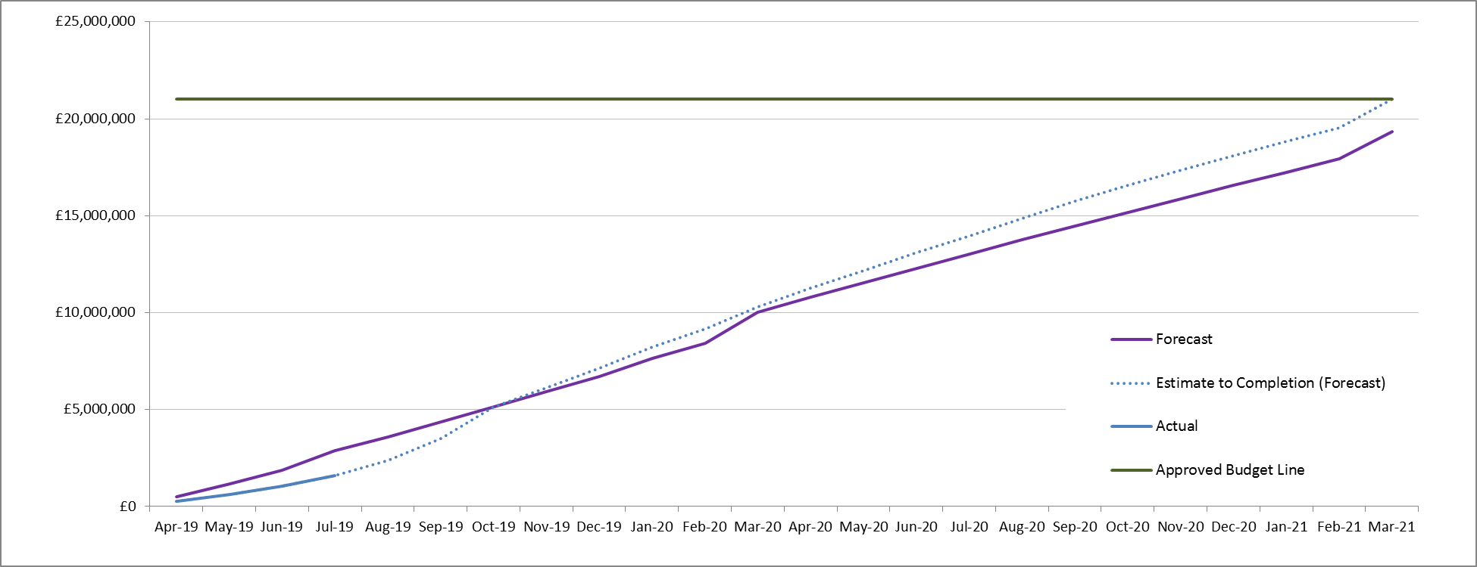
CSSC Funding Status

