Slide 1
7.1 XRN4665 End User Categories (EUC) – Project Update
11/09/19 | Overall Project RAG Status:
 | Schedule | Risks and Issues | Cost | Resources
RAG Status
Status Justification
Schedule | Implementation : Part A successfully deployed on 03/08 to make new EUC bands allowable in ISU to enable sharing of new EUC bands with Industry via the T67 file Part B successfully deployed on 31/08 to implement all code changes to processes affected by new EUC bands Post Implementation Support (PIS) PIS activities (including First Usage monitoring) commenced as per plan PIS Approach internally approved
Risks and Issues | Environments: There continues to be a risk that multiple projects are running in parallel (EUC, GB Charging & Minor Releases). A detailed assessment of co-existence in Pre-production is continually being monitored with relevant project teams. However the current view is that this should not impact the EUC release
Cost | Project delivery costs are tracking to approved internal budgets (Revised BER to include Financial Risk margin approved at ChMC on 10/07/19)
Resources | Weekly monitoring of SME resources supporting multiple demands (e.g. BAU defects, Future Releases etc.) is ongoing

Slide 2
XRN 4665 - EUC Release Timelines
Key Milestone Dates:
Regression Testing activities successfully completed as per milestone date
EUC Part A & Part B deployments successfully implemented as per plan
PIS & First Usage monitoring activities commenced as per plan

Slide 3
7.2 XRN 4954 Minor Release Drop 5 - Project Update
11/09/19 | Overall Project RAG Status:
 | Schedule | Risks and Issues | Cost | Resources
RAG Status
Status Justification
Schedule | Regression Testing has completed successfully Preparation for Implementation underway for 7th Sept
Risks and Issues | Environment availability continues to be a risk as several projects are sharing environments through out delivery and test, implementation.
Cost | All costs tracked to budget
Resources | There is an ongoing risk that SME’s will not be available when required, this is being closely monitored

Slide 4
Potential Minor Release Drop 5 Timeline & Scope
Minor Release Drop 5 Key Milestone Dates:
SPA Change Drill Down Report
Initiation 14/6/19 23/7/19
Design 29/6/19 23/7/19
Build 12/7/19 3/8/19
Test 9/8/19 30/8/19
Implementation 7/9/19 7/9/19
Closedown 20/9/19 20/9/19
2019
Dec
Jan | Feb | Mar | Apr | May | June | July | Aug | Sept | Oct | Nov | Dec
MiR Drop 5
Design
Build
ST & Assurance
CM
RT
IMP
PIS
7/9 Go Live
10/07: Scope Approval

Slide 5
7.3 XRN4828 November 2019 Release - Delivery Plan
11th September | Overall Project RAG Status:
 | Schedule | Risks and Issues | Cost | Resources
RAG Status
Status Justification
Schedule | Start Up, Initiation, Design, Build and System Test phases complete UAT execution commenced on 19/08 and is currently on track for 3/4 changes. The fourth change is still on track to be completed within contingency period Regression and Performance Test preparation in progress High level Implementation plan to be presented at ChMC in September (included in following slides) Funding: BER for full delivery approved in April 2019, BER for XRN4866 UIG Recommendation approved at ChMC on 12th June.
Risks and Issues | Risk: There is a risk that the Nov 19 Release may be impacted by Pre-Production environment congestion due to multiple deliveries running in parallel Risk: There is a risk that the implementation of November 19 is delayed as resources required to support the release are moved to support the Implementation of MOD 700
Cost | The BER with full delivery costs were approved at ChMC in April 2019, BER for XRN4866 UIG Recommendation approved by ChMC on 12th June
Resources | Weekly monitoring of Xoserve SME resources supporting multiple demands (e.g. BAU defects, Future Releases etc) is ongoing

Slide 6
XRN4828 - Nov 19 Release Timelines
Key Milestone Dates:
Design Completion – 12/07/19
Build & Unit Test Completion – 02/08/19
System & UAT Completion – 27/09/19
Regression Test Completion - 11/10/19
Implementation – 09/11/19
PIS Completion – 06/12/19
2019
Jan | Feb | Mar | Apr | May | June | July | Aug | Sept | Oct | Nov | Dec
XRN4828
Nov-19
HLD & Change Pack Production
Design
Build & FUT
ST & SIT
UAT
RT
PT
Test Cont.
IDR
PIS
GO LIVE 09/11/19 - TBC
04/02: EQR Approval
10/04: BER Approval
08/05: Change Pack Approval

Slide 7
UK Link Nov19 Release:
XRN4828 Implementation Approach

Slide 8
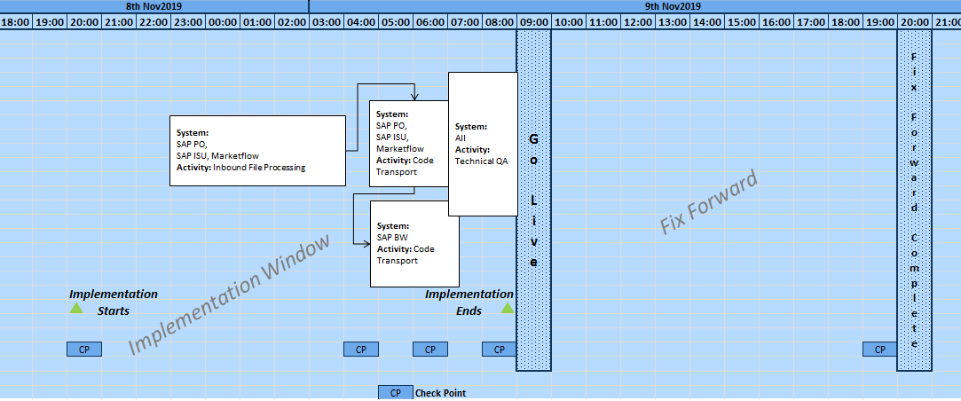
Implementation Approach
Above timings for file processing and implementation start time will be confirmed as part of the File Level Transition Plan however deployment will be between 5 to 7 a.m. on 9th Nov2019

Slide 9
Implementation Approach
Changes of Nov19 will be implemented on 9th Nov
Implementation activities involve:
  Code transports in SAP ISU, SAP PO, Marketflow, SAP BW systems
  Post implementation monitoring of files (including those where new file formats are introduced)
  First usage monitoring after Go-live

Slide 10
Option 1 File Formats – All impacted File Formats Transition Plan
Impacted file view
Change ID | Last inbound in Old File Format (Time = File receipt | Last Outbound in Old File Format (Time = File receipt) | First Inbound in New File Format (Time =File receipt | First outbound processed in New File format (Time = File receipt)
XRN4866 | No File format Change | No File format Change | No File format Change | No File format Change
XRN4621 | NA | No outbound file impacted | 09/11/2019 After 9.00 a.m ( Post Go-live) AQI ,UMR,UBR, UDR | No Outbound file impacted
XRN4725 | No inbound file impact | NA | No inbound file impacted | 09/11/2019 After 9.00 a.m. ( Post Go-live ) MBR
XRN4679 | No inbound file impact | NA | No inbound file impacted | 09/11/2019 After 9.00 a.m. MBR
N/A: Not applicable for XRN4621 for as field CORRECTOR_UNCORRECTED_READING made optional hence old file format will continue to work
N/A Not applicable for XRN4725/ XRN4679 as shippers can continue to receive old value wherever applicable

Slide 11
7.4 XRN4996 June 2020 – Project Update
2nd September 2019 | Overall Project RAG Status:
 | Schedule | Risks and Issues | Cost | Resources
RAG Status
Status Justification
Schedule | Plan: Planning for the Start up, Initiation and Design phases commenced. Design: The 1st design workshops are due to start w/c 16th September. Change Packs: Aiming to deliver the change packs for approval in November.
Risks and Issues | Risk – There is a risk that due to multiple deliveries running in parallel there may be limited access to resources. Risk – There is a risk that there is not sufficient time to complete the design workshops because of limited SME availability for required workshops to complete design leading to delay in submission and approval of change packs
Cost | Project delivery costs expected to be on budget
Resources | Full project mobilisation in progress following appointment of TCS as preferred supplier. Weekly monitoring of Xoserve SME resources supporting multiple demands (e.g. BAU defects, Future Releases etc) is ongoing

Slide 12
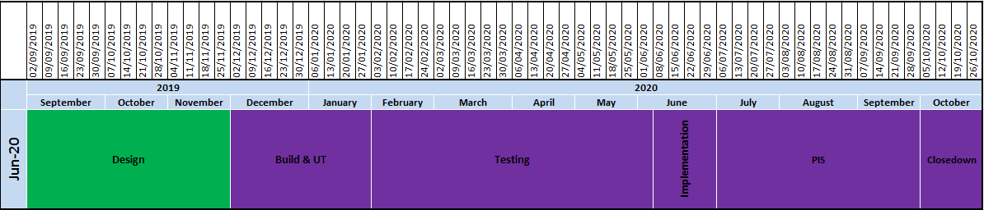
XRN4996 - June 20 Release Timelines
Key Milestone Dates:
Capture completion – 19/09/19
Design Completion – 29/11/19
Build & Unit Test Completion – TBC
System & UAT Completion – TBC
Regression Test Completion - TBC
Implementation – June 20
PIS Completion – TBC

Slide 13
June 20 Release Summary
June 20 Release consists of 11 changes, Implementation is planned for June 2020:
XRN4691 - CSEPs: IGT and GT File Formats (CGI Files)
XRN4692 - CSEPs: IGT and GT File Formats (CIN Files)
XRN4772 - Composite Weather Variable (CWV) Improvements
XRN4780 (B)* - Inclusion of Meter Asset Provider Identity (MAP Id) in the UK Link system (CSS Consequential Change)
XRN4850 - Notification of Customer Contact Details to Transporters
XRN4865 - Amendment to Treatment and Reporting of CYCL Reads
XRN4871 (B) - Changes to Ratchet Regime (MOD0665)
XRN4888 - Removing Duplicate Address Update Validation for IGT Supply Meter Points via Contact Management Service (CMS)
XRN4830 – Requirement to Inform Shipper of Meter Link Code Change
XRN4941* - Auto updates to meter read frequency (MOD0692)
XRN4932 - Improvements to the quality of the Conversion Factor values held on the Supply Point Register (MOD0681S)
* Pending Solution/MOD approval by ChMC/DSG for remaining 2 CRs.

Slide 14
7.5 XRN4914 MOD 0651- Retrospective Data Update Provision –
Proof of Concept Progress update
3rd Sept 2019 | Capture Progress update
Schedule | Proof of Concept requirements approved Procurement: Responses reviewed by Solution Architect and Security; recommended solution option provided Steerco agreed recommended option; 29th August Customer Engagement: Agreeing approach internally
Risks and Issues | Issue: project is behind original draft plan for delivery of Retro Enduring Solution for Nov 2020 Issue: data team / security team resources not allocated to project Risk: that cost required to deliver project is greater than project funding (2017 day rates used) Risk: availability of internal resources (environments/people) may impact plan for delivery of Retro
Cost | Project funding: £1.5 mill; £700k for 2019 and £800k for 2020 Project Cost for Proof of Concept: to be agreed once solution option selected
Resources | Engagement approach to be agreed with Customers
XRN4914 MOD 0651 - Retrospective Data Update Provision - ChMC Update 11th September
Key: highlighted text :update from last meeting

Slide 15
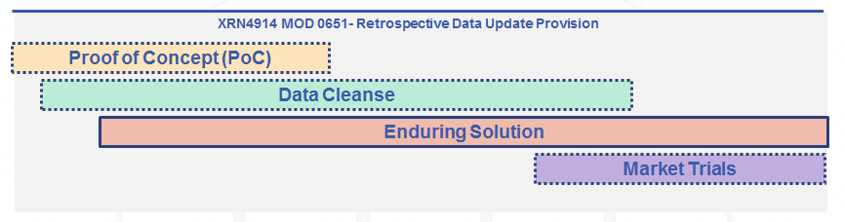
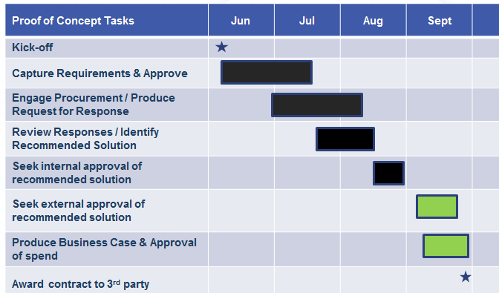
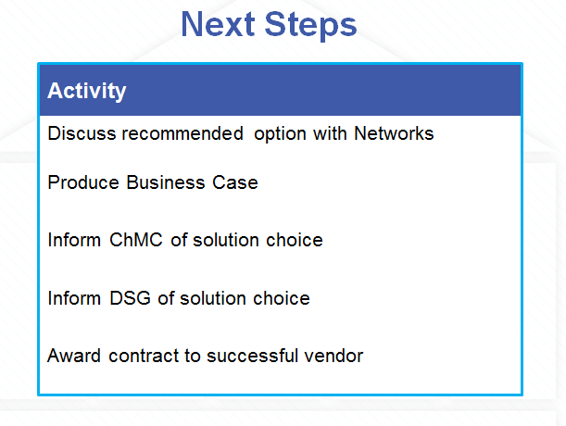
XRN4914 MOD 0651- Retrospective Data Update Provision –
Proof of Concept – What we have done to date and next steps
today
XRN4914 MOD 0651 - Retrospective Data Update Provision - ChMC Update 11th September

Slide 16
UK Link Change Impacts and Release Update
7.6 Retail & Network Update
11th September 2019 ChMC

Slide 17
Agenda
UK Link Scoping Approach:
  Scoping Approach – Capture
  Scoping Approach – In-flight changes
  Scoping Approach – Minor Releases
UK Link Update:
  Delivery timeline
  Governance timeline
  Allocated changes
  Unallocated changes
  3 year view POAP

Slide 18
Release Scoping Approach
UK Link

Slide 19
Release Scoping - Capture
Agree Release Scope
XRN1234
XRN5678
XRN9123
XRN4567
Delivery
Capture

Slide 20
Release Scoping - Capture
Relative estimation is used to impact Changes. Based on assessing against Risk, Certainty and Complexity.
T-shirt size applied to each Change following High Level Solution Options (HLSOs) development
Each T-Shirt size has a number of points associated with it:
120 points is the current realistic capacity possible for a Major Release.
Impact | Points
XS | 3
S | 5
M | 8
L | 13
XL | 21

Slide 21
Why 120 Points?
Months
1 2 3 4 5 6 7 8 9 10 11 12
Start-Up
Initiation
Design
Build/Test/Implement
Scope approved
Change Pack Review
Change Pack Approval
Go Live
Key factors:
SME capacity
SAP design capacity
Build capacity
Test capacity
Customer capacity
Risk to UKLink service.

Slide 22
June 2020 Changes
XRN | Change Title | Impact / T-shirt size | Points
4865 | Amendment to treatment and reporting of CYCL reads | Small | 5
4691 | CSEPs: IGT and GT file formats (CGI files) | Medium | 8
4692 | CSEPs: IGT and GT file formats (CIN files) | Medium | 8
4772 | Composite weather variable improvements | Large | 13
4780 B | Inclusion of Meter Asset Provider Identity (MAP ID) in the UK Link System | Large | 13
4930 | Requirement to inform shipper of meter link code | Small | 5
4932 | Improvements to the quality of the conversion factor values held on the supply point register (MOD681) | Medium | 8
4888 | Removing duplicate address update validation for IGT supply meter points via CMS | Small | 5
4941 | Auto updates to meter read frequency (MOD692) | Medium | 8
4871 B | Ratchet regime changes (MOD665) | Medium | 8
4850 | Notification of customer contact details to transporters | Large | 13
Total |  |  | 94

Slide 23
Managing Scope Changes
Months
1 2 3 4 5 6 7 8 9 10 11 12
Capture
Start-Up
Initiation
Design
Build/Test/Implement
Scope approved
Change Pack Review
Change Pack Approval
Go Live
Scope approved in month 1
Change Packs issued for review in month 5
Change Packs issued for approval in month 6
Go Live in month 12.

Slide 24
Managing Scope Changes
Months
1 2 3 4 5 6 7 8 9 10 11 12
Capture
Start-Up
Initiation
Design
Build/Test/Implement
Scope approved
Change Pack Review
Change Pack Approval
Go Live
120 points
Capture: Full release points available
120 – 94 = 26 points
Start-Up: 120 – scope total = points available
26 – 13 = 13 points
Initiation: 1/2 the points available as in Start-Up
13 – 8 = 5 points
Design: A small change is available

Slide 25
Minor Release Scoping
Weeks
1 2 3 4 5 6 7 8 9 10 11 12
IA
Design
Build & FUT
ST & Assurance
RT & Assurance
Go Live
Due to time / resource constraints and to minimise risk to Live, Minor Releases have a max capacity of 15 points.
No changes accepted that require PT/MT or customer system change
No subsequent changes are accepted once a Minor Release is in-flight.

Slide 26
UK Link CHmc Update
11/09/19

Slide 27
2019 / 2020 UK Link Delivery Timeline
2019 | 2020
Jun | Jul | Aug | Sep | Oct | Nov | Dec
Jan | Feb | Mar | Apr | May | Jun | Jul | Aug | Sep | Oct | Nov | Dec
EUC
Testing
Imp #1
PIS
Imp #2
PIS
Sep-19
MOD700 – Imp Plan to be approved – 11/09/19
Nov-19
Design
Build & UT
ST & SIT
UAT
RT
PT
Test
IDR
PIS
MiR 5
MiR 5
Feb - 20
Documentation Release
MiR 6
MiR 6 – Potential Activity
Jun-20
June 2020
Retro
Retro
Mod678 – Uk Link Impacts
SUPT
UKL PT
UAT
IDR
IMP
UKL RT
UT
PIS
CSS
Design
Build / Testing
SIT / Reg Test
MT
IMP

Slide 28
2019 / 2020 UK Link Governance Timeline
2019 | 2020
Jan | Feb | Mar | Apr | May | Jun | Jul | Aug | Sep | Oct | Nov | Dec | Jan | Feb | Mar | Apr | May | Jun | Jul | Aug | Sep | Oct | Nov | Dec
Sep-19 / EUC
BER Approval
09/01/19
Key
On track
Sept-19
Imp Plan / BER Approval Sept-19
EQR Approval
06/02/19
BER Approval / Change Pack Issue
10/04/19
Complete
Nov-19
BER Approval
10/04/18
MiR 5
ChMC Scope Approval
10/07/19
At risk
Jun - 20
Scope Approval
10/07/19
EQR Approval
Aug-19
BER Approval
Oct-19
Change Pack Issue
Dec-19
Feb-20
Scope Approval
10/07/19
MiR 6
Scope Approval
Oct-19
RETRO
Potential Activity
Governance Approval dates tbc
Assumes RETRO will be Nov 2020 Major Release Delivery
Please note that this includes potential activity within UK Link over the next 24 months

Slide 29
Change Index – UK Link Allocated Change
Proposed Release | XRN | Change Title | Current Status | UK Link Release | Complexity | Finance
MiR 5 | 4871 (A) | Modification 0665 - Changes to Ratchet Regime | In Delivery | MiR 5 | Low / Medium | Shippers / DNs
Sept 19 | 4376 | GB Charging & Incremental (IP PARCA) Capacity Allocation Change Delivery (2019) | In Delivery | September 2019 | High | NTS
 | 4665 | Creation of new End User Categories (EUC) | In Delivery | June/Sep-2019 | High | Shippers
Nov-19 | 4679 | Requiring a Meter Reading following a change of Local Distribution Zone or Exit Zone | In Delivery | November 2019 | Medium | Xoserve
 | 4725 | New read reason type for LIS estimate readings | In Delivery | November 2019 | Medium | Xoserve
 | 4621 | Suspension of the validation between meter index and unconverted index | In Delivery | November 2019 | High | Shipper
 | 4866 | UIG Recommendation – removal of validation on uncorrected read | In Delivery | November 2019 | Low | Shipper
Feb-20 | 4955 | Amendments of MDD PSR needs code descriptions | In Project Start-Up | February - 2020 | Low | Shippers / GT/IGTs
Jun-20 | 4865 | Amendment to Treatment and Reporting of CYCL Reads | In Project Start-Up | June-2020 | Low | Shippers
 | 4691 | CSEPs: IGT and GT File Formats (CGI Files) | In Project Start-Up | June-2020 | Medium | DNs / IGTs
 | 4692 | CSEPs: IGT and GT File Formats (CIN Files) | In Project Start-Up | June-2020 | Medium | DNs / IGTs
 | 4772 | Composite Weather Variable (CWV) Improvements | In Project Start-Up | June-2020 | Medium | Shippers / DNO
 | 4780 – B | Inclusion of Meter Asset Provider Identity (MAP Id) in the UK Link system (CSS Consequential Change) | In Project Start-Up – Awaiting Solution option Approval | June-2020 | Medium | Shippers
 | 4930 | Requirement to Inform Shipper of Meter Link Code Change | In Project Start-Up | June-2020 | Low | Shippers
 | 4932 | Improvements to the quality of the Conversion Factor values held on the Supply Point Register (MOD0681S) | In Project Start-Up | June-2020 | Medium | Shippers / DNO
 | 4850 | Notification of Customer Contact Details to Transporters | In Project Start-Up | June-2020 | Medium | IGTs / DNO
 | 4871 – B | Modification 0665 – Changes to Ratchet Regime | In Project Start-Up | June-2020 | Medium | DNO
 | 4888 | Removing Duplicate Address Update Validation for IGT Supply Meter Points via Contact Management Service (CMS) | In Project Start-Up | June-2020 | Low | IGTs
 | 4941 | Auto updates to meter read frequency (MOD0692) | In Project Start-Up - Approval MOD approval | June-2020 | Medium | Shippers
CSS | 4627 | Consequential Central Switching Services | In Delivery | 2021 | High | Shippers

Slide 30
Change Index – UK Link Unallocated External Impacting Changes
XRN | Change Title | Current Status | Indicative R&N Release | Complexity
4991 | Enabling large scale utilisation of Class 3 - Mod 700 | Solution Approval - DSG | Sept 2019 | TBC
4851 | Moving Market Participant Ownership from SPAA to UNC/DSC | CP in Capture | Feb 2020 | TBC
4645 | The rejection of incrementing reads submitted for an Isolated Supply Meter Point (RGMA flows) | CP in Capture | Major Release | TBC
4801 | Additional information to be made viewable on DES | HLSO in Review | Major Release | TBC
4931 | Submission of Space in Mandatory Data on Multiple SPA Files | CP in Capture | Major Release | TBC
4978 | Notification of Rolling AQ value (following transfer of ownership between M5 and M) | CP in Capture | Major Release | TBC
4990 | Transfer of sites with Low Read Submission Performance from Class 2 and 3 into Class 4 (Mod 664) | CP in Capture | Major Release | TBC
4992 | Creation of new change type to recover last resort supply payment (Mod 0687) | CP in Capture | Major Release | TBC
4914 | Mod 651 - Retrospective Data Update Provisions | Solution Approval | Major Release 2020 | TBC
4716 | Increased Field Length – ‘Updated by’ data item | HLSO in Review | Minor Release | Medium
4854 | Transfer of NDM sampling obligations from Distribution Network Operators to the CDSP | In Capture | Unallocated | TBC
Sept 2019
Feb 2020
Major Release
Retro 2020
Minor Release
Unallocated
KEY

Slide 31
UK Link 3 Year POAP

Slide 32
7.7 Change Assurance Health Check
- EUC Project Change Assurance
Summary Background to the EUC Project
The original, approved B.E.R was for £385k in January 2019
In June, the project team realised that the risk margin (£120k) was in the Business Case but not present in the B.E.R.
The B.E.R was then resubmitted, at £485k, (£20k having been transferred for use by the June 2019 Changes project).
During the EUC project
Two risks were realised, for Wipro resource on Gemini changes, and additional TCS resource requirements
Change Assurance for EUC
The scope for this particular assurance Health Check focused on Operational UAT, as such the Business Case / B.E.R. were agreed out of scope for the assurance.

Slide 33

7.8 Data Office Changes: Agenda
Data Changes: Update
Data Discovery Platform: Drop 1 and Drop 2 Update
PAFA Changes Update
PAFA Options for Access to DDP

Slide 34
Data Changes: XRNs
Capture
Change can be moved
**Estimated delivery dates will be confirmed on completion of Capture and align to the chosen solution.
**Estimated Delivery
Delivery dates cannot be moved
Delivery
Change Proposals | Aug 19 | Sept 19 | Oct 19 | Nov 19 | Dec 19 | Jan 19 | Comments
4738: Shipper portfolio update of proposed Formula Year AQ/SOQ
4859: Increasing MAM Access to CDSP Data to Mitigate Reduced MAM Appointment Timescales
4824: National Grid Transmission Daily Gemini Report |  |  |  |  |  |  | Awaiting Customer Sign off
4860: National ‘Temporary’ UIG Monitoring
4946: Reporting on Installed Meters with Conversion Capability
4795: Amendments to the PARR (520a) reporting |  |  |  |  |  |  | In progress, will move to R and N Plan.
4779: UNC Modification 0657S - Adding AQ reporting to the PARR | Options to Discuss below

Slide 35
Data Changes: XRNs
Change Proposals | Aug 19 | Sept 19 | Oct 19 | Nov 19 | Dec 19 | Jan 20 | Comments
4789: Updating Shipper Reporting Packs and glossary | Completed |  |  |  |  |  | For sign off today ChmC
4876 Changes to PARR reporting – provide further data to PAFA to aid analysis of performance reporting | Options to Discuss below
4980: Change Supply Point Enquiry API to add in extra field and make certain other fields visible. |  |  |  |  |  |  | Dates to be refined at next Forum session, early indication is this will deliver early.
4713: Actual read following estimated transfer read calculating AQ of
DISCUSSION POINT: Are there any of the Change Proposals above that you would like to prioritise once out of capture?
Additional Information:
ASR: 10
External CR: 5
Third Parties: 5

Slide 36

Data Discovery Platform – Drop 1 Update
Drop 1 Scope
Meter Status | P
Meter Point Status | P
No Reads (Class 4) | P
Blank MAM’s | P
Dead report | P
Portfolio AQ | P
Portfolio count | P
Data Discovery Platform update:
The Data Discovery Platform Drop 1 was delivered on time with no scope deviation
Shipper feedback has been positive
Circa 50% (and this is rising) of all Shippers are regularly using the product
Alignment of the existing Shipper Pack and PARR report:
The existing Shipper Pack and PARR have been reviewed and aligned to provide one truth
Two PARR topics have not been included into the Shipper Pack as there is an open defect, they are:
  No Meter Recorded
  No Meter Recorded with Data flow
Once the defect is resolved, the 2 topics will be included into the Shipper Pack (please note they plan to resolve the defect in time for Septembers PARR / Shipper Pack)

Slide 37
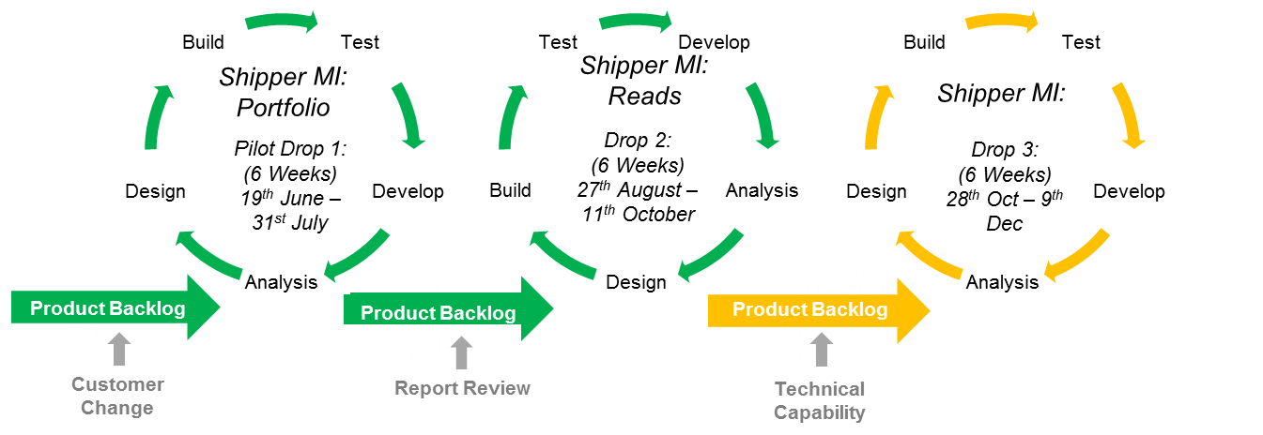
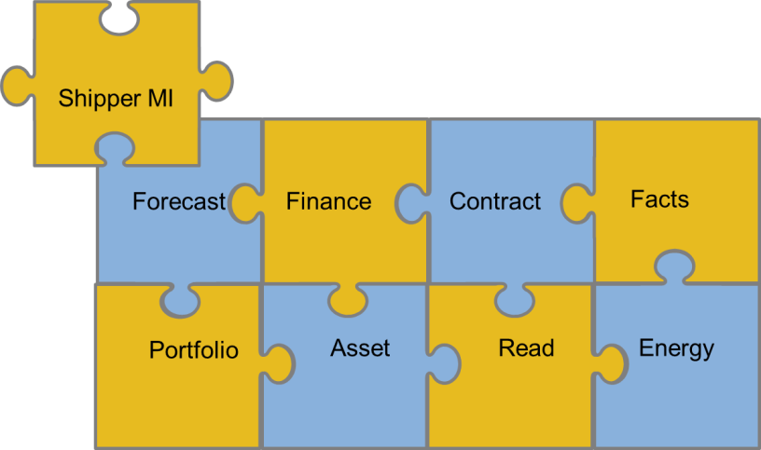
Data Discovery Platform – Drop 2 Scope
Approach:
Shipper MI Drop 2 will be an Agile delivery
The delivery team will look to improve on the success of Drop 1
Anything not delivered will go back into the product backlog and considered for future releases
Reads - Data Package
What do we deliver:
An online portal for Shippers to access Read data
Produce pre-defined set of dashboards for Read topics
Increase the available data within the data discovery platform
Shippers Can:
Access MPRN Read Data via an online portal
Gain insight from predefined dashboards to support meeting industry obligations including:
  Actual vs estimates
  Estimate read trends
  Transfer / Opening Read Performance
  No Reads (class 1, 2 & 3)
Read data availability increased from monthly to daily (where applicable)
Enhance the Portfolio dashboards (Drop 1) based on customer feedback / Beta team comments

Slide 38
APPENDIX: Shipper Pack / PARR report alignment detail
Shipper Pack PARR Alignment – Appendix
PARR Topic | Shipper Performance Pack Topic | Shipper Pack report changes
No Meter Recorded in Supply Point (SP) register | Confirmed No Asset | Due a defect with the PARR topic, it has not been included in the latest Shipper Pack.
No Meter Recorded in SP and dataflow | NA | Due a defect with the PARR topic, it has not been included in the latest Shipper Pack.
No Read for 1,2,3 or 4 | No Reads | Align the topic from the PARR table and show actual count.
Standard Correction Factors | Potentially Incorrect Correction Factors | PARR topic replaces Shipper Pack topic
Estimated & Check Reads | NA | Include PARR topic within the Shipper Pack (split by class)
Shipper Transfer Read Performance | NA | Include PARR topic within the Shipper Pack (split by class)
Read Performance | NA | Include PARR topic within the Shipper Pack (split by class)
Meter Read Validity Monitoring | NA | Include PARR topic within the Shipper Pack
AQ Correction by Reason Code | NA | Include PARR topic within the Shipper Pack
Replaced Meter Reads | NA | Include PARR topic within the Shipper Pack
**Topics marked in red have been provided with low level information for Shippers**

Slide 39
Data Changes: PAFA XRNS
The below details the options around delivering the PAFA XRN Changes:
Change Proposals | Option 1 | Option 2 | Option 3
4795 - Amendments to the PARR (520a) reporting | Change is In-flight delivery end of November. This is being delivered under R and N platform.
4876 - Changes to PARR reporting – provide further data to PAFA to aid analysis of performance reporting | Continue to deliver reporting via Business Objects (with call on priority v. other data changes made at ChMC); Wouldn’t impact current trajectory of DDP scope 4876 constitutes a large change to existing PARR reporting, which also might require further updates – is a BO delivery still the optimal route to deliver this? 4779 is more appropriate for BO delivery approach as less complex | Deliver the reporting requests through DDP. Move the DDP team to focus on PAFA changes from Drop 3 (Dec delivery) or 4 (Feb delivery) Estimated 4 drop duration to fulfil changes (July 2020) Impact will be on progression of Shipper product on DDP | Fund a ring-fenced ‘PAC DDP Drop Team’ Deliver PAC changes alongside Shipper product focussing on the requests made through XRNS and access to DDP Would take an estimated 4-8 weeks to mobilise If this option is viable further cost analysis can be under taken. Consideration of BAU DDP activity would need to be made
4779 - UNC Modification 0657S - Adding AQ reporting to the PARR Schedule reporting suite
4864 - Supply of Meter Point data as part of the PARR Reports | Completed: Delivered as part of Drop 1

Slide 40
Data Changes: PAFA Options: DDP Access
This does not address the XRNS raised this is focussed on access to Data Discovery Platform (DDP) options
These options are based on the Data Items available to Shippers and dependant on any licence and legal discussions being completed
Any drop will require a Beta Test group from PAFA included in the Drop period
Options |  | Impact
Option 1: Drop 3 December Delivery | Focus on delivering access to PAFA to DDP and access to what shippers see already (if data permissions the same) Legal sign off that we can utilise existing licences to provide PAFA access (Legally are they a customer, or licence cost for PAFA) | Is a slower roll out for Shippers with the next roll out for shippers in 2020 after the October delivery. It would impact the ability to enrich the content for Shippers and not provide the detail that PAFA have requested.
Option 2: Fund an additional resource to focus on the PAFA access and Roll out alongside the Shipper MI product | Cost: £45,000, high level estimate Will require a recruitment period of around 4 to 6 weeks | This would expedite access for PAFA and look at still increasing the content available to Shippers in parallel.
Option 3: Alternative Drop | Drop 4 (February 2020) or Drop 5 (April 2020) | Focus on XRN delivery through Business Object Reports, continue to drive with Shipper roll out. This will result in a richer content for PAFA at roll out.
DISCUSSION POINT: Which option would you like to progress for PAFA access to DDP?

