Slide 1
XRN4991 - Enabling large scale utilisation of Class 3 – MOD0700
CoMC 10th December 2019

Slide 2
Class 3 Forecast – February 2019

Slide 3
Class 3 Forecast – July 2019
Notes:
New intel from customers tells us Class3 will grow massively, and the bulk of it intended to be in by by October ’19 to coincide with the new factors.

Slide 4
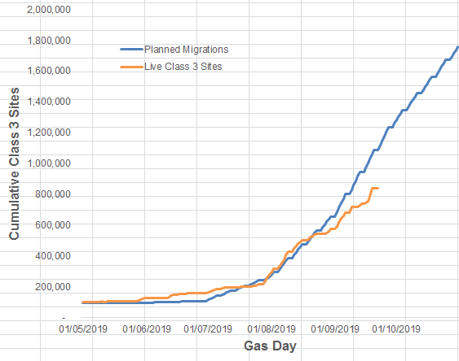
Class 3 Actuals / Forecast – September 2019
Expected that a further 336,000 SMPs will be Class 3 on or around 1st October
Total Class 3 expected to be 1,178,000 by 2nd October

Slide 5
Class 3 Actuals / Forecast – October 2019
Total Class 3 on1st October - 1,135,038
Total Class 3 expected to be 2,089,019 by end of October

Slide 6
Class 3 Actuals / Forecast – November 2019 (Orig)
Total Class 3 on1st November – 1,835,063
Total Class 3 expected to be 2,547,393 by end of November

Slide 7
Class 3 Actuals / Forecast – December 2019
Total Class 3 on1st December – 2,363,191
Increase during November - 528,128
Total Class 3 expected to be 2,952,553 by end of December

