Slide 1
AQ Taskforce Update CoMC
20th May 2020
Version 0.1

Slide 2
Summary
Given the recent exceptional circumstances a number of our key resources have been focused on supporting our business continuity efforts to maintain our critical processes. Understandably this has slowed the progression of AQ taskforce activities.
Additionally, the AQ taskforce team have been heavily involved in supporting the recent COVID-19 suggested MODs in terms of Xoserve assessment, system readiness and aiding the awareness sessions held with industry.
Our focus remains on ensuring that the right level of quality is being applied to the known AQ defects (17 open defects as at 11th May) . A ‘drains up’ review of our defect process has been instigated to ensure appropriate levels of control exist supported by daily ‘drumbeat’ sessions to ensure all parties are working to agreed targets/outcomes.
A 6 week body of work has now been initiated with our technical suppliers and business SME’s to drive out the underlying root cause of issues. The findings, along with supporting recommendations will be shared with you as they become visible.
We continue to assess the current change portfolio to understand what CRs have an impact on AQ functionality and we are now doing internal assessment to understand the delivery implementation for these and may seek to reprioritise with ChMC if needed.
A suite of additional MI reports to further strengthen our operational management/procedures as well as aide root cause is now in development. This will aide our ability to truly assure the AQ correction output.

Slide 3
AQ Taskforce Workstreams
Workstreams
Defects
Ongoing Resolution
Underlying
Root Cause
MI/Reporting
Operational MI
AQ Change Requests
AQ Defect Process Improvements
Process Improvements
System
Business process
Solution
options
Assessment
Test Quality
Correction Tools
Customer data
Analytics
Customer Engagement
Prioritisation
Deriving root cause; prioritising AQ CRs; streamlining our defect, system and business processes and underpinned by meaningful data and MI will support resolution

Slide 4
AQ Defect Status (11th May)
55
Defects impacting AQ since August 2019. Circa 800,000 MPRNs affected
17
Open Defects
3
Analysis
38
Resolved defects
(c.798k MPRNs)
9
UAT
3
Fixed, Deployed Awaiting Data Correction
2
Awaiting Deployment

Slide 5
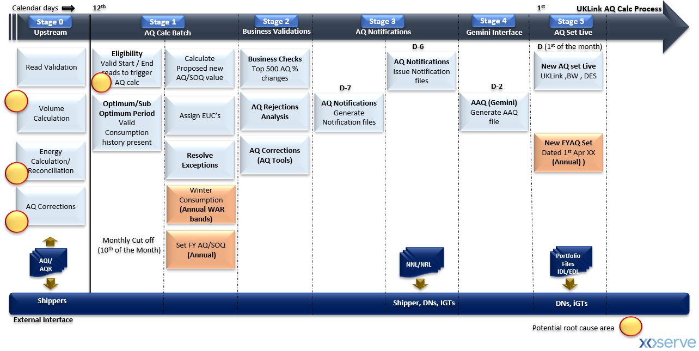
Monthly AQ Process – Defect Heat-Map
Potential Root Cause Areas…
Multiple process/system events occurring on the same day
Business/Technical Exceptions resulting in incorrect AQ
BAU change delivery – Robust regression test of all scenarios/variants
AQ defect process – robustness of process
Others…

Slide 6
Next Steps…
Provide greater visibility on root cause activity; its progress; early findings and what it will mean to the process.
Seek to demonstrate a slowing down of AQ defects being instigated and an increase in resolution times – aided by the focus on improving the overall e2e defect process.
Continue to explore areas for efficiency and overall process improvements.

