Slide 1
MAP Portfolio Reporting

Slide 2
Background
A DRR was presented to CoMC in July-2020 (link) looking to expose data items to facilitate a MAP Portfolio Reporting service
Questions were asked at the time in relation to the CDSP only releasing data within a MAP’s ownership, to which assurances were given to be the case
Ongoing development of this service has progressed and the CDSP wanted to give CoMC visibility of the logic being proposed in relation to this service and seek approval accordingly

Slide 3
Overview
As per the DRR, the below data has been approved to be provided to MAPs where they are, or have been assigned to a MPRN/MSN on UK Link
Supply Point Details
MPRN, MAP Start, MAP End, DCC Flag, DCC EFD
Meter Details
MSN, Installation Date, Model, Manufacture, Type, Mechanism, Capacity, Removal Date
Stakeholder Details
Type (SUP/MAM), Short Code, Name, Start Date, End Date

Slide 4
Details
Due to the migration of MAP Id into UK Link and how the RGMA process (to update the MAP Id) works, there are instances where MAP & asset activity dates may not align
This also applies to stakeholder data held on UK Link
It is proposed that actual dates are provided to the MAP where they span their ownership period (i.e. not to be amended to align to MAP appointment dates)
We will also assume MAPs are owners of the asset if they are assigned for a period of time (but not covering the whole asset period) provided there was no other MAP assigned to the same asset

Slide 5
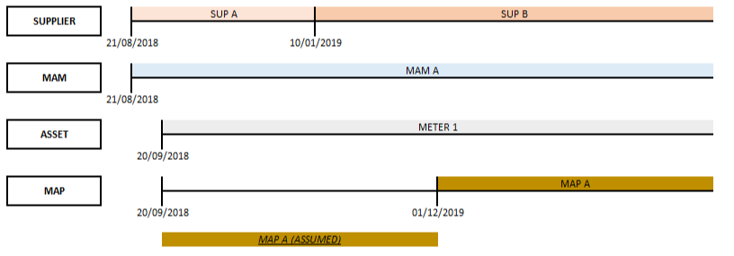
Base Scenario
Where a MAP has been assigned to an asset on UK Link but their appointment date does not conform to the Installation Date recorded on UK Link then the CDSP will assume ownership belongs to the recorded MAP for the entirety of the asset period
This means that Supplier A & B details will be provided to the recorded MAP

Slide 6
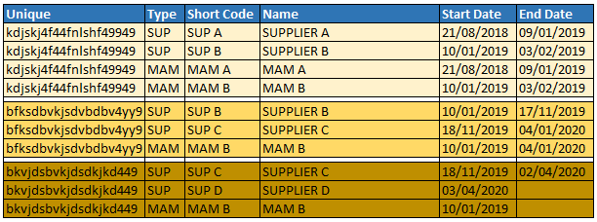
Detailed Scenario 1
This scenario shows a MAP (MAP B) being assigned at a later date to the Asset Installation Date (METER 2)
With this it is proposed that the details of Supplier B & C be released to MAP B (assumed MAP B for the lifecycle of the asset)
For End Dates it is proposed that they will be amended to only show up to the MAP disassociation Date where the asset is removed (Sup C)

Slide 7
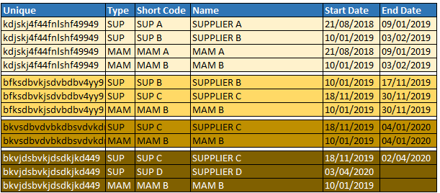
Detailed Scenario 2
This scenario shows MAP (MAP B) being assigned at a later date to an asset effective date but another MAP was assigned to the same asset previously
With this it is proposed that the details of Supplier B & C are released to MAP B and Supplier C only released to MAP C

Slide 8
CoMC Discussion/Approval
In principle do you agree that there are some circumstances where the CDSP will use it’s discretion to release data to MAPs as there are no definitive start and end date(s) surrounding MAP ownership within UK Link?

