Slide 1
XRN5183 - Access to Daily Biomethane Injections
Approval of approach

Slide 2
Background
XRN5183 was raised by Inspired Energy (Shipper) looking to have visibility of daily biomethane injections statistics
Change Justification:
In order to aid further Biomethane projects it would be useful for Xoserve to provide this data to show growing penetration but also support surrounding future projects
Use of data to:
Monitor the reliance of the technology for Biomethane projects
Identify potential sites that could be situated by looking at which LDZ, specifically capacity benefit/issues
Should allow greater penetration of technology as independent data supports project FIDs
To facilitate better pricing of products which will allow greater competition from shippers
Solution options were discussed and approved to move forward with at DSG & ChMC
CDSP wish to ensure the appropriate authority is given to release this information to Shippers

Slide 3
Current Process Overview
Currently National Grid create new Biomethane Entry Points in Gemini and pass the CDSP details on consumption (KwH)
CDSP then extract this data and provide to two parties:
DNs on a monthly/weekly basis for their appropriate LDZs (process set up prior to FGO)
The Government (BEIS) for all Entry Points (requested in 2015 by W&W)
There isn’t currently a DSC Service Line in relation to the above

Slide 4
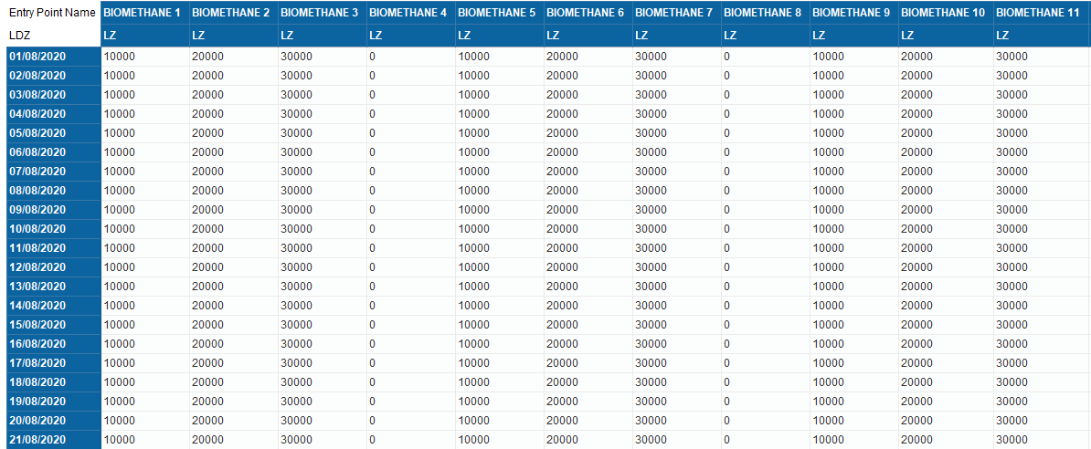
Solution Overview
Existing BEIS report to be published, monthly, to the secured/restricted area on Xoserve.com (same as UIG publication)

Slide 5
Approach Approval
Do CoMC agree that this report can be shared with the Shipper community?

