Slide 1
Change Management Committee
13th January 2021

Slide 2
Section 2: DSC Change Budget & Horizon Planning

Slide 3
DSC Change Budget BP20 (Financial Year To Date)

Slide 4
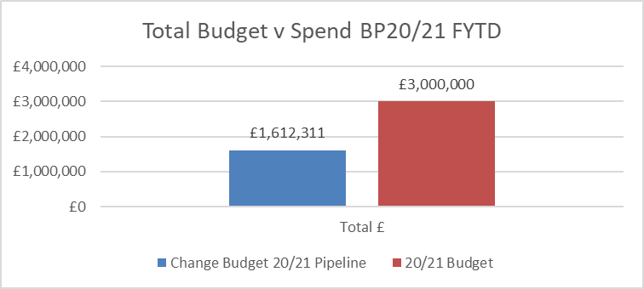
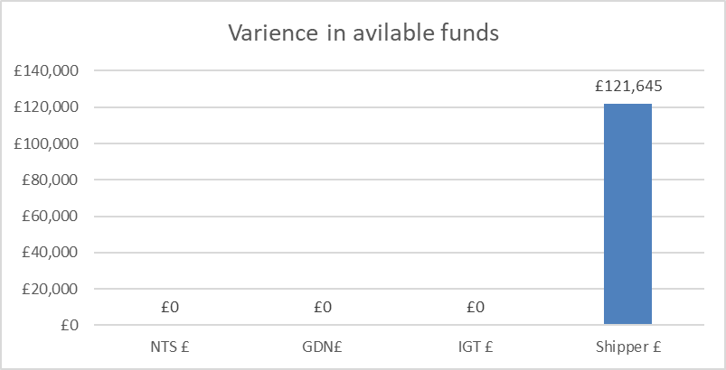
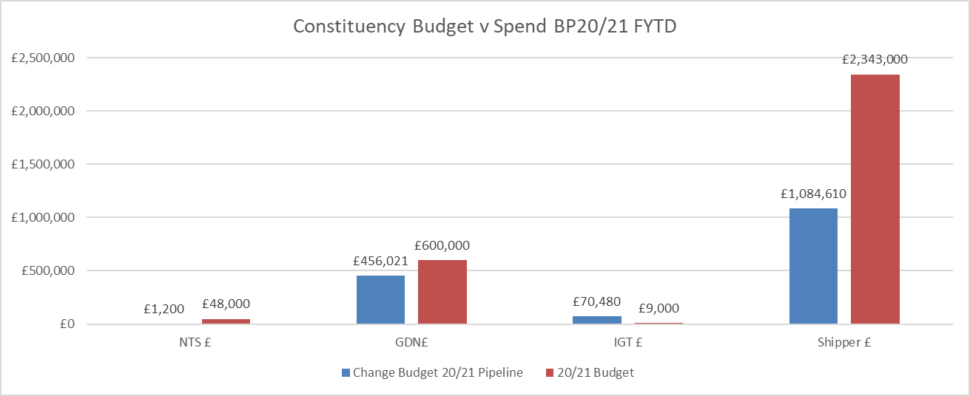
Budget v Spend BP20/21 Financial Year To Date (FYTD)
Available funds have increased by £121k as a result of multiple shipper changes moving through the lifecycle (see 2nd tab in embedded s/s)
Costs for next FY (where known) have been added to s/s

Slide 5
Bubbling Under (pre-capture regulatory change)

Slide 6
Section 3: Capture

Slide 7
Capture: Prioritisation & Target Out Of Capture Dates

Slide 8
In progress - target out of capture date

Slide 9
Withdrawn / Complete

Slide 10
New Change Proposals – Initial Review
XRN / Title | Voting |  |  |  | DSC Service Area
 | Shipper | DNO | IGT | NTS
XRN5290 CNC Bulk Network Report |  | X | X |  | Service Area 16: Provision of Supply Point Information Services and Other Services Required to be Provided Under Condition of the GT Licence
XRN5289 November 21 Major Release | For Information Only |  |  |  | N/A
XRN5294 Minor Release Drop 9 | For Information Only |  |  |  | N/A
XRN5307 Amendments to V15 of the Service Description Table | For Information Only |  |  |  | N/A

Slide 11
XRN5290 CNC Bulk Network Report
Voting Parties
Change Details
Customer Class | Voting Party?
Shipper
Distribution Network Operators (DNOs) | X
National Grid Transmission
IGT’s | X
Problem Statement
As part of the Network usage of the new SMS/Email Notification service a number of Networks have requested Xoserve to identify the percentage saturation per LDZ of the Broadcast 'BRO' data held in UK Link. This will enable Networks to determine whether sufficient data exists to make using the notification service effective.
DSC Service Area: | Service Area 16: Provision of Supply Point Information Services and Other Services Required to be Provided Under Condition of the GT Licence
Link to Change Proposal | Link to CP
Change Description
To provide the Networks with a report that details the %age saturation, by LDZ, of the number of BRO contract details held within UK Link. This will allow the Networks to assess whether there is sufficient data to use the broadcast service to notify end consumers. The report would be generated monthly for an initial 6 month period.
Change Type | Non Regulatory
Priority Score
Sponsor Representative | Xoserve

Slide 12
XRN5289 November 21 Major Release
Voting Parties
Change Details
Customer Class | Voting Party?
Shipper
Distribution Network Operators (DNOs)
National Grid Transmission
IGT’s
No voting needed as for information only
Problem Statement
The request for this Change Proposal is to ensure that there is visibility to ChMC of the changes within scope of this release and progress of November 21 Major Release
Change Description
A parent XRN is required for November 21 Major Release There are 6 changes within this release XRN4941 MOD0692 – Auto updates to meter read frequency XRN5007 Enhancement to reconciliation process where prevailing volume is zero XRN5072 Application and derivation of TTZ indicator and calculation of volume and energy (all classes) XRN5091 Deferral of creation of class change reads at transfer of ownership XRN5142 SEC (MOD) -New allowable values for DCC service flag in DXI file from DCC XRN5180 Inner tolerance validation for replacement reads and read insertions
DSC Service Area: | N/A - See individual Change Proposals
Link to Change Proposal | Link to CP
Change Type | Mixed Regulatory and Non Regulatory
Priority Score
Sponsor Representative | Xoserve

Slide 13
XRN5294 Minor Release Drop 9
Voting Parties
Change Details
Customer Class | Voting Party?
Shipper
Distribution Network Operators (DNOs)
National Grid Transmission
IGT’s
No voting needed as for information only
Problem Statement
The request for this Change Proposal is to ensure that there is visibility to ChMC of the Changes and progress of Minor Release Drop 9
Change Description
A parent XRN is required for Minor Release Drop 9 There are 2 changes within this drop XRN5080 Failure to Supply Gas (FSG/GSOP1) – This is a change to the FSG process for DN’s XRN5135 -Add customer address to invoices – This is a change to ensure inclusion of the registered name and address to invoices for DN’s
DSC Service Area: | N/A - See individual Change Proposals
Link to Change Proposal | Link to CP
Change Type | Non Regulatory
Priority Score
Sponsor Representative | Xoserve

Slide 14
XRN5307 Amendments to V15 of the Service Description Table
Voting Parties
Change Details
Customer Class | Voting Party?
Shipper
Distribution Network Operators (DNOs)
National Grid Transmission
IGT’s
No voting needed as for information only
Change Description
It is proposed to add 3 new service lines to support the Deed of Undertaking Process to reflect that Xoserve will be administering a consolidated Deed of Undertaking on behalf of IGTs when new Suppliers enter the market. Service line ref & Description ASiGT CS SA9 03 - Coordinate the deed of undertaking on behalf of iGTs in response to an application from a licensed applicant supplier ASiGT CS SA9 04 - Coordinate the deed of undertaking on behalf of iGTs in response to an application from a new IGT ASGT-CS SA9-14 - Coordinate a deed a Deed of Undertaking on behalf of the DNs and NTS Amendments to support Mod 0780s A number of references to section G have been made to the Service Description table to reflect changes made in support of Mod 0780s – ‘Re-ordering of the UNC in advance of Faster Switching’. The mod was to re-align the UNC to match the re-ordering as per the legal text that was proposed for the switching programme. The work that was carried out for the legal text changes was carried out by Dentons who made a number of changes to TPD Section G as which included re-ordering the current text (at that time) and the removal of TPD Sections G1.19, G5 and G6 to be reinstated within TPD Sections J1.9,TPD Section B, Annex B-3 and TPD Section B8. See CP for full description
DSC Service Area: | N/A
Link to Change Proposal | Link to CP
Change Type | Non Regulatory
Priority Score | Low
Sponsor Representative | Xoserve

Slide 15
Change Proposals Updates
XRN5218 CDSP provision of Class 1 read service (Mod 0710)

Slide 16
Please Note: The implementation dates for each of the Capabilities are subject to change following completion of the respective Capability design activities

Slide 17
3.4 New Change Proposals – Post Solution Review
XRN5007 Correction in the reconciliation process when volume is zero
XRN5038 Convert Class 2, 3 or 4 meter points to Class 1 when G1.6.15 criteria are met (MOD 0691)
XRN5072 Application and derivation of TTZ indicator and calculation of volume and energy – all classes
XRN5180 Inner Tolerance Validation for replacement reads and read insertions

Slide 18
XRN5007 Correction in the reconciliation process when volume is zero
Proposed Release Link to Change Proposal Change Pak Comm Ref Voting Funding | DSG/ Xoserve Preferred Option | Solution Summary Outcome and implementation date outcome |  |  |  | Comments
 |  | Organisation | Approve | Defer | Reject
Proposed delivery: November 21 Link to CP Link to Change Pack ref: 2741.2 - RT – JR Voting: Shipper, DNO High level Solution cost: Option 1: 120 - 200K Option 2: 70 - 150K Service Area: Service Area 5 Metered Volume and Metered Quantity Funding: Service Area 5 is split 33% Shipper, 67% DNO | Option 2. | EDF | X |  |  | Approve solution option 2
 |  | SSE | X |  |  | We support option 2, as it is less complex than option 1 whilst still providing an adequate solution to reduce delay and subsequent impact on AQ calculations and UIG.

Slide 19
XRN5038 Convert Class 2, 3 or 4 meter points to Class 1 when G1.6.15 criteria are met (MOD 0691)
Proposed Release Link to Change Proposal Change Pak Comm Ref Voting Funding | DSG/ Xoserve Preferred Option | Solution Summary Outcome and implementation date outcome |  |  |  | Comments
 |  | Organisation | Approve | Defer | Reject
Proposed delivery: Adhoc (proposed March/April 21) Link to CP Link to Change Pack ref: 2741.3 - RT – JR Voting: Shippers, DNO, IGT High level Solution cost: 25 – 45K Service Area: Service Area 1 Manage Supply Point Registration Funding: Service Area 1 is 100% Shipper | Option 1 | NGN | X |  |  | Northern Gas Networks support this change proposal to be delivered through ‘Option 1’.
 |  | SSE | X |  |  | We support this change to allow Xoserve to move SMPs to Class 1 where they’ve exceeded the AQ limits beyond the UNC timescales and where a shipper has not taken action to rectify this, as it will help reduce the negative impact on settlement of these sites continuing to remain in classes 2,3 or 4.

Slide 20
XRN5072 Application and derivation of TTZ indicator and calculation of volume and energy – all classes
Proposed Release Link to Change Proposal Change Pak Comm Ref Voting Funding | DSG/ Xoserve Preferred Option | Solution Summary Outcome and implementation date outcome |  |  |  | Comments
 |  | Organisation | Approve | Defer | Reject
Proposed delivery: November 21 Link to CP Link to Change Pack ref: 2741.4 - RT – JR Voting: Shippers High level Solution cost: 120 – 200K Service Area: Service Area 3 Record/submit Data in Compliance with UNC Funding: Service Area is 100% Shipper | Option 1 | EDF | X |  |  | Approve given option with the caveat that we would like to input into detailed design
 |  | SSE | X |  |  | We agree that the proposed review of volume calculations involving a TTZ to address inaccurate calculations post Nexus go-live/LIS will improve understanding and accuracy in the use of the TTZ going forward. It would be useful for a report to be published to DSC Change Management committee/industry stakeholders detailing the investigation and outcome of this review into TTZ and volume calculations. We also request confirmation that it is not the intent of the of XRN5072 to re-invoice shippers on the basis of the review findings?

Slide 21
XRN5180 Inner Tolerance Validation for replacement reads and read insertions
Proposed Release Link to Change Proposal Change Pak Comm Ref Voting Funding | DSG/ Xoserve Preferred Option | Solution Summary Outcome and implementation date outcome |  |  |  | Comments
 |  | Organisation | Approve | Defer | Reject
Proposed delivery: November 21 Link to CP Link to Change Pack ref: 2741.5 - RT – JR Voting: Shippers High level Solution cost: 70 – 150K Service Area: Service Area 5 Metered Volume and Metered Quantity Funding: Service Area 5 is split 33% Shipper, 67% DNO, however, we are proposing this change is 100% Shipper funded as they are the beneficiary of the change and there are no ongoing costs associated with this change for the delivery of Service Area 5. | Option 1 | EDF | X |  |  | None
 |  | SSE | X |  |  | We agree that the proposed solution to utilise the existing file formats and industry processes to amend read validation processes to use the Override flag will help prevent rejections.

Slide 22
3.5 Outages
Outages
Change Request Number | Impacted System | Outage Duration |  |  |  |  | Committee Notified Date
 |  | Start Date | Start Time | End Date | End Time | Brief Description
11024 | UK Link Portal; UK Link On-line Service; DES and CMS | 04/12/2020 | 23:00 | 05/12/2020 | 10:00 | UK Link Disaster Recovery Test 2020 (Failover to DR site) - the UK Link system will operate normally from the DR site in the period between Failover and Failback. NB: UK Link System Application will not be available during this period – but no impacts to Users are expected | 11/11//2020
11024 | UK Link Portal; UK Link On-line Service; DES and CMS | 05/12/2020 | 23:00 | 06/12/2020 | 07:00 | UK Link Disaster Recovery Test 2020 (Failback to primary site) - contingency dates for the test are Friday 15th to Sunday 17th January 2021 with the same timings as above. NB: UK Link System Application will not be available during this period – but no impacts to Users are expected | 11/11//2020
 | UK Link | 16/01/2021 | 04:00 | 27/01/2021 | 07:00 | In order that the UK Link platform continues to be supported we will be carrying out a programme of upgrades to existing systems over the next few months. The upgrades to production systems are planned for early January and will require some system outages which we will aim to carry out over a weekend to ensure impact to the industry is minimised. The detailed upgrade and outage schedule will be shared in November. | Times and Dates updated 12/01/2021
 | UK Link | 30/01/2021 | 12:00 | 30/01/2021 | 18:00

Slide 23
4. Design & Delivery

Slide 24
4. Design Change Pack
XRN5237 Maintenance of a User relationship table for the purpose of AQ amendments (Modification 0736)

Slide 25
XRN5237 Maintenance of a User relationship table for the purpose of AQ amendments (Modification 0736)
Functional Changes
Change Pack ref: 2741.1 - RT - JR Release: Adhoc following January ChMC if approved Voting: Shipper, DNO, IGT Funding: 100% Shipper Service Area 1- Manage Supply Point Registration | Solution & Implementation Summary outcome |  |  |  | Comments
 | Organisation | Approve | Defer | Reject
 | EDF | X |  |  | We think this service should be chargeable immediately as we feel that would be a good incentive for parties to ensure issues are minimised. We also feel reporting should be developed for PAC to monitor non compliance with UNC rules. Also in the XRN document it says ‘Although the Modification is yet to be approved, we have written out to Shipper Contract Managers, to allow them to determine the relevant affiliate information for their organisation and submit this to the CDSP. ' but we have received no contact as yet.
 | NGN | X |  |  | Northern Gas Networks support this change; however we cannot comment on the Retro MOD0736A aspect, as that relates to MOD0746.
 | SSE | X |  |  | We support this change to create a shipper affiliate/ relationship table to help check requests to use reason code 3 for AQ corrections.

Slide 26
XRN4914 MOD 0651- Retrospective Data Update Provision –
Proof of Concept Status Update
 | Overall Project RAG Status
 | Schedule | Risks and Issues | Cost | Resources
RAG Status
Status Justification
Schedule | Delivery: Proof of Concept exercise completed following playback of Step 2 Outputs and Initial recommendations at November Change Management Committee Outputs and recommendations provided to ChMC in November Closure Report to be issued in January for approval
Risks and Issues
Cost | Approval received from DN’s for BER of £270k for proof of concept. Costs within approved budget.
Resources | Project Team to complete closedown activities for POC activity
Updated as of 23/12/20

Slide 27
CCR for XRN4914 MOD 0651- Retrospective Data Update Provision
Voting: DNO

Slide 28
XRN5289 - November 21 Release - Status Update
 | Overall Project RAG Status
 | Schedule | Risks and Issues | Cost | Resources
RAG Status
Status Justification
Schedule | High level timelines have been drafted awaiting approval (please see next slide for more information) Workshop plans have been shared with internal stakeholders Detailed planning to be completed and approved by end of January for all stages until end of detailed design
Risks and Issues | Return to green – requesting approval to descope from release in ChMC 13th January 2021 XRN5187 and XRN5186 – have outstanding Ofgem decisions, Solutions have not been submitted via change pack so if requested to continue could cause delays to the plan to submit change packs by May
Cost | EQR issued for approval in January ChMC
Resources | Return to green on confirmation of all resources required to support Design phase Resource Forecasts and Plans have been defined at a high level until Design but are not yet approved
Updated as of 23rd December 2020

Slide 29
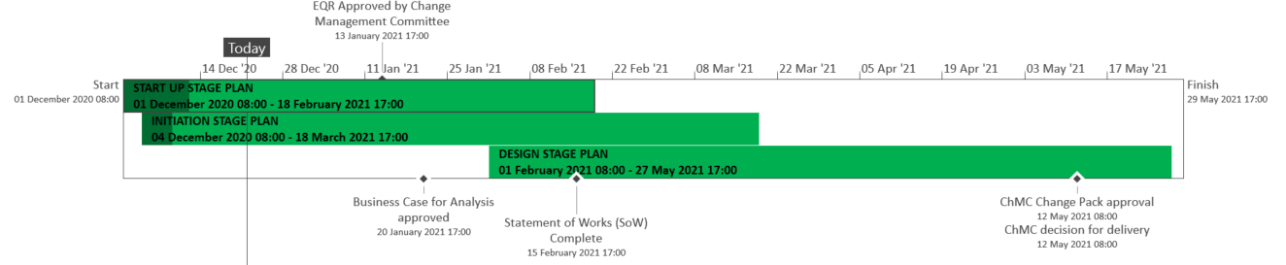
XRN5289 – November 21 Proposed High-Level Plan
Draft version – there is a low risk to major changes to overall timelines
Updated as of 23rd December 2020

Slide 30
XRN5289 - November 21 Release Summary
The initial scope of the November 2021 Major Release consists of 8 changes
In Scope
XRN4941 - MOD0692 - Auto updates to meter read frequency
XRN5007 - Enhancement to reconciliation process where prevailing volume is zero
XRN5072 - Application and derivation of TTZ indicator and calculation of volume and energy – all classes
XRN5091 - Deferral of creation of Class change reads at transfer of ownership
XRN5142 - New allowable values for DCC Service Flag in DXI File from DCC
XRN5180 - Inner tolerance validation for replacement reads and read insertions
XRN5186* MOD0701 – Aligning capacity booking under the UNC and arrangements set out in relevant NExAs
XRN5187* MOD0696 – Addressing inequalities between capacity booking under the UNC and arrangements set out in the relevant NExAs
*Xoserve will seek approval to descope XRNs 5186 and 5187 from the UK Link November 2021 Major Release from 13th January 2021 ChMC
Updated as of 23rd December 2020

Slide 31
Approval Required
ChMC is asked to approve the descoping of XRN5186 and XRN5187 from the November 2021 Major Release, as:
  MOD approval is outstanding for both
  CSS design conflicts with XRN5186 so the solution will not work as the MOD intends
  XRN5187 has impacts to CSS as it is updating the nomination process
Following descope the changes will return to the UK Link unallocated list and will be considered for future releases
Voting: Shipper & DNO
Updated as of 23rd December 2020

Slide 32
EQR for XRN5289 - November 21 Release
Excluding XRNs 5186 & 5187
Including XRNs 5186 & 5187
Voting: Shipper, DNO & IGT

Slide 33
XRN4996 - June 20 Release - Status Update
 | Overall Project RAG Status
 | Schedule | Risks and Issues | Cost | Resources
RAG Status
Status Justification
Schedule | XRN4850 SMS/Email Notification: To date we had had 1 network use the service for both extract and SMS service for a limited number of meter points due to the limited data availability in UK Link which is currently circa 5-million-meter points with a further 2 million planned by end of December 2020, discussions ongoing with Supply Point Administration Agreement (SPAA) group to encourage greater population of data, please contact Max Pemberton at customerexperience@xoserve.com prior to submitting any contact details. Project Closedown: Following completion of PIS project closedown is in progress. The Change Completion Report has been submitted for approval. Scope Variations: XRN4850 design for scope variation for report automation in progress. Report delivery mechanism decision expected during Change Management meeting. Manual reporting will be available in the interim should the service be used. XRN4850 UK Link Portal changes – to allow special characters, increase character limits in text and email and display character number count is in progress XRN4780(B) MAP ID – MAP ID data migration in to UK Link was successfully completed as per plan on 14th December 2020
Risks and Issues | Risk – DN's/IGT's do not use the new SMS/Email broadcast functionality during Post Implementation Support, because of the limited number of customer contact details uploaded to UK Link or networks do not need to send broadcasts during this period. To mitigate, Networks to confirm requirements for the report details to provide % saturation of sites in each LDZ which has BRO data populated.
Cost | Costs have been finalised in the CCR which has been submitted for approval
Resources | No resource issues identified for the remainder of the project
Updates as of the 16th December 2020

Slide 34
Decision Required: Deliver Mechanism for the Network Reporting
Background
Networks have requested to automate the generation and delivery of the Network Delivery Report following delivery of broadcast notifications to end consumers. Three options are being considered: via existing IX channels to deliver the reports Option no longer viable using new Twilio service to email Network users a link to access the reports via Data Discovery Platform (DDP) portal access the reports – option A and option B (Please see next slide) Following a split vote in December, it was agreed to defer the final decision to January Since then, an addition option for DDP has been included as a result of a change in resource circumstances within the DDP team A piece of reporting work that was due to be delivered in early 2021 for the Shippers has been postponed until later in the year therefore freeing up existing DDP resource meaning there is capacity to deliver the reporting as part of DDP BAU delivery without the need for additional resource. This means that the automated reporting can be delivered at zero cost if scheduled for Q1 2021 Xoserve is recommending using the Data Discovery Platform to deliver this reporting requirement. This approach has been ratified by our platform architects as the optimal delivery mechanism in order to provide a consistent customer experience. DDP is our enduring solution, has the necessary security protocols in place and therefore avoids introducing a further delivery mechanism which generates technical debt / avoidable future operational overheads.
Decision Required
A decision is required as to which report delivery option is preferred so that Xoserve can proceed with build, test and deliver. n Required
Updates as of the 22nd December 2020

Slide 35
Decisions Options
Options: Deliver Mechanism for the Network Reporting | Outcome
Azure/Twilio Service Solution: Strategic Delivery timescale: late January/early February 2021 Delivery cost: £0 included within SMS/Email notification allowance Considerations: switch may need to be made to enduring solution at some point in the future, at this point additional costs may be incurred. If alternative service provider is sourced, additional integration costs may be incurred. Data is only available for 7 business days, following that a service desk ticket would be required to obtain the report
Data Discovery Platform (DDP) A Solution: Enduring Delivery timescale: late February/early March Delivery cost: £0 delivered by DDP as part of BAU activities Delivery benefits: when a report is available, an notification email can be delivered so that you only need to access DDP when prompted. Data will be held within DDP for 12 months so supplementary process not required to retrieve reports after 7 business days
Data Discovery Platform (DDP) B Solution: Enduring Delivery timescale: to be agreed with Networks for a future DDP/Minor release implementation Delivery cost: circa £35,000 (DDP integration and project costs) Considerations: existing delivery mechanism for data delivered by Xoserve. Will have to be delivered outside of June 20 release
In this meeting the decision is required on one of the above options – Voting: DNO & IGT
Updates as of the 22nd December 2020

Slide 36
XRN4850 – SMS/Email Broadcast Notification Timeline
Project closedown is in progress.
Daily/Monthly Network Usage report delivery in progress, delivery mechanism decision to be made during the meeting
TODAY
Updates as of the 16th December 2020

Slide 37
CCR for XRN4996 June 20 Release
Voting: Shipper, DNO & IGT

Slide 38
XRN4996 June 20 Release Summary
June 20 Release consists of 7 changes, Implementation was completed for June 20:
In Scope
XRN4772 - Composite Weather Variable (CWV) Improvements
XRN4888 - Removing Duplicate Address Update Validation for IGT Supply Meter Points via Contact Management Service (CMS)
XRN4930 - Requirement to Inform Shipper of Meter Link Code Change
XRN4850 - Notification of Customer Contact Details to Transporters (UKLink file formats, new service to follow)
XRN4865 - Amendment to Treatment and Reporting of CYCL Reads
XRN4932 - Improvements to the quality of the Conversion Factor values held on the Supply Point Register (MOD0681S)
XRN4780 (B)*** – Inclusion of Meter Asset Provider Identity (MAP Id) in the UK Link system (CSS Consequential Change)
Descoped
XRN4691** - CSEPs: IGT and GT File Formats (CGI Files)
XRN4692** - CSEPs: IGT and GT File Formats (CIN Files)
XRN4780 (B) - Inclusion of Meter Asset Provider Identity (MAP Id) in the UK Link system (CSS Consequential Change)
XRN4871 (B)** - Changes to Ratchet Regime (MOD0665)
XRN4941* - Auto updates to meter read frequency (MOD0692)
* Pending Solution/MOD approval by ChMC/DSG for remaining change requests. Descoped at ChMC on 8th January 2020
** Descoped at eChMC on 22nd November 2019
*** Added to scope (revised scope from original)
Updates as of the 16th December 2020

Slide 39
XRN5110 - November 20 Release - Status Update
 | Overall Project RAG Status
 | Schedule | Risks and Issues | Cost | Resources
RAG Status
Status Justification
Schedule | PIS Progressing through first usage as planned 75 instances of first usage have been captured out of a total of 112 planned across all changes 6 defects have been raised – all defects have been fixed and deployed 14 incidents have been raised in total – 1 outstanding 1 Incident relates to data that had been incorrectly deleted as part of the historical cleanse job, there has been no customer impact and the data was restored quickly affecting 18 MPRN’s out of 18k – a change request is being raised to cover the scenarios that were missed resulting in the deletion, this is currently being planned, there will be an extension to PIS and a delay to the recommencing of the historical cleanse job that has been currently placed on hold. Expected implementation of the change is the end of February 2021 The daily cleansing job has recommenced as analysis confirmed it is not impacted by the above incident Return to Green XRN4897/99 change request plan to be completed and approved
Risks and Issues | Risk: DES users may experience a downgrade in performance – monitoring access – no tickets raised so far for slowness Risk: XRN4897/99 delivery verifying 100% GDPR compliance – PIS plans in place to assure – Risk probability being understood Expecting project to remain Amber for the entire PIS period because the above 2 risks will be monitored until the end of PIS Risk: Deployment of defect fixes may be delayed due to the code freeze window – urgent and P1/P2 defects will still be deployed Return to Green for the above risk is that defect fixes will return to normal once the code freeze finishes on 18th January 2021
Cost | BER approved - 10th June 2020 Full Business Case approved XEC – 23rd June 2020 Forecast to complete within budget
Resources | SME resources have been requested to support the first usage and PIS Tech Ops resource has been allocated to support PIS SME & Tech Ops resource has been requested but not confirmed for the delivery of the XRN4897/99 change request Return to Green Resources approved for the delivery of the XRN4897/99 change request
Updates as of the 16th December 2020

Slide 40
XRN5110 - Nov 20 Delivery Timeline & Progress
Note: Above delivery timeline does not include XRN4897/99 change request. Details will be included in the next ChMC
Updates as of the 16th December 2020

Slide 41
XRN5110 - Nov 20 PIS First Usage and Defects
Updates as of the 16th December 2020

Slide 42
XRN5110 - Nov 20 PIS Defect Details
Updates as of the 16th December 2020

Slide 43
XRN5110 - Nov 20 Scope
XRN5110 November 20 Release consists of 5 changes. Implementation is planned for November 2020
In Scope
  XRN 4897 - Resolution of deleted Contact Details (contained within the S66 records) at a Change of Shipper event
  XRN 4899 - Treatment of Priority Service Register Data and Contact Details on Change of Supplier Event
  XRN 4801 - Additional Information in DES
  XRN 4871b - Rachet Regime Changes
  XRN 5014 - Facilitating HyDeploy2 Live Pilot
Descoped changes
  XRN 4931 - Submission of a Space in Mandatory Data on Multiple SPA Files
  XRN 4941 - MOD 692 – Auto Updates to Read Frequency
  XRN 4992 - Supplier of Last Resort Charge Types
To be delivered by CSSC
  XRN 4780c - MAP ID
Updates as of the 16th December 2020

Slide 44
XRN5253 - June 21 Release - Status Update
 | Overall Project RAG Status
 | Schedule | Risks and Issues | Cost | Resources
RAG Status
Status Justification
Schedule | BER Approved at ChMC on 9th December, however a revised BER will need to be issued in February that includes AUGE set up costs previously discussed as part of HLSO. This was unfortunately omitted from original BER version. Detailed Design execution completed and Change Pack for XRN5093 approved at ChMC on 9th December 2020 Build commenced to plan on 14th December 2020, due to complete in January 2021 Test & Implementation Approach under internal review System Testing to commence in January 2021 following conclusion of Build Phase
Risks and Issues | Issue: The project is progressing 2 months behind plan leading to overlap between multiple phases and risk that approvals may not fall in order. It also reduces overall delivery timescales. Mitigation: Detailed Plan up to end of Design to be completed as part of Start Up to ensure tight project control and critical path management
Cost | Return to Green revised BER approved BER Approved at ChMC in December 2020, revised BER to be issued to included AUGE set up costs incorrectly omitted from previous stage
Resources | Resource RAG Status will return to green on confirmation of resources required to support all testing phases Resource Forecasts and Plans have been defined at a high level for future stages
Updated as of 23rd December 2020

Slide 45
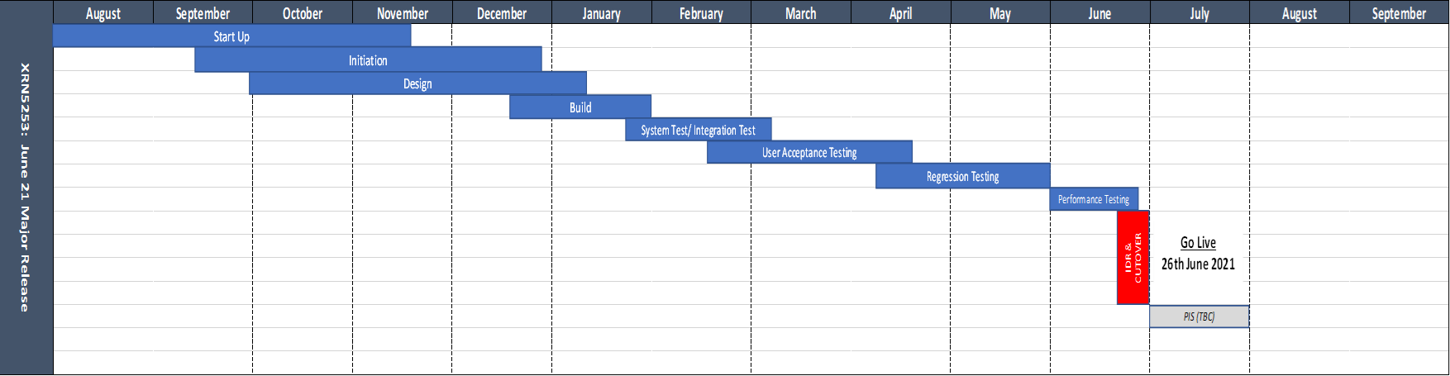
XRN5253 – Proposed June 21 Proposed High Level Plan
TODAY
Updated as of 23rd December 2020

Slide 46
XRN5253 - June 21 Release Summary
June 21 Release now consists of 1 change
In Scope
XRN5093 - MOD0711 – Update of AUG Table to reflect new EUC bands
De-Scoped at Extraordinary Change Management Committee on 26th October 2020
XRN4992 - MOD0687 – Creation of new charge to recover last resort supply payments
De-Scoped at Change Management Committee on 11th November 2020
XRN4941 - MOD0692 - Auto updates to meter read frequency
Updated as of 23rd December 2020

Slide 47
XRN5225 – Minor Release Drop 8 - Status Update
 | Overall Project RAG Status
 | Schedule | Risks and Issues | Cost | Resources
RAG Status
Status Justification
Schedule | There are 3 changes for XRN5225 to be implemented. The implementation was 21st November: XRN5181 - Acceptance of Consumption Adjustments where meter is removed XRN5174 - Agreed FINT Replacement Reads incorrectly triggering rolling AQ calculation XRN5118 - Change how the actual MR data is populated in UK Link Implementation successfully completed on 21st November 2020 PIS Completed on 18th December 2020 1 defect which has impacted the AQ run times by 6 hours. To be fixed during Minor Release 9 once the production like environment is available
Risks and Issues
Cost | Changes are being delivered as part of Minor Release Budget 20/21
Resources
Updated as of the 22nd December 2020

Slide 48
XRN5225 – Minor Release Drop 8 Timelines
Updated as of the 22nd December 2020

Slide 49
XRN5225 – Minor Release Summary
There are 3 changes for XRN5225 to be implemented. The Implementation date was 21st November:
  XRN5181 - Acceptance of Consumption Adjustments where meter is removed
  XRN5174 - Agreed FINT Replacement Reads incorrectly triggering rolling AQ calculation
  XRN5118 - Change how the actual MR data is populated in UK Link
Updated as of the 17th December 2020

Slide 50
XRN5294 - Minor Release Drop 9 Status Update
 | Overall Project RAG Status
 | Schedule | Risks and Issues | Cost | Resources
RAG Status
Status Justification
Schedule | There are 2 changes for Minor Release Drop 9 to be implemented. The proposed implementation date is 20th March 2021 XRN5080- Change to the FSG process for DN’s XRN5135 – Change to UK Link invoices to include registered name and addresses Design sessions completed ahead of schedule Test Case Scenario and First Usage session in progress Testing planned to start 18th January 2021 to plan Minor Release 9 is also managing the defect fix from Minor Release Drop 8 which is to be completed before the February AQ run
Risks and Issues | No major risks to highlight
Cost | Changes are being delivered as part of Minor Release Budget 20/21
Resources | Weekly monitoring of Xoserve SME and Business Process Users to support testing phase and Implementation
Updated as of 17th December 2020

Slide 51
XRN5294 - Minor Release Drop 9 Timelines
Updated as of 17th December 2020

Slide 52
XRN5294 - Minor Release 9 Summary
There are 2 changes for Minor Release 9 to be implemented. The proposed implementation date is 20th March 2021
  XRN5080- Change to the FSG process for DN’s
  XRN5135 – Change to UK Link invoices to include registered name and addresses
Updated as of 17th December 2020

Slide 53
UK Link Releases Update
January 2021 ChMC

Slide 54
UK Link Releases Update – January 2021
Agenda:
UK Link Releases Governance Timeline 2020 – 2021
Allocated Changes - in delivery
Unallocated Changes – in Capture and changes that have completed Capture
February 2021 ChMC agenda items
Glossary

Slide 55
2020-2022 UK Link Governance Timeline
2020 | 2021 | 2022
Sep | Oct | Nov | Dec | Jan | Feb | Mar | Apr | May | Jun | Jul | Aug | Sep | Oct | Nov | Dec | Jan | Feb | Mar | Apr | May | Jun | Jul | Aug
Nov 20
Key:
On track
Jun 21
EQR Approved
Sep ChMC
Scope Approved – August ChMC
Complete
BER Approved
Dec ChMC
At risk
MiR 9
Scope Approved Nov 2020 ChMC
MiR 10
Scope Approval Mar 2021 ChMC
Potential Activity
Nov 21
Scope Approved Nov 2020 eChMC
EQR Approval
Jan ChMC
Retro
POC
MiR
Potential Activity – Minor Releases
Major
Potential Activity – Major Releases
CSSC
CSSC activity
Retro
Potential Activity
Please note that this slide includes potential activity within UK Link over the next 24 months

Slide 56
UK Link Allocated Changes – In Delivery
Confirmed Release | XRN | Change Title | Current Status | UK Link Release Date | Complexity | Finance
Jun 2020 | 4865 | Amendment to Treatment and Reporting of CYCL Reads | In Delivery | June 2020 | Small | Shipper / DN
 | 4772 | Composite Weather Variable (CWV) Improvements | In Delivery | June 2020 | X-Large | Shipper / DN
 | 4930 | Requirement to Inform Shipper of Meter Link Code Change | In Delivery | June 2020 | Small | Shipper
 | 4932 | Improvements to the quality of the Conversion Factor values held on the Supply Point Register (MOD0681S) | In Delivery | June 2020 | Medium | Shipper / DN
 | 4850 | Notification of Customer Contact Details to Transporters | In Delivery | June 2020 | X-Large | IGT / DN
 | 4888 | Removing Duplicate Address Update Validation for IGT Supply Meter Points via Contact Management Service (CMS) | In Delivery | June 2020 | Medium | IGT
 | 4780b | MAP ID Part B | In Delivery | June 2020 | Large | Shipper
CSSC | 4780c | MAP ID Part C | In Capture | tbc - June 2021 | Large | Shipper
 | 4627 | Consequential Central Switching Services | In Delivery | tbc 2022 | N/A | Shipper
Retro | 4914 | Retro Proof of Concept | In Delivery | Standalone | N/A | DN
Nov 2020 | 5014 | Hydeploy Live Trial | In Delivery | Nov 2020 | Large | Northern/DN
 | 4897/ 4899 | Contact details – resolution of deleted contact details and PSR data at change of shipper event | In Delivery | Nov 2020 | Large | Shipper
 | 4801 | Additional info into DES | In Delivery | Nov 2020 | Medium | Shipper
 | 4871b | Ratchet regime changes part B | In Delivery | Nov 2020 | Large | DN
MiR Drop 8 | 5181 | Acceptance of consumption adjustments where meter point moved after meter set to dead | In Delivery | Nov 2020 | Small | MiR Delivery
 | 5118 / 5174 | Service sustaining activity – Change how actual MR data is populated in UK Link / Agreed FINT Replacement Reads Incorrectly Triggering Rolling AQ Calculation | In Delivery | Nov 2020 | Small | MiR Delivery

Slide 57
UK Link Allocated Change - Continued
Confirmed Release | XRN | Change Title | Current Status | UK Link Release Date | Complexity | Finance
June 2021 | 5093 | MOD0711 – Update of AUG Table to reflect new EUC bands | In Delivery | June 2021 | X-Large | Shipper
MiR Drop 9 | 5080 | Failure to Supply Gas (FSG/GSOP1) – System Changes | In Delivery | tbc | Small | MiR Delivery
 | 5135 | DNO and NTS Invoices to Shippers and DNs VAT compliance | In Delivery | tbc | Small | MiR Delivery
Nov 2021 | 4941 | MOD0692 – Auto updates to meter read frequency | Solution Approved | November 2021 | Large | Shipper
 | 5007 | Enhancement to reconciliation process where prevailing volume is zero | HLSO | November 2021 | tbc | DN / Shipper
 | 5072 | Application and derivation of TTZ indicator and calculation of volume and energy (all classes) | HLSO | November 2021 | Large | Shipper
 | 5091 | Deferral of creation of class change reads at transfer of ownership | Solution Approval | November 2021 | Large | Shipper
 | 5142 | New allowable values for DCC service flag in DXI file from DCC | Solution Approved | November 2021 | Large | DN / IGT / Shipper
 | 5180 | Inner tolerance validation for replacement reads and read insertions | Solution Approval | November 2021 | Medium | Shipper
 | 5186 | MOD0701 – Aligning capacity booking under the UNC and arrangements set out in relevant NExAs | Solution Approval | November 2021 | Large | DNO
 | 5187 | MOD0696 – Addressing inequalities between capacity booking under the UNC and arrangements set out in the relevant NExAs | Solution Approval | November 2021 | Medium | DNO
Nov 2021
Agreed at November eChMC to progress through Detailed Design. An informed decision on delivery will be made at the end of this phase once the impacts to CSS for each change are known. XRNs 5186 and 5187 may be descoped from the release (subject to vote).

Slide 58
February ChMC
UK Link Future Releases Updates:
Minor Release Drop 10
  Scope candidates

Slide 59
Glossary
Project Phase Abbrev. | Project Phase
FUT | Factory Unit Testing
IA | Impact Assessment
IDR | Implementation Dress Rehearsal
PIS | Post Implementation Support
PT | Performance Testing
RT | Regression Testing
SIT | System Integration Testing
ST | System Testing
Capture Artefact Abbrev. | Capture Artefact
CP | Change Proposal – an external request for a change to UK Link
CR | Change Request – an internal request for a change to UK Link
HLSO(s) | High Level Solution Option(s)

Slide 60
4. Gemini Horizon Plan

Slide 61
Section 5: Non-DSC Change Budget Impacting Programmes

Slide 62

CSSC Programme Dashboard
January 2021

Slide 63
Programme Update
Programme Health – RAG |  |  | Return to Green Plan
Overall Programme Status | Previous | Current | The programme is now at Amber-Green status based on the progress made with the action tracked by the central programme team. Out of the twelve issues that we raised seven of these have been resolved, we continue to track the remainder, these are planned to be closed by the end of January 21. Xoserve’s delivery status continues to be Green
Programme Plan | Previous | Current
Risk Profile | Previous | Current
Resources | Previous | Current
Executive Summary |  |  |  | Upcoming Activities & Milestones (Next Month)
Key Programme Updates To date, all Xoserve key internal and external milestones have been met Programme Re-plan: Following the Ogem programme re-baseline, caveated with the actions to mitigate concerns that Xoserve raised, we have been tracking these to closure with SI & DCC. Most actions are on track Costs: Costs continue to be monitored closely Missing design changes We continue to track these with DCC and SI. DCC have completed their review. The SI will provide the results of their review of any gaps on 8th January External SIT: Testing is continuing largely to plan with volunteer licence party testing in progress currently. Xoserve have no open defects at this point External NFR SIT: Xoserve have commenced testing. We have 1 defect raised, which is ready to re-test Internal Testing: Internal Testing continues to plan addressing consequential changes and Switching Programme CRs. Transition: Internal planning activities continue alongside engagement with the SI/ Data Migration: DM NF Testing has commenced to plan on 7th December. Data delivery to Landmark for the UIT phases is on track with extraction completed successfully on 21st November. |  |  |  | DMT NFR: Continue test execution External SIT: Continue External SIT support External NFR: Continue test execution Internal Test: Continue SIT & UAT assurance DES:& Secondary APIs Continue development and system test activities. Transition: Continue Transition planning

Slide 64
Green Workstream Updates
RAG Previous MONTH | RAG Current MONTH | WORK STREAM | SUMMARY
 |  | DES & Secondary API | Overall green. Internal & External SIT support in progress. DES Delivery Drop 2 completed to plan, and remains on track for next drop.
 |  | Testing | The overall status remains Green. External SIT support in progress, no Xoserve defects are open at this point. Planning underway for all upcoming test phases such as UEPT, E2E, OT
 |  | Service Management | Impact assessment continues to understand the impact of the proposed Switching Programme SLAs alongside review of the proposed ITIL processes. Awaiting confirmed dates back from the DCC of when the remaining 1-2-1 sessions will take place to address all of the outstanding feedback against the core process maps. Planning for Operational testing is underway for the external OT phase.
 |  | Batch | The overall status is green, with testing support underway.
 |  | Gemini | The overall status is green. Planning underway to undertake a connected Gas Day testing with UK Link.
 |  | Reporting | An internal CR will be raised to incorporate the impact of one newly identified report that will need changes.
 |  | UK Link | Status continues to be Green with work underway to impact assess and deliver Switching Programme changes raised through the last few months whilst supporting test phases.

Slide 65
Green Workstream Updates
RAG Previous MONTH | RAG Current MONTH | WORK STREAM | SUMMARY
 |  | REC | Internal workshops in place for the first consultation response due in January 2021. Continues to remain on track. DIscussions have been conducted with Ofgem & REC to understand dependencies around Transitional REC.
 |  | Data Migration & Provision | DMT NF has commenced on 07/12 and remains on track. Data Provision for UEPT remains on track for delivery in January. Xoserve have received the REL Data provision requests which remains the same as last years with no extra data requested.
 |  | Market Trials | Overall the workstream is green. Re-plan activities continue with both customers and Switching Programme.
 |  | Environments | Workstream continues to be Green with all activities continuing to track to plan.

Slide 66
Key Programme Risks (1/4)
REF | RAG | WORKSTREAM | DESCRIPTION | MITIGATING ACTIONS | LATEST UPDATE | TARGET RESOLUTION DATE
62741 |  | Programme | There is a risk that SIT NFR testing will be deemed invalid if carried out as currently planned because SIT Functional would not have reached the necessary level of code stability for Non functional testing to be carried out leading to additional costs related to resources and environments required to support further cycles of NFR testing once a stable code level has been achieved. High volumes of defects are currently being found in SIT which in turn is impacting progression and therefore delays in completing the SIT cycles required to establish a suitable level of code stability. The current timelines still plan for NFR testing to be carried out prior to the completion of sufficient functional SIT required to establish a stable code set. | Escalate to the SI via all established forums to instigate a near term plan review to ensure these phases are re-planned appropriately. | This risk is still relevant and will continue to be monitored until SIT is complete.. | 03/03/21

Slide 67
Key Programme Risks (2/4)
REF | RAG | WORKSTREAM | DESCRIPTION | MITIGATING ACTIONS | LATEST UPDATE | TARGET RESOLUTION DATE
55513 |  | Programme | There is a risk that in the Programme participants might interpret business rules differently because business rules underpinning the CSS Interfaces have not been published alongside the interface document as well as discrepancies between business rules defined within REC and captured in ABACUS. Leading to significant process mismatches at a later stage (i.e. SIT, UEPT) and potential rework and timeline slippages. | Xoserve to publish design assumptions as part of the RAID reporting to the SI to ensure visibility of Xoserve design assumptions around business rules and processes. | This is likely to become more evident as tests such as connected 'Day in Life processing of CSS' is undertaken. Leaving this risk to be monitored | 27/02/21
61894 |  | Service Management | There is a risk that the CSS proposed SLAs do not align to current service model/SLA's because DCC/Ofgem are proposing a new set of SLA's for all parties regardless of existing arrangements, leading to target operating model changes and potential contractual changes with 3rd party suppliers (considerable increase in operational cost) | Our working assumption is that existing SLAs will prevail however, there are ongoing discussions taking place with DCC to understand their expectation. REC review - no such SLA's imposed on us currently. | Update from meeting held on 17/11 • Tony advised that within the response, parties should confirm a) that the incident is in their scope b) provide acceptance of the incident c) detail high level actions taken d) change the status from New to In Progress. DCC will provide written clarification to Xoserve around what is expected within the response time. • DCC advised that they fully expected push back from all parties around the SLAs. Xoserve will provide DCC with high level risks around the proposed SLA’s whilst continuing with an internal impact assessment. We all agreed that the SLAs do not stop the processes being developed and agreed. • DCC are currently working on creating scenarios for each priority level which will be shared with parties. This will also provide clarity around some of the terminology used within the descriptions. Awaiting further info from DCC. In the meantime, we have an internal session planned to map out the types of incidents that we think we could receive and align to priority level. | 31/12/20

Slide 68
Key Programme Risks (3/4)
REF | RAG | WORKSTREAM | DESCRIPTION | MITIGATING ACTIONS | LATEST UPDATE | TARGET RESOLUTION DATE
55549 |  | Programme | There is a risk that that the approval of the CSS Physical Design does not take into consideration the complete E2E impacts of the Switching Programme because the CSS design is solely focused on the core CSS and primary interactions with CSS. Leading to an inaccurate critical path being followed for the Programme and subsequent downstream delays to the delivery timeline. | 1. Raise with Ofgem to identify owner/RACI 2. E2E CSS design needs to be in place involving all components/systems/interactions which needs to be form the architectural baseline that the Programme is governed against. | This is likely to become more evident as tests such as connected 'Day in Life processing of CSS' is undertaken. Leaving this risk to be monitored | 26/02/21
63929 |  | Data Migration | There is a risk that low level tasks will be difficult to plan for and track because of the new SI approach, whereby the CSSIP includes summary level activity with detailed tasks being added to GetOrganised leading to low/granular level activity not being baselined, and moving around without warning or notice. | Review with the SI | SI has confirmed that this risk is also being assessed internally. The current view from the SI is that planning will be undertaken in MSP with detailed activities tracked via GetOrganised. Awaiting confirmation of this approach. | 27/11/2020
63538 |  | Programme | There is a risk that all CRs (particularly those raised in the early phases of the Switching Programme), may not been incorporated into design and build by the relevant parties because these CRs might have not been incorporated correctly into requirements leading to additional efforts required to incorporate these CRs and testing through the relevant test phases (and as a subsequence delays to already delayed timelines. | Escalate to the SI to revisit the traceability exercise to identify any gaps (if any) and reflect the impacts of these CRs on the plan | Latest updates from DCC indicate that their initial assessment will be completed by end November. | 30/11/20

Slide 69
Key Programme Risks (4/4)
REF | RAG | WORKSTREAM | DESCRIPTION | MITIGATING ACTIONS | LATEST UPDATE | TARGET RESOLUTION DATE
62942 |  | Programme | There is a risk that Xoserve systems will be out of sync with CSS during British Summer Time because CSSP intend to use UTC within the CSS solution and both UK Link and Gemini are believed to use BST leading to incorrect reporting of switches and all relevant data from Xoserve systems during the period where BST is one hour ahead of UTC. | Ofgem have now made a decision that BST will continue to be used across the gas industry so a CR is expected requiring Landmark to make the necessary changes to CSS. | Risk to remain open until CR is tested. | 31/12/20
62695 |  | Service Management | There is a risk that Xoserve is not aware of changes made to the core Service Management processes because of DCC not providing updated process maps leading to re-work to review the revised DCC process maps and update ours accordingly. | Requested copies of the revised process maps to review | Continue to work with DCC to obtain responses to the questions raised against the process maps, The processes have gone through approval within Design Forum - need to understand how any changes will be communicated to parties. | 18/12/20
63646 |  | Service Management | The DCC will be establishing a Service Review. There is a risk that Xoserve will be misrepresented because the DCC have not confirmed what the reporting requirements are for this forum leading to to the Review not providing an accurate view to market participants and a reputation impact on Xoserve. | XOS will push DCC for clarity within the monthly forums. We have requested that this is added as an agenda item within the October forum. | Within the November forum, DCC advised that CSS SMS will be single source of the truth. Reports will be built into the CSS SMS, these can be extracted by SP for further reporting. These will be tested as part of OT. Will continue to monitor this to ensure that we fully understand our responsibilities. | 31/12/20
63645 |  | Service Management | There is a risk that the Performance Assurance board will be formed to assure that that Switching Service is meeting market Participants expectation. There is a risk that Xoserve will be unable to provide the appropriate supporting information in the required timescales because DCC have not confirmed what Service Providers will need to feed into the board and it was discussed at the last Switching - Monthly Engagement Session that this board could ask for anything leading to the Performance Assurance Board not providing an accurate view to market participants and this having a reputational impact on Xoserve as the required information could not be provided in time. | XOS will push DCC for clarity within the monthly forums & 1:1 sessions | Sarah Jones who represents the REC provided a link to the PAB within the monthly forum last week. An internal session will be set up to review. | 31/12/20

Slide 70
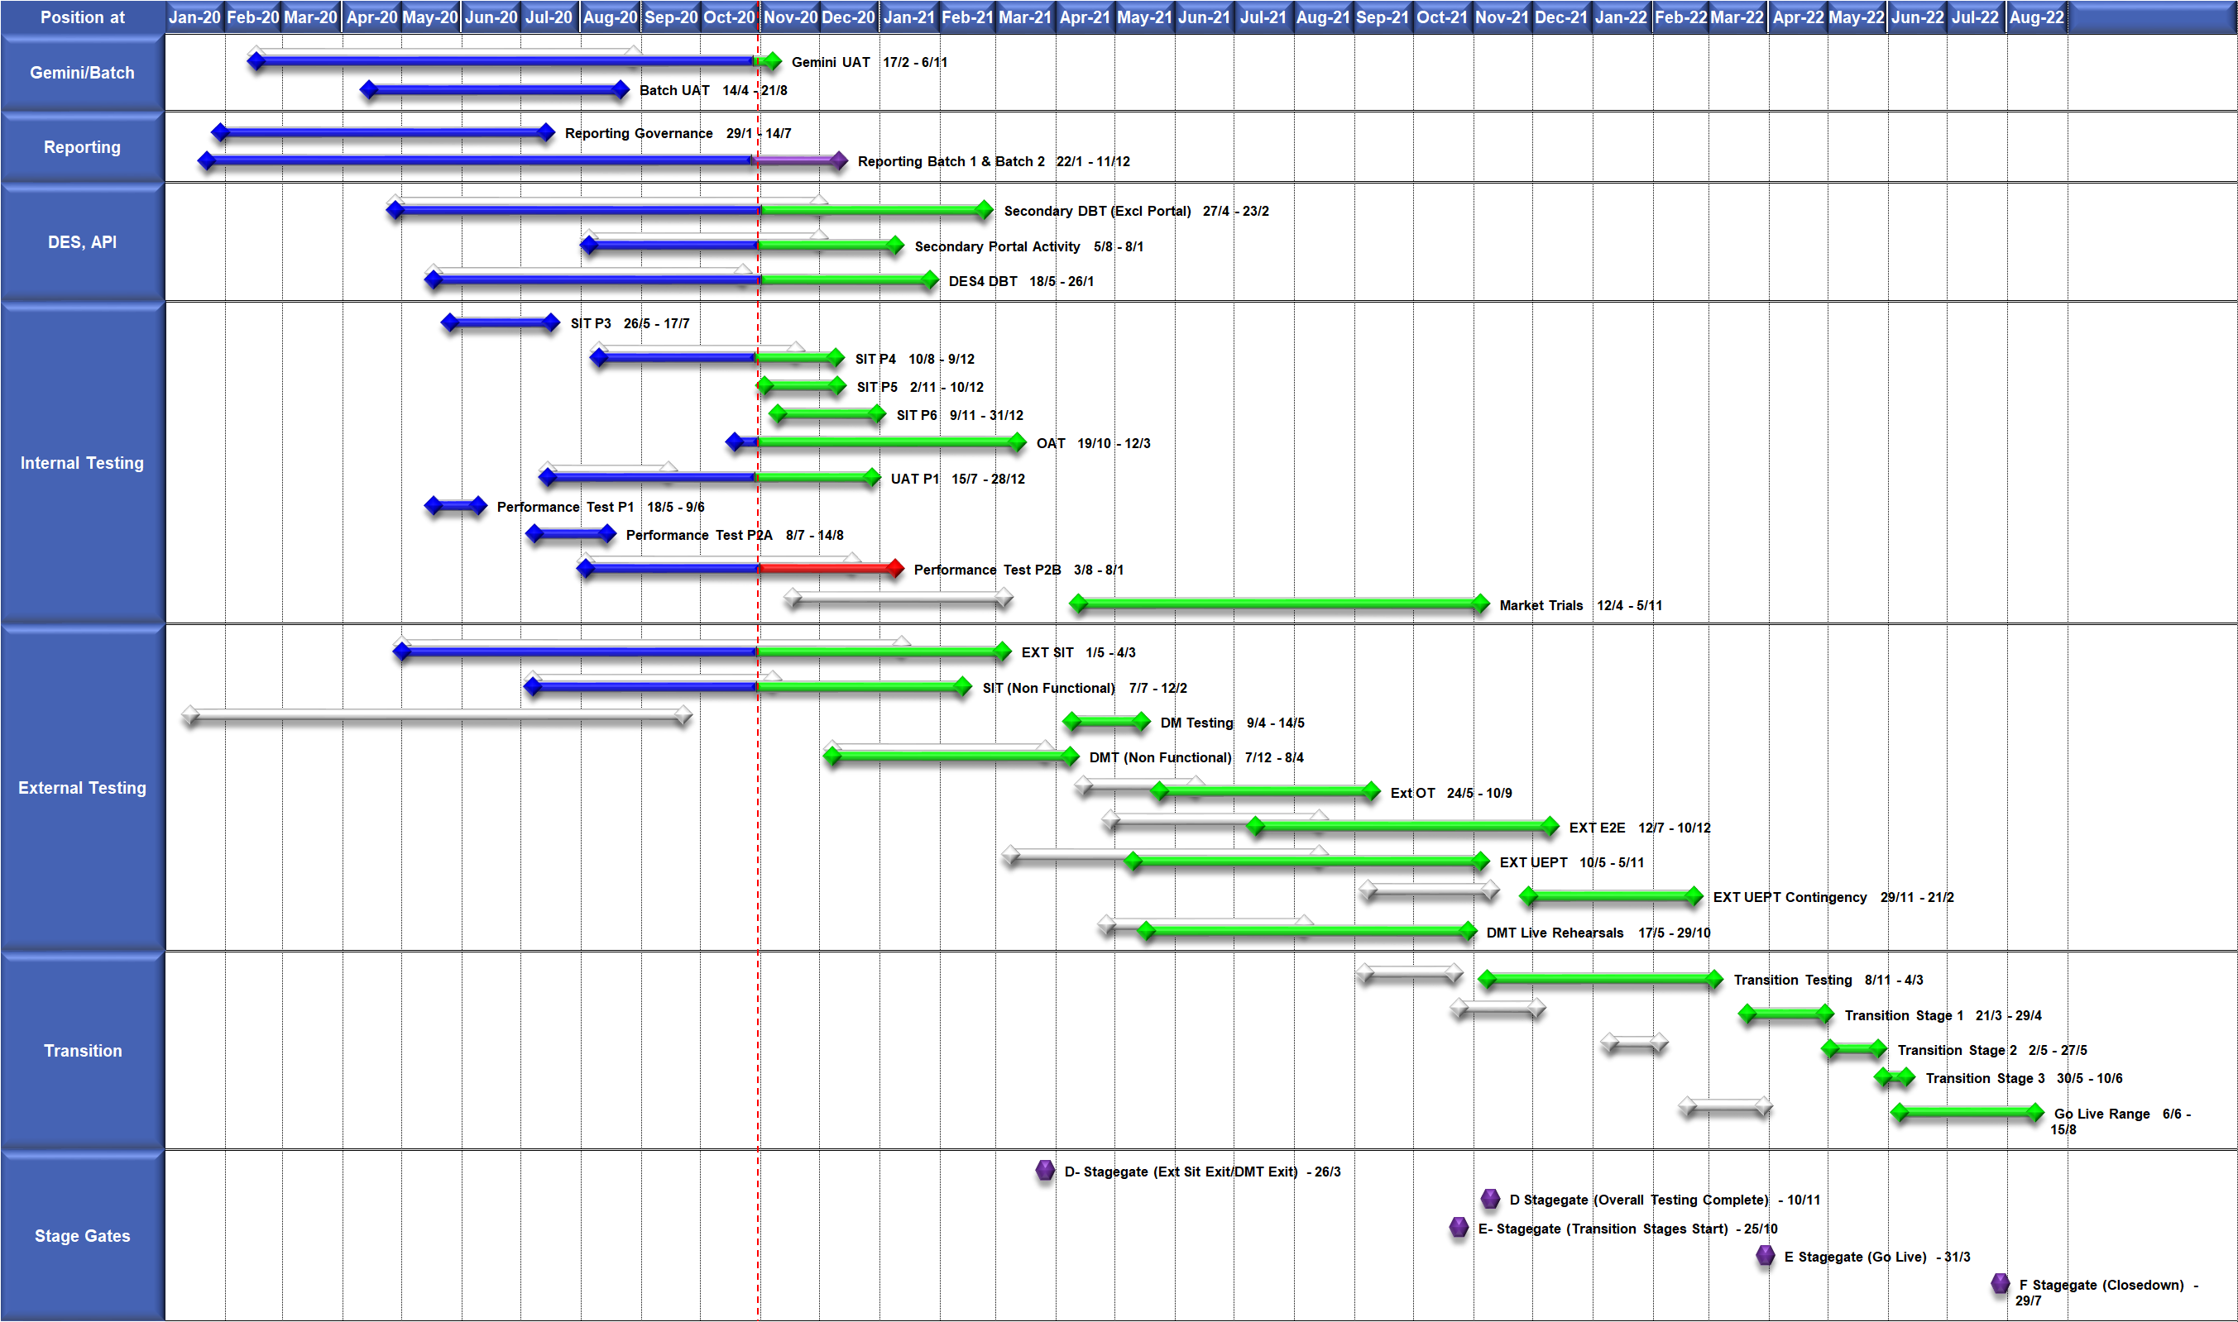
High Level Plan

Slide 71
Switching Programme CR Position – CRs impacting Xoserve
CR Name | CR Ref | High Level Cost IA Cost | Date Raised | Status
Programme Plan Re-Baseline | CR-D002 | £0.00 | 07/11/2019 | Approved - Complete
Updates to the CSS Physical Interface Design (PhID). | CR-D008 | £17,250.00 | 22/01/2020 | Approved - Internal CR Created
CSS_Exception_Handling_Strategy_v0.2 | CR-D014 | £0.00 | 26/02/2020 | Approved - Internal CR Created
Provide_CSS_RegistrationID_to_PUI_and_LPs | CR-D016 | £12,643.00 | 07/08/2020 | Approved - Internal CR Created
Licence Exempt Network Customer Identifier – ABACUS Data Model update | CR-E51 | £0.00 | 29/10/2019 | Approved - Complete
Amendments to the DMS artefact suite | CR-D019 | £6,500.00 | 16/03/2020 | Approved - Internal CR Created
Migration of Terminated Gas RMPS | CR-D022 | £0.00 | 10/06/2020 | Approved - Internal CR Created
Amendments to the NC-0079 for REL (Retail Energy Location) Data Migration and Reconciliation | CR-D024 | £20,000.00 | 06/07/2020 | Approved - Internal CR Created
DMS - PHID Alignment Parties | CR-D026 | £0.00 | 06/07/2020 | Approved - Internal CR Created
Request For a New or Upgraded DMT Environment | CR-D027 | £256,009.00 | 07/08/2020 | Approved - Internal CR Created
Enable TLS connection pooling for all directly connected parties to CSS] | CR-D028 | £2,500.00 | 13/07/2020 | Approved - Internal CR Created
Message Header Format for PKI Certificate Identification] | CR-D029 | £2,500.00 | 13/07/2020 | Approved - Internal CR Created
SIT Functional Test Re Plan Enabling Parallel Testing | CR-D030 | £56,000.00 | 20/07/2020 | Approved - Internal CR Created
DM_Validation Catalogue_Shipper_Effective_Date_Change_ | CR-D032 | £0.00 | 03/08/2020 | Approved - Internal CR Created
Compression During Data Migration | CR-D034 | £500.00 | 09/09/2020 | Approved - Internal CR Created
Uplift to the CSS Interface Specifications | CR-D038 | £70,000.00 | 07/10/2020 | Approved - Internal CR Created
Uplift to Business Data Validation Rules | CR-D039 | £20,000.00 | 25/09/2020 | Approved - Internal CR Created
Programme Plan Re-Baseline | CR-D042 | £14,913,000.00 | 28/09/2020 | Approved - Internal CR Created
Additional Onward Dependencies for MAD Log | CR-D053 | £0.00 | 18/12/2020 | Pending PIA
Changing from GetOrganised to Landmark SFTP for SI receiving files | CR-D054 | £0.00 | 18/12/2020 | Pending PIA
Amendments to the Data Cleansing Catalogue | CR-D055 | £0.00 | 18/12/2020 | Pending PIA

Slide 72
Switching Programme CR Position – CRs not impacting Xoserve
CR Name | CR Ref | High Level Cost IA Cost | Date Raised | Status
Non_Mandatory_MPAS_Metered_Indicator_v0.4 | CR-D001 | £0.00 | 27/01/2020 | Complete - No Xoserve Impact
REC Manager Procurement Timelines | CR-D003 | £0.00 | 02/12/2019 | Complete - No Xoserve Impact
MPAS Related MPAN Disconnection | CR-D004 | £0.00 |  | Withdrawn
Introduction of Validation Message to Logical Mode | CR-D005 | £61,000.00 | 25/11/2019 | Withdrawn
Modification of Related MPAN Cleanse Checkpoint Milestones | CR-D006 | £0.00 | 27/11/2019 | Complete - No Xoserve Impact
ABACUS Corrections and Re-alignments | CR-D007 | £0.00 | 04/12/2019 | Complete - No Xoserve Impact
ECOES REL API Webmethod | CR-D009 | £0.00 | 17/12/2019 | Complete - No Xoserve Impact
CSSIA Uplift to Implement IG Recommendations | CR-D010 | £0.00 | 17/12/2019 | Complete - No Xoserve Impact
Update 3 E2Es to align to CSSIA | CR-D011 | £0.00 | 10/06/2020 | Complete - No Xoserve Impact
CSS_Physical_Interface_Design_Updates_mpxn_v0.2 | CR-D012 | £0.00 | 30/01/2020 | Complete - No Xoserve Impact
Messaging_Requirements_Revisions_REC_Code_Manager_and_CSS_v0.1 Clean | CR-D013 | £0.00 | 28/01/2020 | Complete - No Xoserve Impact
Amendment_of_Xoserve_Consequential_Change_Milestone_Delivery_Dates_v0.2[DRAFT] | CR-D015 | £0.00 | 26/02/2020 | Withdrawn
CSS_Handling_of_MPAS_Business_Dates_v0.2[DRAFT] | CR-D017 | £3,500.00 | 20/07/2020 | Complete - No Xoserve Impact
Confirmation_Responses_to_Outbound_Synchronisations_v0.2[DRAFT] | CR-D018 | £0.00 | 02/03/2020 | Withdrawn
Regulatory Workstream – Programme Milestones Refresh | CR-D020 | £0.00 | 16/03/2020 | Withdrawn
Remove MPAS Interface | CR-D021 | £0.00 | 29/04/2020 | Withdrawn
DSP_Specific_ SIT_ Functional_Exit_Criteria | CR-D023 | £0.00 | 29/05/2020 | Complete - No Xoserve Impact
Changes to support enhanced Solar arrangements | CR-D025 | £0.00 |  | Not Received
CSS Role-based access control (RBAC) | CR-D031 | £48,530.00 | 24/07/2020 | Withdrawn
A Quality Analysis Activity of the Data being used for the DMT Non-Functional Test Phase​​ | CR-D033 | £0.00 |  | Withdrawn
CSS Change from UTC to Local Time | CR-D035 | £0.00 | 22/09/2020 | Complete - No Xoserve Impact
Xoserve CR for DES AI Removal | CR-D036 | £0.00 | 24/09/2020 | Complete - No Xoserve Impact
Provide_CSS_RegistrationID_to_LPs | CR-D037 | £0.00 | 06/10/2020 | Complete - No Xoserve Impact
UEPT Tranche Regulatory Change | CR-D040 | £0.00 | N/A | Complete - No Xoserve Impact
NCT-0073 Functional Script Master Changes | CR-D041 | £0.00 | 25/09/2020 | Complete - No Xoserve Impact
Update to the End to End Testing Plan | CR-D043 | £0.00 | 05/10/2020 | Complete - No Xoserve Impact
Request For a New DMT Environment for DMT Live Rehearsal | CR-D044 | £0.00 | 23/10/2020 | Complete - No Xoserve Impact
NC-0079 Adding Post Load Integrity Check Document | CR-D045 | £0.00 | 09/11/2020 | Complete - No Xoserve Impact
Uplift to the Code of Connection | CR-0046 | £0.00 | 09/11/2020 | Complete - No Xoserve Impact
Correctional Changes to MAD Log v2.0 & POAP v2.0 | CR-D047 | £0.00 | 13/11/2020 | Complete - No Xoserve Impact
Changes to Data Milestones in MAD Log v2.0 & POAP v2.0 | CR-D048 | £0.00 | 09/11/2020 | Complete - No Xoserve Impact
Consequential Changes to Testing Milestones in MAD Log | CR-D049 | £0.00 | 13/11/2020 | On Hold
CSS Environments for Faster Switching Enduring Service | CR-D050 | £0.00 |  | Withdrawn
Changes to Data Validation Rules | CR-D051 | £0.00 | 30/11/2020 | Complete - No Xoserve Impact
Additional and Further Correctional Changes to MAD Log v2.0 | CR-D052 | £0.00 | 05/12/2020 | Complete - No Xoserve Impact

Slide 73
Xoserve IX Refresh
Customer Update
January 2021

Slide 75
Section 6: AOB

Slide 76
DSC Governance Review Group Update
Verbal update to be presented by James Rigby

