Slide 1
2.1 – DSC Change Budget BP20 (Financial Year To Date)

Slide 2
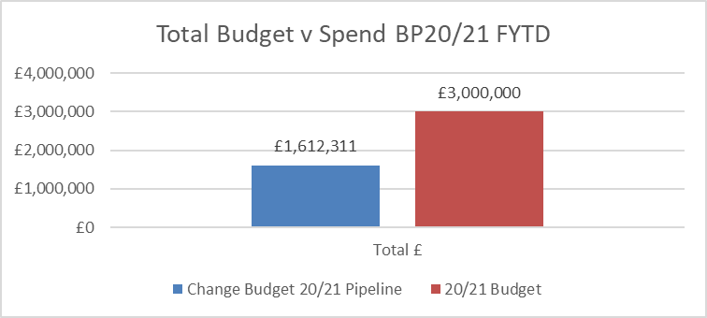
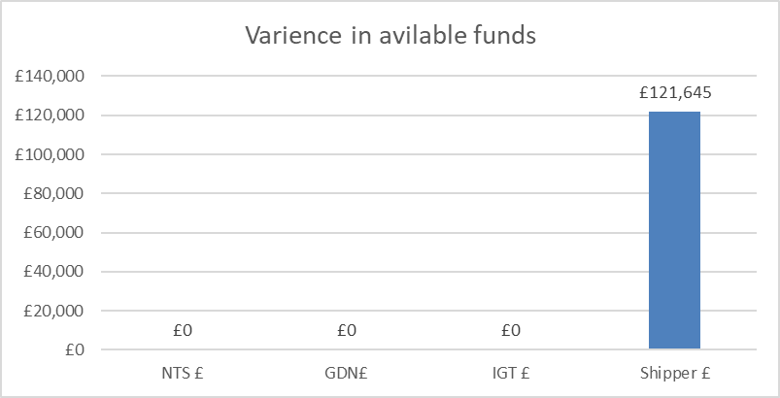
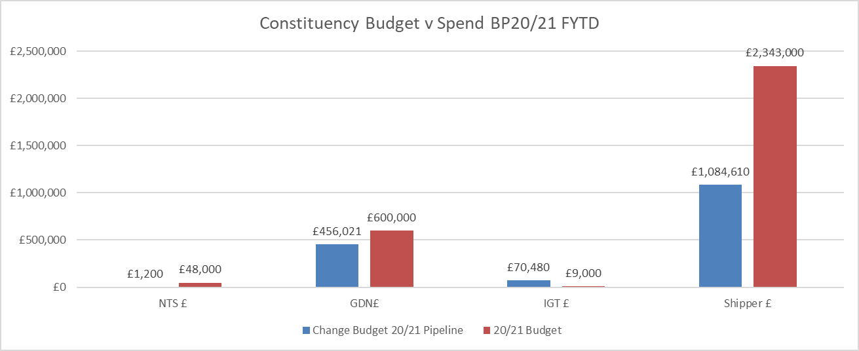
Budget v Spend BP20/21 Financial Year To Date (FYTD)
Available funds have increased by £121k as a result of multiple shipper changes moving through the lifecycle (see 2nd tab in embedded s/s)
Costs for next FY (where known) have been added to s/s

