Slide 1
CMS Rebuild Update
February Updates
Jo Williams

Slide 2
CMS Rebuild - Progress to date
Summary of progress to date
CMS is a dated system which is coming to end of life support, rather than a lift and shift of current processes the project team wanted to understand the following from the actual users of CMS perspective: What are their current processes and activities What are their current pain points What would their ideal version of the process be 18 External Initial Requirements Workshops have been held to date 482 requirements captured, this figure may include duplication and may increase as we refine and expand on the requirements Common themes include: Customer Effort System functionality Visibility All Workshop outputs have been published here: https://www.xoserve.com/systems/contact-management-service/contact-management-service-cms-rebuild-project/ Potential Suppliers are being engaged to understand high level requirements to obtain figures and timescales for High Level Solution Options Internal recommended "to be" workshops have commenced to understand what systems the solution will need to integrate with
Next Steps
Refine the requirements which will be: Remove duplication Add our understanding to the requirements and ratify with customers Understand areas of conflict in requirements Continue internal and schedule external recommended “To Be" workshops Identify possible solutions and seek approval on solution and design from: CoMC ChMC DSG
Key Milestones | Due
Initial Workshops Completed | 22/01/2021
To Be Workshops Commence | 08/02/2021
HLSO – Target Date | March

Slide 3
Dependencies & Potential Consequential Impacts
Whilst the project is still in Capture, we are liaising with teams across Xoserve to understand the Change Horizon and the relationships between any architecture, projects inflight / on the horizon to CMS Rebuild.
Teams have been engaged to understand what impact/potential dependencies CMS Rebuild will have. With the POC completed and closed down externally, the next steps for Retro Mod 0651 discussion is likely to take place in 2021 and we shall continue to liaise to understand impacts.
CCSC & REC
We are discussing with the representatives from both CSSC and REC to understand the impacts, this is including reviewing the revised schedules and understanding any consequential opportunities or impacts on the CMS Contact codes.
CMS Rebuild
Retro
CSSC
REC
DDP
TOG
CRM
UKlink
Website
UKlink
The TOG Modification is being included in all requirement clarifications and considerations to ensure that this is not missed
UKLink releases for June and November have no CMS changes included and the respective Project Managers will continue to be informed of progress
CMS Rebuild Project Team are also engaged within the Website Project to ensure any output will be consistent
Internal architecture conversations have commenced to identify if there are systems / software within Xoserve’s infrastructure that CMS Rebuild can utilise; UK Link, DDP, Pega etc

Slide 4
The Workshop Figures at Initial Refinement*
18 External Workshops
3 Internal
Generic / Process | No. Reqs
Process | 82
Process/System | 96
System | 301
TBC | 3
Grand Total | 482
Duplication &
Non Requirements
removed
Generic / Process | No. Reqs
Process | 65
Process/System | 64
System | 166
TBC | 3
Grand Total | 298
Categorised
Category | No. Requirements
Alignment with other deliveries | 5
Auto populate | 7
Bulk upload | 5
Clarity | 13
Conflict | 40
Contact third Party | 10
DDP | 4
GDPR | 1
MI | 20
Migration | 2
NFR | 13
Process Improvement | 76
System Responses | 18
Training | 9
User Entry | 44
User Experience | 31
Grand Total | 298
Alignment With other deliveries
“aligning to CSSC Deliverables and not missing a trick”
Auto Populate
“Auto fill address details from postcode/MPRN.”
Bulk Upload
“Continue with the ability to upload multiples i.e. QMP file.”
Conflict
“Could we remove MNC process and use the FOM process in its entirety instead? .”
Contact Third Party
“Portal to allow for more two way/ multi conversations between suppliers and Xoserve to aid resolution of the address issue
“
Process Improvement
“Validation before changing an address - LDZ / Network / even a couple of streets. It reduces the safety issue of losing track of live supply“
User Entry
“The functionality to provide and display the meter location when updating addresses”
User Experience…
“Search Function”, “Audit Trails”, “ability to drill down”
* These figures are at Initial refinement, which may change after further understanding from requirements is obtained

Slide 5
Generic Ideal State Journey’s
I want to raise a contact - drafted
I want to search for a status of a contact - drafted
I receive an Xoserve generated Contact– In Progress
I have a PSC (Previously Submitted Contact) – In Progress
Xoserve require more information from me via a DC (Data Clarification)
I need to talk to other parties (UNC & potential non UNC)– yet to be started
* four processes could be managed through the query process due to rarity (low volumes) and complexity

Slide 6
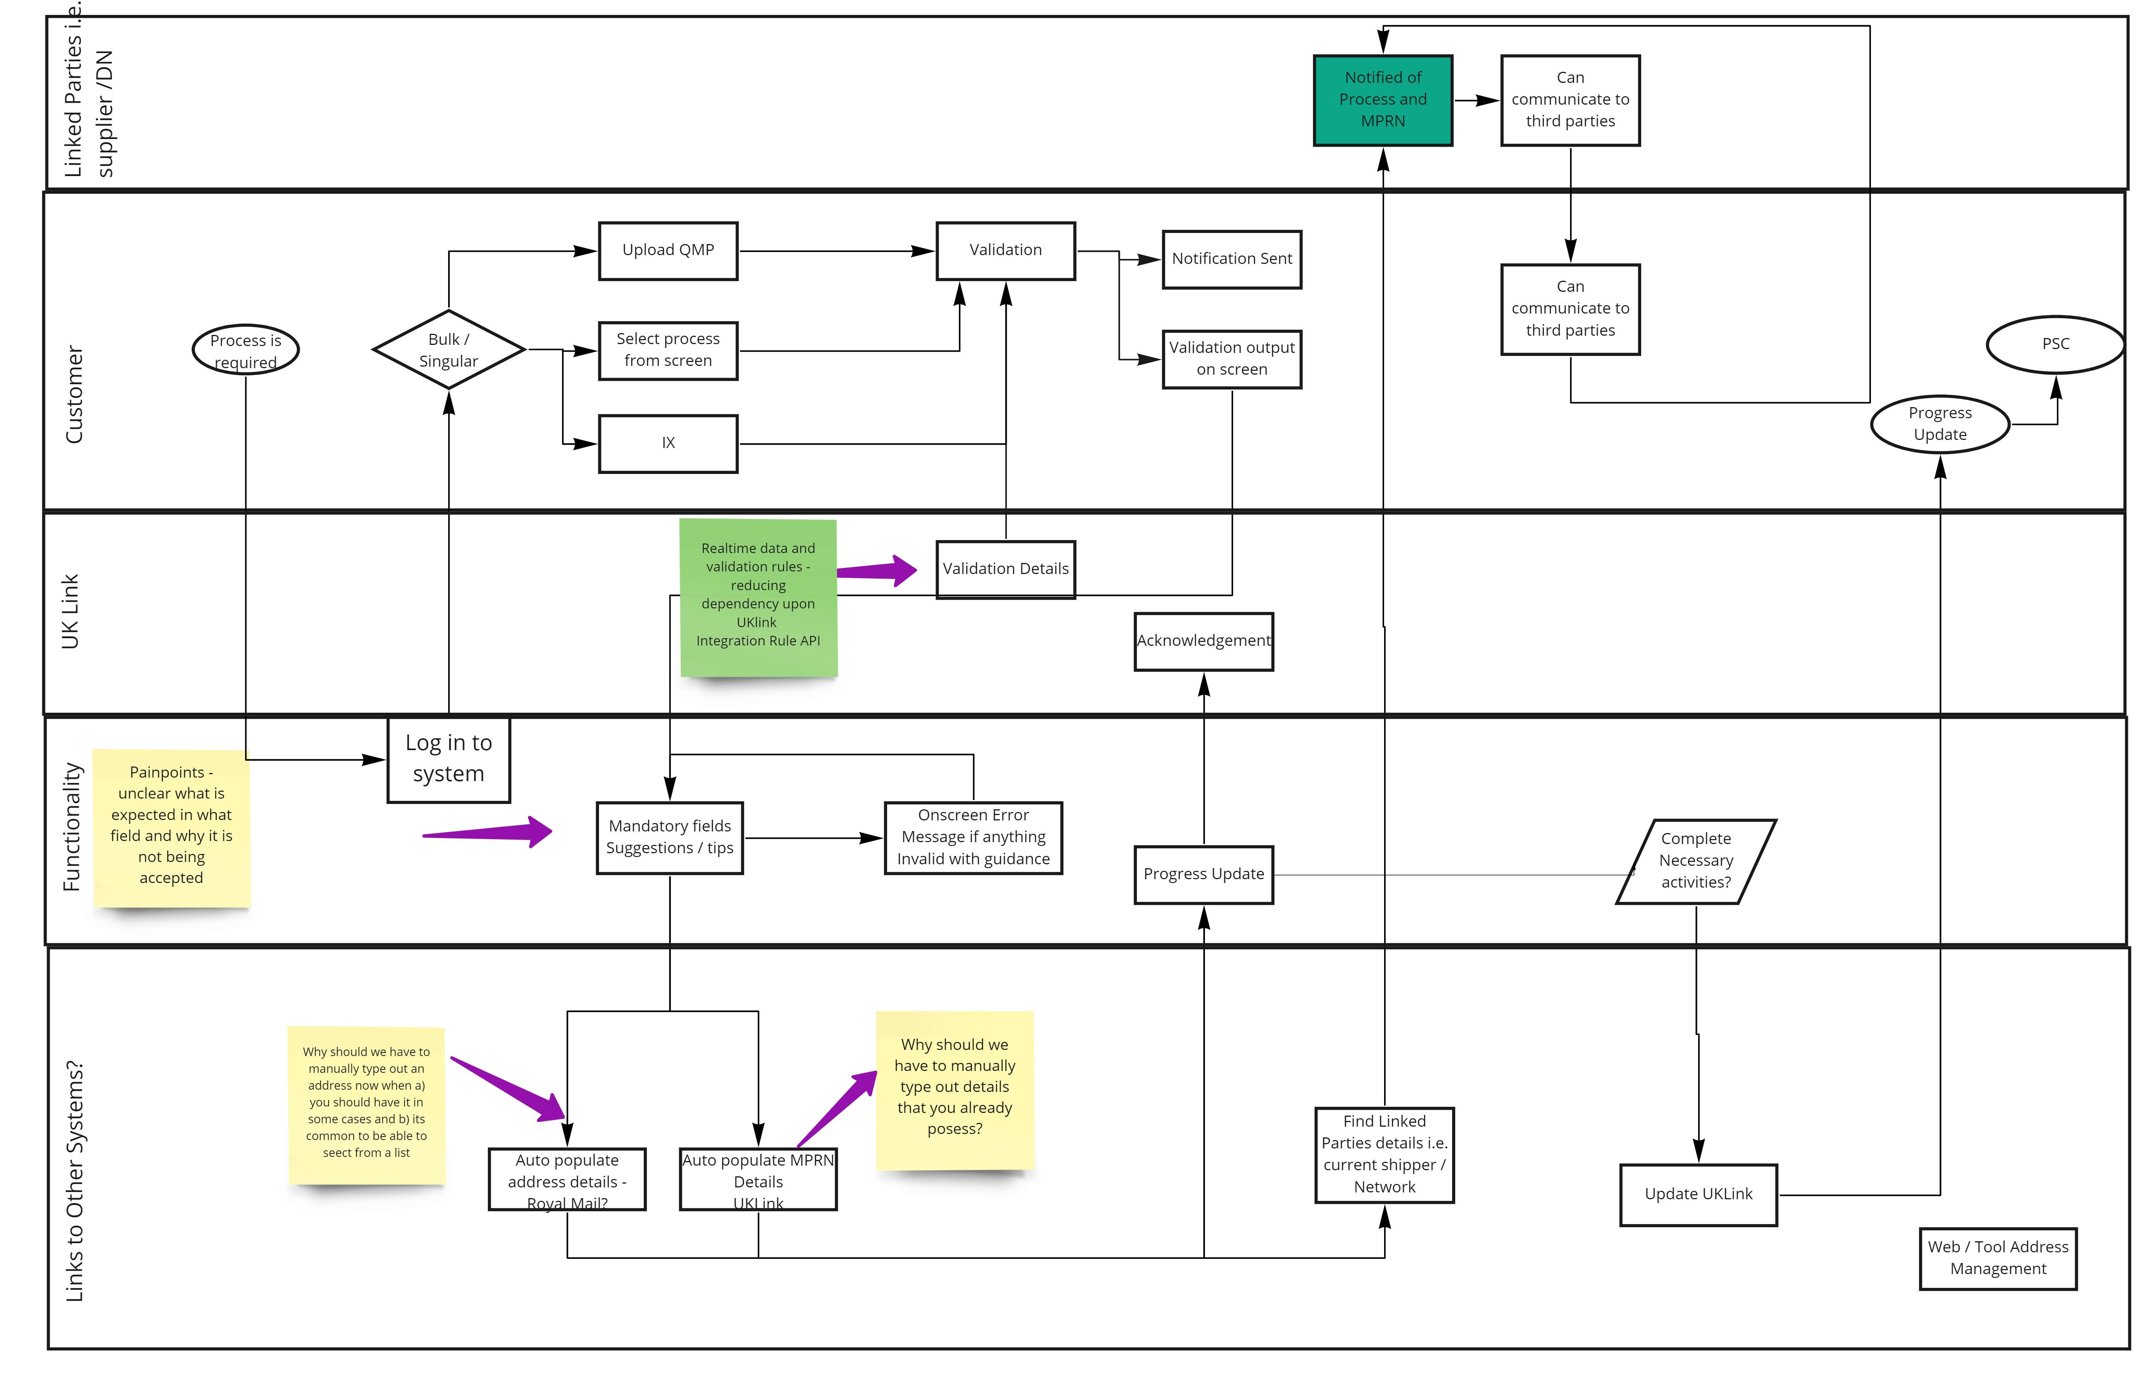
I Want To Raise A Contact – Generic DRAFT
First draft of raising a contact at high level, majority of the processes will follow this generic path

Slide 7
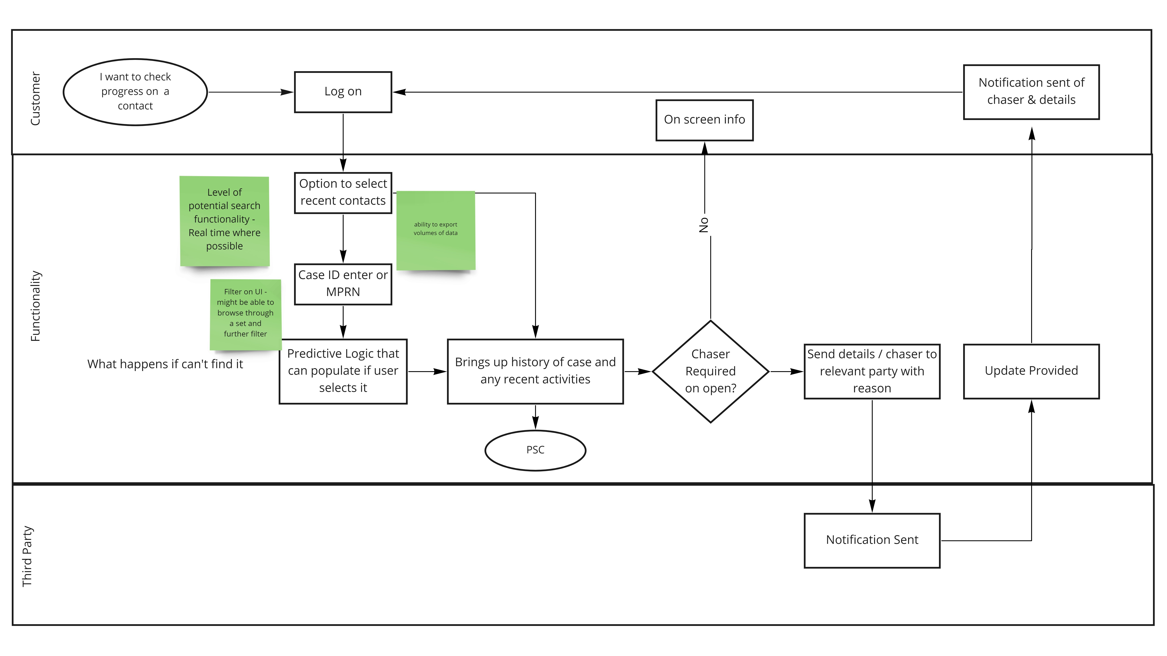
I Want To Search For a Status Update – Generic - DRAFT
First draft of the generic searching for a status update. Tried to incorporate requirements such as:
- clear visibility
- not person specific
- ability to send notifcations

Slide 8
CMS Rebuild Next Steps
Dec | Jan | Feb | March
Painpoint & Req Workshops
It is currently unclear if there is any misalignment on the To be solutions across the processes and these may require several iterations to come to an agreed approach.
Hints & Tips Refreshers published
Internal “To Be” Solution Options
External “To Be” Solution Options
Overall Agreement of “To Be” processes
Progress published – Website, CoMC and DSG
Commentary
Workshops to date have recieved great feedback to date and the findings are consitent accross the board
Completed
On Track
At Risk

Slide 9
Appendix

Slide 10
Requirements captured per process Workshop
Row Labels | ADD | Cons Ad | DUP | FOM | GSR | ISO/DTL | MNC CMS | MNC Off | MUR | MUS | TOG | Grand Total
Alignment with other deliveries | 3 |  |  | 1 |  |  |  |  |  |  | 1 | 5
Auto populate | 1 | 1 |  | 1 |  |  |  | 3 |  |  | 1 | 7
Bulk upload | 2 |  |  |  | 2 |  |  |  |  |  | 1 | 5
Clarity | 1 | 2 |  | 1 | 4 | 1 |  | 1 | 1 |  | 2 | 13
Conflict | 5 | 3 | 3 | 2 | 8 | 1 | 4 | 7 | 3 | 1 | 3 | 40
Contact third Party | 3 |  | 1 |  | 1 |  |  | 2 | 1 | 1 | 1 | 10
DDP |  |  |  |  | 1 |  |  |  | 2 | 1 |  | 4
GDPR |  |  |  |  |  |  |  | 1 |  |  |  | 1
MI | 14 | 1 | 1 | 1 | 1 |  |  |  | 1 |  | 1 | 20
Migration |  |  |  |  |  |  |  |  |  |  | 2 | 2
NFR | 3 |  |  | 1 | 1 | 2 |  |  |  | 2 | 4 | 13
Process Improvement | 26 | 5 | 7 | 8 | 9 | 1 | 1 | 4 | 1 | 4 | 10 | 76
System Responses | 8 | 2 |  |  | 6 | 1 |  |  |  |  | 1 | 18
Training | 2 | 1 |  | 1 | 1 | 3 |  |  |  |  | 1 | 9
User Entry | 16 | 4 | 3 | 1 | 5 | 4 | 1 | 1 | 3 |  | 6 | 44
User Experience | 10 | 3 |  |  | 3 | 3 | 2 | 5 |  | 2 | 3 | 31
Grand Total | 94 | 22 | 15 | 17 | 42 | 16 | 8 | 24 | 12 | 11 | 37 | 298
Many of the requirements gathered cover all the processes, with only a few being Process specific
We are currently refining these requirements so these figures may change after further understanding is obtained

Slide 11
Customer Usage of CMS
Triggered by Customer raised contacts
Contact | Description | 2017 | 2018 | 2019 | 2020 | 2021 | Grand Total
ADD | A challenge to the address that we hold on the UK-Link system which you consider is in line with a PAF valid format and improves the recorded address. | 96,415 | 190,139 | 280,214 | 228,561 | 611 | 795,940
AGG | A challenge where a Shipper believes that a Twin Stream Meter is/is not situated but not reflected on UK Link. | 10 | 2 | 1 |  |  | 13
CDQ | A challenge to the consumption, for a large supply point, as a consequence of incorrect reading data (Bundled / Unbundled) being recorded on UK-Link | 480 | 1,235 | 2,244 | 51 |  | 4,010
DMQ | A request for the Daily Meter Service Provider to investigate the daily read / consumption information or daily read equipment. | 178 | 296 | 75 | 86 |  | 635
DMR |  |  | 3 |  | 3 |  | 6
DTL |  | 999 | 1,488 | 1,290 | 1,521 |  | 5,298
DUP | A challenge that informs us that a single service pipe has more than one MPRN recorded on UK Link. | 1,780 | 2,557 | 2,031 | 1,104 |  | 7,472
FLE |  | 1 | 1 | 3 | 2 |  | 7
FOM |  | 50,560 | 81,764 | 70,324 | 60,320 |  | 262,968
GSR | A contact is raised following Network investigation, concluding a service is still live at the property, with a meter attached and possibly flowing Gas. | 2,530 | 2,387 | 1,391 | 1,228 |  | 7,536
ISO | A challenge to the status of a Supply Meter Point (Service Pipe) | 3,336 | 7,207 | 5,167 | 7,482 | 2 | 23,194
MNC |  | 42 | 418 | 683 | 1,300 | 1 | 2,444
PRS | A challenge to the link code currently held on UK Link for a freestanding meter or a prime and sub meter configuration. | 252 | 211 | 163 | 118 |  | 744
PSI | A challenge to charges received for a prime or sub meter |  |  |  | 1 |  | 1
RFA | A request for adjustment in accordance with late Meter Exchanges / Corrective Exchanges and Incorrect Correction Factors. | 2,233 | 6,241 | 19,466 | 24,382 | 47 | 52,369
TOG | The Theft Of Gas (TOG) process is a mechanism to record and facilitate the investigation of theft allegations and where appropriate recover charges | 3,731 | 8,965 | 7,575 | 5,221 | 23 | 25,515
UNC | Unconfirmed Address Amendment - A Contact challenging the address or postcode details of a site held on UK Link that is currently unconfirmed | 10,392 | 19,941 | 35,977 | 36,936 |  | 103,246
Grand Total |  | 172,939 | 322,855 | 426,604 | 368,316 | 684 | 1,291,398
Snapshot of CMS data as of 22/01/21
Triggered by System raised contacts
Contact, |  | 2017 | 2018 | 2019 | 2020 | 2021 | Grand Total
MUR | When a Meter Reading has not been provided by the Registered Users within the agreed timeframes | 75,553 | 85,780 | 105,552 | 85,475 |  | 352,360
MUS | Manage Unregistered Sites - An MUS contact is raised for every Meter Point Reference Number which has reached the anniversary of its creation date, remains Unregistered and has a Meter Point Status of LI. | 8,209 | 12,334 | 13,507 | 12,097 | 818 | 46,965
Grand Total |  | 83,762 | 98,114 | 119,059 | 97,572 | 818 | 399,325
Indicates potential descoping from CMS Rebuild and managed via Query route or decommissioned

