Slide 1
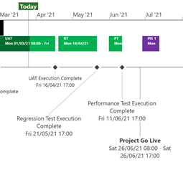
XRN5253 June 21 Major Release - Status Update
 | Overall Project RAG Status
 | Schedule | Risks and Issues | Cost
RAG Status
Status Justification
Schedule | Project On Track System Testing Completed, UAT in Progress, Regression Testing due to commence on 19th April Project Cutover date will be 26th June as per baselined plan, contingency date will be 3rd July Post Implementation Support dates agreed in principle following discussion and agreement on requirements for 1st usage coverage; due to be baseline in April Decision In April ChMC None
Risks and Issues | There is a risk that we cannot define a contingency Go Live date because of the Gemini code freeze which starts on 28th June 2021 leading to a significant delay to Go Live in the event that our original Go Live date cannot be achieved Update: Agreement reached with Gemini team to utilise 3rd July as a contingency date following code analysis exercise. Risk to be closed
Cost | Forecast costs to complete within approved BER
Scope | In Scope (XRN50930 - MOD0711 – Update of AUG Table to reflect new EUC bands Descoped (XRN4992) - MOD0687 – Creation of new charge to recover last resort supply payments – Descoped at Extraordinary ChMC on 26th October 2020 Descoped (XRN4941) - MOD0692 - Auto updates to meter read frequency – Descoped at ChMC on 11th November 2020
Slide updated on 26th March 2021

