Slide 1
XRN5289 - November 21 Release - Status Update
 | Overall Project RAG Status
 | Schedule | Risks and Issues | Cost | Resources
RAG Status
Status Justification
Schedule | Design workshop plan has commenced XRN4941, XRN5142 and XRN5007 have completed its design awaiting final document approvals CSSC/CSS impact assessment timeline and requirements is approved Plans to bring 3 changes change packs for approval 1 month earlier than originally planned High Level Design has been approved by Design Review Board (DRB)
Risks and Issues | RISK – Not a full 6 months before implementation date for design change pack approval Requesting E-ChMC on the 5th May for the remaining changes RISK - XRN5142 - Unknown plans from DCC on their plan of delivery and design Regular touch points with DCC to understand their plan and design have been set up RISK - XRN4941 – CR raised to change the definition of the Operational Smart Meter to only consider a DCC Service Flag of active. Current design considers meter mechanism code and installing Supplier – this has been shared with DSG – please find presentation that was submitted to DSG for further information in the appendix slide. – delay to the timeline for design for this change only Xoserve to follow the internal change control process
Cost | EQR approved by ChMC on the 13th January 2021
Resources | Resource Forecasts and Plans until the end of design have been defined and approved SME resource has been provided for design, approach for technical SME resource to support design has been agreed
Updated as of 24th February 2021

Slide 2
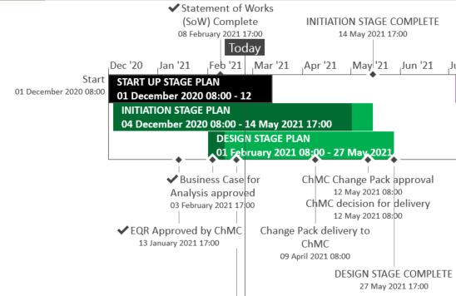
XRN5289 – November 21 High-Level Plan
Updated as of 24th February 2021

Slide 3
For Information Only
Presentation to DSG on XRN4941 Operational Smart Meter Criteria on the 22nd February 2021
Updated as of 24th February 2021

Slide 4
XRN5289 - November 21 Release Summary
The initial scope of the November 2021 Major Release consists of 8 changes
In Scope
XRN4941 - MOD0692 - Auto updates to meter read frequency
XRN5007 - Enhancement to reconciliation process where prevailing volume is zero
XRN5072 - Application and derivation of TTZ indicator and calculation of volume and energy – all classes
XRN5091 - Deferral of creation of Class change reads at transfer of ownership
XRN5142 - New allowable values for DCC Service Flag in DXI File from DCC
XRN5180 - Inner tolerance validation for replacement reads and read insertions
Out of Scope
Approved to removed from 13th January 21 ChMC
XRN5186* MOD0701 – Aligning capacity booking under the UNC and arrangements set out in relevant NExAs
XRN5187* MOD0696 – Addressing inequalities between capacity booking under the UNC and arrangements set out in the relevant NExAs
Updated as of 24th February 2021

