Slide 1
Change Management Committee
7th April 2021

Slide 2
Section 2: DSC Change Budget & Horizon Planning

Slide 3
2.1 – DSC Change Budget 20/21 (Financial Year To Date) & 21/22

Slide 4
Budget v Spend BP20/21 Financial Year To Date
Total available funds have decreased by £600 as a result of 3 changes moving through the lifecycle (see 2nd tab in embedded s/s for details)
Position as of March-21
A full reconciliation of the 20/21 budget will be presented in May ChMC
Link to download the latest ChMC Change Budget document

Slide 5
Budget v Forecasted Spend BP21/22
Total available funds decreased by £45k as result of XRN5218 being moved to 21/22
Previous slide contains document

Slide 6
2.2 – Change Pipeline

Slide 7
Change Development & Delivery Pipeline (DSC Change / Minor Release Budget)
* Pre-capture may contain changes that won’t require delivery / funding

Slide 8

2020-2022 DSC Change / MiR Pipeline
2020 | 2021 | 2022
Sep | Oct | Nov | Dec | Jan | Feb | Mar | Apr | May | Jun | Jul | Aug | Sep | Oct | Nov | Dec | Jan | Feb | Mar | Apr | May | Jun | Jul | Aug
Nov 20
CCR
Governance Approvals Key
Approval on track
Jun 21
EQR
BER
Scope Approved – August ChMC
CCR
Approved
Nov 21
Scope / EQR
BER
CCR
Approval at risk
MiR 8
CCR
Project RAG Key
Not Started
MiR 9
Scope
CCR
Complete
MiR 10
Scope
CCR
On Track
MiR
11
Scope
CCR
Potential risk to plan
Stand Alone
XRNs
5167
XRNs
4645
5164
XRNs
5183
XRNs
5206
5237
XRNs
5146
XRNs
5038
XRNs
5143
5218
XRNs
5120
Plan At Risk
Xo CF
CP / BER
CCR
Non-DSC / MiR
PAC
XRNs
4876
CP / BER
CCR
CCR
CSSC
XRNs
4780c
Activity
Retro
Potential Activity

Slide 9
Section 3: Capture

Slide 10
4.1 New Change Proposals – Initial Review
XRN / Title | Voting |  |  |  | DSC Service Area
 | Shipper | DNO | IGT | NTS
XRN5345 Deferral of creation of Class change reads for DM to NDM and NDM to DM sites at transfer of ownership | X |  |  |  | Service Area 5: Metered volume and quantity
XRN5321 CMS Rebuild | Information Only |  |  |  | N/A

Slide 11
XRN5345 Deferral of creation of Class change reads for DM to NDM and NDM to DM sites at transfer of ownership
Voting Parties
Change Details
Customer Class | Voting Party?
Shipper | X
Distribution Network Operators (DNOs)
National Grid Transmission
IGT’s
Problem Statement
Shippers are not provided with an Opening Read window when a Change of Class and Shipper occurs at the same time. This means that where an actual transfer reading has been obtained it is more complex for the incoming Shipper to get this reading accepted, which can impact their ability to invoice the end consumer with the correct read. CDSP reject potentially valid opening reads where there has been a Class change on transfer date.
DSC Service Area: | Service Area 5: Metered volume and quantity
Link to Change Proposal | Link to CP
Change Description
This change will, in the analysis period, assess each of the scenarios of migration from one Class to another which involve a Class change from DM to NDM and vice versa and understand the current volumes associated with each scenario. It will make recommendations for changes, if necessary, following assessment with Shippers. Please see the CP for the full description
Change Type | Regulatory
Priority Score | High
Sponsor Representative | Xoserve

Slide 12
XRN5343 CMS Rebuild
Voting Parties
Change Details
Voting
This Change has been given an XRN for reference only, so that customers have a reference point for Change Packs that need industry responses. The CMS rebuild is funded through the investment line, and therefore all governance and approvals will go through CoMC.
Problem Statement
The Contact Management System (CMS) is a dated tool at the end of support, the processes managed within are a source of frustration for customers. There is a desire to rebuild the system and processes rather than replace.
Change Description
This will be a large scale change project that impacts all customers. The scale of opportunity is not yet fully known but the rebuild is targeted to improve quality, delivery and customer effort. The Project Team have commenced Capture under the Change Request XRN5234, this included numerous requirement gathering sessions with customers to understand their requirements and view points.
DSC Service Area: | N/A
Link to Change Proposal | Link to CP
Change Type | Non DSC
Priority Score | Medium
Sponsor Representative | Correla on behalf of Xoserve

Slide 13
section 4. Design & Delivery

Slide 14
Design Change Pack
XRN5007 Correction in the reconciliation process when volume is zero
XRN5072 Application and derivation of TTZ indicator
XRN5142 - New Allowable Values for DCC Service Flag
XRN5122 - Gemini System Enhancements

Slide 15
XRN5007 Correction in the reconciliation process when volume is zero
Functional Changes
Change Pack ref: 2788.2 - MT – PO Release: November 21 Voting: Shippers, DNO Funding: SA5 – 33% Shipper 67% DNO Service Area 5: Metered Volume and Metered Quantity | Solution & Implementation Summary outcome |  |  |  | Comments
 | Organisation | Approve | Defer | Reject
 |  |  |  |  | No Reps received

Slide 16
XRN5072 Application and derivation of TTZ indicator
Functional Changes
Change Pack ref: 2788.3 - MT - PO Release: November 21 Voting: Shippers Funding: SA3 – 100% Shipper Service Area 3: Record, submit data in compliance with UNC | Solution & Implementation Summary outcome |  |  |  | Comments
 | Organisation | Approve | Defer | Reject
 |  |  |  |  | No reps received

Slide 17
XRN5142 - New Allowable Values for DCC Service Flag
Functional Changes
Change Pack ref: 2788.5 - MT – PO Release: November 21 Voting: Shippers, DNO, IGT Funding: SA16 – 100% DNO & IGT Service Area 16: GT and IGT Non Code Direct Service | Solution & Implementation Summary outcome |  |  |  | Comments
 | Organisation | Approve | Defer | Reject
 |  |  |  |  | No Reps received

Slide 18
XRN5122 - Gemini System Enhancements
Functional Changes
Change Pack ref: 2788.4 - MT - PO Release: Adhoc Voting: NTS, Shippers, DNO Funding: 100% NTS Service Area 20: Gemini system services | Solution & Implementation Summary outcome |  |  |  | Comments
 | Organisation | Approve | Defer | Reject
 |  |  |  |  | No reps received

Slide 19
Standalone Change Documents for Approval (BER, CCR, EQR)

Slide 20
Standalone Change Documents for Approval (BER, CCR, EQR)
CCR for XRN5146 Data Cleanse of NExA information within UK Link and the Data Enquiry Service (DES)
  Voting DNO, IGT & Shipper
CCR for XRN5135 DNO and NTS Invoices to Shippers and DNs VAT compliance
  Voting DNO & NTS
CCR for XRN5153 iConversion2 Part 2 (non NG interfaces)
  Voting NTS

Slide 21
Gemini Horizon Plan

Slide 22
June 2020 Lessons Learned

Slide 23
June 20 Major Release - Lessons Learned
Scope & Cost
  The scope of the release was not confirmed prior to the start of design resulting in changes being descoped after design works had already been started.
  The final costs for each of the changes were considerably higher than the initial costs quoted during capture (particularly for xrn4850). The capture process has been revisited to provide T-shirt size costings that aim to accurately reflect the complexity of the changes going forward with the BER providing final costs for scope of delivery.
Non Functional Requirements
  The volume impact, daily limits, managing bulk uploads were not fully identified in the requirements and also this could have been communicated earlier in the process. This caused timeline extensions and additional cost for Shippers who were ready to send bulk CNC files. Xoserve was able to increase the capacity of CNC batch processing enabling processing of larger CNC file volumes per day without impacting BAU processes.
Training
  Positive feedback was received from the industry for the external training provided however it was noted that it is sometimes difficult to target the correct external stakeholders in such sessions therefore limiting the audience. Following Go Live, additional sessions have been held with specific stakeholders.

Slide 24
June 20 Major Release - Lessons Learned
File Formats
  Change Packs and training material to be enhanced to provide best practice examples of file formats. This will also include examples of an incorrect file format where the system would reject and the reasons why
  There were inputs needed or clarification required by Xoserve, which were not available at the start. For example, the CNF file formats (S66 record) were interpreted differently by different Shippers which led to unnecessary rejections immediately following implementation. At the earliest opportunity provide example files to the industry to avoid potential rework
Market Trials
  Shipper participation in Market Trials was discussed at ChMC and DSG and recommended by Xoserve. Had shippers been able to participate in Market Trials to enable cross party testing to ensure all new file formats are fully tested (both submission and response/rejections files), this could have eliminated some of the issues experienced post-go-live
  Network participants praised the Market Trials test phase. They were able to test the new functionality end to end and it gave them the opportunity to identify some additional requirements to improve the service which Xoserve are now assessing. However this test phase was not able to test the CNC shipper file flows which led to issues being experienced post go-live
Other
  The Commercial, Legal, Security and Architecture activities involved in implementing a new service requires far more time and diligence than a standard Major Release timeline allows, therefore if a new service is required in the future, to delivery outside of a major release should be explored

Slide 25
November 2020 Major Release

Slide 26
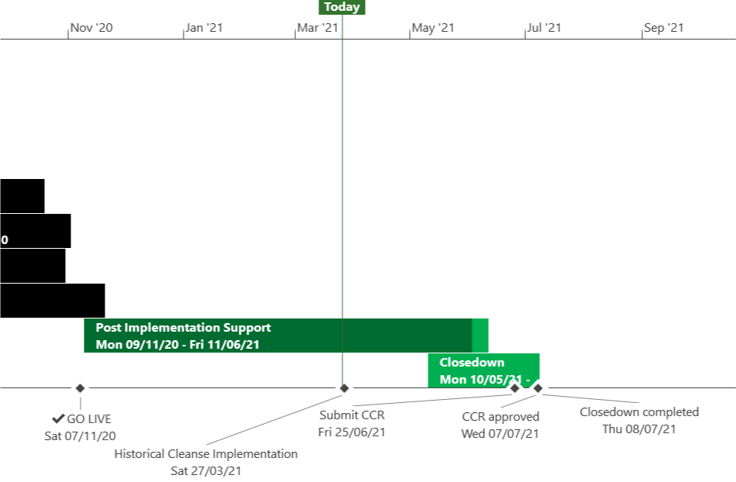
XRN5110 – Nov 20 Release - Status Update
 | Overall Project RAG Status
 | Schedule | Risks and Issues | Cost
RAG Status
Status Justification
Schedule | November 20 Release delivered and final task is Historical Cleanse XRN4897/99 Historical Cleanse to commence on the 27th March, on track to complete to schedule Historical Cleanse expected to run to 4th June CCR to be submitted to July ChMC Decision in April ChMC: None
Risks and Issues | ​Issue: XRN4897/99 Historical Cleanse Change Request needs to be completed to exit Post Implementation Support Risk: Xoserve may be non GDPR compliant following Historical Cleanse due to missing unknown scenarios Return to Green: Completion of XRN4897/99 Historical Cleanse
Cost | Forecast to complete delivery against approved BER
Scope | XRN4897 Resolution of deleted Contact Details (contained within the S66 records) at a Change of Shipper event XRN4899 Treatment of Priority Service Register Data and Contact Details on Change of Supplier Event XRN4801 Additional Information in DES XRN4871b Rachet Regime Changes XRN5014 Facilitating HyDeploy2 Live Pilot Descoped XRN4931 Submission of a Space in Mandatory Data on Multiple SPA Files Descoped XRN4941 MOD 692 – Auto Updates to Read Frequency Descoped XRN4992 Supplier of Last Resort Charge Types Moved to CSSC XRN4870c MAP ID
Slide updated on 26th March 2021

Slide 27
June 2021 Major Release

Slide 28
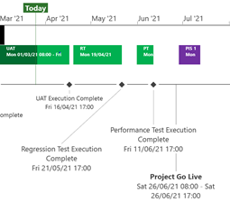
XRN5253 June 21 Major Release - Status Update
 | Overall Project RAG Status
 | Schedule | Risks and Issues | Cost
RAG Status
Status Justification
Schedule | Project On Track System Testing Completed, UAT in Progress, Regression Testing due to commence on 19th April Project Cutover date will be 26th June as per baselined plan, contingency date will be 3rd July Post Implementation Support dates agreed in principle following discussion and agreement on requirements for 1st usage coverage; due to be baseline in April Decision In April ChMC None
Risks and Issues | There is a risk that we cannot define a contingency Go Live date because of the Gemini code freeze which starts on 28th June 2021 leading to a significant delay to Go Live in the event that our original Go Live date cannot be achieved Update: Agreement reached with Gemini team to utilise 3rd July as a contingency date following code analysis exercise. Risk to be closed
Cost | Forecast costs to complete within approved BER
Scope | In Scope (XRN50930 - MOD0711 – Update of AUG Table to reflect new EUC bands Descoped (XRN4992) - MOD0687 – Creation of new charge to recover last resort supply payments – Descoped at Extraordinary ChMC on 26th October 2020 Descoped (XRN4941) - MOD0692 - Auto updates to meter read frequency – Descoped at ChMC on 11th November 2020
Slide updated on 26th March 2021

Slide 29
November 2021 Major Release

Slide 30
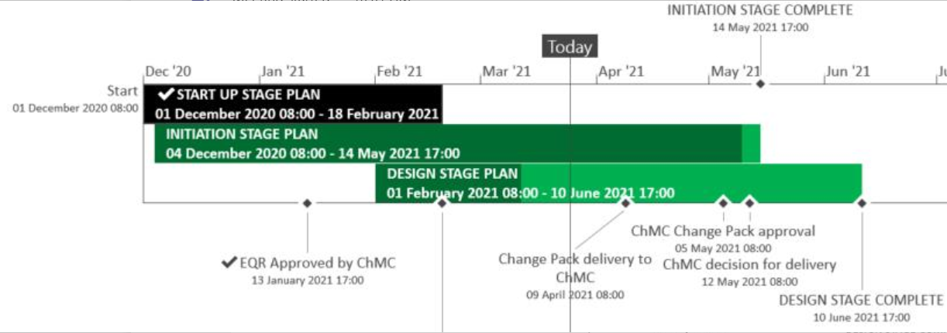
XRN5289 – November 21 Major Release - Status Update
 | Overall Project RAG Status
 | Schedule | Risks and Issues | Cost
RAG Status
Status Justification
Schedule | Design phase on track to complete to current schedule Remaining 3 change packs to be delivered on the 9th April on plan; eChMC arranged for 5th May for approval Attending ChMC on the 12th May, with recommendation for delivery and BER Decision in April ChMC Approved issued change packs (XRN5007, 5072 & 5142)
Risks and Issues | ​RISK (XRN5142) - Unknown plans from DCC on their plan of delivery and design​ for cleanse Mitigation - Regular touch points with DCC to understand their plan and design have been set up; Plan on a page is due shortly also outstanding question on design was due by the 20th April 2021
Cost | Forecast to complete design against approved EQR
Scope | XRN4941 - MOD0692 - Auto updates to meter read frequency​ XRN5007 - Enhancement to reconciliation process where prevailing volume is zero​ XRN5072 - Application and derivation of TTZ indicator and calculation of volume and energy – all classes​ XRN5091 - Deferral of creation of Class change reads at transfer of ownership​ XRN5142 - New allowable values for DCC Service Flag in DXI File from DCC​ XRN5180 - Inner tolerance validation for replacement reads and read insertions​ Descoped - XRN5186 MOD0701 – Aligning capacity booking under the UNC and arrangements set out in relevant NExAs​ Descoped - XRN5187 MOD0696 – Addressing inequalities between capacity booking under the UNC and arrangements set out in the relevant NExAs
Slide updated on 26th March 2021

Slide 31
XRN5294 - Minor Release Drop 9 Update

Slide 32
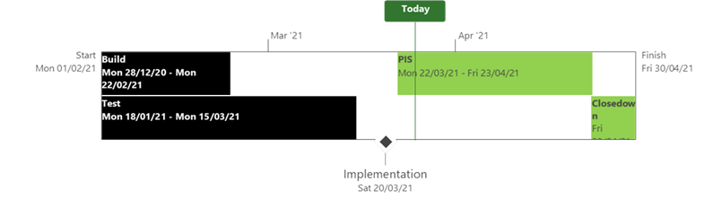
XRN5294 – Minor Release Drop 9 - Status Update
 | Overall Project RAG Status
 | Schedule | Risks and Issues | Cost
RAG Status
Status Justification
Schedule | Implementation successfully completed 20th March Post Implementation Support in progress, on track to complete 23rd April No defects raised First usage has started on plan CCR planned for May ChMC for approval Decision in April ChMC None
Risks and Issues | None Applicable
Cost | On track to complete within approved spend
Scope | There are 2 changes within Minor Release 9: XRN5080 - Failure to Supply Gas (FSG-GSOP1) – System Changes XRN5135 - DNO and NTS Invoice to Shippers and DNs VAT Compliance
Slide Updated on 26th March 2021

Slide 33
XRN5218 Project Update

Slide 35
Section 5: Non-DSC Change Budget Impacting Programmes

Slide 36

CSSC Programme Dashboard
April 2021

Slide 37
Programme Update
Programme Health – RAG |  |  | Return to Green Plan
Overall Programme Status | Previous | Current | The programme remains at a Green status. DMT non functional Cycle 2 testing is on track to complete this Thursday 1st April. Completion of this phase is a key milestone prior to the commencement of Live Rehearsal Testing. Xoserve’s internal Consequential Change test activities have completed this month. This has been an extensive and successful phase with minimal defects but has seen a comprehensive testing programme which included our Programme testing team alongside dedicated business SME’s providing assurance
Programme Plan | Previous | Current
Risk Profile | Previous | Current
Resources | Previous | Current
Executive Summary |  |  |  | Upcoming Activities & Milestones (Next Month)
Key Programme Updates To date, all Xoserve key internal and external milestones have been met Transition: Internal and external preparatory activities continue towards DM Live Rehearsal and Transition test phases. Currently the Programme are progressing CRD-071 which proposes to de-scope In-Flights from the transitional period. SoLR; Discussions continue at Programme level and at ChMC. Internal Testing: Core testing has completed. Change requests are being progressed through internal testing in line with the Switching Programme release cycles and/or milestones. Data Migration: Progressing to plan, Xoserve do have a couple of defects we are tracking through to fix. Presently we are expecting the testing of at least one of the defects to take place during Live Rehearsal. Market Trials: The CR to remove Market Trials has progressed through the Ofgem Change Advisory Team meeting. The CR has now been presented to the Ofgem Testing Workgroups for the relevant milestones to be removed from the Programme Plan. |  |  |  | Live Rehearsal: Commenced smoke testing Internal Test: Progress CR testing and any relevant regression tests DES:& Secondary APIs Continue development and system test activities. Transition: Continue Live Rehearsal & Transition planning SoLR: Discussions continue MAP C: Detailed Design in progress Market Trials: Closure following Switching Programme approval REC: Continue REC schedule review as per Ofgem timelines

Slide 38
Section 6: Any Other Business

Slide 39
APPENDIX

Slide 40
Outages
Change Request Number | Impacted System | Outage Duration |  |  |  |  | Committee Notified Date
 |  | Start Date | Start Time | End Date | End Time | Brief Description
CHG0031092 | Gemini | 15/05/2021 | 03:15 | 15/05/2021 | 08:30 | Gemini Disaster Recovery Test 2021 This is an annual activity to confirm Gemini services can be migrated to a secondary data centre location should there be a catastrophic failure within the primary data centre. During this phase of the test Gemini services will failover from the primary site to the secondary site. The activity starts within the scheduled maintenance window and the system will operate normally during times where there is no outage. | 10/02/2021
CHG0031092 | Gemini | 16/05/2021 | 03:00 | 16/05/2021 | 08:30 | Gemini Disaster Recovery Test 2021 During this phase of the test Gemini services will failback from the secondary site to the primary site. Again the activity starts within the scheduled maintenance window and the system will operate normally during times where there is no outage. NOTE: Contingency dates for these activities are 29th / 30th May | 10/02/2021
CHG0031070 | EFT | 11/06/2021 | 05:00 | 13/06/2021 | 06:00 | EFT Disaster Recovery Test 2021 As part of our annual disaster recovery testing the EFT application will run solely out of our primary and then secondary datacentre locations for a 24 hour period. NOTE: This is an FYI as no outage is expected as under normal conditions the application is configured as active - active across datacentres and the test ensures that the system is capable of running from one datacentre location for an extended period of time by moving services between locations (day 1,2) before resuming full capability across datacentres (day 3) . | New Outage 07/04/2021

Slide 41
Portfolio POAP

Slide 42
CSSC Programme Dashboard
April 2021

Slide 43
Programme Update
Programme Health – RAG |  |  | Return to Green Plan
Overall Programme Status | Previous | Current | The programme remains at a Green status. DMT non functional Cycle 2 testing is on track to complete this Thursday 1st April. Completion of this phase is a key milestone prior to the commencement of Live Rehearsal Testing. Xoserve’s internal Consequential Change test activities have completed this month. This has been an extensive and successful phase with minimal defects but has seen a comprehensive testing programme which included our Programme testing team alongside dedicated business SME’s providing assurance
Programme Plan | Previous | Current
Risk Profile | Previous | Current
Resources | Previous | Current
Executive Summary |  |  |  | Upcoming Activities & Milestones (Next Month)
Key Programme Updates To date, all Xoserve key internal and external milestones have been met Transition: Internal and external preparatory activities continue towards DM Live Rehearsal and Transition test phases. Currently the Programme are progressing CRD-071 which proposes to de-scope In-Flights from the transitional period. SoLR; Discussions continue at Programme level and at ChMC. Internal Testing: Core testing has completed. Change requests are being progressed through internal testing in line with the Switching Programme release cycles and/or milestones. Data Migration: Progressing to plan, Xoserve do have a couple of defects we are tracking through to fix. Presently we are expecting the testing of at least one of the defects to take place during Live Rehearsal. Market Trials: The CR to remove Market Trials has progressed through the Ofgem Change Advisory Team meeting. The CR has now been presented to the Ofgem Testing Workgroups for the relevant milestones to be removed from the Programme Plan. |  |  |  | Live Rehearsal: Commenced smoke testing Internal Test: Progress CR testing and any relevant regression tests DES:& Secondary APIs Continue development and system test activities. Transition: Continue Live Rehearsal & Transition planning SoLR: Discussions continue MAP C: Detailed Design in progress Market Trials: Closure following Switching Programme approval REC: Continue REC schedule review as per Ofgem timelines

Slide 44
Green Workstream Updates
RAG Previous MONTH | RAG Current MONTH | WORK STREAM | SUMMARY
 |  | DES & Secondary API | Overall Amber/Green: due to ongoing resource constraints, mitigations are in place. Internal & External SIT support in progress. On track to delivery to internal testing ahead of external programme testing phases.
 |  | Testing | The overall status remains Green. Planning complete for all upcoming test phases such as UEPT, E2E, OT Smoke testing complete for UIT and OT
 |  | Service Management | Internal Service Management activities continue to feed into OT and internal OAT A CR has been raised (CR-072) and discussed at Change Advisory Workgroup (CAT) to align Switching Programme SLAs to match Xoserve’s existing response times. Our existing resolution times are more stringent than the Programme’s hence needs no change.
 |  | Batch | The overall status is green, with testing support underway.
 |  | Gemini | The overall status is green. Planning underway to undertake a connected Gas Day testing with UK Link.
 |  | Reporting | An internal CR will be raised to incorporate the impact of one newly identified report that will need changes.
 |  | UK Link | Status continues to be Green with work underway to impact assess, deliver and test Switching Programme changes raised through the last few months

Slide 45
Green Workstream Updates
RAG Previous MONTH | RAG Current MONTH | WORK STREAM | SUMMARY
 |  | REC | REC consultation continues with Xoserve actively engaged in relevant RDUG meetings as well as reviewing REC schedules
 |  | Data Migration & Provision | DM NF Cycle 2 is due to complete this Thursday 1st April. Xoserve do have a defects to fix from this cycle, we will be progressing the fix and testing with the SI via a work off plan. Smoke testing for Live Rehearsal is complete. System data refresh activity will commence prior to Live Rehearsal.
 |  | Market Trials | The CR to remove Market Trials milestones from the Switching Programme Plan and discussed with Industry Parties via the CAT Working Group. Pending approval from Ofgem Testing Workgroup for milestone removal.
 |  | Environments | Workstream continues to be Green with all activities continuing to track to plan for all upcoming activities
 |  | MAP C | Detailed Design has commenced and is progressing. Design is due to complete in the next two weeks.
 |  | SoLR | Industry discussion continue at the relevant Governance Workgroups

Slide 46
Key Programme Risks (1/4)
REF | RAG | WORKSTREAM | DESCRIPTION | MITIGATING ACTIONS | LATEST UPDATE | TARGET RESOLUTION DATE
64569 |  | Data | There is a risk that the environment for DM live rehearsal will not be ready in time because of late running DM NF, and insufficient time allowed on the CSSIP for a full refresh to a new data copy (4 weeks) leading to late start to smoke test and test prep (TE700) | Clarity required from SI on what is or isn't needed for the various sub phases of live rehearsal | Requirements completed. Walkthrough with the environment team to be setup. DM NF currently running 3 days ahead of schedule | 02/04/21
64158 |  | Programme | There is a risk that that the Operational Choreography CR that is in progress may be approved because it might be deemed necessary by the central programme leading to further plan considerations (at both the central and individual PUI's plans) and cost implications to Xoserve | This has been raised with SI/DCC & Ofgem. This is being tracked collectively via the MAD log actions. Should this CR be approved, this action will be addressed with central bodies | CR-D060/61 still pending PIA review. Dates moved out further to accommodate. | 24/04/21
64171 |  | Transition and Cutover | There is a risk that the SoLR process might kick off during the transition period because of a supplier going out of business at that time leading to Landmark needing to cater to additional volumes and also the potential for additional requirements for PUIs to undertake to ensure Transition timelines are maintained | Raise the risk with Ofgem and SI to understand what non-functional considerations have been applied to enable Lankmark to manage the increased volumes Raise with the SI to include a transition test scenario if relevant to mitigate this possibility | This has been discussed with the SI and Xoserve and the view from the SI is that Gate Closure is the only processing dependency on CSS. Gate Closure timings have been tested as part of SIT NFR and no concerns have been noted Additionally, Xoserve will undertake Gas Day Testing simulating the Gate Closure from CSS, on the assumption that CSS will be meet the Gate Closure timelines following Go-live. Awaiting confirmation from SI on next steps | 30/04/21

Slide 47
Key Programme Risks (2/4)
REF | RAG | WORKSTREAM | DESCRIPTION | MITIGATING ACTIONS | LATEST UPDATE | TARGET RESOLUTION DATE
55513 |  | Programme | There is a risk that in the Programme participants might interpret business rules differently because business rules underpinning the CSS Interfaces have not been published alongside the interface document as well as discrepancies between business rules defined within REC and captured in ABACUS. Leading to significant process mismatches at a later stage (i.e. SIT, UEPT) and potential rework and timeline slippages. | Xoserve to publish design assumptions as part of the RAID reporting to the SI to ensure visibility of Xoserve design assumptions around business rules and processes. | Continues to be monitored until Tranche 1 of E2E is complete | 01/08/21
61894 |  | Service Management | There is a risk that the CSS proposed SLA's do not align to current service model/SLA's because DCC/Ofgem are proposing a new set of SLA's for all parties regardless of existing arrangements, leading to target operating model changes and potential contractual changes with 3rd party suppliers (considerable increase in operational cost) | Our working assumption is that existing SLAs will prevail however, there are ongoing discussions taking place with DCC to understand their expectation. REC review - no such SLA's imposed on us currently. | This CR has been raised and discussed in CAT. Ofgem will be raising this in Defsign Forum to understand SLA expectations better | 26/04/21
64898 |  | Data | There is a risk that the additional late requests for Rel and RegID loads for UIT can't be accommodated by the Correla data team because they are not planned activity, and the data is expected to be received w/c 12/04 just as prep work for Live rehearsal is underway leading to some missing data in UIT | Xoserve have specified dates by which these requests need to be issued in order to be in a position to fulfil these | Being monitored on a regular basis | 12/04/21
64425 |  | Programme | There is a risk that processing issues (such as key timings not being met) may crop on Day 1 because the end to end Day in Life of CSS processing has not been undertaken from a PUI perspective in any of the Switching Programme Test phases leading to potential industry wide processing challenges on Day 1. | This has been discussed with the SI and Xoserve and the view from the SI is that Gate Closure is the only processing dependency on CSS. Gate Closure timings have been tested as part of SIT NFR and no concerns have been noted | Awaiting confirmation of formal acceptance of this risk from the Switching Programme | 08/04/21

Slide 48
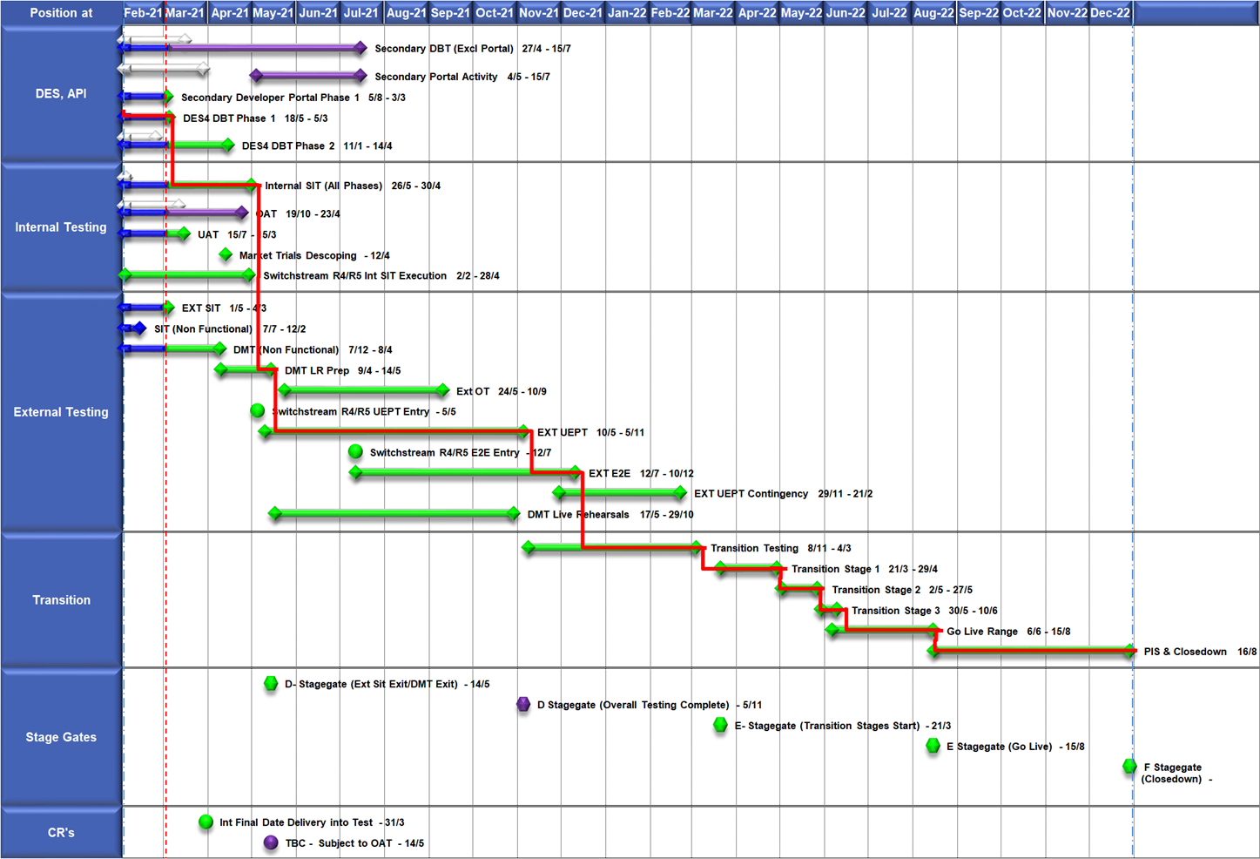
High Level Plan

Slide 49
Switching Programme CR Position – CRs impacting Xoserve
CR Name | CR Ref | High Level Cost IA Cost | Date Raised | Status
Programme Plan Re-Baseline | CR-D002 | £0.00 | 07/11/2019 | Approved - Complete
Updates to the CSS Physical Interface Design (PhID). | CR-D008 | £17,250.00 | 22/01/2020 | Approved - Internal CR Created
CSS_Exception_Handling_Strategy_v0.2 | CR-D014 | £0.00 | 26/02/2020 | Approved - Internal CR Created
Provide_CSS_RegistrationID_to_PUI_and_LPs | CR-D016 | £12,643.00 | 07/08/2020 | Approved - Internal CR Created
Licence Exempt Network Customer Identifier – ABACUS Data Model update | CR-E51 | £0.00 | 29/10/2019 | Approved - Complete
Amendments to the DMS artefact suite | CR-D019 | £6,500.00 | 16/03/2020 | Approved - Internal CR Created
Migration of Terminated Gas RMPS | CR-D022 | £0.00 | 10/06/2020 | Approved - Internal CR Created
Amendments to the NC-0079 for REL (Retail Energy Location) Data Migration and Reconciliation | CR-D024 | £20,000.00 | 06/07/2020 | Approved - Internal CR Created
DMS - PHID Alignment Parties | CR-D026 | £0.00 | 06/07/2020 | Approved - Internal CR Created
Request For a New or Upgraded DMT Environment | CR-D027 | £256,009.00 | 07/08/2020 | Approved - Internal CR Created
Enable TLS connection pooling for all directly connected parties to CSS] | CR-D028 | £2,500.00 | 13/07/2020 | Approved - Internal CR Created
Message Header Format for PKI Certificate Identification] | CR-D029 | £2,500.00 | 13/07/2020 | Approved - Internal CR Created
SIT Functional Test Re Plan Enabling Parallel Testing | CR-D030 | £56,000.00 | 20/07/2020 | Approved - Internal CR Created
DM_Validation Catalogue_Shipper_Effective_Date_Change_ | CR-D032 | £0.00 | 03/08/2020 | Approved - Internal CR Created
Compression During Data Migration | CR-D034 | £500.00 | 09/09/2020 | Approved - Internal CR Created
Uplift to the CSS Interface Specifications | CR-D038 | £70,000.00 | 07/10/2020 | Approved - Internal CR Created
Uplift to Business Data Validation Rules | CR-D039 | £20,000.00 | 25/09/2020 | Approved - Internal CR Created
Programme Plan Re-Baseline | CR-D042 | £14,913,000.00 | 28/09/2020 | Approved - Internal CR Created
Changes to Support Energy Company Data | CR-D059 | £25,500.00 | 25/01/2021 | Pending SI Response
Operational Choreography Detection 0.5 | CR-D060 | £308,205.00 | 25/01/2021 | Pending SI Response
Operational Choreography Rectification 0.3 | CR-D061 | £0.00 | 25/01/2021 | Pending SI Response
Amendment of Data Migration Solution to Protect Programme Timescales - Removal of Transition Stage 1 Delta files | CR-D062 | £83,490.00 | 25/02/2021 | Approved - Internal CR Created
Uplift to the CSS Business Data Validation Rules Doc | CR-D067 |  | 19/03/2021 | Pending PIA
Uplift to the CSS Interface Specification | CR-D068 |  | 15/03/2021 | Pending PIA
REL Dissemination to iDNO and DNO | CR-D069 |  | 15/03/2021 | Pending PIA
Change to Management of In-Flight Switches Approach | CR-D071 | £0.00 | 15/03/2021 | Pending SI Response

