Slide 1
Change Management Committee
12th May 2021

Slide 2
Section 2: DSC Change Budget & Horizon Planning

Slide 3
2.1 – DSC Change Budget 20/21 (Final) & 21/22 YTD

Slide 4
Budget v Spend BP20/21 Financial Year To Date
Total available funds have increased by £160,000 as a result of various changes moving through the lifecycle (see 2nd tab in embedded s/s for details)
31 changes have drawn on £1,559,293 of the total £3,000,000 DSC Change Budget from BP20
20 changes initially listed in BP20 have been moved to BP21
This closes out the BP20 finance tracker with all relevant changes now being tracked in BP21 tracker
Link to spreadsheet

Slide 5
Budget v Committed Spend BP21/22
Total available funds decreased by £135k as result of XRNs 5237 and 5183 being moved to BP21 and XRN5231 being added
Currently £1.3m (v £3.6m budget) of funds committed across 13 XRNs

Slide 6
XRN 5321 - PAC ring-fenced budget reapportionment

Slide 7
Recommendation for approval
It was noted in the February 2021 ChMC that NTS does not have representation at the Performance Assurance Committee (PAC)
As such the NTS constituency group should not pay a % share of the ringfenced PAC budget - a 2.1% share (£2,108) for FY 21/22 was approved in BP21
We proposed to reapportion % share of costs so that the other 3 constituencies pick up an equal 0.7% share of these costs for XRN 5321 (the parent XRN for this FY’s PAC budget)
In monetary terms this would represent an extra £703 each for DN, Shipper and IGT constituencies
We are seeking committee approval to reapportion the costs as per the table

Slide 8
2.2 – Change Pipeline

Slide 9
Change Development & Delivery Pipeline (DSC Change / Minor Release Budget)
* Pre-capture may contain changes that won’t require delivery / funding

Slide 10

2020-2022 DSC Change / MiR Pipeline
 | 2021 |  |  |  |  |  |  |  |  |  |  |  | 2022
 | Jan | Feb | Mar | Apr | May | Jun | Jul | Aug | Sep | Oct | Nov | Dec | Jan | Feb | Mar | Apr | May | Jun | Jul | Aug | Sep | Oct | Nov | Dec
Minor Releases
Major Releases
CSSC
Standalone Change
MiR 9
CCR
Key:
Approval on track
Scope
MiR 10
Scope
MiR 11
CCR
Approved
Scope
MiR 12
CCR
June 2021 (DBTI + PIS/Closedown)
CCR
Approval at risk
BER
Nov 2021 Analysis / Design
November 2021 Build/Test Implement/PIS
XRN
4780C
CCR
Nov 20 PIS
CCR
Nov 2022 Analysis / Design
November 2022 Build/Test/Implement/PIS
Nov 21 IA
Regression
EXTERNAL(MT/UEPT/E2E/Defect Mgmt)
Planning
Transition
Go Live Range
PIS
XRN
4780C
XRN
5206
5237
XRN
5146
XRN
5038
XRN
5120
XRN
52185143
Key:
Retro
On Track
XOS CF
Potential Activity
PAC
Complete
PAC XRN4876
Potential risk to plan
BER
CCR
Plan At Risk

Slide 11
Section 3: Capture

Slide 12
3.1 New Change Proposals – Initial Review
XRN / Title | Voting |  |  |  | DSC Service Area
 | Shipper | DNO | IGT | NTS
XRN5341 - UNC745 - Mandatory Setting of Auction Bid Parameters | Y |  |  | Y | SA14: UKLink Gemini Services.
XRN5352 - Development of the REC Performance Assurance reporting | Y |  | Y |  | TBC once solution options known
XRN5362 - Amendments to Service Description Table V17 | Information Only |  |  |  | N/A
XRN5251 Gemini Exit Zone Change | Y |  |  | Y | SA14: UKLink Gemini Services.

Slide 13
XRN5341 - UNC745 - Mandatory Setting of Auction Bid Parameters
Voting Parties
Change Details
Customer Class | Voting Party?
Shipper | Y
Distribution Network Operators (DNOs)
National Grid Transmission | Y
IGT’s
Problem Statement
There have been several instances of incorrect prices entered by Shippers in the last 12 months in short term capacity auctions. This has generated a considerable amount of work, impacted other auction participants (via invoices) due to the neutrality processing, as well as application of higher overrun charges, and remains a risk. Whilst it is the responsibility of Shippers to enter correct bid data, NG are seeking to reduce the current level of risk and explore system solutions that could support this. Please see the CP for full statement
Change Description
When an attempt is made to place a bid where no User/Shipper preferences have been set up a message would appear stating that the shipper needs to set up User/Shipper preferences for that MoS before being able to participate in placing bids for the auction. The Shipper would be prevented from placing bids until the User/Shipper preferences functionality is in place. Gemini should be able to determine whether a shipper has preferences set up for one MoS over another i.e. if preferences are set up on the WDDNEX but not the DADNEX, the warning only appears for the DADNEX. This change would apply to all shippers, existing and new. Please see the CP for full description
DSC Service Area: | SA14: UKLink Gemini Services.
Link to Change Proposal | Link to CP
Change Type | Regulatory
Priority Score | High
Sponsor Representative | National Grid

Slide 14
XRN5352 - Development of the REC Performance Assurance reporting
Voting Parties
Change Details
Customer Class | Voting Party?
Shipper | Y
Distribution Network Operators (DNOs)
National Grid Transmission
IGT’s | Y
Problem Statement
At the moment it is unclear about the scale of reporting that the REC PA CM envisages for the REC Schedules. It is proposed that a BA resource is identified to work with the REC Regulatory within Xoserve to assist the development of the reporting content, identify the preferred solution approach (e.g. BW Reporting; DDP: others?). It is further proposed that this would probably run in agile deliveries into development as clarity about requirements are known. The REC PA CM has indicated that they wish to have reporting available from 1st September 2021.
DSC Service Area: | TBC once solution options known
Link to Change Proposal | Link to CP
Change Description
Under the REC the Code Manager is appointed to oversee the management of the Code. The REC CM role is split into three – governance; performance assurance (PA) and technical assurance. The REC PA CM is responsible for assessing and reporting upon REC parties performance. Because of the limited data within the CSS system a significant proportion of the performance data will be centrally recorded in the UK Link system – such as Meter Reading and Meter Asset data. CSS only really records Registration data. This change seeks to secure resources to support the REC PA CM to assess the reporting that is proposed, refine these proposals with them, develop, test and implement the reporting framework.
Change Type | Regulatory
Priority Score | High
Sponsor Representative | RECCo

Slide 15
XRN5362 - Amendments to Service Description Table V17
Voting Parties
Change Details
Customer Class
Shipper
Distribution Network Operators (DNOs)
National Grid Transmission
IGT’s
No Voting needed.
Change Description
Service Description Table V17 has been amended to include 2 new service lines: DS-CS SA2 001 SS SA22 088 both of which are introduced as a result of implementation of Mod691. Please note this change is for information only and will be presented at CoMC on 19th April for approval.
DSC Service Area: | N/A
Link to Change Proposal | Link to CP
Change Type | Documentation
Priority Score | M
Sponsor Representative | Xoserve

Slide 16
XRN5251 Gemini Exit Zone Change
Voting Parties
Change Details
Customer Class | Voting Party?
Shipper | Y
Distribution Network Operators (DNOs)
National Grid Transmission | Y
IGT’s
Impacted Parties: NTS & Shipper
Problem Statement
If a meter is moved from one Exit Zone to another, Gemini receives one record for a meter with active indicator as ‘N’ for old exit zone and other record for same meter with active indicator as ‘Y’ for new exit zone. Hence Gemini will first end date the meter as per the first MDS record and then again later as per the second MDS record the meter is set active. In terms of meter status, the functionality suffices all the requirements. When the meter is end dated as per the first record, all the Nominations associated with that meter is cancelled and nomination values are changed to zero. And later the meter is set active as per the second record, however Nominations remain cancelled. The meter is active for all time as the meter is end dated for D day and again set active from D+1 day. (D+1 end date and D+2 active in case of current production scenario)
Change Description
The solution proposed by Gemini application support is, no changes on the meter end date and set active process. On the meter end date process the Nomination status is changed to ‘N’ as mentioned in the SUC however the Nomination values will not be changed. This enables the system to approve the Nominations by the Nomination approval batch job. I.e. the nominations are cancelled during processing the end date record, however the values are not changed. Later if the meter is set active by second record, the Nomination with N status will be picked by the job and approves it. If meter is not active nomination is left unactioned. The Gemini Project team, along with the SMEs have recommended to change the functionality in MDS file loading job, the process of cancelling the nomination to be completely removed in MDS file load and introduce a new job which cancels the Nomination of all inactive meters that runs after MDS file loading job.
DSC Service Area: | SA14: UKLink Gemini Services.
Link to Change Proposal | Link to CP
Change Type | Non regulatory
Priority Score | Low
Sponsor Representative | National Grid
Xoserve would like ChMC to approve the Solution Change Pack to include the Design so once approved in June can be implemented immediately

Slide 17
3.2 Change Proposals – Post Solution Review for Approval
XRN5188 - Interim Data Loads of MAP Id into UK Link
XRN5309 - FSG - Automating the FSR ‘Standard Liability’ Process

Slide 18
XRN5188 - Interim Data Loads of MAP Id into UK Link
Proposed Release Link to Change Proposal Change Pak Comm Ref Voting Funding | DSG/ Xoserve Preferred Option | Solution Summary Outcome and implementation date outcome |  |  |  | Comments
 |  | Organisation | Approve | Defer | Reject
Proposed delivery: MiR10 & MiR 11 Link to CP Link to Change Pack ref: 2808.5 – MT - PO Voting: Shipper HLSO Cost: Option 1 £15K - £20K Funding: 100% Shipper DSC Service Area 1: Manage Supply Point Registration | Option 1 | Scottish Power | Y |  |  | No comment
 |  | CMAP | N/A | N/A | N/A | It is essential that additional data loads of MAP ID into CDSP take place as soon as possible. Additional data loads will reverse data degradation experienced since the initial data load was carried out in December 2020. Interim loads will also enable the loading of new data into CDSP to cover the significant volume of new meters installed under the SMIP since MAPS provided their data in October 2020 for the initial data load. It is unacceptable for no additional data loads to be carried out until the enduring solution proposed under XRN4780C is implemented as we believe that the level of data degradation over the period from October 2020 to enduring solution implementation will be unacceptable and would totally undermines the accuracy of the MAP ID data field and leading to a lack of confidence in the MAP ID data held by the CDSP.

Slide 19
XRN5309 - FSG - Automating the FSR ‘Standard Liability’ Process
Proposed Release Link to Change Proposal Change Pak Comm Ref Voting Funding | DSG/ Xoserve Preferred Option | Solution Summary Outcome and implementation date outcome |  |  |  | Comments
 |  | Organisation | Approve | Defer | Reject
Proposed delivery: MiR 10 Link to CP Link to Change Pack ref: 2808.7 – MT - PO Voting: DNO, IGT HLSO Cost: £20K - £30K Funding: Minor Release Service Area 7: NTS Capacity, LDZ Capacity, Commodity, Reconciliation, Ad-Hoc Adjustment and Energy Balancing Invoices | Option 1 | NGN |  | X |  | Whilst we see the need to automate a manual process for efficiency, all FSG payments that are outside GSoP (I&C or >73,200kWh) are paid in accordance with UNC Section J 3.5.10 3.5.10 For the purposes of Section V10, the rules in paragraphs 3.5.3 and 3.5.5 (but not paragraph 3.5.8, but without prejudice to paragraph 3.5.9(a)) are Compensation Rules within Compensation Group J; and in relation thereto the 'payment month' is the second month following the month in which the relevant failure commenced. Based on this, speeding up the payments may put us in breach of UNC.
 |  | SGN | X |  |  | SGN support the single solution option provided as this will mitigate the manual process currently in place and ensure these sites are captured and reported in a timely manner.

Slide 20
section 4. Design & Delivery

Slide 21
Design Change Pack
XRXRN5218 - Mod 0710 - CDSP Provision of the Class 1 Service
XRN4922 CSSC Shipper BRD

Slide 22
XRN5218 - Mod 0710 - CDSP Provision of the Class 1 Service
Functional Changes
Change Pack ref: 2808.6 – MT - PO Release: Adhoc – date tbc Voting: Shipper, DNO, IGT, NTS Funding: Implementation cost is proposed 98% DNO, 1% IGT and 1% NTS funded Ongoing cost is 100% Shipper funded Service Area 1 Manage Supply Point Registration | Solution & Implementation Summary outcome |  |  |  | Comments
 | Organisation | Approve | Defer | Reject
 |  |  |  |  | No responses received

Slide 23
XRN4922 CSSC Shipper BRD
Functional Changes
Change Pack ref: 2809 – MT - PO Release: CSSC Voting: Shipper Funding: CSSC | Solution & Implementation Summary outcome |  |  |  | Comments
 | Organisation | Approve | Defer | Reject
 |  |  |  |  | No responses received

Slide 24
Standalone Change Documents for Approval (BER, CCR, EQR)
CCR for XRN5038 Convert Class 2, 3 or 4 meter points to Class 1 when [G2.3.15] criteria are met (MOD 0691)
  Voting Shipper

Slide 25
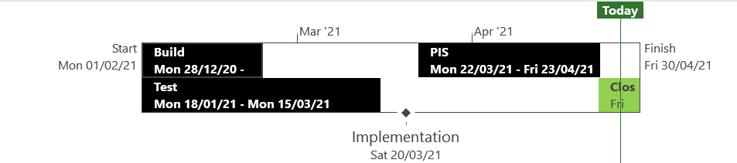
XRN5294 – Minor Release Drop 9 - Status Update
 | Overall Project RAG Status
 | Schedule | Risks and Issues | Cost
RAG Status
Status Justification
Schedule | Post Implementation Support completed successfully on 23rd April No defects raised CCR issued for May ChMC for approval Decision in May ChMC CCR approval being sought
Risks and Issues | None Applicable
Cost | On track to complete within approved spend
Scope | There are 2 changes within Minor Release 9: XRN5080 - Failure to Supply Gas (FSG-GSOP1) – System Changes XRN5135 - DNO and NTS Invoice to Shippers and DNs VAT Compliance
Slide Updated on 27th April 2021

Slide 26
XRN5294 – Minor Release Drop 9 - Approval
CCR for XRN5294 – Minor Release Drop 9
  Voting Shipper, DNO, IGT, NTS

Slide 27
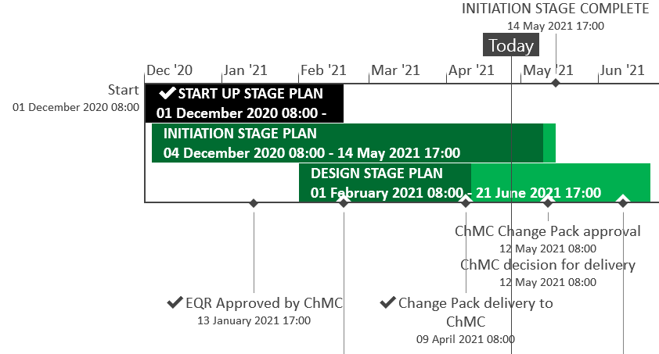
XRN5289 – November 21 Major Release - Status Update
 | Overall Project RAG Status
 | Schedule | Risks and Issues |  | Cost
RAG Status
Status Justification
Schedule | Design phase on track to complete to current schedule Remaining 3 change packs delivered on plan; eChMC arranged for 5th May for approval Implementation approach and full project timeline planned to be delivered following scope confirmation Implementation window 5th November Contingency Implementation window 12th November No recommendation for Market Trials for the changes in scope Decision in May ChMC & Return to Green: Approve BER and agree November 21 Delivery Scope
Risks and Issues | ​RISK (XRN5142) - Unknown volumes for data cleanse Mitigation - Regular touch points with DCC in place, we understand the method, need to understand the expected volume and plan
Cost | Forecast to complete design against approved EQR Return to Green: Approval of BER required to progress to Build phase
Scope | XRN4941 - MOD0692 - Auto updates to meter read frequency​ XRN5007 - Enhancement to reconciliation process where prevailing volume is zero​ XRN5072 - Application and derivation of TTZ indicator and calculation of volume and energy – all classes​ XRN5091 - Deferral of creation of Class change reads at transfer of ownership​ XRN5142 - New allowable values for DCC Service Flag in DXI File from DCC​ XRN5180 - Inner tolerance validation for replacement reads and read insertions​ Descoped - XRN5186 MOD0701 – Aligning capacity booking under the UNC and arrangements set out in relevant NExAs​ Descoped - XRN5187 MOD0696 – Addressing inequalities between capacity booking under the UNC and arrangements set out in the relevant NExAs
Slide updated on 28th April 2021

Slide 28
N21 Delivery Scope
CSSC Impact Assessment

Slide 29
Introduction
CSS is due to be implemented in 2022 and Ofgem have stated that any system changes implemented prior to this must not put the CSS implementation at risk.
In January it was agreed at ChMC to proceed with a November 21 release until the end of detailed design and to include an impact assessment against CSS, which has now been completed.
The following slides contain the outcome of the assessment including Correla’s scoping recommendations for the November 21 Major Release that will protect CSS.

Slide 30
Correla Evaluation/Recommendation
Change | Design Change Pack | November 21 Delivery
XRN5007 | Approved | Yes
XRN5072 | Approved | Yes
XRN5142 | Approved | Yes
XRN5180 | eChMC – 5th May | Yes
XRN4941 | eChMC – 5th May | Deliver reduced scope for November 21 Remaining scope post CSS – Information change pack will be issued with updated scope
XRN5091 | eChMC – 5th May | No – deliver post CSS

Slide 31
Decisions and Approvals
Change | Detail | Action
XRN4941 | Deliver the reduced scope | Approve or Descope
XRN5091 | Remove from November 21 scope | Approve

Slide 32
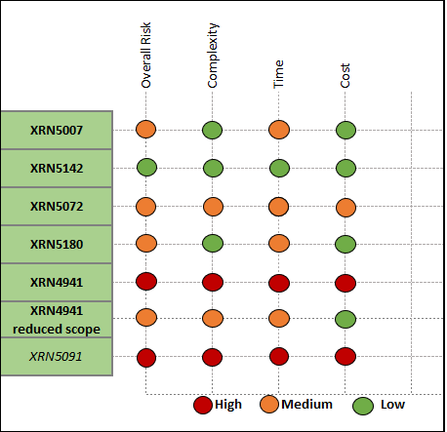
CSSC Impact Assessment

Slide 33
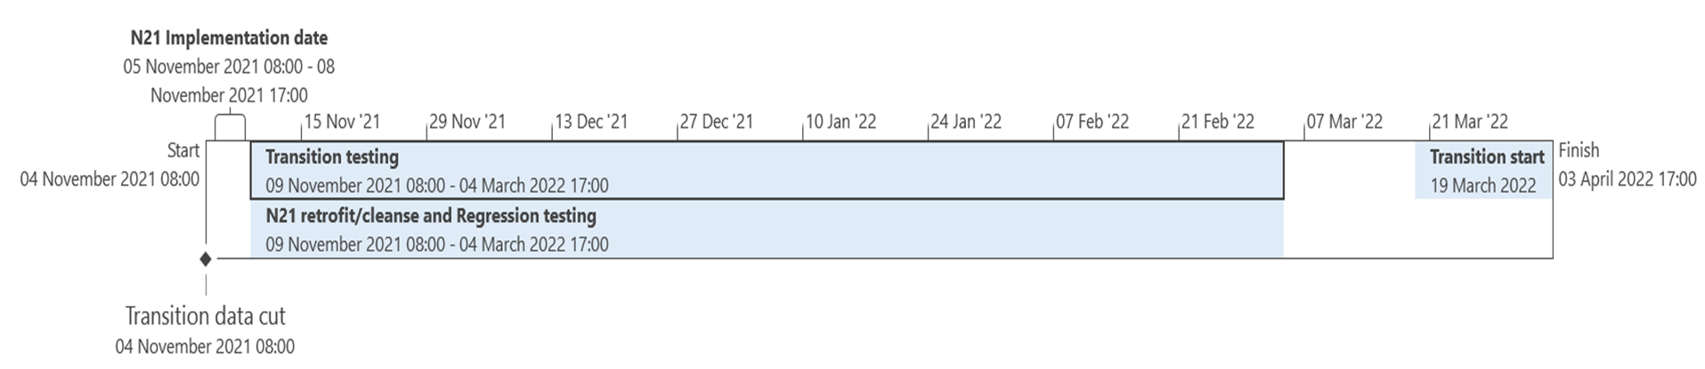
CSSC Timeline Impacts
Retrofit is required to merge the code to keep the integrity of the code sacrosanct
No window of opportunity to retrofit prior to transition testing or transition start, so will need to be completed in parallel
Risk of not full transition testing against all November 21 code, assessments show minimal impact for the recommended scope
Note: Transition testing is the test phase being used to test all the bespoke code and programs that have been written in order to carry out transition.

Slide 34
XRN4941 Reduced Scope
XRN4941 has major code impacts to CSSC due to the confirmation and nomination workflow changes that are critical in the CSS delivery program.
This alternative scope will not impact the CSSC design and can be delivered within the CSSC timelines and will deliver the requirements of the MOD. ​
​
Changes to current design​:
There will be no changes to the confirmation and nomination workflow. ​
The RGMA process will continue to ignore sites with a switch in flight and will parameterise this period so that it can be amended, post CSS, to be in line with the new, shorter, timeline. ​
The data cleanse job will be enhanced to identify sites that have gone live within the previous week/month (depending on how often the job is run) and update the MRF to monthly at that time. ​
​
Impact to Shippers​
By not amending the confirmation and nomination workflow, Shippers will be able to take on a site with a non-monthly read frequency which we will change to monthly when the amended data cleanse job is triggered. ​
Increase in unsolicited SCR file/record when meter read frequency is changed by the CDSP due to the amended data cleanse job
NOTE: A second change will need to be raised and agreed for delivery to complete the changes to the transfer workflow (both CSS and Non-CSS transfers) post CSS with additional cost estimated circa 75k including redesign for CSS changes -

Slide 35
XRN4941 Scope comparison
​High Level Requirements | MOD Requirement | Reduced Scope | Current Scope
Batch job to update MRF where DCC Service Flag is A​ | Yes | Yes​ | Yes​
RGMA updated to update MRF where AMR is installed​ | Yes | Yes​ | Yes​
Batch job to update MRF where AQ =>293,000​ | Yes | Yes​ | Yes​
Issue unsolicited SCR file/record to Shippers advising them of MRF change​ | No - DSG recommendation | Yes​ | Yes​
Reject Supply Point Amendments where MRF should be monthly​ | No - DSG recommendation | Yes​ | Yes​
Data Cleanse job created to update MRF for current portfolio ​ | Yes | Yes​ with minor enhancement | Yes​
Meter Read context updated​ | No - DSG recommendation | Yes​ | Yes​
Confirmation workflow updated to change MRF, once live, where criteria is met​ | No - DSG recommendation | To be delivered by the Data Cleanse Job​ | Yes​
Reject nominations where MRF should be monthly ​ | No - DSG recommendation | No​ | Yes​
Reject confirmations where MRF should be monthly​ | No - DSG recommendation | No​ | Yes​

Slide 36
XRN4941 – Decision: Deliver the Reduced Scope
BACKGROUND
This change has major code impacts to change the Confirmation and Nomination workflow aspect of the change within the CSSC change – this alternative scope can still deliver the functionality of the MOD and update the MRF as required.
OPTIONS | DESCRIPTION
Option 1 | Approve reduced scope change
Option 2 | Descope change from November 21 Release and deliver post CSS
 | Option 1 | Option 2
Pro’s | Delivers the functionality of the MOD No customer impacting changes | Full solution will be delivered in one change post CSS No customer change for November 21
Con’s | No immediate rejections for incorrect MRF Delay for the MRF to be updated following a confirmation | MOD functionality has not been implemented
Recommended (Y/N) | Yes | No

Slide 37
XRN5091 Background
XRN5091 was raised by Customers due to the issue seen when there is a Change of Shipper with a change in Class (from 3 to 4 or from 4 to 3) for the same effective date (on average 40k per month) resulting in:
Shippers opening reads getting rejected due to the Class change estimated read being present
Class change estimated reads being issued to Shippers
The opening read window being satisfied by the Class change estimated read
The prioritised impacts of this issue are:
The MBR is issued on the effective date which will be used by the outgoing shipper to bill the end consumer
Shippers are unable to submit an opening read without using the SAR process therefore the opening read provided by the end consumer may not be used to bill them
UK Link is not compliant to UNC as there should be an opening read window (that is not satisfied by the change in class)
RGMA, non-opening reads and LDZ changes occurring in the opening read window are managed differently where the class change estimated read has been generated
Opening Read performance for Shippers is impacted negatively as CDSP reports that an opening read has not been provided
Rejected Read performance for Shippers is impacted negatively
Shippers can currently re-issue the opening read as a replacement however this should follow the Shipper Agreed Read (SAR) process. The SAR process is in place so that both Shippers have agreed the new opening read before it is entered onto UKLink. This process also ensures that the end consumer is aware of the change to the opening read and can expect a revised bill from the outgoing Supplier.

Slide 38
XRN5091 Reason to Descope
XRN5091 has major design impacts to CSSC as this is adding and amending the opening read window processes where there is a change of class
Time impact to redesign, amend the code and retest is not achievable alongside the CSSC timeline
Alternative Solutions were reviewed but none would mitigate the main customer impacts of this change

Slide 39
5091 impacts
 |  |  |  | Contract Change |  |  |  |  |  |  |  |  |  |  |  |  |  |  |  |  |  |  |  |  |  |  |  |  |  |  |  |  |  |  | Capacity Billing | Commodity Billing | Amendment Billing
 |  |  |  |  |  |  |  |  |  |  |  |  |  |  |  |  |  |  |  |  | DM Read Upload |  | NDM Read Upload |  | Consumption Adj |  |  |  | Check to Check Rec.
SMP Creation |  | Registration |  |  | Update SMP |  | Portfolio Files |  | RGMA |  | C& D Store |  | Back Billing |  | Rolling AQ |  | Formula AQ |  | Annual EUC/WC calc |  |  |  |  |  |  |  | Normal Rec. |  |  |  | NDM Estimation |  | Read Screens
SPA
RGMA/AQ
Reads
Billing/Inv.
Addition of check for Shipper transfer / Re-confirmation with Class Change to & from Class 3 / Class 4
- Creation of a transfer window/at D+11, the reads will need to be estimated
This same functionality need to be assessed and added in CSS supplier switch (CSS_N_W_01) and shipper change workflow (CSS_N_W_02).
As part of CSS - the class change estimation of transfer read will need to be removed.
This will need a new design in CSSC.
RGMA requests with the appt. / read date (or processing date) within the transfer window, will follow the newer rules.
Current CSSC functionality does not check open transfers in previous class (they would have been estimated)
This will need a new design in CSSC.
Transfer Read window needs to be open for receiving Opening reads/non opening reads.
All the new rules for switch with class change (3 to 4 or 4 to 3) will have to be aligned to faster switching & multiple open transfer read windows.
This will need a new design in CSSC.
Regression Impacts to Estimation and Billing/Invoicing for XRN 5091
This will invoke further Regression in CSSC due to redesign of the SPA/RGMA/Reads processes.
There are a number of Process and Technical design changes required in UKLINK due to XRN 5091 which impact critical CSSC processes and rules.
Primary impacts to
Transfer Read Window
Estimation logic
Confirmation Workflows
Additional Activity within Transfer Read window (as a result of 5091 changes)
CSSC Rework
Redesign
Significant Redesign/Retest will be needed.
This is not considered achievable alongside the CSSC timeline.
Regression and code retrofit will be time intensive due to the number of technical objects impacted
Retest
Regression
Retrofit Code (CSSC & XRN 5091 code changes)

Slide 40
XRN5091 – Decision: Remove from November 21 Scope
BACKGROUND
XRN5091 is not able to be completed within the November 21 scope, due to the complexity and detrimental impacts to the CSSC program as the code changes are too complex to complete within the timelines for CSSC. Alternative solutions were reviewed but none of the options were viable to meet the main impacts of this change
OPTIONS | DESCRIPTION
Option 1 | Descope the change from November 21
 | Option 1
Pro’s | CSSC design will not need to be amended CSS timelines are not impact No CSS retesting to be completed (internal and external parties)
Con’s | Customer Impacts are not address UNC Code is still not compliant
Recommended (Y/N) | Yes

Slide 41
Decision and Action
Change | Detail | Outcome
XRN4941 | Deliver the reduced scope
XRN5091 | Remove from November 21 scope
Have we received agreement on all of the above

Slide 42
XRN5289 – November 21 Major Release - Approval
BER for XRN5289 – November 21 Major Release - Full Scope
  Voting Shipper, DNO, IGT,
BER for XRN5289 – November 21 Major Release - Recommended Scope
  Voting Shipper, DNO, IGT,

Slide 43
Minor Release Drop 10 – Request For Scope Approval
Potential Release | XRN | Change Title | Comments | Complexity | Points
MiR Drop 10 | 5309 | FSG: Automating the FSR Process | Provides DNs with automated FSR file / reporting mechanism | Low | 3
 | 5188 | Interim Data Loads of MAP ID into UK Link | An additional data load of MAP ID into UK Link to ensure data integrity prior to XRN4780c implementation | Low | 5
 | 5246 | Confirmation File Processing Capacity Improvement | Amends cap limit on automated daily transfer. Enables speedier and less labour intensive portfolio transfer | Medium | 8
ChMC Approval requested for the above changes to be scoped for delivery in Minor Release Drop 10
Drop 10 plan and implementation date to be shared, for review and approval, at June ChMC.
Indicative implementation date, for all 3 changes, is 28th August 2021.

Slide 44
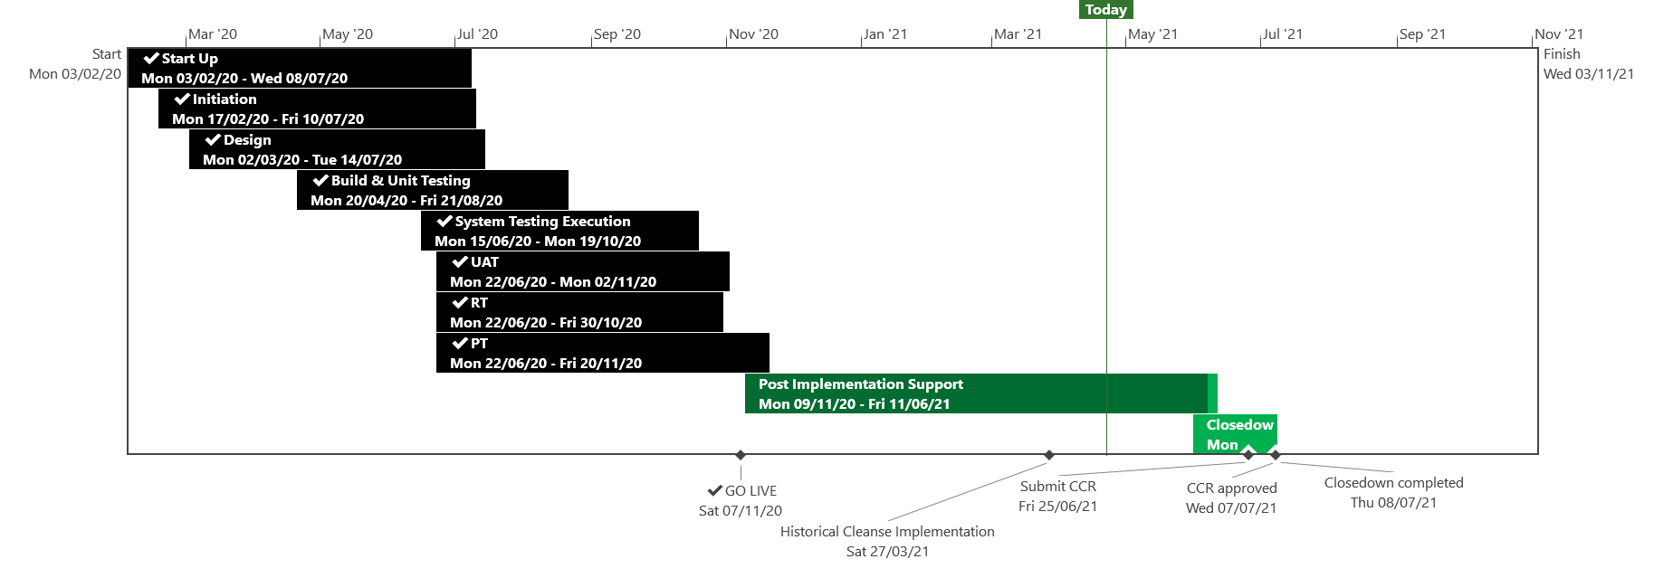
XRN5110 – Nov 20 Release - Status Update
 | Overall Project RAG Status
 | Schedule | Risks and Issues | Cost
RAG Status
Status Justification
Schedule | November 20 Release delivered, final activity for Historical Cleanse XRN4897/99 is on going, due to be completed to schedule Historical Cleanse commenced on the 27th March, on track to complete to schedule Historical Cleanse expected to run to 4th June CCR to be submitted to July ChMC Decision in May ChMC: None
Risks and Issues | ​Issue: XRN4897/99 Historical Cleanse Change Request needs to be completed to exit Post Implementation Support Risk: UK Link may be non GDPR compliant following Historical Cleanse due to missing unknown scenarios Return to Green: Completion of XRN4897/99 Historical Cleanse
Cost | Forecast to complete delivery against approved BER
Scope | In Scope - XRN4897 Resolution of deleted Contact Details (contained within the S66 records) at a Change of Shipper event In Scope - XRN4899 Treatment of Priority Service Register Data and Contact Details on Change of Supplier Event In Scope - XRN4801 Additional Information in DES In Scope - XRN4871b Rachet Regime Changes In Scope - XRN5014 Facilitating HyDeploy2 Live Pilot Descoped - XRN4931 Submission of a Space in Mandatory Data on Multiple SPA Files Descoped - XRN4941 MOD 692 – Auto Updates to Read Frequency Descoped - XRN4992 Supplier of Last Resort Charge Types Moved to CSSC - XRN4870c MAP ID
Slide updated on 28nd April 2021

Slide 45
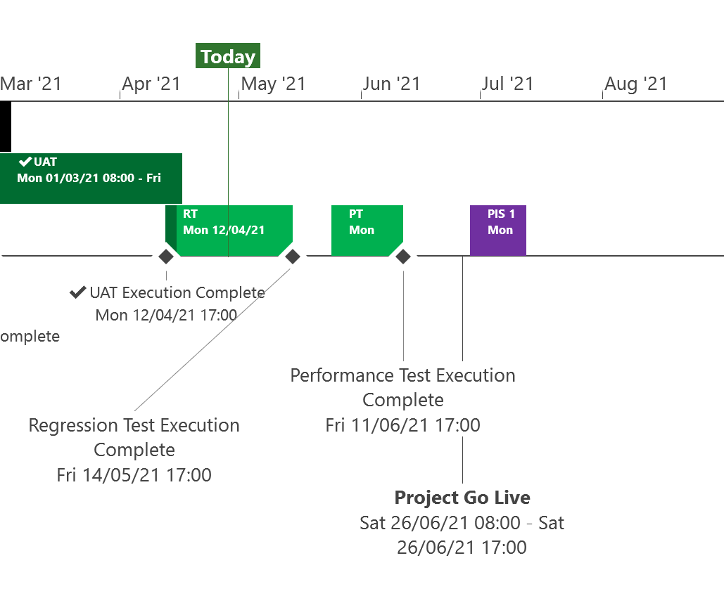
XRN5253 June 21 Major Release - Status Update
 | Overall Project RAG Status
 | Schedule | Risks and Issues | Cost
RAG Status
Status Justification
Schedule | Project On Track Testing phase progressing to plan System Testing and User Acceptance Testing complete. Regression Testing commenced to plan in April and on track to complete to schedule. E-Learning awareness training to be available from 28th May Project Cutover will be completed via code transport on Saturday 26th June Post Implementation Support dates agreed and to be made available in June ChMC Decision In May ChMC None
Risks and Issues | None Applicable
Cost | Forecast costs on track to complete within approved BER
Scope | In Scope (XRN5093) - MOD0711 – Update of AUG Table to reflect new EUC bands Descoped (XRN4992) - MOD0687 – Creation of new charge to recover last resort supply payments – Descoped at Extraordinary ChMC on 26th October 2020 Descoped (XRN4941) - MOD0692 - Auto updates to meter read frequency – Descoped at ChMC on 11th November 2020
Complete
On Track
At Risk
Overdue
Not Baselined
Slide updated on 26th April 2021

Slide 47
Gemini Horizon Plan

Slide 48

CSSC Programme Dashboard
May 2021

Slide 49
Programme Update
Programme Health – RAG |  |  | Return to Green Plan
Overall Programme Status | Previous | Current | The programme remains at a Green status however we are actively monitoring the COVID-19 situation in India to mitigate any potential impacts on to our suppliers. This risk is also actively being monitored at the Switching Programme level Smoke Testing is complete for DM Live Rehearsal. All preparatory activities are now complete for entry into UEPT . Preparations continue for Operational Testing. However, at the point of writing this, 2 multi-party defects are being progressed. Should testing of these fail, there is a risk to the commencement of UEPT. An ad-hoc implementation group has been planned to discuss if necessary. Xoserve also encountered this defect, which has been fixed and tested internally, awaiting joint-up testing.
Programme Plan | Previous | Current
Risk Profile | Previous | Current
Resources | Previous | Current
Executive Summary |  |  |  | Upcoming Activities & Milestones (Next Month)
Key Programme Updates To date, all Xoserve key internal and external milestones have been met Transition: Internal and external preparatory activities continue towards DM Live Rehearsal and Transition test phases.CR-D071 which proposes to de-scope In-Flights from the transitional period is now due for approval on 11th May 2021. Internal detailed workshops have commenced with all key stakeholders. Preparations are underway to create an external facing cutover calling out all key activities for shippers to undertake during the various phases. Governance planning will commence following CR-D071 approval. An open question exists with the Switching Programme to understand the catch-up processing approach. This will need to be planned in both the cutover plan and potentially within UNC governance. SoLR; Discussions continue with Ofgem. Internal Testing: Programme change requests continue to be progressed through internal testing in line with the Switching Programme release cycles and/or milestones. Data Migration: REL cycle 4 data work has completed and has been delivered 1 week early. A request has been received for Cycle 5 (non-rel) Analysis reports due for delivery on July. Market Trials: The CR to remove Market Trials has been approved by the Switching Programme. A support group has been set up provide support, information and set up in readiness for E2E Business Change: Internal knowledge transfer sessions continue. Target Operating Model activitiies are on track |  |  |  | Live Rehearsal: Smoke testing complete Internal Test: Progress CR testing and any relevant regression tests DES:& Secondary APIs Continue development and system test activities. Transition: Continue Live Rehearsal & Transition planning SoLR: Discussions continue MAP C: Shipper Change Pack out for reps. MAMCOP change pack due for release REC: Continue REC schedule review as per Ofgem timelines Business Change: Continue awareness and knowledge transfer session

Slide 50
UK Link Cloud Programme
Verbal update presented by Emma Lyndon

Slide 51
CMS Rebuild Update
Jo Williams

Slide 52
CMS Rebuild - Progress to date
Summary of progress to date
All Ideal “To Be” Workshops have now been facilitated with some great discussion and internal “focus” groups have been stood up to investigate some of the requirements in more detail, an example of this is for the Must Reads process. SLAs have been a reoccurring requirement and painpoint, so there maybe future discussions regarding introducing or amending SLAs to the processes i.e. Must Reads or Consumption Adjustments. A small focus group has been established to try and identify the cross communication process requirements in lower level so we can Inform the suppliers of any discussion. During this discussion a similar collaboration tool (SDEP) that has been launched and mandated by Ofgem and so further investigation is taking place to understand the value of another collaboration tool within the CMS rebuild option. Advocates are undertaking an Industry end to end new connections journey workshop and CMS team will attend to identify any additional requirements that could be delivered through CMS. Suppliers have submitted their HLSO as per the agreed date and the team are currently completing due diligence on the options provided. Included in this month’s presentation there will be a high level verbal update from the team, as we are still in confidential discussions with the suppliers there is a limit on what can be shared in a wider forum.
Next Steps
Continue to understand the SDEP integration and identify any potential impact. Identify the recommended solution from the supplier options and take this option to CoMC for approval to proceed, following which the ChMC shall be advised of the recommended option and the necessary change governance shall commence. Approval of processes to remain in scope of CMS
Key Milestones | Due
Initial Workshops Completed | 22/01/2021
To Be Workshops Commence | 08/02/2021
HLSO – Target Date | 21/04/2021

Slide 53
CMS Rebuild – High Level Solution Options
For Discussion

Slide 54
High Level Solution Options
Category | Details
Number of Suppliers engaged | 4
Delivery Options | Phased Delivery (two Phases) or a Single Delivery
Delivery Timescales from mobilisation | Shortest: 12 months Longest: 16 Months
NB – All the above are initial views of the bid submissions and need to be fully validated and evaluated. Therefore they are subject to change
Next Steps:
Assess bids and choose option based on satisfying customer requirements, total cost to operate and change capability
Provide update to CoMC in May and request funds to mobilise the detailed design phase
Agree engagement approach with customers during detailed design (DSG/interactive sessions)
Consult on phased or single delivery with customers, during detailed design phase

Slide 55
Section 6: Any Other Business

Slide 56
DSC Governance Sub-Committee 27th April 2021

Slide 57
Agenda / Approximate Timings
Introductions & scene setting (10 mins)
‘Xoserve Change Fund’ (45 mins)
ChMC interactions with non-DSC-change-funded change programmes (30 mins)
4. Financial Analysis and Management Information Discussion (30 mins)
5. Summary & Next Steps (15 mins)
6. AOB (15 mins)

Slide 58


2. Xoserve Change Fund – background and intent
The concept of was discussed in ChMC during the business planning process and was ultimately recommended for approval by ChMC in September 2020 (and subsequently approved as part of the wider business plan)
A ‘parent’ XRN 5237 has been raised to allow drawdown from the associated budget of £200,000 for financial year 21/22, with the aim to:
“Allow Xoserve greater flexibility to deliver appropriate changes with more agility, which will further lead to process and system improvements to increase efficiency and boost customer experience”
XRN 5237 was deferred by ChMC in March 2021 so that members could better understand the process via which the funds could be accessed and how ChMC would be engaged – this is the purpose of this agenda item
In principle, the fund would be accessible to deliver Change Requests (CRs) if:
Customer benefits can be clearly articulated
No functional impacts to customer systems have be identified
Flexibility is beneficial to deliver the change

Slide 59
Documentation proposal
A stated aim of having a ring-fenced budget is to reduce the need for individual (child) XRNs to pass through CP governance and therefore lead to greater fluency / flexibility. Changes that would draw on this money will be Change Requests (CRs) rather than Change Proposals (CPs)
Assessment criteria of customer ‘impact’
Changes to screens (portal, DES, Gemini, etc.)
Change in process
New rejection code
Any change required to file formats and allowable values
Change to UNC code communications
Any functional change to UK Link systems, including the full suite of UK Link Systems: the UK Link Network, UK Link Gemini, DES and CMS
Any change to the UK Link Manual including all interface documents, rejection codes, screens, etc.
The changes that will be consistent with the principles on the previous slide are CRs (not CPs). As such we propose that XRN 5237 is re-launched as a parent CR and given its own location on Xoserve.com (e.g. like a release page).
Any subsequent child CR that seeks to draw-down on the budget will be given it’s own XRN reference and will be published on the dedicated part of Xoserve.com and discussed in the quarterly DSC Governance Sub-Committee before funds are drawn / work started
Each child XRN will stipulate customer benefits and (lack of) customer impacts and state associated costs of work
Plan and associated costs of delivery will be shared on Xoserve.com and discussed in the DSC Governance Sub-Committee with financial MI included in the appropriate ChMC agenda item that tracks spend v remaining budget

Slide 60
Project 1stop
We propose to make improvements to the change-related pages on xoserve.com to improve customer experience and think this change (associated XRN to follow) is suitable for the ring-fenced budget
These changes will provide a ‘1-stop-shop’ for consumers of this content (e.g. DSG, ChMC, any individual or organisation that uses the information we share)
We will be seeking your input (now and in upcoming dedicated sessions) to build ‘user stories’ and prioritise them for delivery
Let’s update the form to drive good conversations in ChMC re priority
“I am a shipper and I only want to see the changes that impact me etc – without having to go into an embedded s/s in a ChMC slide”
Let’s build visual key process maps that can be updated when changes to them occur
“I want the CP form on the website to be easier to list stated aims and benefits of my change”
Let’s build ‘slice / dice’ options so different customers to get to relevant info quicker
“I want to be able to more easily navigate the UKL Manual so I can understand and visualise key gas industry processes”

Slide 61

What are your ideas for how we can improve your experience of change via self-serve on xoserve.com?
Do you agree 1stop is a suitable candidate for accessing the ring-fenced budget?

Slide 62
3. ChMC interactions with non-DSC-change-funded programmes
What are they - CSSC, CMS Rebuild, UK Link Cloud
What we do – when we need decisions on solution/design options we utilise existing governance framework (DSG, ChMC, solution/design change packs, outages). We manage these approvals alongside ‘BAU’ decisions to help keep voting condensed - is this still a requirement, or is it confusing for people
What we don’t do – ask for approval of spend (EQR, BER etc) because the work is not being paid for via the DSC Change Budget
Does this work and what (if anything) should we do differently

Slide 63
4. Financial Analysis and Management Information Discussion
What are we measuring (and will be publishing) – the evolution from initial estimate (High Level Solution Option) through the lifecycle and related refinements / fixing of cost (Evaluation Quotation Report, Business Evaluation Report) for changes that draw down on the DSC Change Budget
Why – to measure how accurate estimated costs (HLSO ‘t-shirt’ sizes) are in relation to costs ChMC are asked to approve and to use the statistics to articulate what we learn from one release to the next
What initial analysis shows us – that our estimates are becoming more accurate through each major release since t-shirt sizing was established
What else would be useful to see when we share findings in June ChMC

Slide 64
5. Summary of Outcomes (post-meeting update)
2. ‘Xoserve Change Fund’
Further thought has gone into how we can make the most effective use of this pot of money (formally approved into the DSC Change Budget via BP21), while allaying any concerns raised in February ChMC re XRN 5327 (which was deferred pending discussion in the sub-committee)
Instead of using the money to deliver small scale / non-customer impacting UK Link change requests (CRs) with more flexibility than major/minor release windows allow, the CDSP believes it can utilise some of these funds (how much is to be determined following consultation with ChMC / sub-committee on priorities and then with Correla on delivery costs) to make improvements to the change process itself, focussing at first on the change-related content on Xoserve.com
This is to make the experience of using xo.com for change related activity easier, so that the consumers of change info have more opportunity to self-serve and can navigate to what they need to know quicker and more intuitively.
This work will be packaged-up under Project 1stop with ChMC and the sub-committee driving priority of delivery of user stories identified (by customers)
A CR XRN for ‘Project 1stop’ to be raised and formally introduced in June’s ChMC with a page on Xo.com dedicated to it when appropriate. Customer concerns over lack of governance / transparency of cost drawdown and any risk of CDSP making ‘ungoverned’ changes therefor will be avoided, with new opportunities to drive efficiencies created.
ChMC interactions with non-DSC-change-funded change programmes
Agreement that non-DSC budget-impacting investment projects need to continue to come to ChMC for updates with greater clarity in material produced on website / in the committee as to how each project fits into total change delivery ‘POAP’
CDSP took action to explore whether updates on these investments were as detailed as required in CoMC and report back to attendees / wider DSC committee members on improvements
Financial Analysis and Management Information Discussion
Xoserve planning to bring some analysis of how costs evolve from initial estimates (HLSO) through to CCR, starting with major releases
Sub-committee would also like to see evidence that lessons are being learned and costs becoming more accurate
Despite being pragmatic in recognising that HLSOs are high level estimates and can’t be detailed, sub-committee would like to know the elements that make up a HLSO, which can be shared in the scheduled

Slide 65
APPENDIX

Slide 66
Outages
Outages
Change Request Number | Impacted System | Outage Duration |  |  |  |  | Committee Notified Date
 |  | Start Date | Start Time | End Date | End Time | Brief Description
CHG0031092 | Gemini | 15/05/2021 | 03:15 | 15/05/2021 | 07:30 | Gemini Disaster Recovery Test 2021 This is an annual activity to confirm Gemini services can be migrated to a secondary data centre location should there be a catastrophic failure within the primary data centre. During this phase of the test Gemini services will failover from the primary site to the secondary site. The activity starts within the scheduled maintenance window and the system will operate normally during times where there is no outage. Note: The activity starts within the scheduled Gemini maintenance window and continues to the times specified | 10/02/2021 12/05/2021 Time updated from 8:30 to 7:30 Updated note
CHG0031092 | Gemini | 16/05/2021 | 03:00 | 16/05/2021 | 07:30 | Gemini Disaster Recovery Test 2021 During this phase of the test Gemini services will failback from the secondary site to the primary site. Again the activity starts within the scheduled maintenance window and the system will operate normally during times where there is no outage. Note: The activity starts within the scheduled Gemini maintenance window and continues to the times specified | 10/02/2021 12/05/2021 Time updated from 8:30 to 7:30 Updated note
CHG0031070 | EFT | 11/06/2021 | 05:00 | 13/06/2021 | 06:00 | EFT Disaster Recovery Test 2021 As part of our annual disaster recovery testing the EFT application will run solely out of our primary and then secondary datacentre locations for a 24 hour period. NOTE: This is an FYI as no outage is expected as under normal conditions the application is configured as active - active across datacentres and the test ensures that the system is capable of running from one datacentre location for an extended period of time by moving services between locations (day 1,2) before resuming full capability across datacentres (day 3) . | 07/04/2021

Slide 67
Portfolio POAP

Slide 68
CSSC Programme Dashboard
May 2021

Slide 69
Programme Update
Programme Health – RAG |  |  | Return to Green Plan
Overall Programme Status | Previous | Current | The programme remains at a Green status however we are actively monitoring the COVID-19 situation in India to mitigate any potential impacts on to our suppliers. This risk is also actively being monitored at the Switching Programme level Smoke Testing is complete for DM Live Rehearsal. All preparatory activities are now complete for entry into UEPT . Preparations continue for Operational Testing. However, at the point of writing this, 2 multi-party defects are being progressed. Should testing of these fail, there is a risk to the commencement of UEPT. An ad-hoc implementation group has been planned to discuss if necessary. Xoserve also encountered this defect, which has been fixed and tested internally, awaiting joint-up testing.
Programme Plan | Previous | Current
Risk Profile | Previous | Current
Resources | Previous | Current
Executive Summary |  |  |  | Upcoming Activities & Milestones (Next Month)
Key Programme Updates To date, all Xoserve key internal and external milestones have been met Transition: Internal and external preparatory activities continue towards DM Live Rehearsal and Transition test phases.CR-D071 which proposes to de-scope In-Flights from the transitional period is now due for approval on 11th May 2021. Internal detailed workshops have commenced with all key stakeholders. Preparations are underway to create an external facing cutover calling out all key activities for shippers to undertake during the various phases. Governance planning will commence following CR-D071 approval. An open question exists with the Switching Programme to understand the catch-up processing approach. This will need to be planned in both the cutover plan and potentially within UNC governance. SoLR; Discussions continue with Ofgem. Internal Testing: Programme change requests continue to be progressed through internal testing in line with the Switching Programme release cycles and/or milestones. Data Migration: REL cycle 4 data work has completed and has been delivered 1 week early. A request has been received for Cycle 5 (non-rel) Analysis reports due for delivery on July. Market Trials: The CR to remove Market Trials has been approved by the Switching Programme. A support group has been set up provide support, information and set up in readiness for E2E Business Change: Internal knowledge transfer sessions continue. Target Operating Model activitiies are on track |  |  |  | Live Rehearsal: Smoke testing complete Internal Test: Progress CR testing and any relevant regression tests DES:& Secondary APIs Continue development and system test activities. Transition: Continue Live Rehearsal & Transition planning SoLR: Discussions continue MAP C: Shipper Change Pack out for reps. MAMCOP change pack due for release REC: Continue REC schedule review as per Ofgem timelines Business Change: Continue awareness and knowledge transfer session

Slide 70
Green Workstream Updates
RAG Previous MONTH | RAG Current MONTH | WORK STREAM | SUMMARY
 |  | DES & Secondary API | Overall Green: Delivery on track for UEPT. Work continues with the SI to load DES User for UEPT/E2E. Logon details will be provided via the SI.
 |  | Testing | The overall status remains Green. Planning complete for all upcoming test phases such as UEPT, E2E, OT. Smoke testing complete for UIT and OT 2 multi-party defects are being progressed at the progarmme level. Should testing of these fail, there is a risk to the commencement of UEPT.
 |  | Service Management | Internal Service Management activities continue to feed into OT and internal OAT A CR has been raised (CR-072) and discussed at Change Advisory Workgroup (CAT) to align Switching Programme SLAs to match Xoserve’s existing response times. Awaiting direction from Ofgem on the next steps.
 |  | Batch | The overall status is green, with testing support underway.
 |  | Gemini | The overall status is green.
 |  | Reporting | An internal CR will be raised to incorporate the impact of one newly identified report that will need changes.
 |  | UK Link | Status continues to be Green with work underway to impact assess, deliver and test Switching Programme changes raised through the last few months

Slide 71
Green Workstream Updates
RAG Previous MONTH | RAG Current MONTH | WORK STREAM | SUMMARY
 |  | REC | REC consultation continues with Xoserve actively engaged in relevant RDUG meetings as well as reviewing REC schedules
 |  | Data Migration | REL cycle 4 data work has completed and has been delivered 1 week early. A request has been received for Cycle 5 (non-rel) Analysis reports due for delivery on July.
 |  | Environments | Workstream continues to be Green with all activities continuing to track to plan for all upcoming activities. Awaiting confirmation from DCC and REC around the need for enduring environments post Go-live
 |  | MAP C (XRN-4780C) | Shipper Change Pack is out for reps. MAMCOP Change Pack is due for release.
 |  | SoLR (XRN-5144) | Industry discussion continue with Ofgem

Slide 72
Key Programme Risks (1/3)
RTC | RAG | Workstream | Description | Mitigation Strategy | Latest Update | Resolution Date
65114 |  | Transition and Cutover | There is a risk that Live Rehearsal may not reflect the Transition Runbook because of the number of CRs in flight which will impact on the Transition plan leading to Previously untested process change at formal Transition testing | Track progress at SITDG | escalated by parties at SITDG on 20/04. Risk remains | 26/07/21
64158 |  | Programme | There is a risk that that the Operational Choreography CR that is in progress may be approved because it might be deemed necessary by the central programme leading to further plan considerations (at both the central and individual PUI's plans) and cost implications to Xoserve | This has been raised with SI/DCC & Ofgem. This is being tracked collectively via the MAD log actions. Should this CR be approved, this action will be addressed with central bodies | Still awaiting clarity. Ofgem/SI/DCC meeting next week to discuss further | 25/05/21
64171 |  | Transition and Cutover | There is a risk that the SoLR process might kick off during the transition period because of a supplier going out of business at that time leading to Landmark needing to cater to additional volumes and also the potential for additional requirements for PUIs to undertake to ensure Transition timelines are maintained | Raise the risk with Ofgem and SI to understand what non-functional considerations have been applied to enable Landmark to manage the increased volumes Raise with the SI to include a transition test scenario if relevant to mitigate this possibility | SI to draft scenarios and walk through / role play to identify impacts | 28/05/21
65122 |  | Transition and Cutover | There is risk that additional Transitional changes could change scope of Transition because more changes are identified as Transition planning continues at the Central programme level leading to changes to the Transition plan and Xoserve planned activities. | Xoserve are actively involved in all programme work groups to monitor and mitigate this risk. | Xoserve actively monitoring this. | 26/07/21
64513 |  | Data | There is a risk that data cleansing requirements may not be met because Xoserve are not responsible for the data in UK Link, and can't compel shippers / GTs / iGTs to correct their data leading to incorrect data at the point of go live. | Communicate requirements through DSG and track progress | Xoserve will continue to advise customers of cleansing requirements, but can't guarantee compliance | 30/12/22

Slide 73
Key Programme Risks (2/3)
RTC | RAG | Workstream | Description | Mitigation Strategy | Latest Update | Resolution Date
55513 |  | Programme | There is a risk that in the Programme participants might interpret business rules differently because business rules underpinning the CSS Interfaces have not been published alongside the interface document as well as discrepancies between business rules defined within REC and captured in ABACUS. Leading to significant process mismatches at a later stage (i.e. SIT, UEPT) and potential rework and timeline slippages. | Xoserve to publish design assumptions as part of the RAID reporting to the SI to ensure visibility of Xoserve design assumptions around business rules and processes. | Continues to be monitored until Tranche 1 of E2E is complete | 01/08/21
55549 |  | Programme | There is a risk that that the approval of the CSS Physical Design does not take into consideration the complete E2E impacts of the Switching Programme because the CSS design is solely focused on the core CSS and primary interactions with CSS. Leading to an inaccurate critical path being followed for the Programme and subsequent downstream delays to the delivery timeline. | 1. Raise with Ofgem to identify owner/RACI 2. E2E CSS design needs to be in place involving all components/systems/interactions which needs to be form the architectural baseline that the Programme is governed against. | Continues to be monitored until Tranche 1 of E2E is complete | 01/08/21
61894 |  | Service Management | There is a risk that the CSS proposed SLA's do not align to current service model/SLA's because DCC/Ofgem are proposing a new set of SLA's for all parties regardless of existing arrangements, leading to target operating model changes and potential contractual changes with 3rd party suppliers (considerable increase in operational cost) | Our working assumption is that existing SLAs will prevail however, there are ongoing discussions taking place with DCC to understand their expectation. REC review - no such SLA's imposed on us currently. | CR was presented at Switching Programme CAB on 26/3. | 31/05/21
65127 |  | Transition & Cutover | There is risk that the reconciliation change could impact transition timelines because the reconciliation approach is yet to be finalized leading to leading to downstream impacts. | Work with the SI to agree an approach with minimal impacts | Discussions in progress to agree on an approach with SI. | 26/07/21

Slide 74
RTC | RAG | Workstream | Description | Mitigation Strategy | Latest Update | Resolution Date
64642 |  | Service Management | There is a risk that the CSS implementation plan does not capture all Service Management activities because of DCC and SI requesting information or completion of documents at the last minute or not currently within scope, I.e recent Service Design Assurance exercise leading to additional time, and therefore impact and cost on CSS staff, and potentially also changing of scope and requirements. | Any concerns to be raised with SI and DCC and CSSC Management team | Any concerns to be raised with SI and DCC and CSSC Management team. Continued to be monitored | 31/12/21
63646 |  | Service Management | The DCC will be establishing a Service Review. There is a risk that Xoserve will be misrepresented because the DCC have not confirmed what the reporting requirements are for this forum leading to to the Review not providing an accurate view to market participants and a reputation impact on Xoserve. | XOS will push DCC for clarity within the monthly forums. We have requested that this is added as an agenda item within the October forum. | Some reporting is being tested during SM OT testing. We will review this and continue to discuss wider reporting requirements with DCC | 31/08/21
65155 |  | Transition & Cutover | There is risk that reconciliation change may not be deployed in time for DM LR because the reconciliation approach is yet to be finalized leading to an impact during Transitional testing. | Work with the SI to agree an approach with minimal impacts | New risk raised on 27/04 | 26/07/21

Slide 75
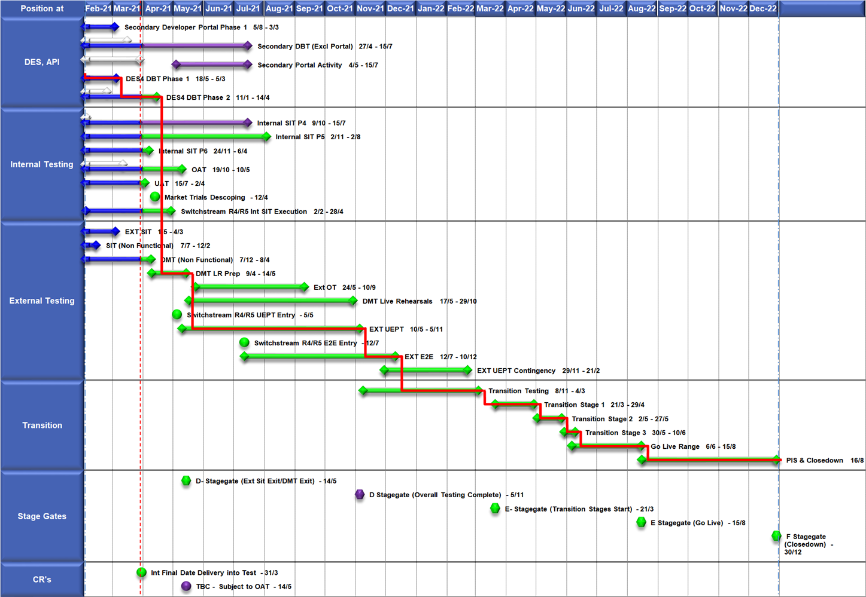
High Level Plan

Slide 76
Switching Programme CR Position – CRs impacting Xoserve
CR Name | CR Ref | High Level Cost IA Cost | Date Raised | Status
Programme Plan Re-Baseline | CR-D002 | £0.00 | 07/11/2019 | Approved - Complete
Updates to the CSS Physical Interface Design (PhID). | CR-D008 | £17,250.00 | 22/01/2020 | Approved - Internal CR Created
CSS_Exception_Handling_Strategy_v0.2 | CR-D014 | £0.00 | 26/02/2020 | Approved - Internal CR Created
Provide_CSS_RegistrationID_to_PUI_and_LPs | CR-D016 | £12,643.00 | 07/08/2020 | Approved - Internal CR Created
Licence Exempt Network Customer Identifier – ABACUS Data Model update | CR-E51 | £0.00 | 29/10/2019 | Approved - Complete
Amendments to the DMS artefact suite | CR-D019 | £6,500.00 | 16/03/2020 | Approved - Internal CR Created
Migration of Terminated Gas RMPS | CR-D022 | £0.00 | 10/06/2020 | Approved - Internal CR Created
Amendments to the NC-0079 for REL (Retail Energy Location) Data Migration and Reconciliation | CR-D024 | £20,000.00 | 06/07/2020 | Approved - Internal CR Created
DMS - PHID Alignment Parties | CR-D026 | £0.00 | 06/07/2020 | Approved - Internal CR Created
Request For a New or Upgraded DMT Environment | CR-D027 | £256,009.00 | 07/08/2020 | Approved - Internal CR Created
Enable TLS connection pooling for all directly connected parties to CSS] | CR-D028 | £2,500.00 | 13/07/2020 | Approved - Internal CR Created
Message Header Format for PKI Certificate Identification] | CR-D029 | £2,500.00 | 13/07/2020 | Approved - Internal CR Created
SIT Functional Test Re Plan Enabling Parallel Testing | CR-D030 | £56,000.00 | 20/07/2020 | Approved - Internal CR Created
DM_Validation Catalogue_Shipper_Effective_Date_Change_ | CR-D032 | £0.00 | 03/08/2020 | Approved - Internal CR Created
Compression During Data Migration | CR-D034 | £500.00 | 09/09/2020 | Approved - Internal CR Created

Slide 77
Switching Programme CR Position – CRs impacting Xoserve
CR Name | CR Ref | High Level Cost IA Cost | Date Raised | Status
Compression During Data Migration | CR-D034 | £500.00 | 09/09/2020 | Approved - Internal CR Created
Uplift to the CSS Interface Specifications | CR-D038 | £70,000.00 | 07/10/2020 | Approved - Internal CR Created
Uplift to Business Data Validation Rules | CR-D039 | £20,000.00 | 25/09/2020 | Approved - Internal CR Created
Programme Plan Re-Baseline | CR-D042 | £14,913,000.00 | 28/09/2020 | Approved - Internal CR Created
Changes to Support Energy Company Data | CR-D059 | £25,500.00 | 25/01/2021 | Pending SI Response
Operational Choreography Detection 0.5 | CR-D060 | £308,205.00 | 25/01/2021 | Pending SI Response
Operational Choreography Rectification 0.3 | CR-D061 | £0.00 | 25/01/2021 | Pending SI Response
Amendment of Data Migration Solution to Protect Programme Timescales - Removal of Transition Stage 1 Delta files | CR-D062 | £83,490.00 | 25/02/2021 | Approved - Internal CR Created
Uplift to the CSS Business Data Validation Rules Doc | CR-D067 |  | 19/03/2021 | Pending PIA
Uplift to the CSS Interface Specification | CR-D068 |  | 15/03/2021 | Pending PIA
REL Dissemination to iDNO and DNO | CR-D069 |  | 15/03/2021 | Pending PIA
Change to Management of In-Flight Switches Approach | CR-D071 | £0.00 | 15/03/2021 | Pending SI Response

Slide 78
Switching Programme CR Position – CRs not impacting Xoserve
CR Name | CR Ref | High Level Cost IA Cost | Date Raised | Status
Non_Mandatory_MPAS_Metered_Indicator_v0.4 | CR-D001 | £0.00 | 27/01/2020 | Complete - No Xoserve Impact
REC Manager Procurement Timelines | CR-D003 | £0.00 | 02/12/2019 | Complete - No Xoserve Impact
MPAS Related MPAN Disconnection | CR-D004 | £0.00 |  | Withdrawn
Introduction of Validation Message to Logical Mode | CR-D005 | £61,000.00 | 25/11/2019 | Withdrawn
Modification of Related MPAN Cleanse Checkpoint Milestones | CR-D006 | £0.00 | 27/11/2019 | Complete - No Xoserve Impact
ABACUS Corrections and Re-alignments | CR-D007 | £0.00 | 04/12/2019 | Complete - No Xoserve Impact
ECOES REL API Webmethod | CR-D009 | £0.00 | 17/12/2019 | Complete - No Xoserve Impact
CSSIA Uplift to Implement IG Recommendations | CR-D010 | £0.00 | 17/12/2019 | Complete - No Xoserve Impact
Update 3 E2Es to align to CSSIA | CR-D011 | £0.00 | 10/06/2020 | Complete - No Xoserve Impact
CSS_Physical_Interface_Design_Updates_mpxn_v0.2 | CR-D012 | £0.00 | 30/01/2020 | Complete - No Xoserve Impact
Messaging_Requirements_Revisions_REC_Code_Manager_and_CSS_v0.1 Clean | CR-D013 | £0.00 | 28/01/2020 | Complete - No Xoserve Impact
Amendment_of_Xoserve_Consequential_Change_Milestone_Delivery_Dates_v0.2[DRAFT] | CR-D015 | £0.00 | 26/02/2020 | Withdrawn
CSS_Handling_of_MPAS_Business_Dates_v0.2[DRAFT] | CR-D017 | £3,500.00 | 20/07/2020 | Complete - No Xoserve Impact
Confirmation_Responses_to_Outbound_Synchronisations_v0.2[DRAFT] | CR-D018 | £0.00 | 02/03/2020 | Withdrawn
Regulatory Workstream – Programme Milestones Refresh | CR-D020 | £0.00 | 16/03/2020 | Withdrawn
Remove MPAS Interface | CR-D021 | £0.00 | 29/04/2020 | Withdrawn
DSP_Specific_ SIT_ Functional_Exit_Criteria | CR-D023 | £0.00 | 29/05/2020 | Complete - No Xoserve Impact
Changes to support enhanced Solar arrangements | CR-D025 | £0.00 |  | Withdrawn
CSS Role-based access control (RBAC) | CR-D031 | £48,530.00 | 24/07/2020 | Withdrawn
A Quality Analysis Activity of the Data being used for the DMT Non-Functional Test Phase​​ | CR-D033 | £0.00 |  | Withdrawn
CSS Change from UTC to Local Time | CR-D035 | £0.00 | 22/09/2020 | Complete - No Xoserve Impact
Xoserve CR for DES AI Removal | CR-D036 | £0.00 | 24/09/2020 | Complete - No Xoserve Impact
Provide_CSS_RegistrationID_to_LPs | CR-D037 | £0.00 | 06/10/2020 | Complete - No Xoserve Impact
UEPT Tranche Regulatory Change | CR-D040 | £0.00 | N/A | Complete - No Xoserve Impact

Slide 79
Switching Programme CR Position – CRs not impacting Xoserve
CR Name | CR Ref | Date Raised | Status
NCT-0073 Functional Script Master Changes | CR-D041 | 25/09/2020 | Complete - No Xoserve Impact
Update to the End to End Testing Plan | CR-D043 | 05/10/2020 | Complete - No Xoserve Impact
Request For a New DMT Environment for DMT Live Rehearsal | CR-D044 | 23/10/2020 | Complete - No Xoserve Impact
NC-0079 Adding Post Load Integrity Check Document | CR-D045 | 09/11/2020 | Complete - No Xoserve Impact
Uplift to the Code of Connection | CR-0046 | 09/11/2020 | Complete - No Xoserve Impact
Correctional Changes to MAD Log v2.0 & POAP v2.0 | CR-D047 | 13/11/2020 | Complete - No Xoserve Impact
Changes to Data Milestones in MAD Log v2.0 & POAP v2.0 | CR-D048 | 09/11/2020 | Complete - No Xoserve Impact
Consequential Changes to Testing Milestones in MAD Log | CR-D049 | 13/11/2020 | Withdrawn
CSS Environments for Faster Switching Enduring Service | CR-D050 |  | Withdrawn
Changes to Data Validation Rules | CR-D051 | 30/11/2020 | Complete - No Xoserve Impact
Additional and Further Correctional Changes to MAD Log v2.0 | CR-D052 | 05/12/2020 | Complete - No Xoserve Impact
Additional Onward Dependencies for MAD Log | CR-D053 | 18/12/2020 | Complete - No Xoserve Impact
Changing from GetOrganised to Landmark SFTP for SI receiving files | CR-D054 | 18/12/2020 | Complete - No Xoserve Impact
Amendments to the Data Cleansing Catalogue | CR-D055 | 18/12/2020 | Complete - No Xoserve Impact
MAD Log Changes for UIT Environment Verification | CR-D057 | 25/01/2021 | Complete - No Xoserve Impact
Discontinuance of Xoserve Consequential Change Market Trials | CR-D058 | 25/01/2021 | Complete - No Xoserve Impact
Uplift to SMS CoCo | CR-D063 | 29/01/2021 | Complete - No Xoserve Impact
Changes to SIT Functional Test Scenarios | CR-D064 | 29/01/2021 | Complete - No Xoserve Impact
Uplift to the Code of Connection | CR-D065 | 29/01/2021 | Complete - No Xoserve Impact
Removal of UEPT Stage 1 Data Allocation and Verification for Tranche 3 and 4 Participants and delivery acceleration of Stage 2 Data Allocation | CR-D070 | 05/03/2021 | Complete - No Xoserve Impact
Re-align Switching Programme Response SLAs with Xoserve response SLAs | CR-D072 |  | On Hold
Changes to MAD Log v2.2 to rectify incorrect milestone descriptions | CR-D074 | 29/03/2021 | Complete - No Xoserve Impact
Update Service Management Baseline Requirement | CR-D076 | 20/04/2021 | Complete - No Xoserve Impact

