Slide 1
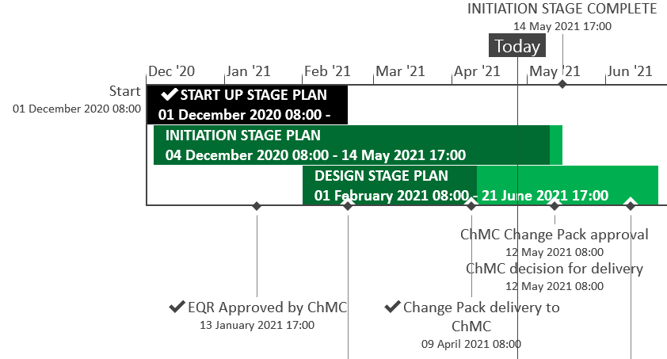
XRN5289 – November 21 Major Release - Status Update
 | Overall Project RAG Status
 | Schedule | Risks and Issues |  | Cost
RAG Status
Status Justification
Schedule | Design phase on track to complete to current schedule Remaining 3 change packs delivered on plan; eChMC arranged for 5th May for approval Implementation approach and full project timeline planned to be delivered following scope confirmation Implementation window 5th November Contingency Implementation window 12th November No recommendation for Market Trials for the changes in scope Decision in May ChMC & Return to Green: Approve BER and agree November 21 Delivery Scope
Risks and Issues | ​RISK (XRN5142) - Unknown volumes for data cleanse Mitigation - Regular touch points with DCC in place, we understand the method, need to understand the expected volume and plan
Cost | Forecast to complete design against approved EQR Return to Green: Approval of BER required to progress to Build phase
Scope | XRN4941 - MOD0692 - Auto updates to meter read frequency​ XRN5007 - Enhancement to reconciliation process where prevailing volume is zero​ XRN5072 - Application and derivation of TTZ indicator and calculation of volume and energy – all classes​ XRN5091 - Deferral of creation of Class change reads at transfer of ownership​ XRN5142 - New allowable values for DCC Service Flag in DXI File from DCC​ XRN5180 - Inner tolerance validation for replacement reads and read insertions​ Descoped - XRN5186 MOD0701 – Aligning capacity booking under the UNC and arrangements set out in relevant NExAs​ Descoped - XRN5187 MOD0696 – Addressing inequalities between capacity booking under the UNC and arrangements set out in the relevant NExAs
Slide updated on 28th April 2021

