Slide 1
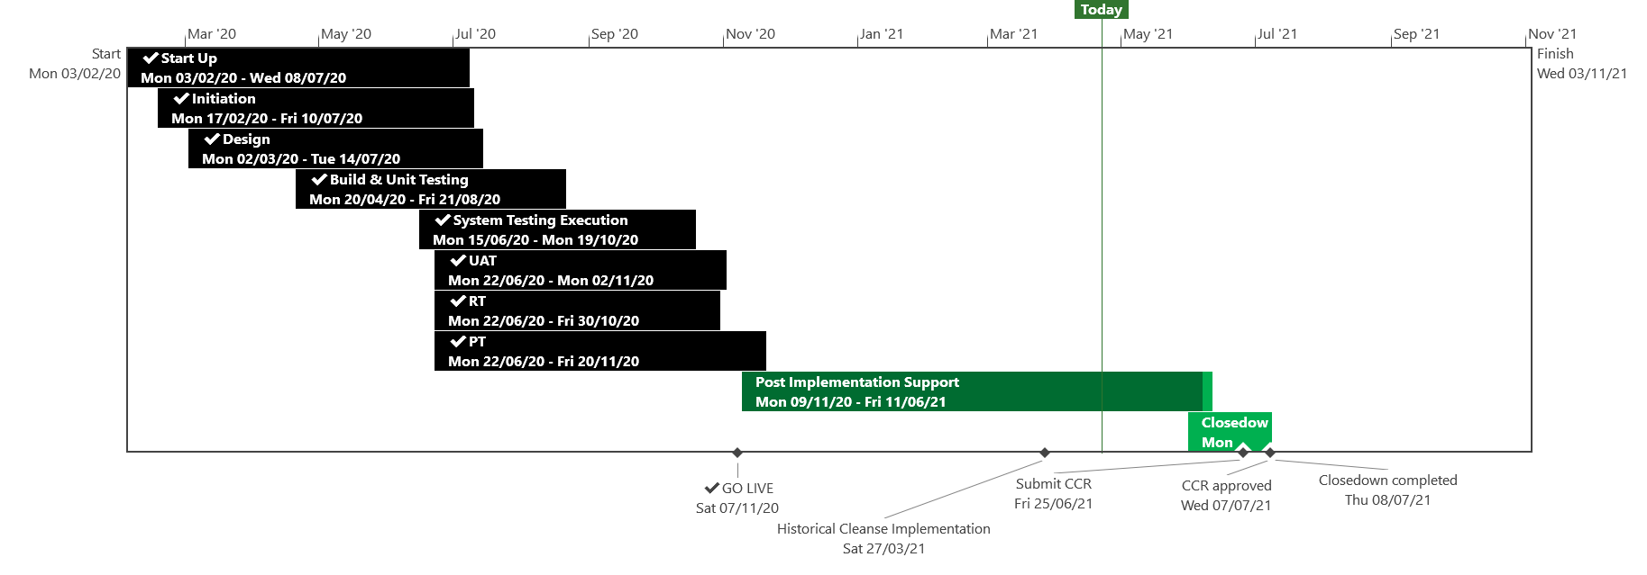
XRN5110 – Nov 20 Release - Status Update
 | Overall Project RAG Status
 | Schedule | Risks and Issues | Cost
RAG Status
Status Justification
Schedule | November 20 Release delivered, final activity for Historical Cleanse XRN4897/99 is on going, due to be completed to schedule Historical Cleanse commenced on the 27th March, on track to complete to schedule Historical Cleanse expected to run to 4th June CCR to be submitted to July ChMC Decision in May ChMC: None
Risks and Issues | ​Issue: XRN4897/99 Historical Cleanse Change Request needs to be completed to exit Post Implementation Support Risk: UK Link may be non GDPR compliant following Historical Cleanse due to missing unknown scenarios Return to Green: Completion of XRN4897/99 Historical Cleanse
Cost | Forecast to complete delivery against approved BER
Scope | In Scope - XRN4897 Resolution of deleted Contact Details (contained within the S66 records) at a Change of Shipper event In Scope - XRN4899 Treatment of Priority Service Register Data and Contact Details on Change of Supplier Event In Scope - XRN4801 Additional Information in DES In Scope - XRN4871b Rachet Regime Changes In Scope - XRN5014 Facilitating HyDeploy2 Live Pilot Descoped - XRN4931 Submission of a Space in Mandatory Data on Multiple SPA Files Descoped - XRN4941 MOD 692 – Auto Updates to Read Frequency Descoped - XRN4992 Supplier of Last Resort Charge Types Moved to CSSC - XRN4870c MAP ID
Slide updated on 28nd April 2021

