Slide 1
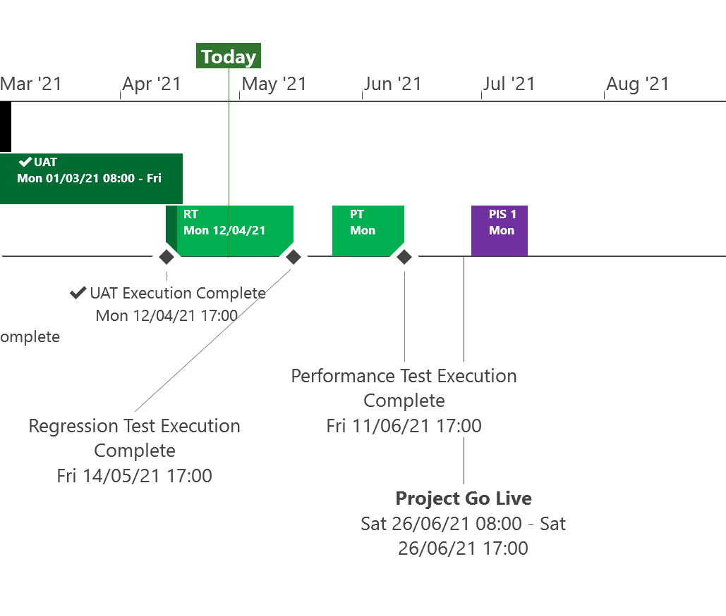
XRN5253 June 21 Major Release - Status Update
 | Overall Project RAG Status
 | Schedule | Risks and Issues | Cost
RAG Status
Status Justification
Schedule | Project On Track Testing phase progressing to plan System Testing and User Acceptance Testing complete. Regression Testing commenced to plan in April and on track to complete to schedule. E-Learning awareness training to be available from 28th May Project Cutover will be completed via code transport on Saturday 26th June Post Implementation Support dates agreed and to be made available in June ChMC Decision In May ChMC None
Risks and Issues | None Applicable
Cost | Forecast costs on track to complete within approved BER
Scope | In Scope (XRN5093) - MOD0711 – Update of AUG Table to reflect new EUC bands Descoped (XRN4992) - MOD0687 – Creation of new charge to recover last resort supply payments – Descoped at Extraordinary ChMC on 26th October 2020 Descoped (XRN4941) - MOD0692 - Auto updates to meter read frequency – Descoped at ChMC on 11th November 2020
Complete
On Track
At Risk
Overdue
Not Baselined
Slide updated on 26th April 2021

