Slide 1
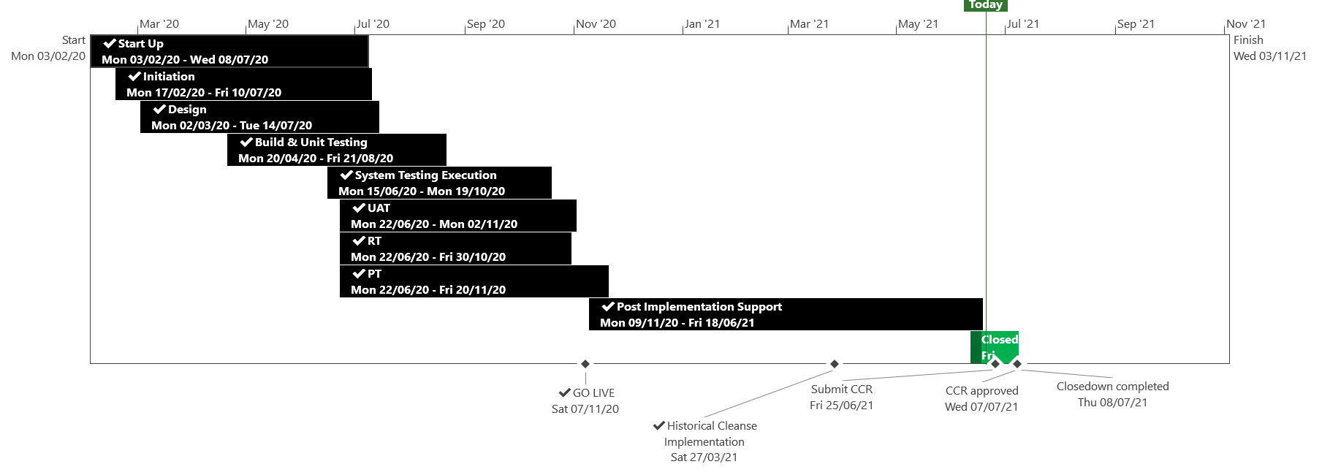
XRN5110 – Nov 20 Release - Status Update
 | Overall Project RAG Status
 | Schedule | Risks and Issues | Cost
RAG Status
Status Justification
Schedule | November 20 Release completed Historical Cleanse completed successfully on the 4th June 2021 Final Shipper reports issued on the 8th June 2021 All Shipper reports will be saved for 3 months until 24th September 2021 in each shippers unique SharePoint folder CCR submitted to July ChMC for approval Decision in July ChMC: Approval required of CCR
Risks and Issues | No open risks or issues to report
Cost | Forecast to complete delivery against approved BER
Scope | In Scope - XRN4897 - Resolution of deleted Contact Details (contained within the S66 records) at a Change of Shipper event In Scope - XRN4899 - Treatment of Priority Service Register Data and Contact Details on Change of Supplier Event In Scope - XRN4801 - Additional Information in DES In Scope - XRN4871b - Rachet Regime Changes In Scope - XRN5014 - Facilitating HyDeploy2 Live Pilot Descoped - XRN4931 Submission of a Space in Mandatory Data on Multiple SPA Files Descoped - XRN4941 MOD 692 – Auto Updates to Read Frequency Descoped - XRN4992 Supplier of Last Resort Charge Types Moved to CSSC - XRN4870c MAP ID
Complete
On Track
At Risk
Overdue
Not Baselined
Complete
On Track
At Risk
Overdue
Not Baselined
Slide updated on 22st June 2021

