Slide 1
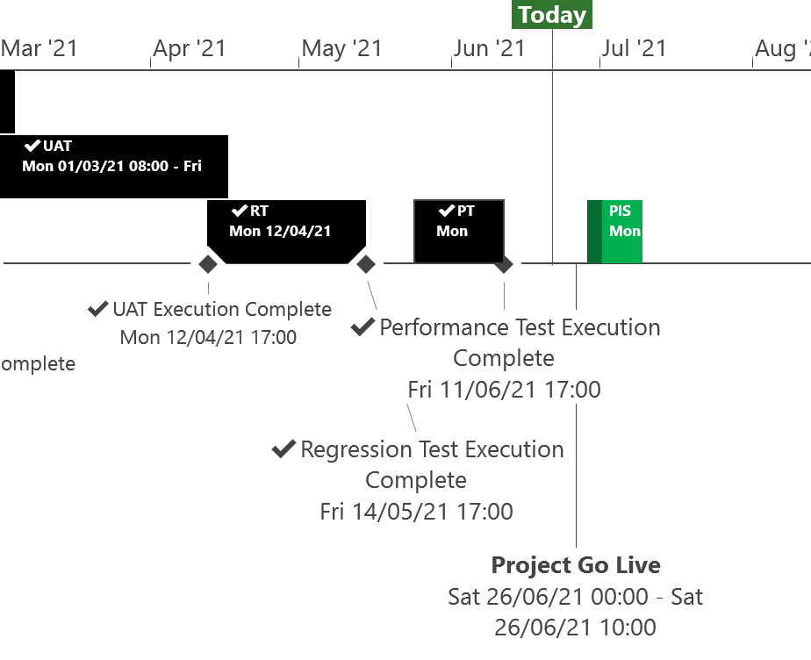
XRN5253 June 21 Major Release - Status Update
 | Overall Project RAG Status
 | Schedule | Risks and Issues | Cost
RAG Status
Status Justification
Schedule | XRN5253 June 21 Project is on track All Testing phases successfully completed Implementation Dress Rehearsal has successfully completed ahead of Go live Go Live is scheduled for Saturday 26th June First Post Implementation Support (PIS) period to commence from 28th June and run until 9th July Further PIS periods scheduled between September and December to cover all 1st Usage. Decision In July ChMC None
Risks and Issues | None Applicable
Cost | Forecast costs on track to complete within approved BER
Scope | In Scope (XRN5093) - MOD0711 – Update of AUG Table to reflect new EUC bands Descoped (XRN4992) - MOD0687 – Creation of new charge to recover last resort supply payments – Descoped at Extraordinary ChMC on 26th October 2020 Descoped (XRN4941) - MOD0692 - Auto updates to meter read frequency Descoped at ChMC on 11th November 2020
Complete
On Track
At Risk
Overdue
Not Baselined
Slide updated on 21st June 2021

