Slide 1
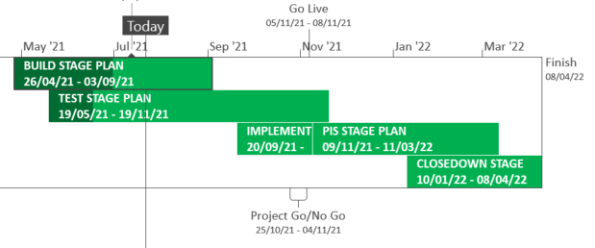
XRN5289 – November 21 Major Release - Status Update
 | Overall Project RAG Status
 | Schedule | Risks and Issues |  | Cost
RAG Status
Status Justification
Schedule | Build is completed and System Test has commenced for XRN4941 and XRN5007 System Testing is complete for XRN5142 and in progress for remaining changes User Acceptance Testing has commenced for XRN5072, XRN5142 and XRN5180 XRN4780C plan is currently being detailed out Decision In August ChMC: No decisions are required this month.
Risks and Issues | Risk (RTC66544) - ​Increase in the number of BAU defects being found for XRN5072 during testing. Mitigation, defects are currently all planned to be deployed prior to exiting testing
Cost | Forecast to complete delivery against approved BER
Scope | In Scope – XRN4941 - MOD0692 - Auto updates to meter read frequency In Scope - XRN5007 - Enhancement to reconciliation process where prevailing volume is zero​ In Scope - XRN5072 - Application and derivation of TTZ indicator and calculation of volume and energy – all classes​ In Scope - XRN5142 - New allowable values for DCC Service Flag in DXI File from DCC​ In Scope - XRN5180 - Inner tolerance validation for replacement reads and read insertions​ In Scope – XRN4780C – Inclusion of Meter Asset Provider Identity (MAP Id) in the UK Link system (CSS Consequential Change) Descoped - XRN5091 - Deferral of creation of Class change reads at transfer of ownership​ Descoped - XRN5186 MOD0701 – Aligning capacity booking under the UNC and arrangements set out in relevant NExAs​ Descoped - XRN5187 MOD0696 – Addressing inequalities between capacity booking under the UNC and arrangements set out in the relevant NExAs
Complete
On Track
At Risk
Overdue
Not Baselined
Slide updated on 22nd July 2021

