Slide 1
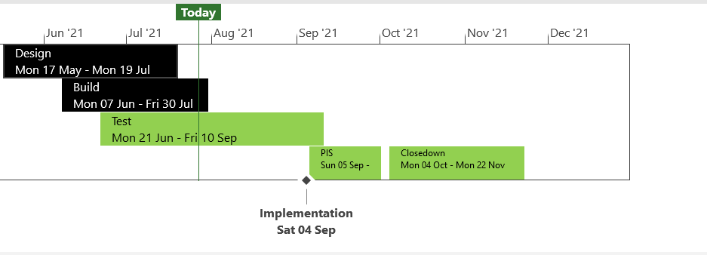
XRN5371 - Minor Release Drop 10 - Status Update
 | Overall Project RAG Status
 | Schedule |  | Risks and Issues | Cost
RAG Status
Status Justification
Schedule | Build phase completed for all changes Acceptance Testing phase competed for all changes Regression Testing in progress, expecting to meet milestones as per plan Performance Testing preparation in progress Go Live on track for Saturday 4th September Decision in August: No decisions are required this month.
Risks and Issues | None applicable
Cost | On track to complete within approved spend
Scope | XRN5309 - FSG Automation of FSR Process XRN5188 - MAP ID Data Upload to UK Link XRN5246 - Confirmation File Performance improvements
Complete
On Track
At Risk
Overdue
Not Baselined
Slide Updated on 27th July 2021

