Slide 1
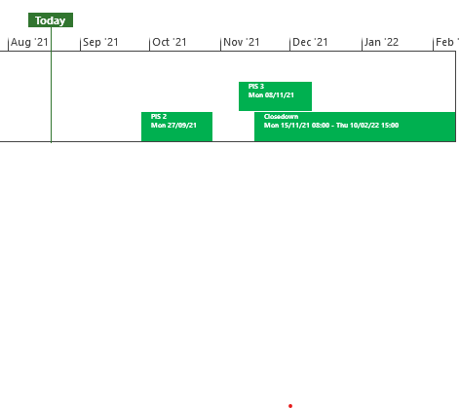
XRN5253 June 21 Major Release - Status Update
 | Overall Project RAG Status
 | Schedule | Risks and Issues | Cost
RAG Status
Status Justification
Schedule | Project On Track Post Implementation Support (PIS) period 2 to commence on 27/09/21 Decision In September ChMC None
Risks and Issues | None Applicable
Cost | Forecast costs on track to complete within approved BER
Scope | In Scope (XRN5093) - MOD0711 – Update of AUG Table to reflect new EUC bands Descoped (XRN4992) - MOD0687 – Creation of new charge to recover last resort supply payments – Descoped at Extraordinary ChMC on 26th October 2020 Descoped (XRN4941) - MOD0692 - Auto updates to meter read frequency – Descoped at ChMC on 11th November 2020
Complete
On Track
At Risk
Overdue
Not Baselined
Slide updated on 19th August 2021

