Slide 1
Change Management Committee
11th August 2021

Slide 2
Section 2: DSC Change Budget & Horizon Planning

Slide 3
DSC Change Budget 21/22 YTD
For discussion

Slide 4
Budget v Committed Spend BP21/22
Full finance tracker linked here with commentary on monthly variance

Slide 5
Annual General (DSC) Change Budget in BP22
ChMC recommendation required

Slide 6
Headlines
The suggested DSC (UNC/REC, value add) Change Budget for has a similar size and shape to BP21
Rather than being based on an existing change backlog (this time last year we knew more about the changes already in the pipeline and had a predictable delivery backdrop) we are instead basing this budget on potential delivery windows and historic costs to deliver change
All unspent funds returned at end of financial year with ChMC in control of scoping decisions throughout

Slide 7
Approach
xoserve-bp22-principles-and-approach-draft-single.pdf

Slide 8
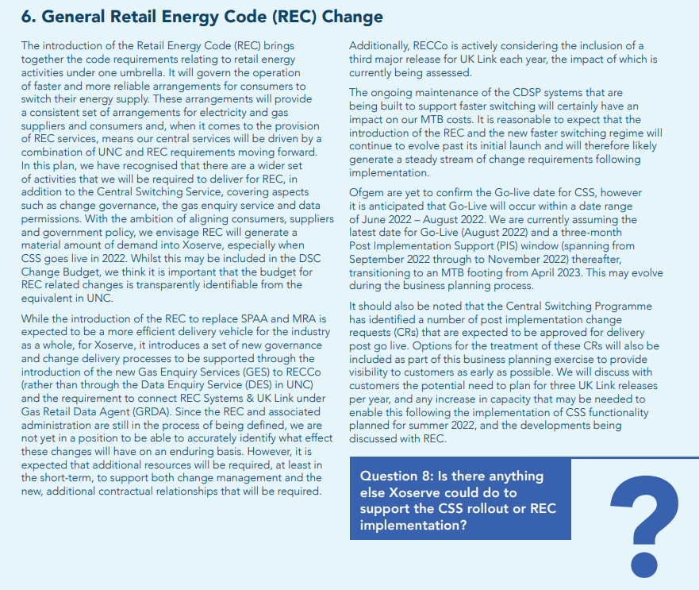

Slide 9
REC Impacts on Change Delivery and Development
As well as being CDSP under DSC, Xoserve is appointed under REC as Gas Retail Data Agent (GRDA) and Gas Enquiry Service (GES)
Changes will arise from REC like they do from other codes (UNC) and these changes will impact DSC IT systems / process (e.g. UK Link). These changes will need DSC funding in BP22 and beyond
A budget will be required to sit alongside the ‘Annual UNC Budget’ (DSC Change) to fund REC change
Known
Assumption
Impact
REC combines related gas and electricity changes together under one code
There will be a requirement to deliver change in February as well as June / November, to align with other fuel change delivery releases
Future change budgets will need to be appropriately sized to fund a 3rd major release
Delivery
Xoserve’s current business plan doesn’t include any costs associated with ‘BAU’ (non CSSC programme) REC change.
UNC / DSC change will continue to be raised at historic pace, at the same time as a potentially busy period of REC change (post CSS implementation)
Xoserve / Correla change development / delivery resource capacity / capability will need to reflect this increased demand
Development

Slide 10
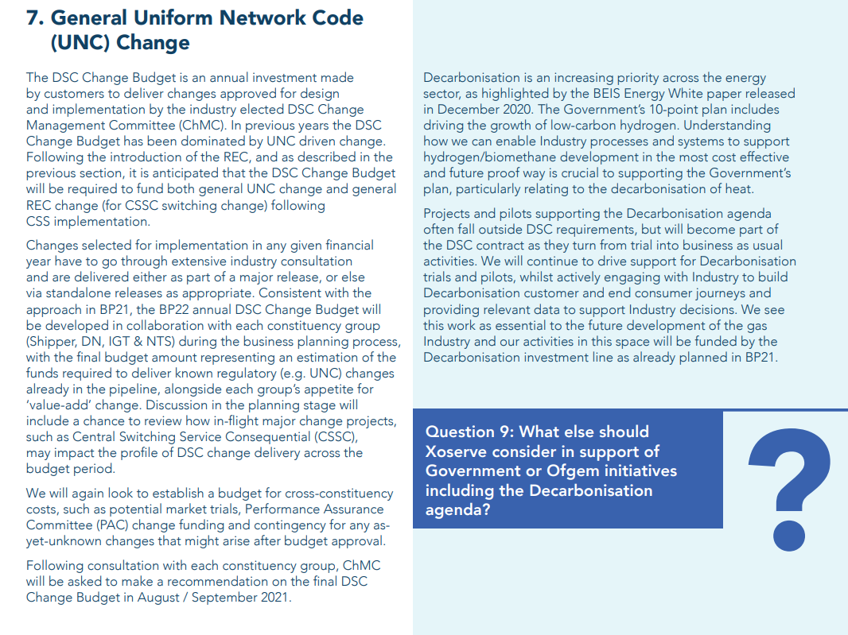

Slide 11
Potential Releases & Impacts to Change Budget BP22
 | 2022 |  |  |  |  |  |  |  |  |  |  |  | 2023 |  |  |  |  |  |  |  |  |  |  |  | 2023
 | Jan | Feb | Mar | Apr | May | Jun | Jul | Aug | Sep | Oct | Nov | Dec | Jan | Feb | Mar | Apr | May | Jun | Jul | Aug | Sep | Oct | Nov | Dec | Jan | Feb | Mar | Apr
Minor
Major
CSSC
MiR 12
MiR 13
MiR 14
MiR 15
MiR 16
MiR 17
MiR 18
N22
Develop
Design
Build/Test
PIS
F23
Develop
Design
Build/Test
PIS
J23
Develop
Design
Build/Test
PIS
N23
Develop
Design
Build/Test
PIS
Key
BP22 Delivery Budget Impact
Planning
Transition
Go Live Range
PIS
BP22 Development Budget Impact
BP22 No Impact

Slide 12
Suggested Major Release Delivery Budget
The image below uses the average post-Nexus costs listed in Change Completion Reports (CCRs) for major releases
Where project delivery crosses financial years, only the elements that will be approved (via EQR / BER) have been included.
EQR value based on c10% of total release costs
The costs don’t include development (capture) costs
£2.4m
Historic Costs to calculate average
N22
£0.73m
F23
£0.81m
J23
£0.81m
N23
£0.08m
N22
Develop
Design
Build/Test
PIS
F23
Develop
Design
Build/Test
PIS
J23
Develop
Design
Build/Test
PIS
N23
Develop
Design
Build/Test
PIS

Slide 13
Suggested REC Change Development Budget
Additional resources will be required to develop REC changes alongside more traditional change sources (e.g. UNC)
It is appropriate to seek investment (rather than to increase MTB) to cover this work for at least 1 year post CSS implementation so that demand can be assessed
Some change development costs will apply throughout the financial year, with resources being utilised to interact with REC governance, impact assess incoming change and work with DSC customers to develop solutions (capture)
£0.25m
N22
Develop
Design
Build/Test
PIS
F23
Develop
Design
Build/Test
PIS
J23
Develop
Design
Build/Test
PIS
N23
Develop
Design
Build/Test
PIS

Slide 14
Suggested % Share of Budget
It is proposed that the budget is funded based on the % splits applied in BP21 (which also have a similar profile to what was spent by each constituency in BP20)
It is proposed that contingency may not be required as we are using delivery bandwidth, rather than bottom-up change approach to set total budget - however constituencies may wish to add specific contingency amounts, which would not impact any other constituency weighting
All uncommitted funds are returned at the end of the financial year

Slide 15
Change Pipeline

Slide 16
Change Development & Delivery Pipeline (DSC Change / Minor Release Budget)
* Pre-capture may contain changes that won’t require delivery / funding

Slide 17

2020-2022 DSC Change / MiR Pipeline
 | 2021 |  |  |  |  |  |  |  |  |  |  |  | 2022
 | Jan | Feb | Mar | Apr | May | Jun | Jul | Aug | Sep | Oct | Nov | Dec | Jan | Feb | Mar | Apr | May | Jun | Jul | Aug | Sep | Oct | Nov | Dec
Minor Releases
Major Releases
CSSC
Standalone Change
MiR 9
CCR
Key:
Approval on track
Scope
MiR 10
MiR 11
CCR
Approved
Scope
MiR 12
CCR
Scope
June 2021 (DBTI + PIS/Closedown)
CCR
Approval at risk
Nov 2021 Analysis / Design
November 2021 Build/Test Implement/PIS
BER
XRN
4780C
CCR
Nov 20 PIS
CCR
Nov 2022 Analysis / Design
November 2022 Build/Test/Implement/PIS
Nov 21 IA
Regression
EXTERNAL(MT/UEPT/E2E/Defect Mgmt)
XRN
4780C
Planning
Transition
Go Live Range
PIS
XRN
5206
5237
XRN
5146
XRN
5038
XRN
5231
Key:
Retro
On Track
XOS Change Fund 21/22
Potential Activity
PAC
Complete
PAC XRN4876
Potential risk to plan
BER
CCR
Plan At Risk

Slide 18
Section 3: Capture

Slide 19
3.1 New Change Proposals – Initial Review
XRN / Title | Voting |  |  |  | DSC Service Area
 | Shipper | DNO | IGT | NTS
XRN4900 Biomethane Sites with Reduced Propane Injection | Y | Y
XRN5393 Implementation of NTS Capacity related UNC Modifications 0752S, 0759S & 0755S | Y | Y |  | Y | TBC
XRN5402 Request impact assessment on proposed REC Change Management Impact Assessment | Y | Y | Y | Y | N/A

Slide 20
XRN4900 Biomethane Sites with Reduced Propane Injection
Voting Parties
Change Details
Customer Class | Voting Party?
Shipper | Y
Distribution Network Operators (DNOs) | Y
National Grid Transmission
IGT’s
Problem Statement
As part of its carbon Net Zero ambitions, SGN is assessing the potential to reduce the requirement to inject propane at biomethane entry points in Scotland. LDZ embedded entry points may inject biomethane with ~4% propane content to increase the energy value of the gas to meet the GDN target CV which is calculated based on the current Scotland LDZ average daily CV (FWACV).
Change Description
To facilitate the correct energy balancing / billing and transportation charging (use of a site-specific CV and energy adjustments), SGN requires Xoserve to provide solution options considering impacts on: LDZ System commodity invoice, LDZ Entry invoice, NTS commodity invoice(s)) and, the relevant Shipper’s energy balancing position Capacity charging (incorrect consumptions would lead to incorrect AQs and possibly incorrect SOQs) Impacts of meter reads, reconciliation, ratchets, check-check reads, site visits Adjustments received after D+5 exit close-out Any acceptable solution option should be considered a pragmatic, tactical solution. Cadent’s Future Billing Methodology (FBM) Project is assessing the possibility to introduce sub-LDZ CV charging zones. It is anticipated a future rollout of FBM will provide a robust and enduring solution that will support the revised biomethane arrangements.
DSC Service Area: | TBC
Link to Change Proposal | Link to CP
Change Type | Regulatory
Priority Score | High
Sponsor Representative | SGN

Slide 21
XRN5393 Implementation of NTS Capacity related UNC Mods 0752S, 0759S & 0755S
Voting Parties
Change Details
Customer Class | Voting Party?
Shipper | Y
Distribution Network Operators (DNOs) | Y
National Grid Transmission | Y
IGT’s
Problem Statement
Implementation of UNC Modifications as per the solutions set out in the modifications 0752S - Introduction of Weekly Entry Capacity Auction 0755S - Enhancement of Exit Capacity Assignments 0759S - Enhancements to NTS Within-Day Firm Entry and Exit Capacity Allocations
Change Description
0752S “Introduction of Weekly Entry Capacity Auction” - Stage 1 RMTnTSEC - Stage 2 RMTnTSEC - Move the monthly batch job forward from the last gas day of the month - Introduce of the weekly auction type to provide the option to purchase entry capacity in weekly strips.. - Add in a weekly batch job at D-7 to occur each week after allocation - Introduce the ability to charge two different prices for days within the week that will span 2 gas years - Post implementation support 0759S “Enhancements to NTS Within-Day Firm Entry and Exit Capacity Allocations” - Introduce hourly allocations for NTS Exit Capacity - Allow additional NTS entry and exit capacity allocation at 02:00 - Extend the NTS entry and exit capacity bid invitation windows - Introduce a 30-minute capacity allocation period for NTS Exit Capacity - GNCC to have visibility of obligated and non-obligated quantities Automatic processing of obligated bids when the bid processing automation is set to “off” - Roll over to the next auction any exit capacity restrictions put in place 0755S “Enhancement of Exit Capacity Assignments” - Ability to assign (entitlement and liability) all or part of a Users capacity holdings - Partial assignments invoiced accordingly See CP for full description
DSC Service Area: | TBC
Link to Change Proposal | Link to CP
Change Type | Regulatory
Priority Score | High
Sponsor Representative | National Grid

Slide 22
XRN5402 Request impact assessment on proposed REC Change Management Impact Assessment
Voting Parties
Change Details
Customer Class | Voting Party?
Shipper | Y
Distribution Network Operators (DNOs) | Y
National Grid Transmission | Y
IGT’s | Y
Problem Statement
The CDSP needs the ability to respond to REC's requests for various levels of Impact Assessments and conform to the agreed timescales in accordance with the REC Change Management Schedule, due to be implemented with the introduction of the REC in September 2021.
Change Description
The Retail Energy Code Manager will, in accordance with the REC Change Management Schedule, request from identified Service Providers (of which the CDSP resides) various levels of Impact Assessments in relation to REC Change Proposals. These impact assessments will conform to various deadlines for delivery and should cover any impacts/cost/delivery timescales in relation to CDSP Systems/Services, CDSP Service Provider System/Services & CDSP Customer System/Services (where appropriate). It is anticipated that there will be three levels of Impact Assessments being formally requested by the Code Manager: Standard Impact Assessment - 5WD Preliminary Impact Assessment - 15WD Detailed Impact Assessment - 40WD (Timeframe may differ depending on approval from the Code Manager) The CDSP (and it's service providers) need to ensure that the appropriate level of detail is provided back to the REC Code Manager within the agreed timeframes to ensure adherence with the REC performance standards (PAB).
DSC Service Area: | N/A
Link to Change Proposal | Link to CP
Change Type | Regulatory
Priority Score | High
Sponsor Representative | Xoserve

Slide 23
XRN5365 - Request impact assessment on aligning Major Releases to the REC Release Schedule
Initial Review Change Pack Response Summary

Slide 24
Overview
XRN5365 was raised to carry out an impact assessment on the proposed alignment of Major Release delivery timescales with the REC
Discussion have been ongoing with REC Code Managers, with the CDSP informing them the outcome of the high level impact assessment
As part of this we requested ChMC to feed us any details the proposals would have on their respective businesses
A Change Pack was issued out in July (2859.5 - MT - PO) asking a number of questions to be fed into the REC as part of our impact assessment

Slide 25
Questions Asked
Do DSC Customers envisage that the CDSP will coordinate and facilitate REC related changes to DSC Services?
Do DSC Customers intend to retain control over the implementation dates of REC related changes that impact CDSP systems and processes?
Do you feel that the proposals set out by the REC present any risks, issues or associated costs to your organisation and / or the market?
Do you feel that the proposals set out by the REC may benefit your organisation and / or the market?
Are you in favour of introducing an additional functional Major or Minor Release into the DSC Release Calendar?
Do you support moving Major Release implementation dates to a weekday to align with the REC proposals?
Would you have similar support or concern if the same approach is adopted for Minor Release implementations?
If the proposals set out by the REC are opposed to, would it be accurate to assume that similar concerns would exist for those customers who operate gas and electricity system changes?
Please feed in any other comments and considerations that you feel will aid our assessment

Slide 26
Response Summary
CDSP to continue to coordinate REC related change to DSC systems/services (as per UNC Code changes)
No additional risks or issues are foreseen within your respective organisations from the proposals
Visibility of potential increase in DSC costs are currently unknown (fed into Business Planning activities)
Overall support for the proposed alignment of implementation dates to the REC
Overall support for the proposed additional Major Release in February

Slide 27
Next Steps
CDSP have passed the rep responses to the REC
CDSP to continue to work with the REC Code Manager to understand the Change Management process and horizon of change
Following final confirmation from the REC on the Implementation Approach, a more detailed IA to be carried out and required action to be undertaken
Continued ChMC engagement on impacts to the change processes

Slide 28
3.2 Change Proposals – Post Solution Review for Approval
XRN4931 – Submission of a Space in Mandatory Data on Multiple SPA Files
XRN5318 and 5319 – MPID Reassignment of Supplier Short Code and other Party Types

Slide 29
XRN4931 – Submission of a Space in Mandatory Data on Multiple SPA Files
Proposed Release Link to Change Proposal Change Pak Comm Ref Voting Funding | DSG/ Xoserve Preferred Option | Solution Summary Outcome and implementation date outcome |  |  |  | Comments
 |  | Organisation | Approve | Defer | Reject
Proposed delivery: Minor Release Link to Change Pack ref: 2859.1 - MT - PO Voting: Shipper Funding: 100% Shipper DSC Service Area 1: Manage Supply Point Registration | Option 3 Withdraw the change | SSE | X Option 3 |  |  | Option 3 - withdraw the change as the issue seems to have been mostly resolved without requiring a technical change solution.
 |  | EDF | X Option 3 |  |  | We support the option to withdraw this change if Xoserve believe this can now be managed without the need for change
 |  | Scottish Power | X Option 3 |  |  | We support Option 3 - Withdraw the Change Proposal - however, if volumes were to increase in the future to look at possibly again.

Slide 30
Post solution review - for approval
XRN5318 and 5319 – MPID Reassignment of Supplier Short Code and other Party Types

Slide 31
Change Summary and Output Review
Changes XRN5318 and XRN5319 requested that a feasibility analysis be completed to assess the size, complexity, cost and delivery timescale of Market Participant ID (MPID)
The findings of this analysis, which have been shared with the proposer, are as follows:
  The changes would be of a high complexity and extra large in size requiring a major release slot to be delivered
  The costs identified in the feasibility assessment were circa £1million to £1.75million
  This assessment identified significant impacts to UK Link, notably SPA, Invoicing and reporting
The proposer confirmed that this analysis met the requirements of the change and that they should be presented to DSG and ChMC to confirm completion
The findings were presented to DSG members on 26th July 2021 and members were in support of the recommendation to close the changes as complete
  It was noted that, should functional changes be required in the future, new Change Proposals should be raised in order to progress
Xoserve recommendation is that the Changes Proposals are marked as complete – on the basis that requested analysis has been completed and shared with customers and the Proposer
  Change Proposer and DSG members have provided their support on our recommendation

Slide 32
section 4. Design & Delivery

Slide 33
Standalone Change Documents for Approval (BER, CCR, EQR)
EQR for XRN5379 Class 1 Read Service Procurement Exercise (Modification 0710)
  Voting - Shippers
EQR for XRN5231 FWACV (Flow Weighted Average Calorific Value)
  Voting - DNO
BER for XRN5321 PAC Ring-Fenced DSC Change Budget 21/22
  Voting – Shippers, DNO, IGT

Slide 34
Gemini Horizon Plan
BER for XRN5368 Gemini Change Programme Sustain
- Voting - NTS

Slide 35
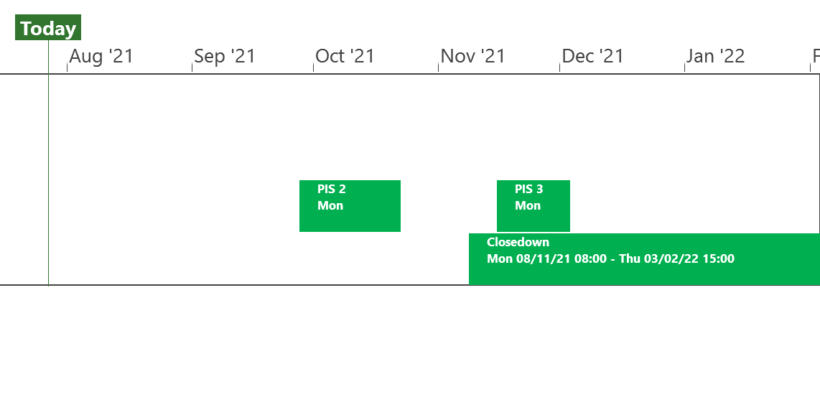
XRN5253 June 21 Major Release - Status Update
 | Overall Project RAG Status
 | Schedule | Risks and Issues | Cost
RAG Status
Status Justification
Schedule | Project On Track Project Go Live Successfully completed on 26/06/21 Post Implementation Support (PIS) Period 1 commenced to plan on 28/06/21 and completed on 09/07/21 Further PIS periods 2 & 3 scheduled between September and December to cover all 1st Usage. Decision In August ChMC No decisions are required this month.
Risks and Issues | None Applicable
Cost | Forecast costs on track to complete within approved BER
Scope | In Scope (XRN5093) - MOD0711 – Update of AUG Table to reflect new EUC bands Descoped (XRN4992) - MOD0687 – Creation of new charge to recover last resort supply payments – Descoped at Extraordinary ChMC on 26th October 2020 Descoped (XRN4941) - MOD0692 - Auto updates to meter read frequency – Descoped at ChMC on 11th November 2020
Complete
On Track
At Risk
Overdue
Not Baselined
Slide updated on 21st July 2021

Slide 36
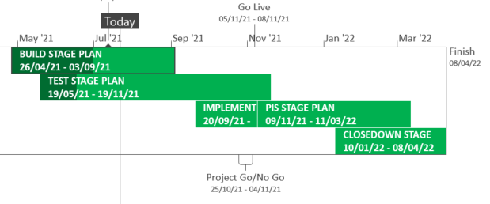
XRN5289 – November 21 Major Release - Status Update
 | Overall Project RAG Status
 | Schedule | Risks and Issues |  | Cost
RAG Status
Status Justification
Schedule | Build is completed and System Test has commenced for XRN4941 and XRN5007 System Testing is complete for XRN5142 and in progress for remaining changes User Acceptance Testing has commenced for XRN5072, XRN5142 and XRN5180 XRN4780C plan is currently being detailed out Decision In August ChMC: No decisions are required this month.
Risks and Issues | Risk (RTC66544) - ​Increase in the number of BAU defects being found for XRN5072 during testing. Mitigation, defects are currently all planned to be deployed prior to exiting testing
Cost | Forecast to complete delivery against approved BER
Scope | In Scope – XRN4941 - MOD0692 - Auto updates to meter read frequency In Scope - XRN5007 - Enhancement to reconciliation process where prevailing volume is zero​ In Scope - XRN5072 - Application and derivation of TTZ indicator and calculation of volume and energy – all classes​ In Scope - XRN5142 - New allowable values for DCC Service Flag in DXI File from DCC​ In Scope - XRN5180 - Inner tolerance validation for replacement reads and read insertions​ In Scope – XRN4780C – Inclusion of Meter Asset Provider Identity (MAP Id) in the UK Link system (CSS Consequential Change) Descoped - XRN5091 - Deferral of creation of Class change reads at transfer of ownership​ Descoped - XRN5186 MOD0701 – Aligning capacity booking under the UNC and arrangements set out in relevant NExAs​ Descoped - XRN5187 MOD0696 – Addressing inequalities between capacity booking under the UNC and arrangements set out in the relevant NExAs
Complete
On Track
At Risk
Overdue
Not Baselined
Slide updated on 22nd July 2021

Slide 37
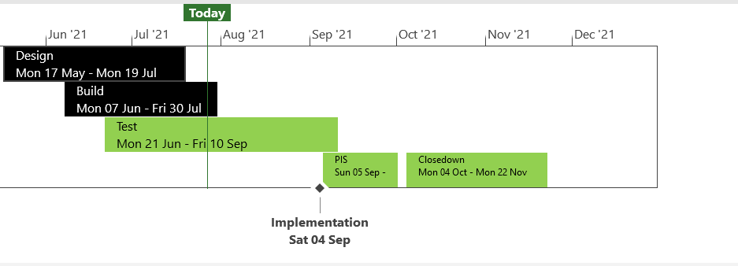
XRN5371 - Minor Release Drop 10 - Status Update
 | Overall Project RAG Status
 | Schedule |  | Risks and Issues | Cost
RAG Status
Status Justification
Schedule | Build phase completed for all changes Acceptance Testing phase competed for all changes Regression Testing in progress, expecting to meet milestones as per plan Performance Testing preparation in progress Go Live on track for Saturday 4th September Decision in August: No decisions are required this month.
Risks and Issues | None applicable
Cost | On track to complete within approved spend
Scope | XRN5309 - FSG Automation of FSR Process XRN5188 - MAP ID Data Upload to UK Link XRN5246 - Confirmation File Performance improvements
Complete
On Track
At Risk
Overdue
Not Baselined
Slide Updated on 27th July 2021

Slide 38

CSSC Programme Dashboard

Slide 39
Programme Update
Programme Health – RAG |  |  | Return to Green Plan
Overall Programme Status | Previous | Current | The programme remains at a Green status. Ofgem has shared some Go-live date principles by which they are looking at non-Mondays as potential Go-live dates. This analysis is currently a high focus area whilst we continue to work with Ofgem to provide them with the detail required to baseline their Go-live principles.
Programme Plan | Previous | Current
Risk Profile | Previous | Current
Resources | Previous | Current
Executive Summary |  |  |  | Upcoming Activities & Milestones (Next Month)
Key Programme Updates To date, all Xoserve key internal and external milestones have been met Transition: Live Rehearsal Cycle 1 has completed successfully. LR Cycle 2 commences on 30/07, with Transition Testing starting on 06/11. Internal & External Testing: All testing activities are on track. UEPT continues with no major impacts or defects. E2E Testing has commenced successfully. No defects to date. Business Change: Internal activities continue to plan including Target Operating Model. Service Management: Xoserve’s CR-D072 which was aiming to change the Response SLAs have now been through Industry consultation following a position being agreed across all PUIs. This is expected to be approved in August. Data Migration: Planning to begin to support Rel cycle 4b - due Oct. |  |  |  | Live Rehearsal: Commence Cycle 2 Internal Test: Progress CR testing and any relevant regression tests DES:& Secondary APIs Continue Test support Transition: Continue Transition planning MAP C: Delivery continues to plan, build updates will be provided via Nov 21 updates. REC: Continue REC version 3 review complete. Business Change: Continue awareness and knowledge transfer sessions

Slide 40
CMS Rebuild Update
June Updates for August’s ChMC
Jo Williams

Slide 41
CMS Rebuild - Progress to date
Summary of progress to date
Following on from the Must Reads Workshop and consequential discussions we are continuing to analyse the Must Read Options. We are evaluating the options to understand the benefits to all customer constituencies, as well as understanding additional process overheads that the options may create. We will be talking directly to customers where requested, as well as discussing at the relevant Detailed Analysis Workshop. Internal teams are continuing to revisit the GSR process to see if additional improvements can be identified and built into the Ideal “To Be” process, which will form the foundations of the GSR Detailed Analysis Workshop. The CMS Rebuild Team have completed the input to Rec Schedule 3 review, in relation to the CSSC the Programme senior BA has visibility of requirements of the CMS requirements. The BA shall also be a key attendance at the relevant CMS Workshops to ensure we understand any consequences. We shall continue to do this for any other key changes that are inflight too. We continue to work with the Xoserve Governance Team on the TOG Mod, the outputs shall be shared as the MOD Develops. We are refining the Workshop plan for both internal and external workshops, internal workshops will commence first to provide input into the external workshops. We are intending to run a kick off workshop during August, invites will be issued to the open distribution list in due course.

Slide 42
Section 6: Any Other Business

Slide 43
Interactive Unidentified Gas Data Charts
For Information

Slide 44
Interactive UIG Data Charts
We’ve launched two new interactive charts showing Unidentified Gas (UIG) data. The charts are accessed directly from the Xoserve website and allow users to ‘drill down’ to display data for a specific date range. The charts are:
  UIG Percentage by Gas Day – shows daily national UIG percentage levels for the first (D+1) and last (D+5) run of allocation (updated weekly).
  UIG as a Percentage of Total Throughput – shows monthly UIG as a percentage of total throughput at allocation and after reconciliations processed to date (updated monthly).
Both charts are available via the ‘UIG Interactive Data’ area of the 'Unidentified Gas (UIG)' page or from the Xoserve homepage, click Services and using the Issue Management dropdown, select Unidentified Gas (UIG) (Orange Section titled “UIG Interactive Data”).
Any queries in relation to this please contact the UIG team via uigtaskforce@xoserve.com

Slide 45
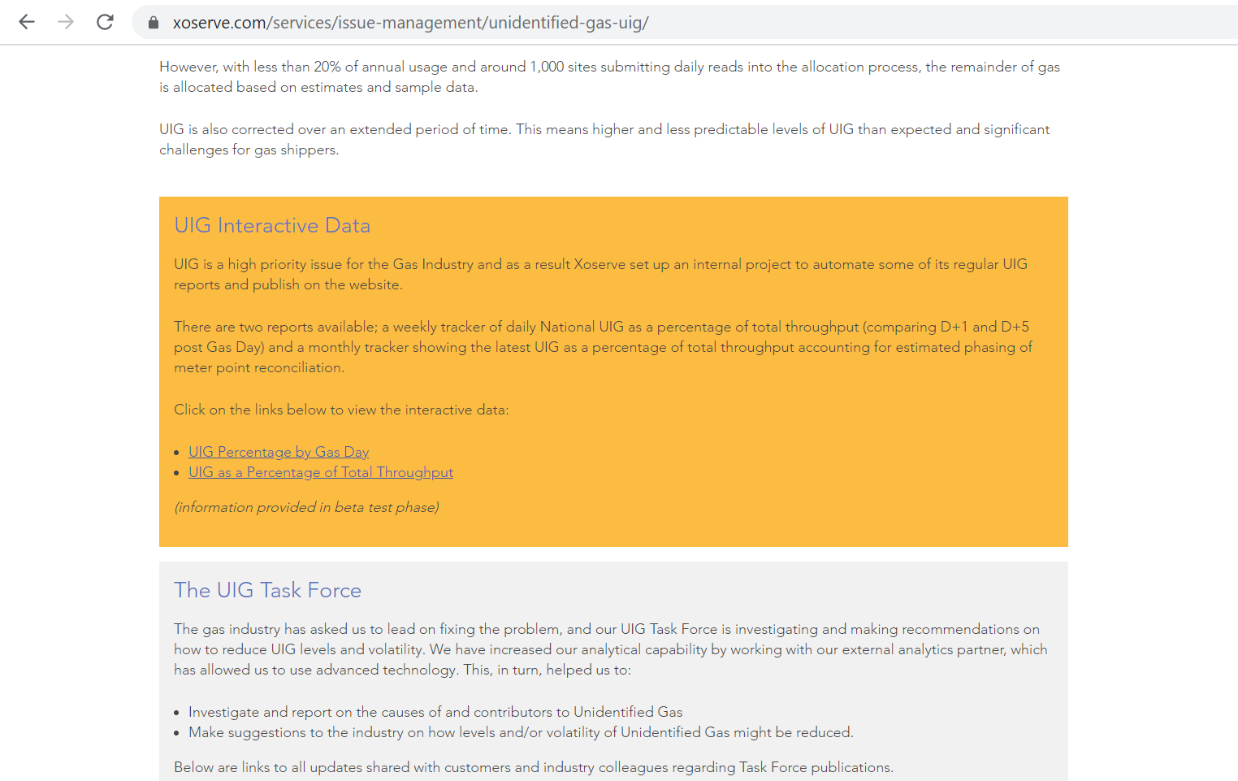
Website Location

Slide 46
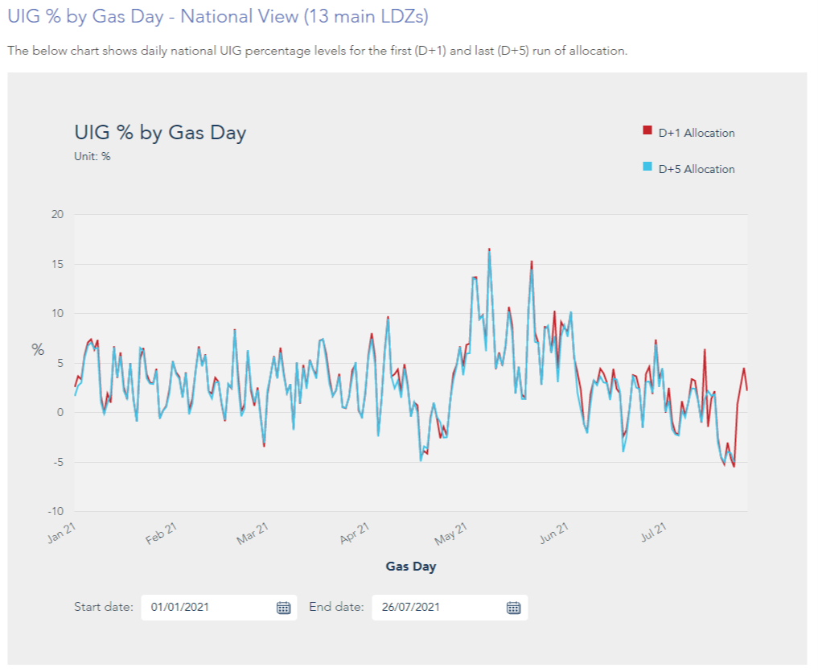
UIG Percentage by Gas Day

Slide 47
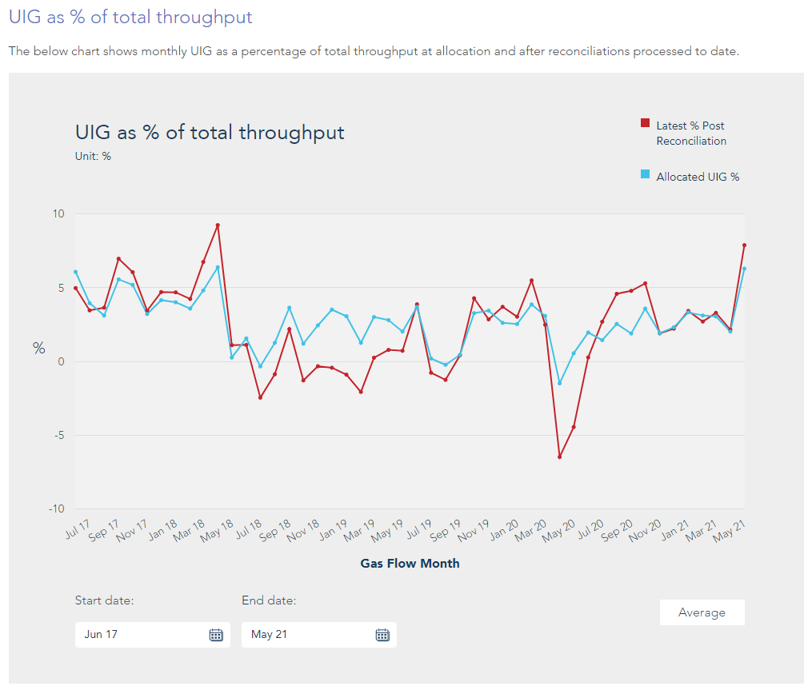
UIG as a Percentage of Total Throughput

Slide 48
APPENDIX

Slide 49
Outages
Outages
Change Request Number | Impacted System | Outage Duration |  |  |  |  | Committee Notified Date
 |  | Start Date | Start Time | End Date | End Time | Brief Description
CHG0031149 | UKLink | TBC |  | TBC |  | UKLINK Disaster Recovery Test 2021 This is an annual activity to confirm UKLink services can be migrated to a secondary data centre location should there be a catastrophic failure within the primary data centre. During this phase of the test UKLink services will failover from the primary site to the secondary site. | 11/08/2021 - Postponed until later in the year
CHG0031149 | UKLink | TBC |  | TBC |  | UKLINK Disaster Recovery Test 2021 During this phase of the test UKLink services will failback from the secondary site to the primary site. | 11/08/2021 - Postponed until later in the year

Slide 50
Portfolio POAP

Slide 51
CSSC Programme Dashboard
August 2021

Slide 52
Programme Update
Programme Health – RAG |  |  | Return to Green Plan
Overall Programme Status | Previous | Current | The programme remains at a Green status. Ofgem has shared some Go-live date principles by which they are looking at non-Mondays as potential Go-live dates. This analysis is currently a high focus area whilst we continue to work with Ofgem to provide them with the detail required to baseline their Go-live principles.
Programme Plan | Previous | Current
Risk Profile | Previous | Current
Resources | Previous | Current
Executive Summary |  |  |  | Upcoming Activities & Milestones (Next Month)
Key Programme Updates To date, all Xoserve key internal and external milestones have been met Transition: Live Rehearsal Cycle 1 has completed successfully. LR Cycle 2 commences on 30/07, with Transition Testing starting on 06/11. Internal & External Testing: All testing activities are on track. UEPT continues with no major impacts or defects. E2E Testing has commenced successfully. No defects to date. Business Change: Internal activities continue to plan including Target Operating Model. Service Management: Xoserve’s CR-D072 which was aiming to change the Response SLAs have now been through Industry consultation following a position being agreed across all PUIs. This is expected to be approved in August. Data Migration: Planning to begin to support Rel cycle 4b - due Oct. |  |  |  | Live Rehearsal: Commence Cycle 2 Internal Test: Progress CR testing and any relevant regression tests DES:& Secondary APIs Continue Test support Transition: Continue Transition planning MAP C: Delivery continues to plan, build updates will be provided via Nov 21 updates. REC: Continue REC version 3 review complete. Business Change: Continue awareness and knowledge transfer sessions

Slide 53
Green Workstream Updates
RAG Previous MONTH | RAG Current MONTH | WORK STREAM | SUMMARY
 |  | DES & Secondary API | Overall Green: UEPT/E2E support continues specifically around setting up users. No defects raised to date for the external testing phases.
 |  | Testing | The overall status remains Green. UEPT and E2E continues well. At the point of writing this, no significant defects have been seen. Operational Testing with DCC is also progressing well, with no defects raised against Xoserve. This is due to complete in September
 |  | Service Management | Service Management requirements have been clarified with DCC. CR-D072 has been through industry consultation and is expected to be tabled up for approval in August.
 |  | Batch | The overall status is green, with testing support underway for UEPT/E2E activities
 |  | Gemini | The overall status is green
 |  | Reporting | An internal CR will be raised to incorporate the impact of one newly identified report that will need changes.
 |  | UK Link | Status continues to be Green with work underway to impact assess, deliver and test Switching Programme changes raised through the last few months

Slide 54
Green Workstream Updates
RAG Previous MONTH | RAG Current MONTH | WORK STREAM | SUMMARY
 |  | REC | REC version 3 consultation is complete.
 |  | Data Migration | Planning to begin to support Rel cycle 4b - due Oct.
 |  | Environments | Workstream continues to be Green with all activities continuing to track to plan for all upcoming activities.
 |  | MAP C (XRN-4780C) | Delivery continues to plan, detailed delivery updates will be provided via Nov 21 updates.
 |  | SoLR (XRN-5144) | Engagement continues with Ofgem

Slide 55
Key Programme Risks (1/2)
RTC | RAG | Workstream | Description | Mitigation Strategy | Latest Update | Resolution Date
65426 |  | Transition & Cutover | There is a risk that the Go Live assumption day of Monday may get changed because various variables (factors) are being looked at by OFGEM leading to rework on Transition plan and related activities. | Internal assessment planned to assess impact of this ask by Ofgem to provide an assessment that covers everything that could impact Xoserve | Internal assessment planned to assess impact of this ask by Ofgem to provide an assessment that covers everything that could impact Xoserve | 31/08/21
55513 |  | Programme | There is a risk that in the Programme participants might interpret business rules differently because business rules underpinning the CSS Interfaces have not been published alongside the interface document as well as discrepancies between business rules defined within REC and captured in ABACUS. Leading to significant process mismatches at a later stage (i.e. SIT, UEPT) and potential rework and timeline slippages. | Xoserve to publish design assumptions as part of the RAID reporting to the SI to ensure visibility of Xoserve design assumptions around business rules and processes. | Continues to be monitored until E2E is complete | 30/11//21
61894 |  | Service Management | There is a risk that the CSS proposed SLA's do not align to current service model/SLA's because DCC/Ofgem are proposing a new set of SLA's for all parties regardless of existing arrangements, leading to target operating model changes and potential contractual changes with 3rd party suppliers (considerable increase in operational cost) | Our working assumption is that existing SLAs will prevail however, there are ongoing discussions taking place with DCC to understand their expectation. REC review - no such SLA's imposed on us currently. | CRD072 PIA responses have been favourable and is expected to be tabled for approval in August | 30/08/21
65156 |  | Transition & Cutover | There is risk that the change freeze scope could impact Transition because the scope of Programme Change Freeze from 03/01/22 is not clearly defined leading to impacts during actual Transition | Work with the SI to collectively define the scope of Change Freeze | Internal discussions are ongoing within Ofgem to define the scope of this Change Freeze | 30/08/21

Slide 56
Key Programme Risks (2/2)
RTC | RAG | Workstream | Description | Mitigation Strategy | Latest Update | Resolution Date
64171 |  | Transition and Cutover | There is a risk that the SoLR process might kick off during the transition period because of a supplier going out of business at that time leading to Landmark needing to cater to additional volumes and also the potential for additional requirements for PUIs to undertake to ensure Transition timelines are maintained | Raise the risk with Ofgem and SI to understand what non-functional considerations have been applied to enable Landmark to manage the increased volumes Raise with the SI to include a transition test scenario if relevant to mitigate this possibility | Still awaiting confirmation from the SI that Ofgem have accepted this risk. This risk will be accepted once this is formally confirmed | 30/07/21
65122 |  | Transition and Cutover | There is risk that additional Transitional changes could change scope of Transition because more changes are identified as Transition planning continues at the Central programme level leading to changes to the Transition plan and Xoserve planned activities. | Xoserve are actively involved in all programme work groups to monitor and mitigate this risk. | The probability of this risk has been reduced. Recon CR is being IA'ed, the CR itself is not impacting Transition activites, however testing considerations need to be understood and assessed | 26/07/21
64513 |  | Data | There is a risk that data cleansing requirements may not be met because Xoserve are not responsible for the data in UK Link, and can't compel shippers / GTs / iGTs to correct their data leading to incorrect data at the point of go live. | Communicate requirements through DSG and track progress | No update on the data cleansing. However have this week challenged CR-D083 - new assumption NCA476 that data providers will be responsible for cleansing any data issues found during transition - as this responsibility is with data owners not data providers | 30/12/22
65176 |  | Transition and Cutover | There is a risk that the Runbook may not be properly tested because schedules to be used across test phases (DM LR / Transition testing) are being developed seperately leading to potential for discrepancies and for insights from one activity being missed by the other | Liaise with the SI to ensure that all plans are aligned. Request early sight of plans to ensure adequate review in advance | Awaiting DM LR plans to compare against the latest issued Transition Test schedule | 01/03/22
65157 |  | Transition & Cutover | There is risk that the catch up processing could impact transition timelines because the catch up processing is not being exercised/rehearsed during Central Programme Transition Testing leading to impacts during actual Transition. | Work with the SI to assess if this activity can be tested in advance of Transition | This was discussed at the SI Transition Group on 16/06. The current expectation is that the approach will be landed in August, which still carries the risk that the held switch processing will not be tested during Transition and was raised by Xoserve at the call | 26/07/21

Slide 57
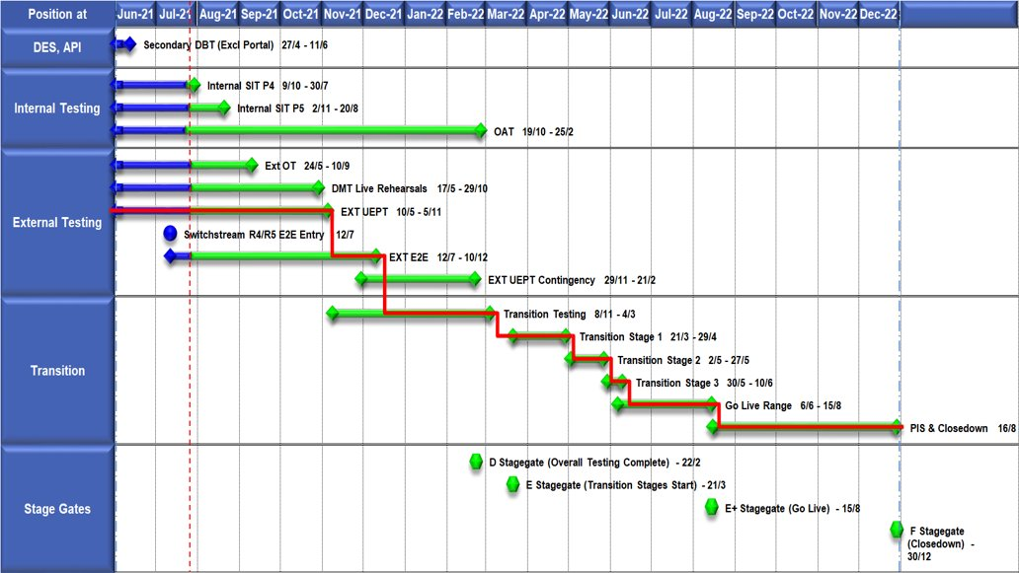
High Level Plan

Slide 58
Switching Programme CR Position – CRs impacting Xoserve
CR Name | CR Ref | High Level Cost IA Cost | Date Raised | Status
Programme Plan Re-Baseline | CR-D002 | £0.00 | 07/11/2019 | Approved - Complete
Updates to the CSS Physical Interface Design (PhID). | CR-D008 | £17,250.00 | 22/01/2020 | Approved - Internal CR Created
CSS_Exception_Handling_Strategy_v0.2 | CR-D014 | £0.00 | 26/02/2020 | Approved - Internal CR Created
Provide_CSS_RegistrationID_to_PUI_and_LPs | CR-D016 | £12,643.00 | 07/08/2020 | Approved - Internal CR Created
Licence Exempt Network Customer Identifier – ABACUS Data Model update | CR-E51 | £0.00 | 29/10/2019 | Approved - Complete
Amendments to the DMS artefact suite | CR-D019 | £6,500.00 | 16/03/2020 | Approved - Internal CR Created
Migration of Terminated Gas RMPS | CR-D022 | £0.00 | 10/06/2020 | Approved - Internal CR Created
Amendments to the NC-0079 for REL (Retail Energy Location) Data Migration and Reconciliation | CR-D024 | £20,000.00 | 06/07/2020 | Approved - Internal CR Created
DMS - PHID Alignment Parties | CR-D026 | £0.00 | 06/07/2020 | Approved - Internal CR Created
Request For a New or Upgraded DMT Environment | CR-D027 | £256,009.00 | 07/08/2020 | Approved - Internal CR Created
Enable TLS connection pooling for all directly connected parties to CSS] | CR-D028 | £2,500.00 | 13/07/2020 | Approved - Internal CR Created
Message Header Format for PKI Certificate Identification] | CR-D029 | £2,500.00 | 13/07/2020 | Approved - Internal CR Created
SIT Functional Test Re Plan Enabling Parallel Testing | CR-D030 | £56,000.00 | 20/07/2020 | Approved - Internal CR Created
DM_Validation Catalogue_Shipper_Effective_Date_Change_ | CR-D032 | £0.00 | 03/08/2020 | Approved - Internal CR Created
Compression During Data Migration | CR-D034 | £500.00 | 09/09/2020 | Approved - Internal CR Created
Uplift to the CSS Interface Specifications | CR-D038 | £70,000.00 | 07/10/2020 | Approved - Internal CR Created
Uplift to Business Data Validation Rules | CR-D039 | £20,000.00 | 25/09/2020 | Approved - Internal CR Created
Programme Plan Re-Baseline | CR-D042 | £14,913,000.00 | 28/09/2020 | Approved - Internal CR Created
Operational Choreography Detection 0.5 | CR-D060 | £308,205.00 | 25/01/2021 | Awaiting Decision
Operational Choreography Rectification 0.3 | CR-D061 | £0.00 | 25/01/2021 | Awaiting Decision
Amendment of Data Migration Solution to Protect Programme Timescales - Removal of Transition Stage 1 Delta files | CR-D062 | £83,490.00 | 25/02/2021 | Approved - Internal CR Created
Change to Management of In-Flight Switches Approach | CR-D071 | £0.00 | 15/03/2021 | Approved - Internal CR Created
Amend the Transition Testing Milestones TR210 & TR220 for PUI Production Data Cuts v0.4 | CR-D078 | £0.00 | 14/05/2021 | Awaiting Decision
Increase Cadence of Data cuts | CR-D080 | £24,600.00 | 10/05/2021 | Awaiting Decision
Amendment to Assumptions as a result of analysis undertaken during CP1 v0.4] | CR-D083 | £0.00 | 24/05/2021 | Awaiting Decision
Request for an additional Data Reconciliation Activity at the end of DMT Live Rehearsal Cycle 2 v0.2 | CR-D086 | £76,000.00 | 01/06/2021 | Rejected
TT Remediation & Paper-Based Testing Workshop | CR-D095 | £34,000.00 | 28/06/2021 | Awaiting Decision

Slide 59
Switching Programme CR Position – CRs not impacting Xoserve
CR Name | CR Ref | Date Raised | Status
Non_Mandatory_MPAS_Metered_Indicator_v0.4 | CR-D001 | 27/01/2020 | Complete - No Xoserve Impact
REC Manager Procurement Timelines | CR-D003 | 02/12/2019 | Complete - No Xoserve Impact
MPAS Related MPAN Disconnection | CR-D004 |  | Withdrawn
Introduction of Validation Message to Logical Mode | CR-D005 | 25/11/2019 | Withdrawn
Modification of Related MPAN Cleanse Checkpoint Milestones | CR-D006 | 27/11/2019 | Complete - No Xoserve Impact
ABACUS Corrections and Re-alignments | CR-D007 | 04/12/2019 | Complete - No Xoserve Impact
ECOES REL API Webmethod | CR-D009 | 17/12/2019 | Complete - No Xoserve Impact
CSSIA Uplift to Implement IG Recommendations | CR-D010 | 17/12/2019 | Complete - No Xoserve Impact
Update 3 E2Es to align to CSSIA | CR-D011 | 10/06/2020 | Complete - No Xoserve Impact
CSS_Physical_Interface_Design_Updates_mpxn_v0.2 | CR-D012 | 30/01/2020 | Complete - No Xoserve Impact
Messaging_Requirements_Revisions_REC_Code_Manager_and_CSS_v0.1 Clean | CR-D013 | 28/01/2020 | Complete - No Xoserve Impact
Amendment_of_Xoserve_Consequential_Change_Milestone_Delivery_Dates_v0.2[DRAFT] | CR-D015 | 26/02/2020 | Withdrawn
CSS_Handling_of_MPAS_Business_Dates_v0.2[DRAFT] | CR-D017 | 20/07/2020 | Complete - No Xoserve Impact
Confirmation_Responses_to_Outbound_Synchronisations_v0.2[DRAFT] | CR-D018 | 02/03/2020 | Withdrawn
Regulatory Workstream – Programme Milestones Refresh | CR-D020 | 16/03/2020 | Withdrawn
Remove MPAS Interface | CR-D021 | 29/04/2020 | Withdrawn
DSP_Specific_ SIT_ Functional_Exit_Criteria | CR-D023 | 29/05/2020 | Complete - No Xoserve Impact
Changes to support enhanced Solar arrangements | CR-D025 |  | Withdrawn
CSS Role-based access control (RBAC) | CR-D031 | 24/07/2020 | Withdrawn
A Quality Analysis Activity of the Data being used for the DMT Non-Functional Test Phase​​ | CR-D033 |  | Withdrawn
CSS Change from UTC to Local Time | CR-D035 | 22/09/2020 | Complete - No Xoserve Impact
Xoserve CR for DES AI Removal | CR-D036 | 24/09/2020 | Complete - No Xoserve Impact
Provide_CSS_RegistrationID_to_LPs | CR-D037 | 06/10/2020 | Complete - No Xoserve Impact
UEPT Tranche Regulatory Change | CR-D040 | N/A | Complete - No Xoserve Impact
NCT-0073 Functional Script Master Changes | CR-D041 | 25/09/2020 | Complete - No Xoserve Impact
Update to the End to End Testing Plan | CR-D043 | 05/10/2020 | Complete - No Xoserve Impact
Request For a New DMT Environment for DMT Live Rehearsal | CR-D044 | 23/10/2020 | Complete - No Xoserve Impact
NC-0079 Adding Post Load Integrity Check Document | CR-D045 | 09/11/2020 | Complete - No Xoserve Impact
Uplift to the Code of Connection | CR-0046 | 09/11/2020 | Complete - No Xoserve Impact
Correctional Changes to MAD Log v2.0 & POAP v2.0 | CR-D047 | 13/11/2020 | Complete - No Xoserve Impact
Changes to Data Milestones in MAD Log v2.0 & POAP v2.0 | CR-D048 | 09/11/2020 | Complete - No Xoserve Impact
Consequential Changes to Testing Milestones in MAD Log | CR-D049 | 13/11/2020 | Withdrawn
CSS Environments for Faster Switching Enduring Service | CR-D050 |  | Withdrawn
Changes to Data Validation Rules | CR-D051 | 30/11/2020 | Complete - No Xoserve Impact

Slide 60
Switching Programme CR Position – CRs not impacting Xoserve
CR Name | CR Ref | Date Raised | Status
Additional and Further Correctional Changes to MAD Log v2.0 | CR-D052 | 05/12/2020 | Complete - No Xoserve Impact
Additional Onward Dependencies for MAD Log | CR-D053 | 18/12/2020 | Complete - No Xoserve Impact
Changing from GetOrganised to Landmark SFTP for SI receiving files | CR-D054 | 18/12/2020 | Complete - No Xoserve Impact
Amendments to the Data Cleansing Catalogue | CR-D055 | 18/12/2020 | Complete - No Xoserve Impact
MAD Log Changes for UIT Environment Verification | CR-D057 | 25/01/2021 | Complete - No Xoserve Impact
Discontinuance of Xoserve Consequential Change Market Trials | CR-D058 | 25/01/2021 | Complete - No Xoserve Impact
Changes to Support Energy Company Data | CR-D059 | 25/01/2021 | On Hold
Uplift to SMS CoCo | CR-D063 | 29/01/2021 | Complete - No Xoserve Impact
Changes to SIT Functional Test Scenarios | CR-D064 | 29/01/2021 | Complete - No Xoserve Impact
Uplift to the Code of Connection | CR-D065 | 29/01/2021 | Complete - No Xoserve Impact
In-Flight Reg ID Dissemination | CR-D066 |  | Withdrawn
Uplift to the CSS Business Data Validation Rules Doc | CR-D067 | 19/03/2021 | Complete - No Xoserve Impact
Uplift to the CSS Interface Specification | CR-D068 | 15/03/2021 | Complete - No Xoserve Impact
REL Dissemination to iDNO and DNO | CR-D069 | 15/03/2021 | Complete - No Xoserve Impact
Removal of UEPT Stage 1 Data Allocation and Verification for Tranche 3 and 4 Participants and delivery acceleration of Stage 2 Data Allocation | CR-D070 | 05/03/2021 | Complete - No Xoserve Impact
Re-align Switching Programme Response SLAs with Xoserve response SLAs | CR-D072 | 07/05/2021 | Complete - No Xoserve Impact
Changes to MAD Log v2.2 to rectify incorrect milestone descriptions | CR-D074 | 29/03/2021 | Complete - No Xoserve Impact
Update Service Management Baseline Requirement | CR-D076 | 20/04/2021 | Complete - No Xoserve Impact
Amend the Transition Testing Milestones TR210 & TR220 for PUI Production Data Cuts v0.4 | CR-D078 | 14/05/2021 | Complete - No Xoserve Impact
Removal of SMS005 from UEPT Test Scenarios v0.2 | CR-D081 | 14/05/2021 | Complete - No Xoserve Impact
Engagement for Early E2E Testing v0.2 | CR-D082 | 14/05/2021 | Withdrawn
Change to Transition Stage 3 File-Based Migration Sequencing v0.2 | CR-D084 | 26/05/2021 | Complete - No Xoserve Impact
Request for an additional Data Reconciliation Activity at the end of DMT Live Rehearsal Cycle 2 v0.2 | CR-D086 | 01/06/2021 | Withdrawn
Update to UIT E2E Plan and Artefacts to incorporate the additional scope identified on the outcome of REL Gap Analysis v0.7 | CR-D087 | 17/06/2021 | Complete - No Xoserve Impact
Elevation of L2-TR070 (Transition Stage 1 Start) to a L1 milestone | CR-D088 | 04/06/2021 | Complete - No Xoserve Impact
NC-0107 Master Handover Pack Purpose Change | CR-D089 | 04/06/2021 | Complete - No Xoserve Impact
REC Code Manager Market Intelligence Reporting | CR-D090 | 11/06/2021 | Complete - No Xoserve Impact
Removal of Transition Test Artefacts | CR-D091 | 24/06/2021 | Complete - No Xoserve Impact
Feasibility study on potential to update Domestic Premises Indicator (DPI) electricity flags to reflect license status during transition stages, 1, 2 & 3 | CR-D093 | 28/06/2021 | Complete - No Xoserve Impact
Changes to Operational Testing | CR-D094 | 28/06/2021 | Complete - No Xoserve Impact
Changes to milestone date for L3-TE720 | CR-D096 | 28/06/2021 | On Hold

