Slide 1
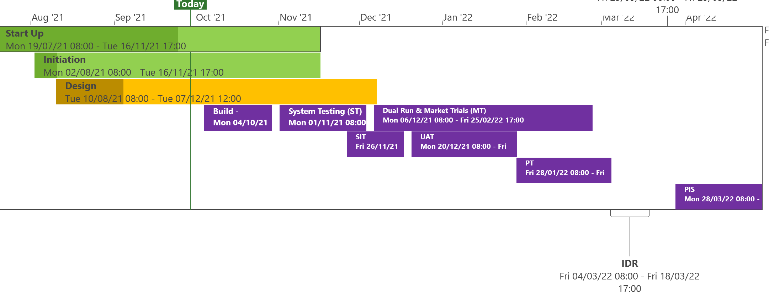
XRN5231 Flow Weighted Average CV
 | Overall Project RAG Status
 | Schedule | Risks and Issues | Cost
RAG Status
Status Justification
Schedule | Overall Status set to Amber due multiple phases progressing in parallel and the need to baseline the project phases following design completion, funding approval & outstanding clarifications/decisions required from National Grid and DNs. Start Up and Initiation Phase progressing in parallel with Design Design Change Pack to be published on 1st October, approval to be sought at October Committee BER to be published to seek approval at the October 21 ChMC Proposed Project Engagement Strategy to be published to NG and DN outlining how the project will engage through project delivery phases to seek support/approval Testing, Dual Run and Market Trials dates to be baselined in conjunction with customer engagement sessions over the coming weeks Change due to be implemented by March 2022 Decision In October ChMC Approval of BER Document
Risks and Issues | There is a risk that until the transition & cutover approach is agreed between Xoserve, National Grid & DNs to confirm the length of Post Implementation Support and what support dependencies are required from National Grid as the existing service provider. There is a risk that National Grid have served notice to terminate the current FWACV service on the 31st March 2022 and the project plan does not meet an implementation date of the new service from the 01st April 2022, resulting in the need to negotiate an extension of the service by National Grid.
Cost | BER is being presented for a decision to proceed at October’s ChMC for the scope defined
Scope | XRN5231 Flow Weighted Average (CV) XRN5282 PRCMS Processing (Gemini Consequential Change – Part A)
Complete
On Track
At Risk
Overdue
Not Baselined
Slide updated on 28th September for FWACV

