Slide 1
Data Cleanse Approach/Plan

Slide 2
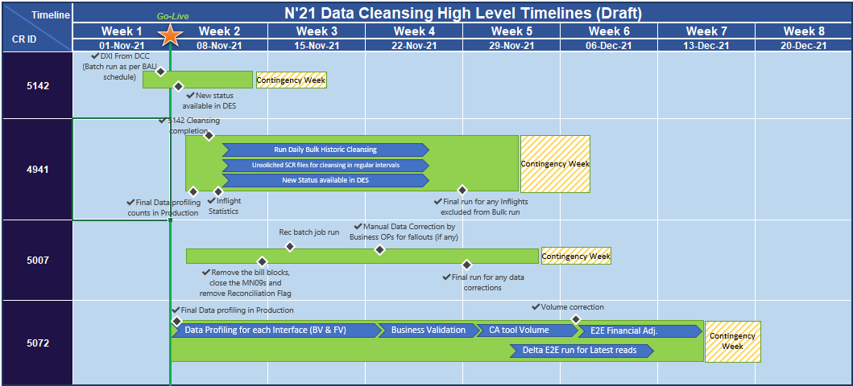
November 21 Data Cleansing - Proposed Timeline
High Level Timelines for Data cleansing planned during the PIS period are shown below.
These timelines will be finalised as part of Performance Test sign off from Technical Operations based on final volumes for cleansing, job run times and available time slot to cleanse the data in Production environment.
Any outbound files impacted by the below will follow the standard batch schedule

Slide 3
Data Cleansing Approach – XRN4941
This change will allow the CDSP to update the Meter Read Frequency (MRF) for Class 4 Supply Meter Point’s (SMP) under the following circumstances:
Where a Supply Meter Point’s AQ value is amended to 293,000 kWh or above on the Supply Point Register and does not currently have a monthly Meter Read Frequency
Where a Supply Meter Point has AMR Meter installed on the Supply Point Register and does not currently have a monthly Meter Read Frequency
Where a Supply Meter Point is operational smart meter where a DCC Service Flag is ‘Active’ on the Supply Point Register and does not currently have a monthly Meter Read Frequency
In the above circumstances, the Meter Read frequency of the supply meter points with product class 4, will be amended to monthly by the CDSP.
We are expecting up to 4 million MRF’s this will be shared with the customer advocates who will share the information with all parties
# | List of Activities | Dependencies | Remarks
1 | Final Data profiling in Production before running the Historic cleansing for Class 4 non-monthly MRF sites for: 1. AQ >=293000, 2. DCC_STAT = A, 3. AMR device | SQL queries will be developed & run to identify the exact volumes (these will be first run as part of PT) | These will be run nearer to Go-Live Estimated Volumes for cleansing are up to 4M (AQ ~ 10K, DCC ~ 3M, AMR ~ 1M)
2 | Identify Inflight workflows where Auto MRF update should be taken care post old confirmation workflow is LIVE | SQL queries developed & run to identify the exact volumes (Run prior to historic job) | Confirmation in ‘CO’/ Contract change workflow at D-2.
3 | Unsolicited SCR in regular intervals for historic load |  | Adhoc SCR trigger for bulk load

Slide 4
Data Cleansing Approach – XRN5007
The change is raised to address the issue being experienced currently where a period has been reconciled to a zero position and then a valid read related to that period is received and re-reconciliation takes place. At this point a divide by zero error is encountered as the prevailing metered volume is zero, and the MN09 exception is generated. The scenarios that have been identified as causing this are:
Re-reconciliation of a zero reconciled period triggered by a site visit or replacement reading
A Breaking Rec (where a previously reconciled period is split as a result of an inserted read) on a non-consuming period.
# | List of Activities | Dependencies | Remarks
1 | Any MN09 sites with existing data issues or new exception will be shared with Tech Ops / Bus Ops for standard resolution steps. |  | To be determined as result of PT
2 | In case of high MN09 volumes, invoicing volumes to be generated for that billing month will be agreed with Business Ops which can be accommodated for MN09 closure for a particular month | Business Operations to determine the split based on Pre-prod statistics

Slide 5
Data Cleansing Approach – XRN5072
Since Nexus implementation, there have been a number of scenario specific defects raised concerning the use of the TTZ indicator provided in the Meter Reading files and how the subsequent volume and energy is then being calculated. The TTZ indicator confirms whether the meter readings provided have clocked (gone through the zeros) since the last actual read and the means to derive consumption. However, through the defects raised and analysis of these issues, inconsistencies and errors in the use of TTZ and derivation of consumption have been seen.
In the instances where the application of TTZ is incorrect, system then creates a reduced/increased volume and energy, it has knock on effects to the AQ and downstream processes such as EUC (End user category) assignment, daily allocation and calculation of unidentified gas.
This change will need to ensure that the TTZ indicator received in meter reading files is correctly applied in the calculation of volume and energy. This change does not impact the TTZ derivation logic for RGMA flows.
In addition to the enduring solution, this change will also cleanse the existing data where volume calculated incorrectly due to incorrect application of TTZ indicator for identified scenarios. This covers below:
Option to pause and resume in case of any critical BAU activity in priority
Identify initial and final volumes for volume correction/Consumption Adjustment (CA)

Slide 6
XRN5072 – List of Data Cleansing Activities Production
# | List of Activities | Dependencies | Remarks
1 | Run Data profiling program in Production based on agreed run time and Volumes for each of the trigger type in PIS period | Indicative volumes will be available in PT | Batch run time, no. of parallel work processes & schedule be determined in PT
2 | Feed the identified Data cleansing sites to internal Consumption Adjustment tool for volume correction |  | To be determined as result of PT
3 | Next steps to correct the data Bill doc reversals Consumption Adjustment with reason ‘Others’ (‘Remarks’ - N21 release – TTZ Vol correction) Rolling AQ correction Formula AQ correction Financial adjustment |  | Existing BAU tools to be used to correct the data

Slide 7
Data Cleansing Approach – XRN5142
This change removes the allowable values of “S” - Suspended and “W” – Withdrawn and replace them with values of “N” – Non-Active and “I” – InstalledNotCommissioned.
In addition to the enduring solution, this change will also ensure that all data using the DCC service values is cleansed for the current data set in the system. This activity will be performed collaboratively with inputs from the DCC. This covers below:
For data cleansing, DXI files to be received from DCC with new values ‘N’ & ‘I’ for identified sites
UKLink existing BAU job to be utilised to process the data cleansing
In case PT results shows that DXI volumes are to be processed over multiple intervals, then timings to run the job for each day will be agreed with Tech-Ops as part of PT result assurance.
Option to pause and resume in case of any critical BAU activity in priority
Dependency on DCC to send the data to UKLink via DXI file to initiate the data cleansing activity (Approx. volumes = 60K)
# | List of activities | Dependencies | Remarks
1 | DXI file will be processed for cleansing post go live | DCC issue updated DXI file | To be determined from PT results
2 | New values will be available to view in DES

Slide 8
XRN5142 – List of Data Cleansing Activities Production
# | List of Activities | System | Dependencies | Start Time | End Time | Remarks
1 | Final Data profiling before running the Historic DCC cleansing for Sites with DCC_Flag = A, S or W in production | SAP ISU | DCC to provide the stats during PT. | TBD | TBD | Table statistics
2 | Utilise the existing BAU schedule for DXI file processing for data cleansing for new DCC_SERVICE_FLAG values | SAP ISU | Final Volumes will be determined nearer to Go-Live (Current estimate is 60K sites to be cleansed ) | TBD | TBD | Batch run time, no. of parallel work processes & schedule will be determined in PT
3 | Hold/Pause the job if required for any BAU critical activity | SAP ISU | Final counts for cleansing | TBD | TBD | To be determined as result of PT
4 | New values to be extracted to BW as part of daily BW jobs | SAP BW | DCC data cleansing completion | TBD | TBD
5 | Report the successful, unsuccessful, next steps for historic cleansing statistics for each of the DCC_STAT status | SAP ISU | Completion of data cleansing run | TBD | TBD | Daily and Final counts

