Slide 1
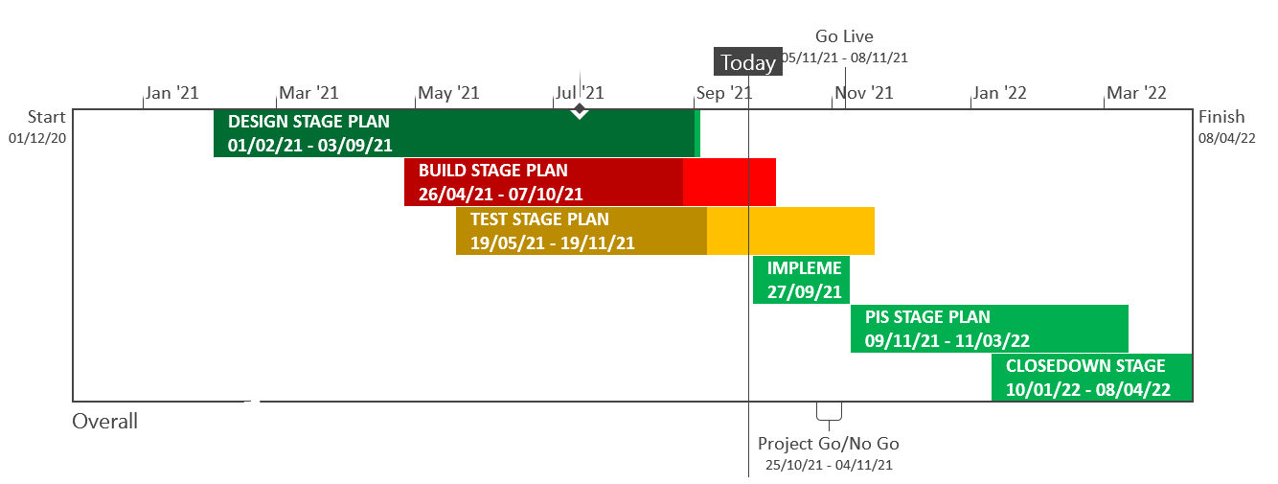
XRN5289 – November 21 Major Release - Status Update
 | Overall Project RAG Status
 | Schedule | Risks and Issues |  | Cost
RAG Status
Status Justification
Schedule | User Acceptance and Regression testing is in progress and being re-planned due to below issues for remaining testing Implementation Dress Rehearsal planned for 30th September - 1st October Performance Testing due to commence 4th October Decision In October ChMC: No decisions are required this month.
Risks and Issues | Issue (RTC65631) - ​Increase in the number of BAU defects being found impacting XRN5072, XRN5007 and XRN5180 during testing. Mitigation, defects are currently all planned to be deployed prior to exiting test Issue (RTC66115) - MAP ID changes have not been delivered by third party in time and is now impacting the timelines
Cost | Forecast to complete delivery against approved BER
Scope | In Scope: XRN4941 MOD0692 - Auto updates to meter read frequency XRN5007 Enhancement to reconciliation process where prevailing volume is zero​ XRN5072 Application and derivation of TTZ indicator and calculation of volume and energy – all classes​ XRN5142 New allowable values for DCC Service Flag in DXI File from DCC​ XRN5180 Inner tolerance validation for replacement reads and read insertions​ XRN4780C Inclusion of Meter Asset Provider Identity (MAP Id) in the UK Link system (CSS Consequential Change) Descoped: XRN5091 Deferral of creation of Class change reads at transfer of ownership​ XRN5186 MOD0701 Aligning capacity booking under the UNC and arrangements set out in relevant NExAs​ XRN5187 MOD0696 Addressing inequalities between capacity booking under the UNC and arrangements set out in the relevant NExAs
Complete
On Track
At Risk
Overdue
Not Baselined
Slide updated on 24th September 2021

