Slide 1
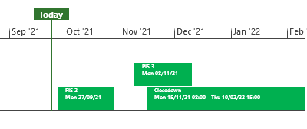
XRN5253 June 21 Major Release - Status Update
 | Overall Project RAG Status
 | Schedule | Risks and Issues | Cost
RAG Status
Status Justification
Schedule | Project on track Post Implementation Support (PIS) period 2 to commenced on 27/09/21 1st usage being tracked PIS due to complete on 28th Oct Decision In October ChMC None
Risks and Issues | None applicable
Cost | Forecast costs on track to complete within approved BER
Scope | In Scope: XRN5093 - MOD0711 – Update of AUG Table to reflect new EUC bands Descoped: XRN4992 - MOD0687 – Creation of new charge to recover last resort supply payments (Descoped at extraordinary ChMC on 26th October 2020) XRN4941 - MOD0692 - Auto updates to meter read frequency (Descoped at ChMC on 11th November 2020)
Complete
On Track
At Risk
Overdue
Not Baselined
Slide updated on 24th September 2021

