Slide 1
KPM Results - Relationship Management
Q2 2021/22 (September ‘21 Survey)

Slide 2
KPM Relationship Survey
Breakdown of responses per question (All Segments)
Trust Scores
76.9%
69.2%
69.2%
KPM Relationship Management - Xoserve
Do you trust Xoserve to deliver DSC services?
Target | Sep 21
95% | 71.76%
Do you trust Xoserve in the management of Correla for the provision of a seamless service?
Do you trust Xoserve with making strategic decisions?
KPM Relationship Management - Correla
Trust Scores
73.1%
57.7%
61.5%
Do you trust Correla to deliver the DSC operational services?
DSC+ Target | Sep 21
85% | 64.10%
Do you trust Correla in putting customers first?
Do you trust Correla with developing strategic investments?
Commentary:
​A significant number of responses were given as ‘Too Early To Say’ and ‘Starting to Distrust’. This will be tracked over time as we progress improvements and work with customers to build trust.
A drop in customer Trust seen across all key measures and across the majority of customer constituents. The drivers of this have been identified (please see slide 4).

Slide 3
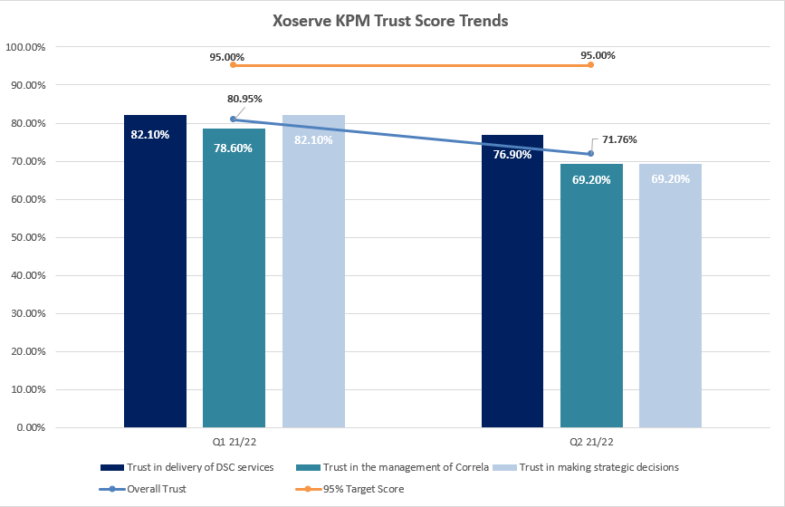
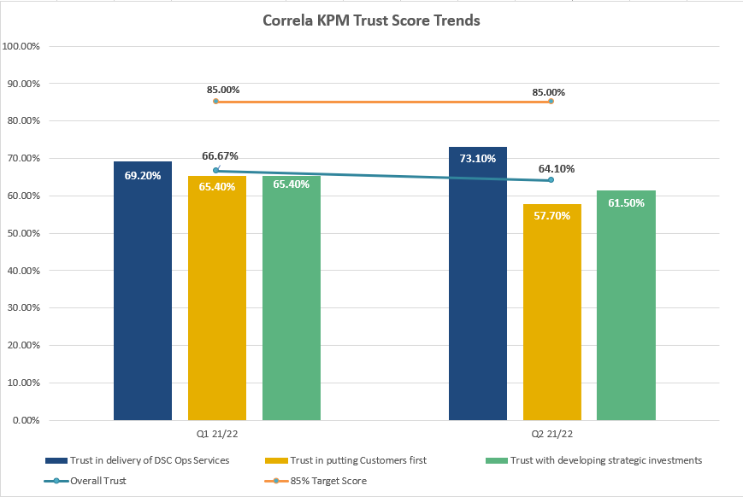
Quarterly Trends

Slide 4
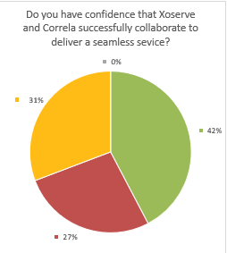
Do you have confidence that Xoserve and Correla successfully collaborate to deliver a seamless service?
June 2021
September 2021

Slide 5
Customer Feedback
Customer Feedback - Drivers of decreasing Trust | Follow up actions / comments
Time taken to progress XRN Change & ASR request, not kept informed of progress and clarity of who is providing which services | Xoserve and Correla are focused on improving the following areas; Simplify the routing of change more efficiently with clear ownerships of assessment and E2E customer engagement Improving early engagement and capture phases of DSC Change. Improving process structure and efficiency, with clearer roles and responsibilities across Xoserve and Correla Digital improvements to change section of website underway as project 1stop
DDP backlog prioritisation and customer engagement | Advocates are working closely with the DDP team to improve engagement and visibility of the DDP backlog for each customer segment.
Trust around IT infrastructure and Service Management following March P2 | Advocates are engaging with customers to share details of the Service Improvement progress since March p2.
Customer feedback “Correla are leading BP22 conversations instead of Xoserve” | Xoserve is accountable for drafting the CDSP Business Plan and it is Xoserve’s Board that approves the final version. All customer discussions have been led by Xoserve with support provided by the Customer Advocates in co-ordinating the meetings.

