Slide 1
0672 Text Clarification-
November 2021

Slide 2
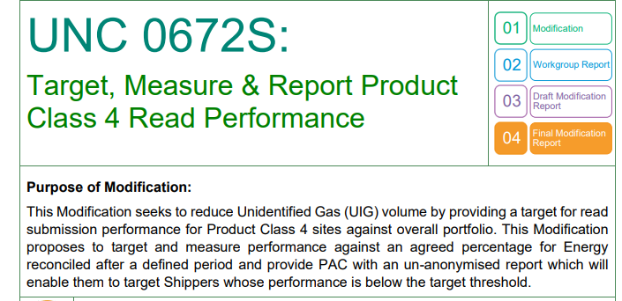
Background
0672 was raised as part of the UIG suite of Modifications and progressed through the UIG workgroup: 0672

Slide 3
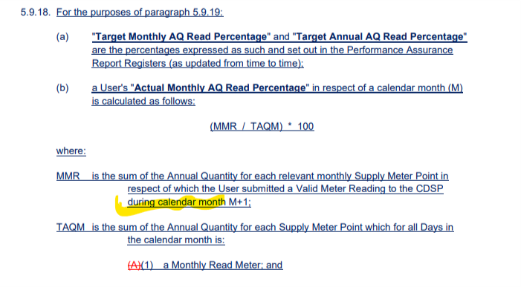
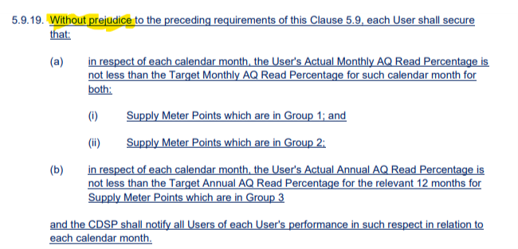
Questions arising during Development
M5.9.18 states Reading performance reporting will be at the end of Month+1 – e.g. report Class 4 Reading performance for August at end of September
NB: think that there is an error as it states that the reads must be submitted during M+1 (possibly should be submitted by end of M+1?)
This report will be produced in M+2 (following M+1 concluding)
Challenge identified that within UNC M5.9.4 states that a Shipper has a period of 25 Working Days to provide the Reading
We read that for 0672S (M5.9.19) in order to be performant under 0672S rules it must be submitted by M+1 AND be compliant with M5.9.4

Slide 4
Questions arising during Development
Within reporting Month changes of Meter Read Frequency or Shipper…. The following are inconsistencies in the Mod and the Business Rules:
Change of Shipper – cannot see any point in the legal text that excludes ‘part month’ for this reason – e.g. an additional / equivalent exclusion needs to be added to M5.9.21 for Shippers:

