Slide 1
Decarbonisation Update Victoria Mustard December

Slide 2
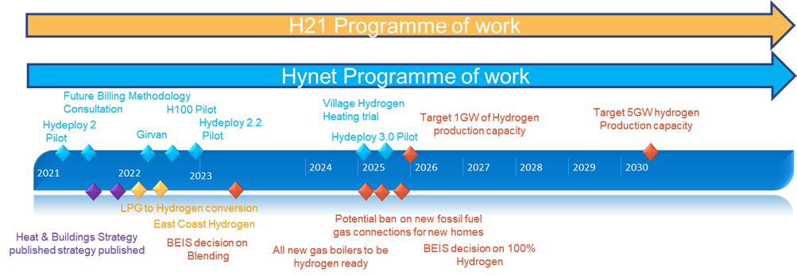
Hydrogen projects we are supporting
Hydrogen Town heating pilot
East Coast Hydrogen Programme of work
GMAP Programme of work (GOO / Deblending)

Slide 3
Q3/Q4 Workload
H100 – Prepping for Detailed design following approval to progress at CHMC
Hydeploy – ongoing support and next steps
Hydrogen Village – providing updates, Data development and supporting all trial submissions
Xoserve Website development – Decarbonisation pages
Planning and preparing for 2022 Project support
Industry parties Decarbonisation engagement
Decarbonisation Industry Customer Journey & Personas development
Future Billing Methodology – industry Engagement and prepping Consultation documentation

Slide 4
Decarbonisation stakeholder workshops
December 2021 onwards

Slide 5
The Design Process
DISCOVER
Orient and Engage, understand the service today
Get informed and inspired by customers and colleagues
DEFINE
Use the research to define areas to focus on
DESIGN
Generate a spread of ideas - explore widely to reduce the chance of missing something valuable, before focusing in and designing solutions
Design the target experience with customers in mind and review this with users. This may be an iterative process to establish the finalised journey and concepts.
DELIVER
Determine change plan and business case.
Handover to business with appropriate monitoring/measures agreed
Phases
Sessions and Outputs
Project Kick Off
Customer & Employee Listening
Define (Project team)
Opportunity Spotting
Journey Design
Customer Evaluation
Requirements & Change Plan
Delivery
As Is Journey
(as we see it)
Research approach and discussion guide
Persona Approach
Insights
Customer Journey
As Is journey
Personas
Inspiration Report
Draft To Be journey (target experience)
Draft Concepts and Enablers
Finalised To Be Journey
Concepts (for customers and colleagues)
Requirement
Value case
Implementation Approach
Draft KPIs
Journey Dashboard
Comms plan
Change plan
Governance to monitor
Clarity on enduring ownership
Journey Dashboard
Key Outputs
Scope document
Stakeholder mapping
Data to support research (SATs, queries, volumes etc)
Stakeholder engagement re. potential concepts
Data ownership/ gathering
Supporting Info
Notes:
Double diamond

Slide 6
Objective
Decarbonisation will have a profound effect on the energy industry, and while electricity often takes centre stage, the decarbonisation of gas represents a significant means of reducing emissions across the UK.
Embedded biomethane is fairly widespread and a number of hydrogen trials are underway, but if we’re to truly realise the benefits of decarbonising gas – while keeping consumer experience and fairness as our top priority – it’s vital that we come together as an industry to determine how we manage the transition to a greener gas system.
Collaboration is key, and by gaining a clear understanding of the interactions between parties and the impacts of change to each, we stand to create the most practical solution possible.
These stakeholder sessions are designed to do just that, consulting with each group individually to start with, with a view to putting together transition options that take into account the needs of the vast number of parties involved in delivering gas to consumers.

Slide 7
Structure
The emphasis of each session will be slightly different depending on the audience, however all will broadly follow this structure:
The Challenge. A scene set running through:
Decarbonisation targets
Industry decision making milestones for gas
Key considerations that must frame the discussion, e.g. consumer experience
The Journey. We’ll run through the “life of a molecule” from transmission to bill, assessing the interactions by stakeholder group. We’ll run through this to look at:
Today
Scenario 1: Impact if a 20% hydrogen blend is introduced - domestic/ I&C
Scenario 2: How this would look in a 100% hydrogen world – domestic/ I&C (if time permits)
Learnings from the HyDeploy trial can be mapped onto the journey to aid/ accelerate discussion where appropriate.

Slide 8
Outcomes
Following each of these stakeholder workshops we want to understand:
Interactions between industry parties, including those in which Xoserve are not directly involved
Impacts of a changing/ variable CV to each party, supporting informed recommendations
A view of the scale of those impacts
Relative responsibilities within those interactions, e.g. which party (or parties) is responsible for making data/ billing adjustments through the journey?
Tech/ equipment/ system constraints today
Funding required/ available to support industry change

Slide 9
Outputs
Customer journey by stakeholder group, including expected crunch/ pain points
IGT
MAM/ MAP
Supplier (small domestic, large domestic, I&C)
Shipper (domestic, I&C)
Persona – pen portrait for each group detailing:
Their business interests
Role in the gas industry
Relationship to consumers
Principle industry touchpoints
Decarbonisation position
Overall sentiment
Preferred engagement method/ frequency by stakeholder type, inc. what information they need and when through consultation and then implementation
Documented major/ minor considerations
High level recommendations – most obvious ideas with potential/ major showstoppers

